Slide 1
The Project for Skill’s Development of ICT Engineers Targeting Japanese Market
FE PM Question 4)

Slide 2
Question 4
Read the following description of a relational database used in an airline company and the answer sub questions 1 and 2.
Fly4You is an airline company that operates domestic and i9nternational flights. The airline records information of its daily flights in the table Flight.
Table : Flight
FlightID | Segment number | Origin Airport | Depart Time | Dest Airport | Arrive Time | Meal | Flying Time | Miles | Aircraft
4U221 | 1 | MDL | 08:30 | RGN | 09:55 | - | 1:25 | 357 | Y747
4U221 | 2 | RGN | 12:30 | DAC | 14:15 | L | 2:15 | 605 | Y747
4U321 | 1 | BKK | 08:00 | KUL | 11:10 | B | 2:10 | 748 | Y747
4U380 | 1 | ULN | 09:45 | NRT | 15:30 | L | 4:45 | 1887 | X757
4U380 | 2 | NRT | 18:15 | MNL | 22:20 | D | 5:05 | 1879 | X757
4U536 | 1 | MNL | 10:30 | SGN | 12:50 | L | 3:20 | 1001 | X757

Slide 3
Question 4
Each flight is identified by flight ID. There are two types of flights: direct flight and one-stop flight. One-stop flight is a flight that stops at one intermediate airport before arriving at the final destination airport. A direct flight is registered in one row of record with segment number 1. One stop flight is registered in two rows of records with segment number 1 and 2. For example, in the above sample data, flight 4U221 is a one-stop flight from MDL to DAC via RGN. The first record segment number 1 contains the flight information from the origin airport MDL to the intermediate airport RGN and the second record (segment number 2) contains the flight information from the intermediate airport RGN to the destination airport DAC.
Sub question 1:
To control flight schedules at intermediate airports, the management wants to generate a report that displays all of the one-stop flights registered in the table Flight.
For this purpose, the SQL statement “SQL1” is created.

Slide 4
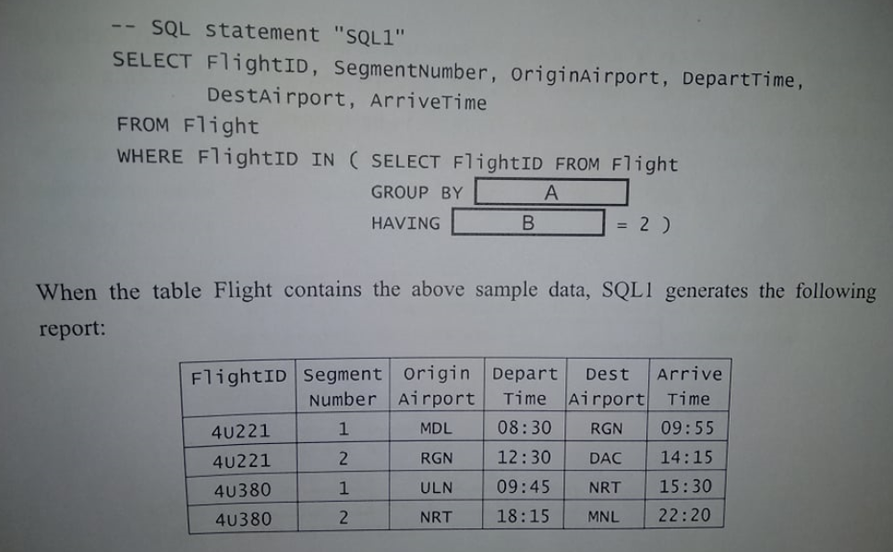
Question 4 Sub Question 1

Slide 5
Question 4 Sub Question 1 Answer Group
COUNT(*)
FlightID
Segment Number
SUM(FlightID)
SUM(SegmentNumber)

Slide 6
Question 4 Sub question 1
We want to find out the flights which have transits or not going directly to the destination. For that reason, we need to group the flight of those who have 2 segment numbers.
Ans A: b) FlightID
Ans B: a) count(*)

Slide 7
Question 4 Sub question 2
Fly4You airline manages flight reservation information in the table Reservation. The table Reservation maintains the latest number of seats reserved by seat classes. There are two types of seat classes; business class and economy class. A record of the table Reservation indicates the Reservation status of one segment of one flight on a specific day.
Furthermore, different types of aircraft have different number of seats by seat classes. Fly4You airline manages the number of seats by seat classes by aircraft in the table Aircraft. The structures of the table Reservation and table Aircraft are as follows:
Reservation (FlightID, Segment Number, FlightDate, BusinessSeatsReserved, EconomySeatsReserved)
Aircraft (Aircraft, BusinessSeats, EconomySeats)
To reduce the flight costs, Fly4You airline wants to allocate smaller aircrafts for high-vacancy rate flights routes. For this purpose, the SQL statement “SQL2” is created, which generates a report that displays all of the flight segments whose vacancy rate (percentage of seats that are not reserved) of economy class is 50% and higher on a specific day, in the descending order of the vacancy rate. Here, the specific date is given by the host variable : SpDate.

Slide 8
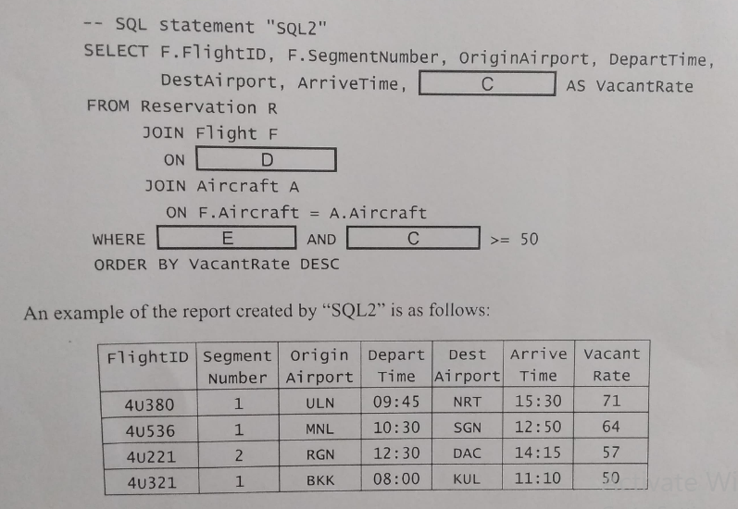
Question 4 Sub question 2

Slide 9
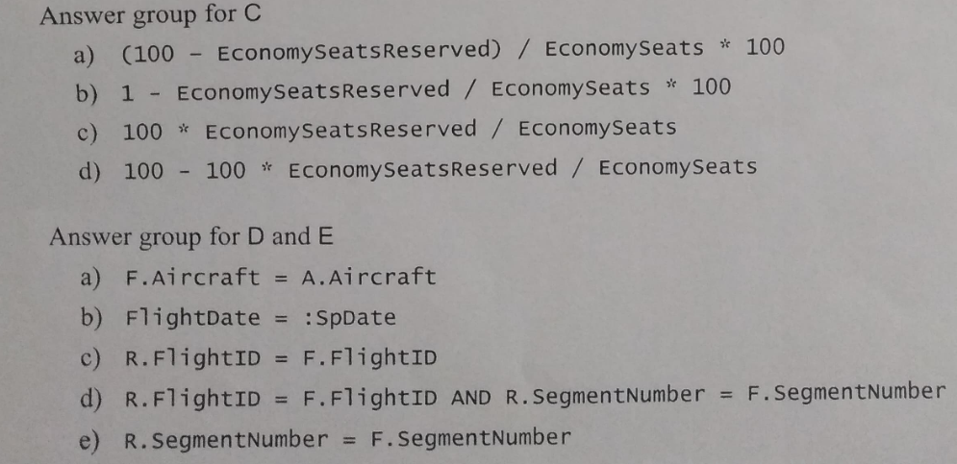
Question 4 Sub Question 2 Answer Group for C,D,E

Slide 10
Question 4 Sub question 2
Vacant rate -> % of seats that are not reserved. Here we are addressing vacancy rate for economy class. From total economy seats how many seats are reserved that value need to subtract from total percentage of seats. Then we will get the vacant seat rate.
Ans C: d) 100 – 100 * Economy seats reserved/ Economy Seats
When we are joining two tables we need a joining attribute which is common in both table. The value of the joining attribute will be same or equal.
ANS D: d) R.flightID = F. FlightID AND R. SegmentNumber = F.SegmentNumber
Ans E:e) R.Segment Number = F. SegmentNumber

