Slide 1

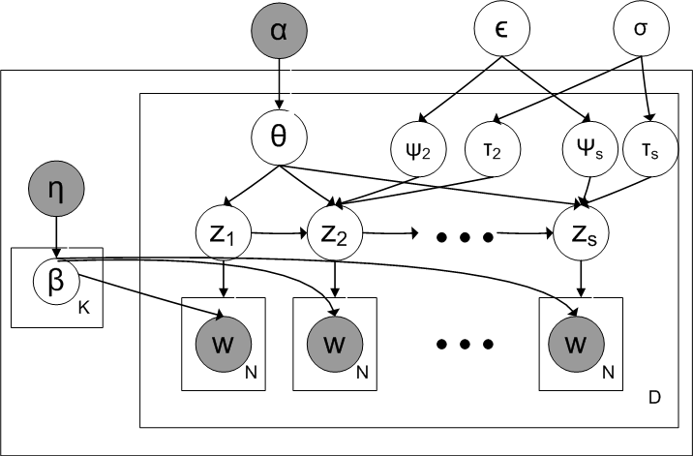
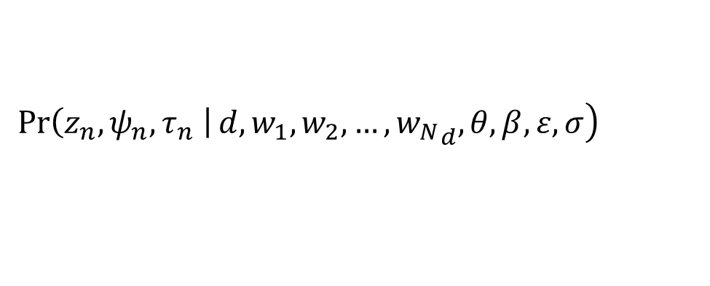

Hidden Topic Sentiment Model
Md Mustafizur Rahman Hongning Wang
Department of Computer Science, University of Virginia
{mr4xb,hw5x}@virginia.edu
Motivation
Abstract
.
Cons:
Recorder, mic
Especially when recording with speakers, the sound level gets blown out sounding horrible on playback. There is no mic jack for using a separate (adjustable) mic which would be handy.
Video quality is great though. 1080/30p looks beautiful
Observations
Sentences used in the reviews either follow the topics of previous sentences or changed into new one.
Users have consistent positive or negative attitude towards the same aspects of the entity in one review.
User generated reviews contain useful evaluation of various aspects of products with various sentiment, i.e. positive or negative. To better model the sentiment and topics, we propose a novel probabilistic modeling framework called Hidden Topic Sentiment Model (HTSM). HTSM assumes that each sentence in a review document is only associated with one sentiment and one topic; and the sentiment and topic assignment of next sentence will be dependent on the previous sentence. The results show that the topics and sentiment identified by HTSM are much coherent than those topics and sentiment identified by traditional topic models.
Pros: Video, look …
Methods
ε is controlling the topic transition and σ is for controlling sentiment
EM Algorithm
E-Step: compute (z, τ, ψ) by alpha- beta recursion
$$E\left(C_{d},_{Z}\right)= \sum_{n=1}^{N_{d}}{Pr(z_{d},_{n}=z, ψ_{d},_{n}=1|}w_{1},w_{2},…,{w_{N}}_{d})$$
$$E\left(C_{z},_{w}\right)= \sum_{d=1}^{D}{\sum_{n=1}^{N_{d}}{\operatorname{Pr}\left(z_{d},_{n}=z, w_{d},_{n}=w \right|w_{1},w_{2},…,{w_{N}}_{d})}}$$
M-Step: update (β, ε ,σ) by maximum likelihood estimation
$$ε= \frac{\sum_{d=1}^{D}{\sum_{n=2}^{N_{d}}{\operatorname{Pr}{ {(ψ}_{d},_{n}=1|}w_{1},w_{2},…,{w_{N}}_{d})}}}{\sum_{d=1}^{D}{(S−1)}}$$
$$σ= \frac{\sum_{d=1}^{D}{\sum_{n=2}^{N_{d}}{\operatorname{Pr}{ {(τ}_{d},_{n}=1|}w_{1},w_{2},…,{w_{N}}_{d})}}}{\sum_{d=1}^{D}{(S−1)}}$$
$$β_{z},_{w} ∞ E\left(C_{z},_{w}\right)+ η−1$$
$$\left.\operatorname{Pr}\left(z_{n},ψ_{n}, τ_{n} \right|d,w_{1},w_{2},…,{w_{N}}_{d}, θ, β, ε,σ\right)$$
Maximum entropy model to predict the τ and ψ
Hidden Markov Model to model the transition of topic and sentiment
Figure: Graphical Representation of
Hidden Topic Sentiment Model
Viterbi algorithm for posterior inference
Experimental Results
Sentiment Classification
F-1 measure on Positive Sentiment
Review summarization on Tablet dataset
Electronics Reviews from Amazon & NewEgg
Baseline
- Joint Topic Sentiment Model ^{[1]}
- Aspect Sentiment Unification
Model ^{[2]}
F-1 measure on Negative Sentiment
Category | Amazon | NewEgg
Camera | 6919 | 3020
Tablet | 6147 | 407
Phone | 6899 | 268
Tv | 4729 | 1662
Category | JST | ASUM | HTSM
Camera | 0.693 | 0.456 | 0.779
Tablet | 0.614 | 0.515 | 0.674
Phone | 0.767 | 0.626 | 0.791
Tv | 0.722 | 0.560 | 0.810
Category | JST | ASUM | HTSM
Camera | 0.484 | 0.591 | 0.708
Tablet | 0.569 | 0.580 | 0.485
Phone | 0.734 | 0.616 | 0.659
Tv | 0.619 | 0.671 | 0.802
Aspects | Most Probable Sentence
(-, Apps) | The apps keep freezing up especially yahoo mail
(-, Power) | The power cable is not connecting
(+, Battery) | Battery lasts for week
Top words from Phone dataset
Perplexity on Tablet dataset
Review summarization on Phone dataset
Sentiment seed words
Speaker(p) | Speaker(n) | Message(n)
good | speaker | Text
speaker | phone | send
sound | bad | receive
great | hear | message
quality | volume | problem
Aspects | Most Probable Sentence
(-, Storage) | Storage Capacity very les
(-, Connectivity) | Poor Wi-fi sensitivity
(-, call quality) | Persistent echo during call
good, nice, excellent, positive, fortunate
bad, nasty, poor, negative, unfortunate
Conclusion
References
1. C. Lin and Y. He. Joint sentiment/topic model for sentiment analysis. In Proceedings of the 18th ACM conference on Information and knowledge management, pages 375-384. ACM, 2009.
2. Y. Jo and A. H. Oh. Aspect and sentiment unification model for online review analysis. In Proceedings of the fourth ACM international conference on Web search and data mining, pages 815-824. ACM, 2011
HTSM enhances the independence assumption of sentiment and topics in a opinionated text document and thus captures the dependency among them. Through extensive experiment evaluations, HTSM better modeled sentiment and topics in review texts and outperforms existing joint topic sentiment models.

