Slide 1

Hidden Topic Sentiment Model
Md Mustafizur Rahman and Hongning Wang
Department of Computer Science
University of Virginia, Charlottesville,
Virginia, VA 22903
Notes:
Hello everyone, today I am going to present the hidden topic sentiment model which is a generative sentiment topic model to capture the topic and sentiment jointly from the unstructured text documents.

Slide 2



Motivation
Observation
Method
Experimental
Analysis
Conclusion
Motivation
Overall Rating or classification
does not give enough information
I especially like its portability (3 pounds with a small
footprint) and the speed of its solid state drive. When it come
looks you have to give it to the Inspiron. It definitely has the
sleek look of an ultrabook . The combination of brushed aluminum
with black trim, keys and bezel make for a very classy,
“corporate” presence. The fit and finish are first
rate. However, the sound sucks . I have owned 10 notebook
and laptop computers over the past two decades and this
Inspiron has the worst sound of any before it. It is weak, tinny
and what low end it has is muddy and indistinct. While we’ve
all come to expect pretty lousy sound from notebooks, this
is subpar even considering those low standards.
What do we need?
Sentiment topic models
Aspect Level Sentiment Analysis
Figure 1: A review from Amazon
Notes:
Let take a look at this review of Amazon kindle. Here user is providing his experience of using the it. He is quite happy about the portability, harddisk, appearance but he is quite annoyed about the sound. So now the overall rating star of 4 only gives us the high level idea that kindle is good, but it does not give us the information which aspects of the kindle is good? And users are specially interested about those aspects.
So what we need? We need aspect level sentiment analysis. To identify the aspects/topic from this kind of unstructured text review documents, the topic models are very prominent tool. So based on the topic model,
there are a lot of topic model based sentiment analysis emerged. The purpose of these models is to capture both the aspect and sentiment jointly.

Slide 3
Sentiment-Topic Models : Assumptions
Motivation
Observation
Method
Experimental
Analysis
Conclusion
Topic 1
sleek
fit
low
Topic 2
worst
solid
sound
A document is a mixture of latent sentiment [1][2]
Each sentiment is a mixture of latent topics [1][2]
Given the sentiment label, selection of the topics are
independent over words [1][2]
By: Kindle Customer Date: June 25, 2014
I especially like its portability (3 pounds with a small
footprint) and the speed of its solid state drive. When it come
looks you have to give it to the Inspiron. It definitely has the
sleek look of an ultrabook . The combination of brushed aluminum
with black trim, keys and bezel make for a very classy,
“corporate” presence. The fit and finish are first
rate. However, the sound sucks . I have owned 10 notebook
and laptop computers over the past two decades and this
Inspiron has the worst sound of any before it. It is weak, tinny
and what low end it has is muddy and indistinct. While we’ve
all come to expect pretty lousy sound from notebooks, this
is subpar even considering those low standards.
Topic 3
weak
comput
small
Topic 4
suck
movie
half
Limitations
Sentence is structured & coherent
Topic independency assumption fails to capture topic coherence
Sentence independency assumptions cannot handle sentiment consistency
Figure 2: Result of applying Joint Sentiment Topic model [1]
Notes:
At first, let us discuss what are the assumption of existing sentiment topic models like joint sentiment topic model (JST) [1], and Aspect Sentiment Unification Model (ASUM) [2]. First assumption is that a document is a mixture of latent sentiment. For example user wants to cover 60% about positive sentiment and 40% about negative sentiment. Next assumption, each sentiment is a mixture of topics. For example, under positive sentiment user wants to cover the batter life and picture quality aspect of the camera he bought and under the negative sentiment he wants cover the customer service quality. And the final assumption is that given the sentiment label, the assignment of topic over the words are independent from each other.
Now let us a take a look, the application of existing sentiment-topic models[1][2] on this review. You can see that the many of the words are colored by different color, where each color basically indicate a topic. According the sentiment-topic model, a document is a mixture of sentiment under each sentiment the assignment of the topic are independent from each other. For these kind of overly simplified assumption these sentiment-topic models cannot capture the rich structure embedded in the text document, rather we can see from the highlighted line that the word weak come from one topic and the word low is assigned to another topic. However, actually these words should allocate under same topic which we called as topic coherence and existing models cannot handle it.
Besides, the simple topic-sentiment mixture assumptions prevents the existing models to capture the sentiment consistence i.e. users always express same kind of sentiment towards the same topic.

Slide 4
Hidden Topic Sentiment Model
Motivation
Observation
Method
Experimental
Analysis
Conclusion
Assumptions
Sentence is the basic structure unit
All the words in a sentence share the same topic
Enforces topic coherence
Topic and sentiment of current sentence influence the topic and sentiment of the next sentence
Enhances topic coherence
Captures sentiment consistency
Notes:
Based on the observation of the previous example and in order to capture the topic coherence and sentiment consistency we have developed our model with some assumptions.
Since, we have noticed that document exhibits some kind of structure and sentence are related and coherent, so our first assumption is that sentence is the basic structure of the topic model.
Next, in order to ensure topic coherence i.e. words in close proximity share the same topic, we assume that the all the words in a sentence share the same topic.
And the final assumption is that Topic and sentiment of current sentence influence the topic and sentiment of the next sentence in this way we are making sure that user can express consistent sentiment towards the same topic which further enhances the topic coherence.

Slide 5
Motivation
Observation
Method
Experimental
Analysis
Conclusion
Generative Explanation of HTSM
Document-topic proportion θ
Portability,+ | Appearance,+ | Sound,-
0.25 | 0.25 | 0.50
Portability,+
Portability
Small
…
Appearance,+
look
classy
...
Sound,-
sound
Worst
…
P(w|z,β)
Ψ = 0, τ = 0 | Keep same topic and sentiment
Ψ = 0, τ = 1 | Keep previous sentiment, change topic
Ψ = 1, τ = 1 | Change both topic and sentiment
ε
σ
Aspect switch ψ
Sentiment switch τ
Hidden
Z₁
Z₂
Z₃
Z₄
I especially like its portability (3 pounds with a small
footprint) ^{{portability,+}} .
P,+
P,+
P,+
P,+
It definitely has the sleek look of an
ultrabook ^{{appearance,+}} .
Sentiment Consistency
However, the sound sucks ^{{sound,-}} .
A+
A+
A+
A+
I have owned 10 notebook and laptop computers over the past two decades and this Inspiron has the worst sound of any before it ^{{sound,-}} .
S,-
S,-
S,-
S,-
Observable
Topic Coherence
Sentence position
Hidden
Notes:
Here we will take a look at the generative story of HTSM model. Before starting writing the review the user will set up something in their mind. At first he will decide which topics will be covered in the review. Here for example he wants to cover the positive about the portability, the positive about the appearance, and the negative about the sound. So he develop a word-topic probabilty \beta. Next the he also decides the document-topic proportion (\theta).
Now he will start generating sentence. During the first sentence generation he can randomly pick any of the three topics. Suppose he randomly pick the portability topic and sample the words from that topic to generate the first sentence I especially like its portability.
Next, he has to generate the second sentence, he can transit to three different topics. However, in order to do so, he will consult to himself, more specifically he has two indicator variables \psi and \tau controlled by \epsilon and \sigma to decide about the whether he will keep the previous topic or sentiment, we can take a look at the table here. There are 3 rows of this table, because one possible combination of \psi and \tau that is 1 and 1 is invalid in our model, that is when user decides to change sentiment he has to change the topic also. So let us assume that user wants to change the topic but keep the previous sentiment. As a result at the second position he has only one option that appearance., so he picks that and randomly sample word from it to generate the second choice.
Now similarly for the third sentence, he again consult to \psi and \tau, and makes decision to change both topic and sentiment, so which leaves him with one option of sound with negative sentiment, so he generate the third sentence. So if we take a look at the second and third sentence, we will get an idea about how user are making consistent sentiment across to different topics.
Finally let us assume that user decides not to change the topic and sentiment, so he completes the fourth sentence by using the sound topic. Now we get an overall idea of the generative story of HTSM
If you notice among all these things, we can only observe the reviews generated by the users, we do not have any knowledge of all those parameters inside the reviewers mind. So the job of model, during the training phase is to estimate those parameters (\theta, \zi, \beta, \epsilon, \sigma).

Slide 6

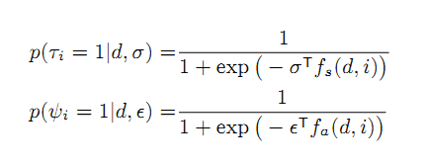
Motivation
Observation
Method
Experimental
Analysis
Conclusion
Can we do better
than coin tossing?
It definitely has the sleek look of an ultrabook ^{{appearance,+}} . However, the sound sucks ^{{sound,-}} .
ε
σ
Observable
ψ
τ
SentiWordNet
P,+
P,+
Sentence 1 | It definitely has the sleek look of an ultrabook | Positive Sentiment
Sentence 2 | However, the sound sucks | Negative Sentiment
A+
A+
S,-
S,-
Sentiment Transition Feature f_{s}(d,i)
Bias Term
Content-based cosine similarity
sentiWordNet score
Jaccard coefficient between POS tag
Negation count
Topic Transition Feature f_{a}(d,i)
Bias Term
Content-based cosine similarity
Length ratio
Relative position of sentence
Notes:
Now we know that the user decides about the sentiment and topic switch controlled by two parameters \epsilon and \sigma. Here we will discuss why do we need these two parameters? Suppose in the easiest case user can do the coin tossing to make decision about the sentiment and topic switch. So if a head appears then switch or vice versa. But can we do better than coin tossing.
Of course, we can. We have the observable sentences, right? Now take a look at the two sentences, and we can find out the first sentence contains the sleek and the next sentence contains sucks. So definitely, these two sentences contain two different kind of sentiment. We can pass this information to SentiWordNet,a ontology of word which provides the sentiment score of the word, get that information. This is just one feature for sentiment transition, however, we can generate other features from observed sentences for both sentiment and topic transition as depicted in these table. Finally we can use a parameterized logistic regression to learn the parameter \epsilon and \sigma in a EM algorithm setting.

Slide 7
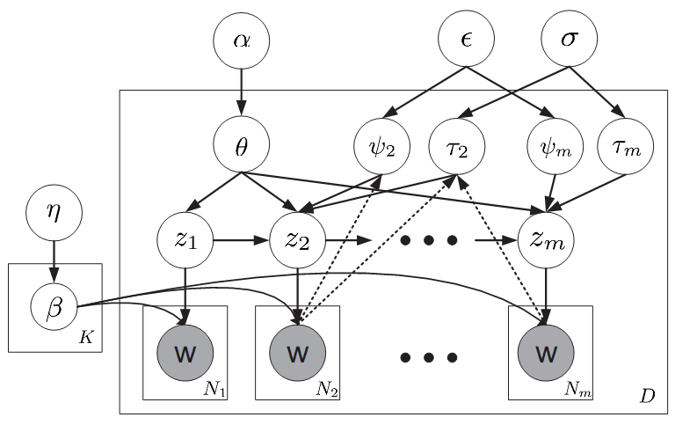
Motivation
Observation
Method
Experimental
Analysis
Conclusion
Topic and sentiment transition selector
First order
Markov model
Ensure Topic Coherence & Sentiment Consistency
One sentence contains one topic :
Topic coherence
Sentence the basic unit of HTSM
7
Notes:
In the figure, we represent our model in plate notation. The hyper-parameters are \alpha and \eta which are working as prior on document-topic proportion \theta and word-topic probability matrix \beta respectively.
As we can see the all the words in a sentence are sampled from the one topic z_i and in this way we are enforcing the first and second assumption. And we enforce our third assumption by introducing the first order markov model i.e. we can see the topic z_2 of sentence 2 is getting influenced by the topic z_1 of sentence 1 and so on. And finally to make informed decision about whether to switch from the topic and sentiment of the previous sentence we have introduced the indicator variable \psi and \tau which are controlled by two other continues random variable \epsilon and \sigma.

Slide 8
Posterior Inference ( , )
Motivation
Observation
Method
Experimental
Analysis
Conclusion
Sentence-level topic assignment (discrete random variable)
Document-level topic proportion (continues random variable)
Exact posterior inference is not feasible!
Solution
approximate posterior inference via coordinate ascent
will converge to a local maximum of data likelihood function of the document d
Notes:
Now inside each document, we have to infer the parameters \zi and \theta. However \zi is discrete random variable and \theta is a continues random variable and because of the parameter tying we exact posterior inference is not feasible. So standard procedure is to do approximate posterior inference using coordinate ascent method, where fix one parameter and try to optimize the others and next set the other optimize the current one. And it is proved that they will converge to the local optima for the likelihood function of the document d

Slide 9
Parameter Estimation
Motivation
Observation
Method
Experimental
Analysis
Conclusion
Model Parameters (β, ε, σ)
Expectation Maximization (EM) algorithm
Randomly initialize (β^{t}, ε^{t} σ^{t}) at time t
Expectation Step (E step):
Approximate inference for (z, θ) is computed for each document with model parameters (β^{t}, ε^{t} σ^{t})
Maximization Step (M step):
maximum likelihood estimator is used to compute the model parameters at time T+1 (β^{T+1}, ε^{T+1}, σ^{T+1})
Some review websites
(i.e. newegg.com) provides the sentiment switch explicitly (σ), where our model can be trained in a semi-supervised manner
Notes:
So finally the model parameters are \beta,. \epsilon and \sigma. The standard procedure for parameter estimation in topic model is to use the Expectation-Maximization algorithm. Initially we set the parameter \beta, \epsilon and \sigma. Then, in the Expectation step, we compute the approximate posterior inference and collect the sufficient statistics and in the maximization steps, we use maximum likelihood estimate the new set of parameter \beta, \epsilon and \sigma. Now we plug in this value in the E-step again, do the procedure again. In this way we continue until we reach a local optima.
It is to be noted that some website like newegg.com provide the sentiment transition information explicitly, in that case we do not need to learn the \sigma parameter and we can train our model in a semi-supervised setting also.

Slide 10
Dataset
Motivation
Observation
Method
Experimental
Analysis
Conclusion
Product review dataset from 2 different websites
Amazon and NewEgg website
Four (4) different products (Camera, Phone, Tablet, and TV)
Table 1: Description of Dataset
Dataset | Amazon | NewEgg | Vocabulary Size
Camera | 6919 | 3020 | 1406
Tv | 4729 | 1662 | 1410
Tablet | 6147 | 407 | 1515
Phone | 6899 | 268 | 1282
Notes:
For the experimental evidence we have collected the review data from two different websites, Amazon and NewEgg.com. We have collected data for four different categories; camera, tablet, phone and tv. The number of reviews under each category is depicted in the Table 1. We have collected data from newEgg.com because this website provides reviews in pros and cons section, which is used as a ground truth in our sentiment classification experiment.

Slide 11


Performance Metrics
Motivation
Observation
Method
Experimental
Analysis
Conclusion
Topic Model Evaluation
Perplexity
In Information theory, perplexity is a measurement of how well a probability distribution or probability model predicts a sample
Sentiment Classification
F-1 measure
Notes:
Since we need two kind of evaluation one is topic evaluation and another is sentiment classification we need two quantitatively measure. We measure perplexity to determine how well our model can predict a sample. According to the information theory, we can say perplexity is the number of bits required to compress the information, so the lower the perplexity the better the model is.
And for sentiment classification, we have used the standard F-1 measure which is defined in terms of precision and recall as depicted here.

Slide 12
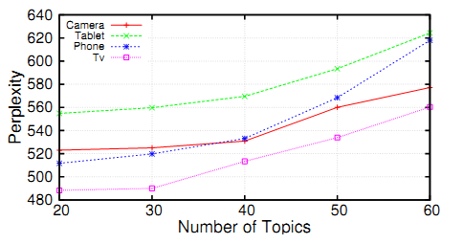
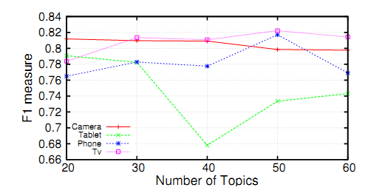
Motivation
Observation
Method
Experimental
Analysis
Conclusion
Number of Topics: Empirical Evidence
Figure 3: Effects of varying the number of topics on perplexity (left) and F-1 measure (right)
Table 2 : Number of Topics
Category | Camera | Phone | Tablet | Tv
Number of topics | 26 | 26 | 30 | 16
Notes:
Now in the topic model, we need the specify the number of topics. So we perform an empirical evaluation to set this parameter. We change the number of topics from 20 to 60 and calculate both perplexity and F-1 measure for all four different categories. From the Figure 3, we get an idea that once we exceed the number of topic 30, our model starts getting over-fitted i.e. higher perplexity and lower F-1 value. So from this empirical evaluation we have set the number of topics under each category as shown in Table 2.

Slide 13
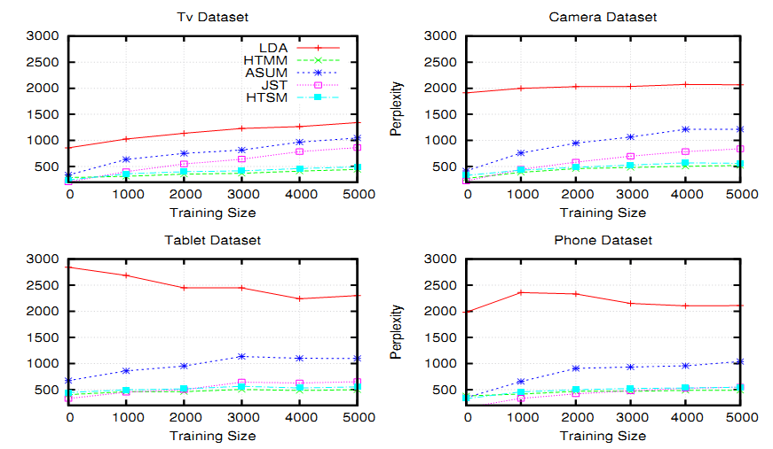
Motivation
Observation
Method
Experimental
Analysis
Conclusion
Topic Evaluation
Figure 4 : Perplexity with increasing training size on four different review document sets
Notes:
In order to measure how our model can predicts a sample we have used the perplexity. As a baseline here, we have used Latent Dirichlet Allocation (LDA), Hidden Topic Markov Model (HTMM), Joint Sentiment Topic Model (JST) and Aspect Sentiment Unification Model (ASUM). From the figure 4 we get the overview that our model outperforming the LDA, JST and ASUM by large margin for all the four categories. The only exception is HTMM, and it is to be noted that HTMM is a topic models whereas our model is a sentiment-topic models, as a result our models are assigning word under more number of topics than HTMM, which follows the slightly lower perplexity of HTMM

Slide 14
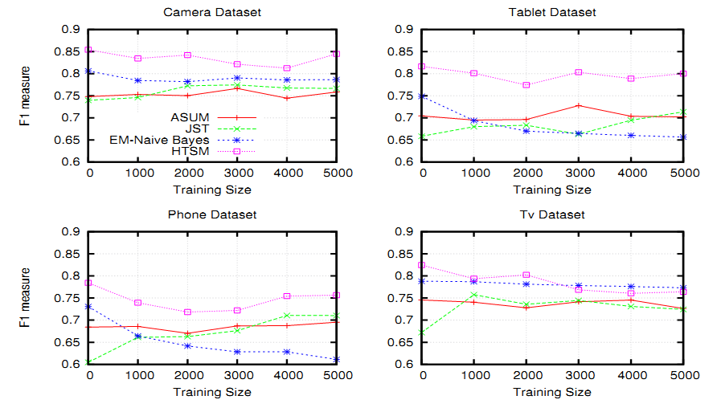
Motivation
Observation
Method
Experimental
Analysis
Conclusion
Sentiment Classification
Figure 5 : Sentiment classification performance with increasing training size on four different review document sets
Notes:
We have compared our model against some state-of-the topic-sentiment model like JST, ASUM and EM-Naïve Bayes, a semi-supervised algorithm. In figure 5, the x-axis represents the number of reviews in the training set. As we can see at each point we increase the number of reviews from Amazon by 1000. However, all these point of on x-axis, also include the training data from newEgg. Finally we test against the data obtain from newEgg.com because in Amazon dataset we do not have the sentiment-level annotation. From the figure 5, it is evident that HTSM outperform the other model by a good margin almost 10% percentage of improvement over the existing models.
However, adding more and more Amazon data has mixed impact on the performance. There is significantly no trends whether adding those un-annotated reviews really helps or not.

Slide 15

Motivation
Observation
Method
Experimental
Analysis
Conclusion
Word Intrusion Experiment [4]
Model (m) generates the topics
Annotators have to find out which two words are intruding?
Topic 1 | Probability
Charge | 0.150
Recharge | 0.135
Battery | 0.124
Life | 0.105
…
Dock | 0.003
Topic 2 | Probability
Lens | 0.161
Screen | 0.159
Display | 0.157
Touch | 0.142
View | 0.125
Topic 1
Battery
Dock
Life
Screen
Recharge
Charge
Inter-topic
Intruding Word
Intra-topic
Intruding Word
Successful identification of intruding words means the model (m) can generate topics that are human interpretable
Notes:
So far we have performed quantitative experimental analysis, 1) perplexity for topic evaluation and 2) F-1 measure for sentiment classification. So we need to perform some qualitative analysis to understand how well our model is.
Here, now we want to know whether the topic identified by our model, is actually human interpretable or not, so we have decided to perform the word intrusion experiment. We identify the word which has relatively low probability as an intra-topic intruding word and a word which has a higher probability in other topic (topic 2 here) but not in the current topic as an inter-topic intruding word for the topic 1. Then we randomly mix up these two kind of words with the top five words of topic 1 and present this to annotator. The job of the annotator is to identify these two intruding words and if he can successfully identify the word then it implies that the model (m) can generate topics that are human interpretable

Slide 16

Motivation
Observation
Method
Experimental
Analysis
Conclusion
Topic Evaluation (Word Intrusion)
Performance Metric
Table 3: Word intrusion measurement across different topic
models of four categories of product reviews
Inter-topic MR
Category | LDA | HTMM | ASUM | HTSM
Camera | 0.167 | 0.218 | 0.218 | 0.282
Tablet | 0.356 | 0.256 | 0.244 | 0.389
Phone | 0.192 | 0.179 | 0.231 | 0.333
Tv | 0.188 | 0.188 | 0.271 | 0.313
Intra-topic MR
Category | LDA | HTMM | ASUM | HTSM
Camera | 0.474 | 0.385 | 0.436 | 0.346
Tablet | 0.478 | 0.533 | 0.456 | 0.522
Phone | 0.551 | 0.500 | 0.487 | 0.346
Tv | 0.625 | 0.646 | 0.563 | 0.500
Notes:
As performance metric we have used the metric shown here, where K is the number of topics and S is the number of annotators. From the table 3, we get the idea that our model HTSM is performing very goof across all the four categories for inter-topic intrusion measurement. However, for the intra-topic intrusion measurement, there is no single winner. We believe that the selection process of intra-topic intrusion word and the way annotators interpret this might be the contributing factors for relatively low performance of HTSM

Slide 17
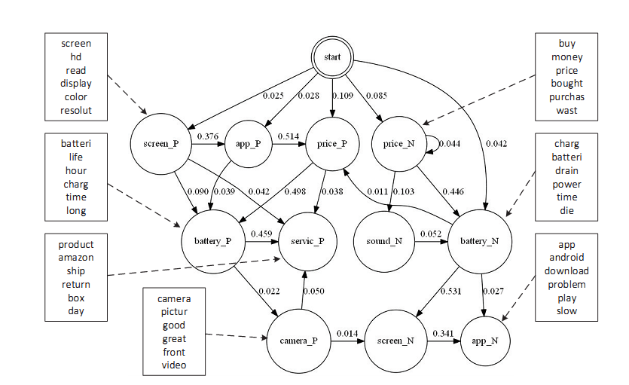
Motivation
Observation
Method
Experimental
Analysis
Conclusion
Topic Evaluation (Topic Transition)
When users have negative sentiment
When users have positive sentiment
Figure 6 : Estimated topic transition and top words under selected topic on tablet data set
Notes:
Here we want to know, how an user makes transition from one topic to another he write the review. So we have generated the topic transition diagram for Tablet category. For example, when users are happy about their product, it is likely that they usually start with something positive the price i.e. the tablet is worth of the money, then it is likely that they will discuss that the battery quality is pretty good, which might be followed by the customer service of tablet. Similarly when the users are not satisfied about the purchase, it is highly likely that they will complain about the price, then negative reviews of the battery charge is most likely and then next highly likely they will discuss the screen etc.

Slide 18
Motivation
Observation
Method
Experimental
Analysis
Conclusion
Aspect-Based Contrastive Summary
Table 4 : Aspect-based contrastive summarization on tablet dataset
Topic | Samsung Galaxy Note 10.1 | Amazon Kindle Fire HDX
(+, battery) | Battery life is very good, it is easily an all day device with wifi on and high brightness while taking notes | Battery life is ok - probably need to recharge every other day with normal use
(-, battery) | My only issue is that it takes a long time to take a full charge and does not charge rapidly enough to use while charging, but the battery life is not bad | Everything works great, but the battery life is not nearly as long as advertised
(+, sound) | it has pretty good battery life, it also has an excellent quality sounding speakers, which I wasn't expecting on any tablet | Sound is really good (not home theater quality or anything) but better than any phone I've heard
(-, sound) | The audio became occasionally inoperative and the headphone jack would crackle when using my ear buds | Users can get confused with volume buttons on the other side
Notes:
Another qualitative study, we have performed is Aspect-Based Contrastive Summary. The idea is to pick the most likely sentence by a model, given the topic, sentiment and a set of reviews for a specific product. For example suppose that user care about the two products Samsung galaxity Note 10.1 and Amazon Kindle Fire HDX. Now before buying the tablet, he wants to know about the battery and sound aspect of the two tablets. So the input of the user will be two aspects (battery and sound) and a set of reviews fro each of the products. Then our model HTSM will pick the most likely sentences for each of the aspects from each product and present those to the user in the table format depicted here.
From the table 4, the user gets the idea that battery of Amazon is not that good as it is advertised by the company, however, the battery of Samsung Galaxy tab is good but it takes long time to charge. Based on this kind of contrastive summary the user can make informed decision about which product he should buy.

Slide 19

Motivation
Observation
Method
Experimental
Analysis
Conclusion
User Study for Summarization
Interleave the summarized sentences from all models
Reduce position bias
Ask annotators
E.g. Pick two sentences POSITIVE about PRICE Aspect
Performance Metric
Annotators selection of a sentence generated from model (m), means it (model m) can pick more informative sentence than other models
Table 5: Interleaved document summarization quality test
Category | ASUM | HTMM | HTSM
Camera | 0.078 | 0.362 | 0.560
Tablet | 0.153 | 0.370 | 0.477
Phone | 0.118 | 0.439 | 0.443
Tv | 0.173 | 0.338 | 0.489
Notes:
Here, we want to know whether the contrastive summary is actually helpful or not. So for this experiment we have used three models HTSM, HTMM and ASUM. Then we have selected the most likely 2 sentences from each of these three models for a specific product with specific aspect of interest. Then we interleave the generated six sentences to reduce the position and present those to the annotators. The job of the is pick two sentence those are most informative given the annotators are only provided the aspect and sentiment, he does not have any knowledge about which model generate which sentence.
If the annotators pick a sentence that is selected by model (m), that means that model m is generating more informative sentence than other models. So based on this, we have defined the performance metric depicted here, where M is the number of models, K is the number of topics and S is the number of annotators. From the table 5, it is evident that our model is clearly selecting more informative sentence the other two models. It is to be noted that ASUM is also a sentiment topic model, however since ASUM is not capturing the pair wise sentence level dependency to enforce the topic coherence and sentiment consistency their performance is the worst here, whereas HTMM is performing relatively better because HTMM is trying to capture the topic coherence by introducing binomial distribution in switching of topic between tow consecutive sentence.

Slide 20
Motivation
Observation
Method
Experimental
Analysis
Conclusion
Summary of Contributions
A unified topic model to explicitly capture
topic coherence
By enforcing the constraint that the sentence can have one topic
sentiment consistency
Using the constraint that the sentiment and topic of previous sentence affects the sentiment and topic of the next sentence
capture the sentiment and topic switch from observable text reviews
Flexible modeling assumption enables both unsupervised and semi-supervised estimation of model parameters
Notes:
Finally here are the contribution of this paper. We have introduced the unified topic model which introduces the topic coherence and sentiment consistency in the generative settings of topic model thus capturing the sentiment and topic jointly better than existing state-of-the-art sentiment topic models. The topic coherence is enforced by the constraint that the sentence can have one topic which is further enhanced by the first order markov model structure. And sentiment consistency is ensured by the condition that the sentiment and topic of previous sentence affects the sentiment and topic of the next sentence. Besides, the our model is flexible enough to train in both unsupervised and semi-supervised setiings.

Slide 21
Motivation
Observation
Method
Experimental
Analysis
Conclusion
Future Works
Capture long-term dependency
Skip-chain
Incorporate document-level rating
Overall rating from 1 to 5 star rating
Value of the product user care about
Notes:
So here are the possible future extension of our model. At first it is evident that our model HTSM currently cannot capture long-term dependency. Because capturing long term independency is computationally infeasible in the current setting. However, we can introduce the skip-chain to capture this long term dependency in some sense.
And secondly, we have not utilized the document level overall rating to do the sentiment classification. However, based this document level ratings can be used as a feature weight to decide the topic and sentiment switch. Besides, if we perform rating analysis we can also infer the value of the aspect of a particular product the user care about, which can be incorporated in the future development of HTSM.

Slide 22
References
[1] C. Lin and Y. He. Joint sentiment/topic model for sentiment analysis. In Proceedings of the 18th ACM conference on Information and knowledge management , pages 375–384. ACM, 2009.
[2] Y. Jo and A. H. Oh. Aspect and sentiment unification model for online review analysis. In Proceedings of the fourth ACM international conference on Web search and data mining , pages 815–824. ACM, 2011.
[3] D. M. Blei, A. Y. Ng, and M. I. Jordan. Latent dirichlet allocation. the Journal of machine Learning research, 3:993–1022, 2003.
[4] J. Chang, S. Gerrish, C. Wang, J. L. Boyd-Graber, and D. M. Blei. Reading tea leaves: How humans interpret topic models. In Advances in neural information processing systems, pages 288–296, 2009.
[5] A. Gruber, Y. Weiss, and M. Rosen-Zvi. Hidden topic markov models. In International Conference on Artificial Intelligence and Statistics , pages 163–170, 2007
[6] T. Hofmann. Probabilistic latent semantic analysis. In Proceedings of the Fifteenth conference on Uncertainty in artificial intelligence , pages 289–296. Morgan Kaufmann Publishers Inc., 1999
[7] Mei, Qiaozhu, et al. "Topic sentiment mixture: modeling facets and opinions in weblogs." Proceedings of the 16th international conference on World Wide Web. ACM, 2007.

