Slide 1
Deque
By
Mokadderul Islam
18CSE075

Slide 2
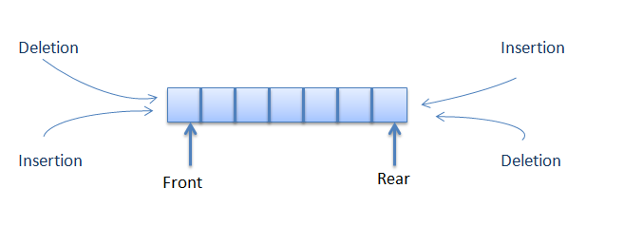
What is deque?
A double-ended queue is an abstract data type that generalizes a queue, for which elements can be added to or removed from either the front or rear.
It is also often called a head-tail linked list.

Slide 3
TYPES OF DEQUE
Input restricted Deque
->Elements can be inserted only at one end.
->Elements can be removed from both the ends.
Output restricted Deque
->Elements can be removed only at one end.
->Elements can be inserted from both the ends.

Slide 4
Deque as Stack and Queue
As Stack:
->When insertion and deletion is made at the same side.
As Queue:
->When items are inserted at one end and removed at the other end.

Slide 5
OPERATIONS IN DEQUE
Insert element at back
Insert element at front
Remove element at front
Remove element at back

Slide 6
Algorithm Insert element at front
step1. Start
step2. Check the queue is full or not as if (r == max-1) &&(f==0)
step3. If false update the pointer f as f= f-1
step4. Insert the element at pointer f as Q[f] = element
step5. Stop

Slide 7
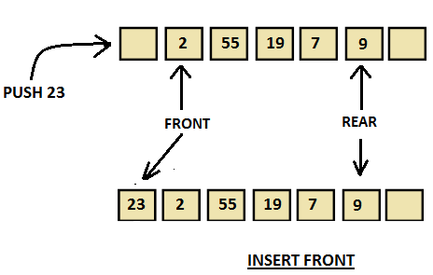
Insert front()
Insert_front() is a operation used to push an element into the front of the Deque

Slide 8
Alogrithm Insert element at back
Step1: Start
Step2: Check the queue is full or not as if (r == max-1) &&(f==0) if yes queue is full
Step3: If false update the pointer r as r= r+1
Step4: Insert the element at pointer r as Q[r] = element
Step5: Stop

Slide 9
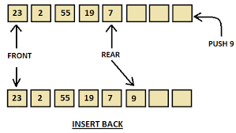
Insert_back()
Insert_back() is a operation used to push an element at the back of a Deque.

Slide 10
Alogrithm Remove element at front
Step1: Start
Step2: Check the queue is empty or not as if (f == r) if yes queue is empty.
Step3: If false update pointer f as f = f+1 and delete element at position f as element = Q[f]
Step4: If ( f== r) reset pointer f and r as f = r = -1
Step5: Stop

Slide 11
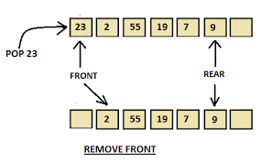
Remove_front()
Remove_front() is a operation used to pop an element on front of the Deque.

Slide 12
Alogrithm Remove element at back
step1. Start
step2. Check the queue is empty or not as if (f == r) if yes queue is empty
step3. If false delete element at position r as element = Q[r]
step4. Update pointer r as r = r-1
step5. If (f == r ) reset pointer f and r as f = r= -1
step6. Stop

Slide 13
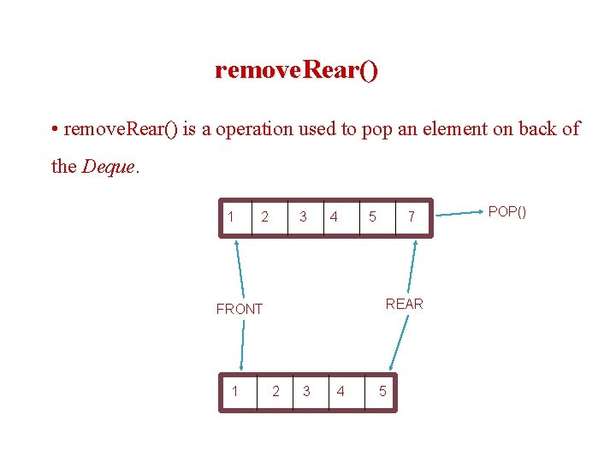
Remove_back()
Remove_back() is a operation used to pop an element on back of the Deque.

Slide 14
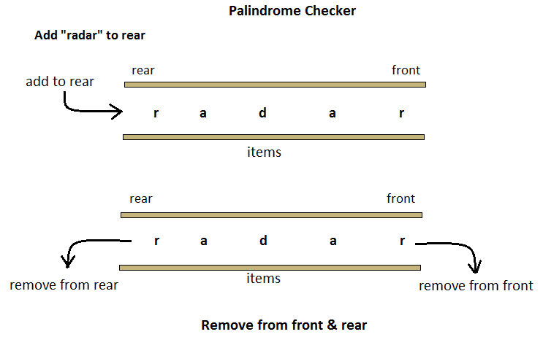
APPLICATIONS OF DEQUE
Palindrome-checker

Slide 15
APPLICATIONS OF DEQUE
The A-Steal algorithm implements task scheduling for several processors(multiprocessor scheduling).
The processor gets the first element from the deque.
When one of the processor completes execution of its own threads it can steal a thread from another processor.
It gets the last element from the deque of another processor and executes it.

Slide 16
Thank you

