Slide 1
Metro Rail Ticket Management System

Slide 2

-:Group Members:-
Serajus Salekin (2017-1-60-006)
Nasif wasek Fahim (2017-1-60-037)
Mueem Nahid Ibn Mahbub (2017-1-60-089)
(Department of Computer Science and Engineering)

Slide 3
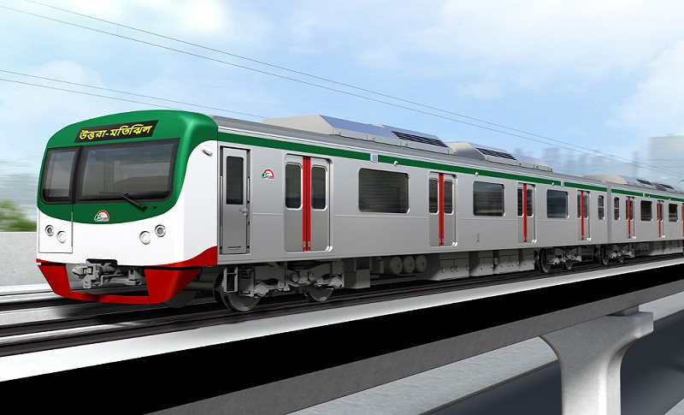
Introduction

Slide 4
Why this system is necessary?

Slide 5
System Ensures:
Increases efficiency and reliability.
Easier Access and easy to use.
Provide accurate information to the user for taking
necessary decisions.
System ensure that right information reaches the right
person at the right time.
The options used can be easily accessed, used and realized.

Slide 6
20
Q/A
Thank You

