Slide 1
01
PIXEL ART
EDITOR
A console-based pixel drawing application developed in C
CSE115 • Section 4 • Group 6
15 × 15 canvas • 16-color palette
Draw • Erase • Fill • Load • Save
Nahidul Islam Anim • Md Samiuzzaman Bhuiyan • Jubair Pasha • Anindita Barua Sneha • Lamia Nazmul
Project presentation
Group 6 | Nahidul Islam Anim, Md Samiuzzaman Bhuiyan, Jubair Pasha, Anindita Barua Sneha, Lamia Nazmul

Slide 2
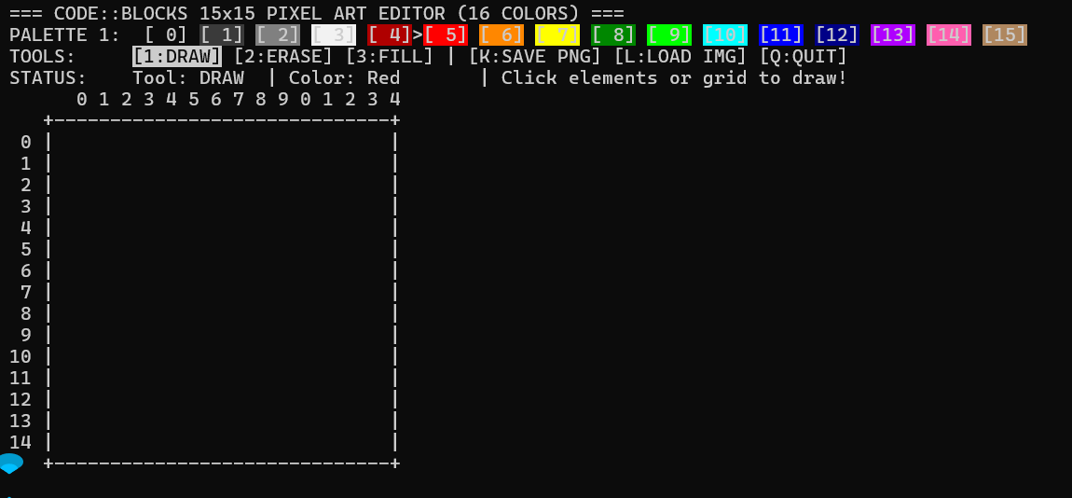
01 / SCOPE
02
Project Overview
What the application does
• Represents a drawing canvas as a 15 × 15 grid.
• Uses a fixed 16-color palette and menu-driven interaction.
• Supports pixel drawing, erasing, and color-region filling.
• Demonstrates 2D arrays, functions, loops, conditions, and input handling.
Console interface: 15 × 15 Canvas
Design Principle
Keep editing operations small, explicit, and easy to validate.
Core structure
Canvas
→
Tools
→
Input
→
Render
Mouse interaction selects tools, colors, and canvas positions.
Group 6 | Nahidul Islam Anim, Md Samiuzzaman Bhuiyan, Jubair Pasha, Anindita Barua Sneha, Lamia Nazmul

Slide 3

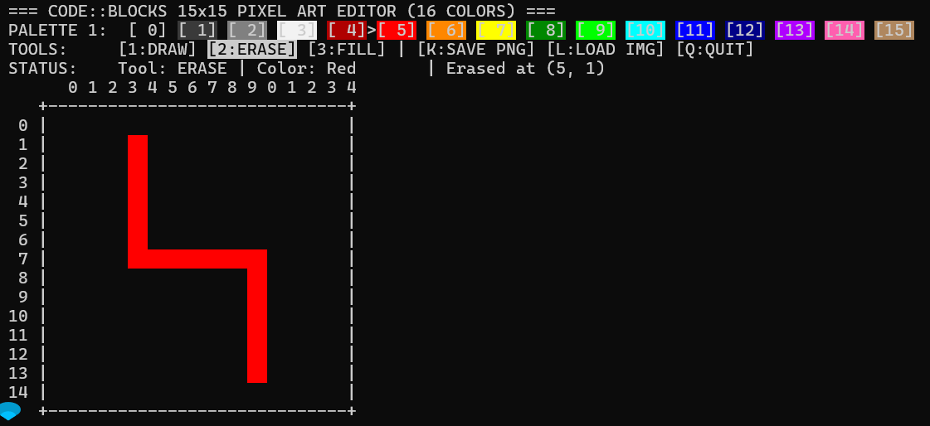
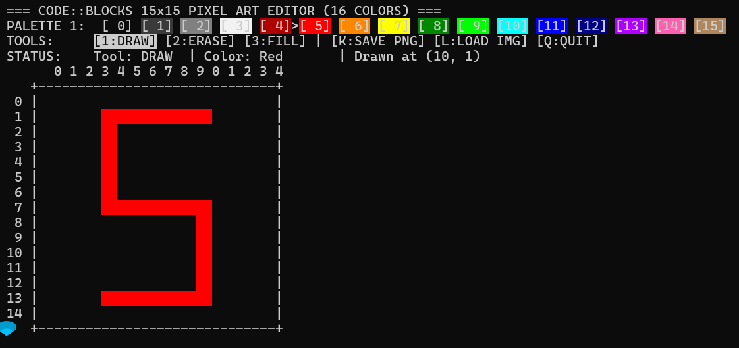
02 / EDITING
03
Editing Tools — Draw & Erase
DRAW
ERASE
Paint one pixel at a time
Reset a selected cell to blank
• Select a row and column through mouse input.
• Choose the active color from the palette.
• Write the color value into the selected cell.
• Validate coordinates before changing the canvas.
• Select the target position using mouse input.
• Reset the selected pixel to zero.
• Apply boundary validation before editing.
Example: The number “5” is drawn on the canvas.
Example: Erased Rows & Columns
Group 6 | Nahidul Islam Anim, Md Samiuzzaman Bhuiyan, Jubair Pasha, Anindita Barua Sneha, Lamia Nazmul

Slide 4
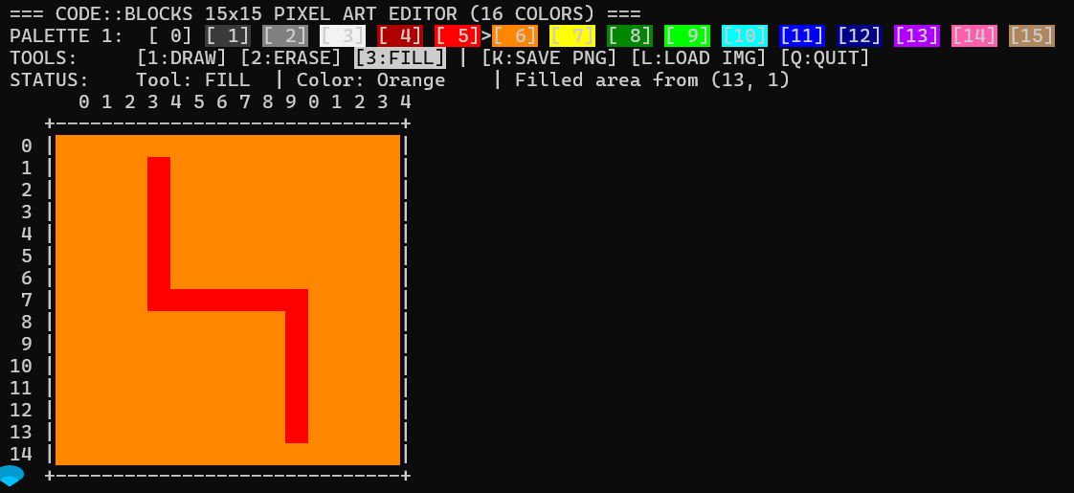
03 / REGION EDITING
04
Editing Tools — Fill
FILL
Change a connected color region
• Select a target color and replacement color.
• Find matching pixels in the selected region.
• Replace the existing color with the new color.
• Useful for quickly recoloring repeated areas.
Example: Fill Operation
Operation
Target color
→
Replacement
Source Example: Same-Colored pixels are changed to orange.
One selection can update multiple matching cells.
Group 6 | Nahidul Islam Anim, Md Samiuzzaman Bhuiyan, Jubair Pasha, Anindita Barua Sneha, Lamia Nazmul

Slide 5
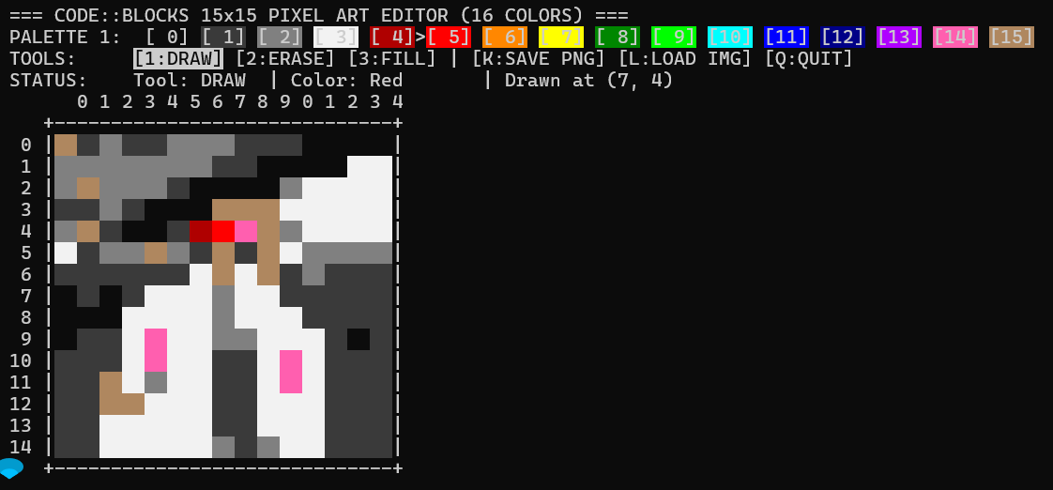
04 / FILE OPERATIONS
05
Save & Load Images
File Workflow
01
Select image
02
Render image to cells
Loaded Image represented on the Canvas
03
Adjust to canvas ratio
04
Save work as PNG
LOAD
Select an image from the computer and map it to the 15 × 15 Canvas.
PNG export keeps the finished artwork available on the Computer.
Group 6 | Nahidul Islam Anim, Md Samiuzzaman Bhuiyan, Jubair Pasha, Anindita Barua Sneha, Lamia Nazmul

Slide 6
05 / WORKFLOW
06
How the Editor Works
User Workflow
1
Choose color
2
Select Tool
3
Click Canvas
4
View Update
5
Save / Load
→
→
→
→
Implementation Focus
Interaction Model
• Global 2D array stores the 15 × 15 canvas.
• Separate functions handle drawing, erasing, filling, and interaction.
• Boundary checks protect valid canvas coordinates.
• Mouse input selects pixels and controls.
• The interface is refreshed after an editing action.
• Keyboard shortcuts support save, load, and quit.
Group 6 | Nahidul Islam Anim, Md Samiuzzaman Bhuiyan, Jubair Pasha, Anindita Barua Sneha, Lamia Nazmul

Slide 7
06 / CLOSE
07
Conclusion & Key Takeaways
A compact C project with a complete interactive workflow.
The project connects fundamental programming concepts to a practical visual application.
01
Core Concepts
02
Core Features
03
User Experience
• 2D Arrays
• Functions
• Loops
• Control Structures
• Draw
• Erase
• Fill
• Load
• Save
• Simple
• User-Interactive
• Console-Based
Successfully built a simple, functional pixel art editor in C using a structured, user-interactive design.
Thank You!
Group 6 | Nahidul Islam Anim, Md Samiuzzaman Bhuiyan, Jubair Pasha, Anindita Barua Sneha, Lamia Nazmul

