Slide 1

Image-to-Image Translation with Conditional Adversarial Networks
Phillip Isola, Jun-Yan Zhu, Tinghui Zhou, Alexei A. Efros
[GitHub] [Arxiv]
Slides by Víctor Garcia [GDoc] UPC Computer Vision Reading Group (25/11/2016)

Slide 2
Index
Introduction
State of the Art
Method
Network Architecture
Losses
Experiments
Qualitative Results
Sentence interpolation
Style Transfer
Conclusions

Slide 3
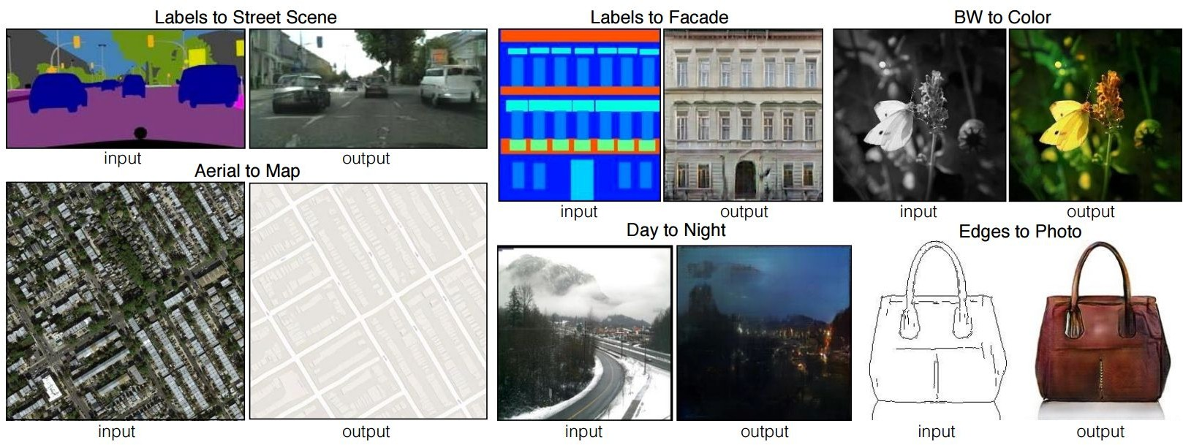
Introduction
Image → Image
GANs

Slide 4
Index
Introduction
State of the Art
Image to Image
Method
Experiments
Conclusions

Slide 5
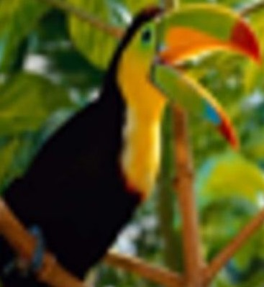
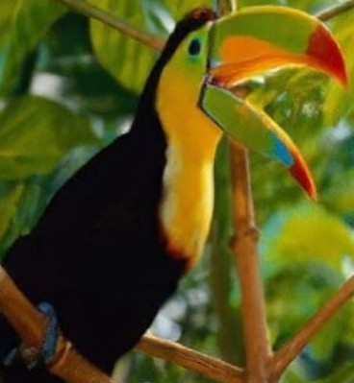
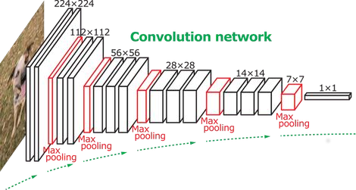
State of the Art - Image to Image
Super-Resolution
Loss = MSE(Φ(Iin), Φ(Iout))
CNN

Slide 6
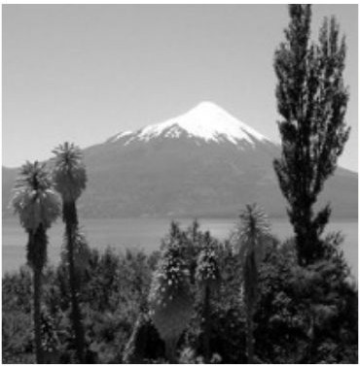
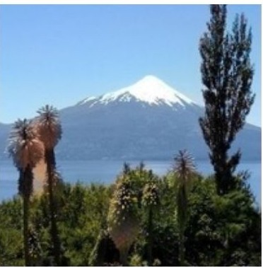
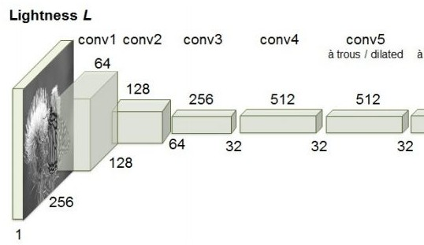
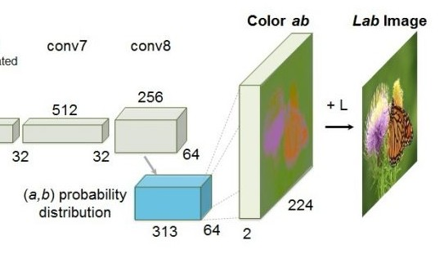
State of the Art - Image to Image
Super-Resolution
Loss = MSE(Φ(Iin), Φ(Iout))
CNN
Image colorization
Loss = CE(Φ(Iin), Φ(Iout)) weighted
CNN

Slide 7
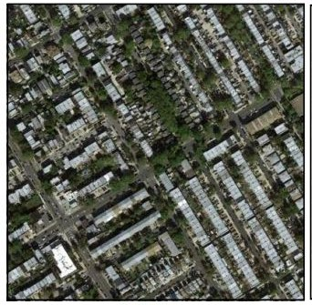
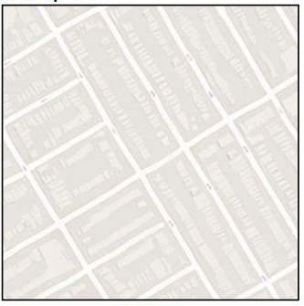
State of the Art - Image to Image
Generator
Global Loss ?

Slide 8
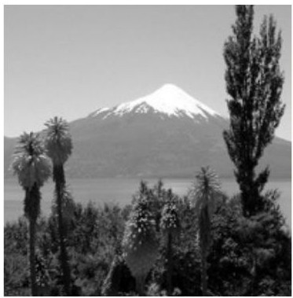
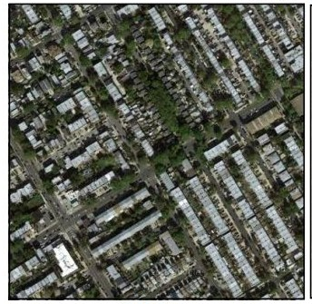
State of the Art - Image to Image
Generated Pairs
Generator
Discriminator
Loss → BCE
Ground Truth Pairs
Real World

Slide 9
State of the Art - Image to Image
Some works already use conditional GANs for Image to Image translation
Photo-Realistic Single Image Super-Resolution Using a Generative Adversarial Network. (2 Weeks ago)
Loss1 = MSE_VGG(Φ(Iin), Φ(Iout))
CNN
Loss2 = Regularization
Loss3 = GAN Loss

Slide 10
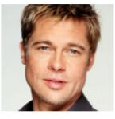
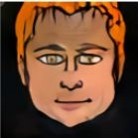
State of the Art - Image to Image
Some works already use conditional GANs for Image to Image translation
Photo-Realistic Single Image Super-Resolution Using a Generative Adversarial Network. (2 Weeks ago)
Loss1 = MSE_VGG(Φ(Iin), Φ(Iout))
CNN
Loss2 = Regularization
Loss3 = GAN Loss
Unsupervised cross-domain Image Generation (2 Weeks ago)
z

Slide 11
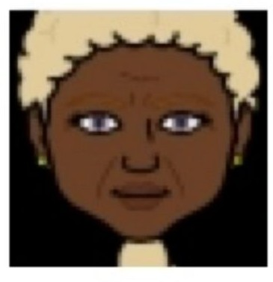
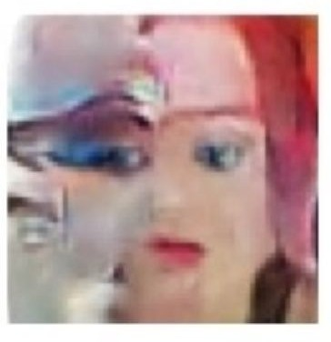
State of the Art - Image to Image
Some works already use conditional GANs for Image to Image translation
Photo-Realistic Single Image Super-Resolution Using a Generative Adversarial Network. (2 Weeks ago)
Loss1 = MSE_VGG(Φ(Iin), Φ(Iout))
CNN
Loss2 = Regularization
Loss3 = GAN Loss
Unsupervised cross-domain Image Generation (2 Weeks ago)
z

Slide 12
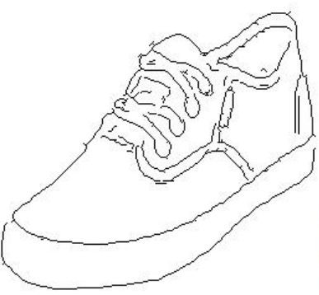
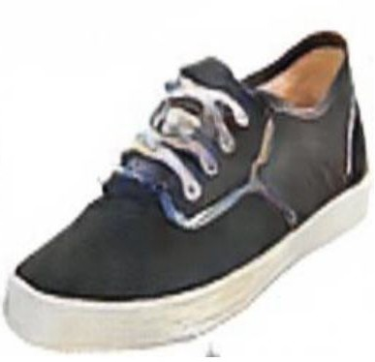
State of the Art - Image to Image
z
This paper solves the problem of Image to Image Translation using the same architecture for any task without need of handcrafting any Loss function.

Slide 13
Index
Introduction
State of the Art
Method
Conditioned GANs
Generator - Skip Network
Discriminator - PatchGAN
Optimization Losses
Experiments
Conclusions

Slide 14
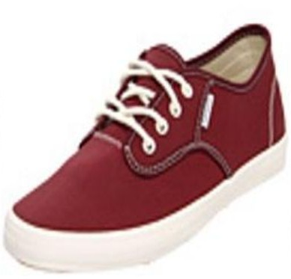
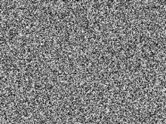
GANs
True/False
Discriminator
Generator
Real World

Slide 15
GANs
True/False
Discriminator
Generator
Real World

Slide 16
GANs
True
Discriminator
Generator

Slide 17
GANs
True/False
Discriminator
Generator
Real World

Slide 18
GANs
True
Discriminator
Generator

Slide 19
GANs
True/False
Discriminator
Generator
Real World

Slide 20
GANs - Conditional
True/False
Discriminator
Generator
Real World

Slide 21
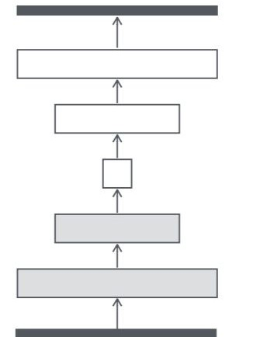
Generator - Unet

Slide 22
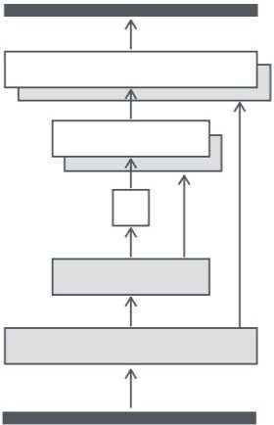
Generator - Unet
Skip Connections

Slide 23

Discriminator - Patch GAN
1/0
256x256x3

Slide 24

Discriminator - Patch GAN
1 1
0 0
1 1
0 0
Faster
Training with larger Images
Equal or better results
NxNxdepth
512x512x3

Slide 25





Discriminator - Patch GAN
PixelGAN
PatchGAN
ImageGAN

Slide 26
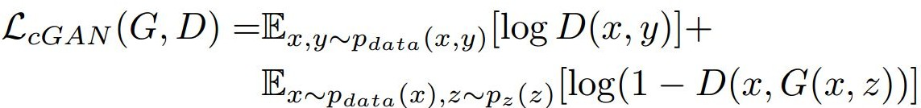
Optimization Losses
For training they are only using two Losses:
GAN Loss:

Slide 27
Optimization Losses
For training they are only using two Losses:
GAN Loss:
L1 Loss (Enforce correctness at Low Frequencies):

Slide 28
Optimization Losses
For training they are only using two Losses:
GAN Loss:
L1 Loss (Enforce correctness at Low Frequencies):

Slide 29
Index
Introduction
State of the Art
Method
Experiments
Experiment types
Evaluation Metrics
Cityscapes
Colorization
Map <-> Aerial
Conclusions

Slide 30
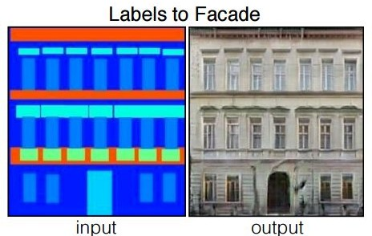
Experiments
Archirectural labels → photo, trained on Facades
Semantic labels <-> photo, on Cityscapes
Map <-> Aerial photo, from Google Maps
BW → Color photos, trained on Imagenet
Edges → Photo, trained on Handbags and Shoes
Sketch → Photo, human drawn sketches
Day → Night

Slide 31
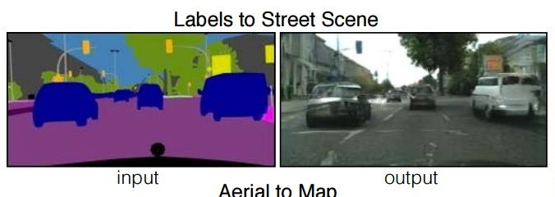
Experiments
Archirectural labels → photo, trained on Facades
Semantic labels <-> photo, on Cityscapes
Map <-> Aerial photo, from Google Maps
BW → Color photos, trained on Imagenet
Edges → Photo, trained on Handbags and Shoes
Sketch → Photo, human drawn sketches
Day → Night

Slide 32
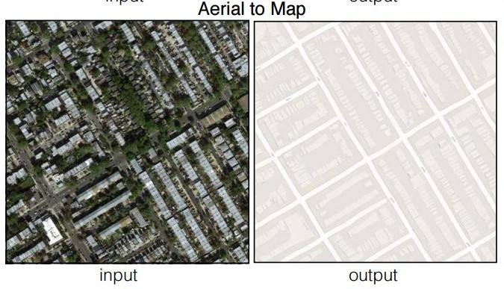
Experiments
Archirectural labels → photo, trained on Facades
Semantic labels <-> photo, on Cityscapes
Map <-> Aerial photo, from Google Maps
BW → Color photos, trained on Imagenet
Edges → Photo, trained on Handbags and Shoes
Sketch → Photo, human drawn sketches
Day → Night

Slide 33
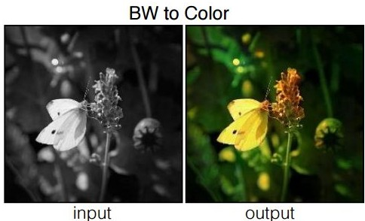
Experiments
Archirectural labels → photo, trained on Facades
Semantic labels <-> photo, on Cityscapes
Map <-> Aerial photo, from Google Maps
BW → Color photos, trained on Imagenet
Edges → Photo, trained on Handbags and Shoes
Sketch → Photo, human drawn sketches
Day → Night

Slide 34
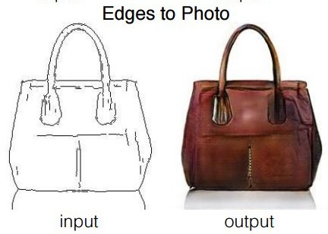
Experiments
Archirectural labels → photo, trained on Facades
Semantic labels <-> photo, on Cityscapes
Map <-> Aerial photo, from Google Maps
BW → Color photos, trained on Imagenet
Edges → Photo, trained on Handbags and Shoes
Sketch → Photo, human drawn sketches
Day → Night

Slide 35
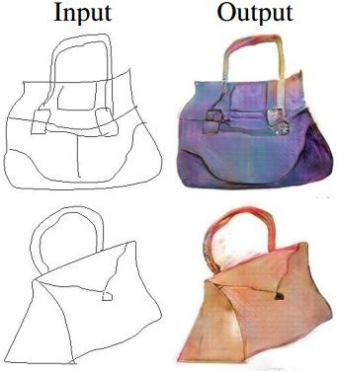
Experiments
Archirectural labels → photo, trained on Facades
Semantic labels <-> photo, on Cityscapes
Map <-> Aerial photo, from Google Maps
BW → Color photos, trained on Imagenet
Edges → Photo, trained on Handbags and Shoes
Sketch → Photo, human drawn sketches
Day → Night

Slide 36
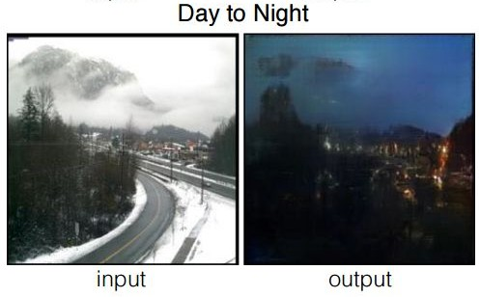
Experiments
Archirectural labels → photo, trained on Facades
Semantic labels <-> photo, on Cityscapes
Map <-> Aerial photo, from Google Maps
BW → Color photos, trained on Imagenet
Edges → Photo, trained on Handbags and Shoes
Sketch → Photo, human drawn sketches
Day → Night

Slide 37
Experiments
Archirectural labels → photo, trained on Facades
Semantic labels <-> photo, on Cityscapes
Map <-> Aerial photo, from Google Maps
BW → Color photos, trained on Imagenet
Edges → Photo, trained on Handbags and Shoes
Sketch → Photo, human drawn sketches
Day → Night

Slide 38
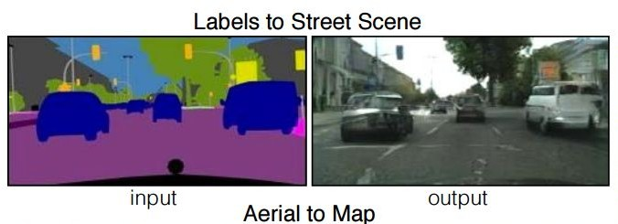
Evaluation Metrics - Cityscapes
Evaluation for qualitative images is an open and difficult problem
For semantic labels <-> Photo in Cityscapes we are using:
FCN-Score

Slide 39
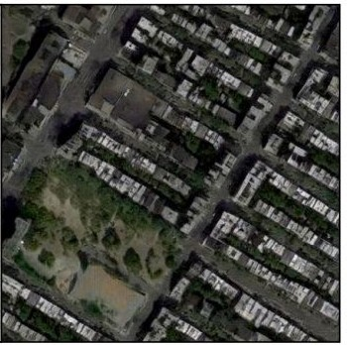
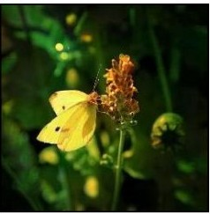
Evaluation Metrics - Colorization and Maps
Amazon Mekanical Turks
Is this picture Real ? Yes/No

Slide 40
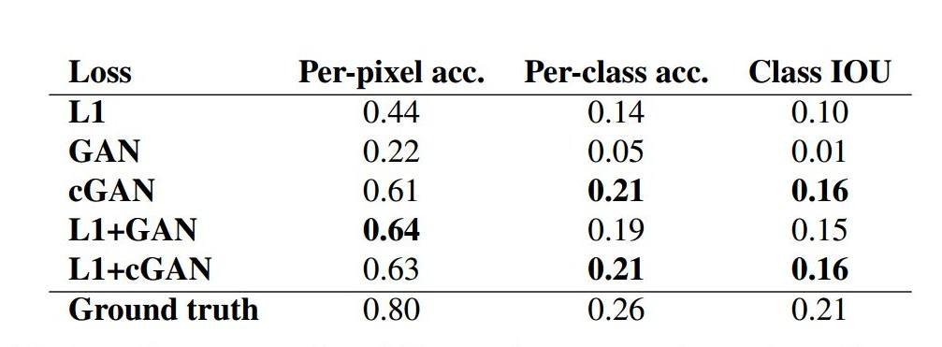
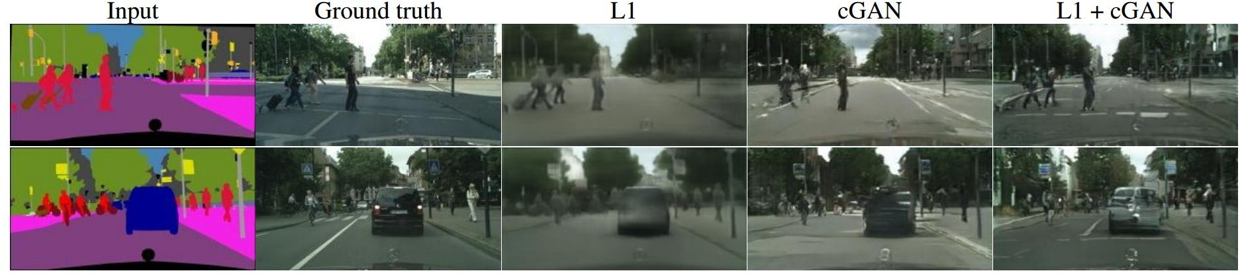
Cityscapes - FCN Score
- FCN-score

Slide 41
Cityscapes - FCN Score
- FCN-score

Slide 42
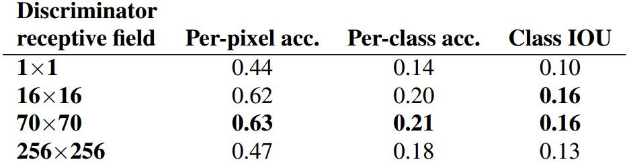
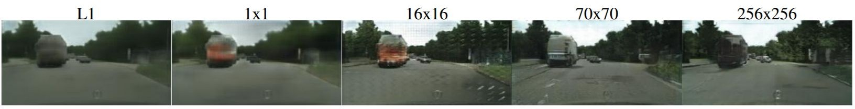
Cityscapes - PatchGAN
no-GAN
PixelGAN
PatchGAN
ImageGAN

Slide 43
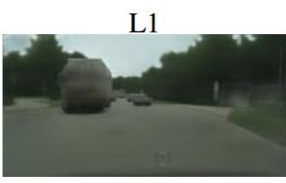
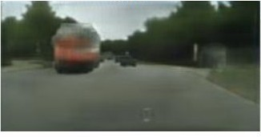
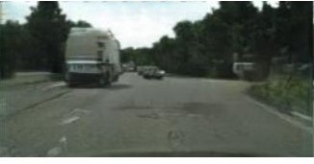
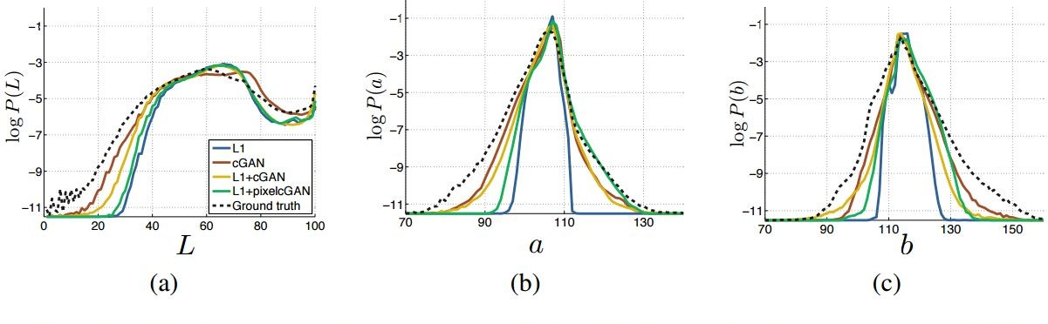
Cityscapes - Color Distribution
L1 + pixelcGAN
L1 + cGAN

Slide 44
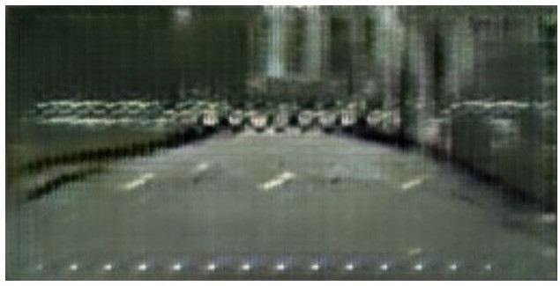
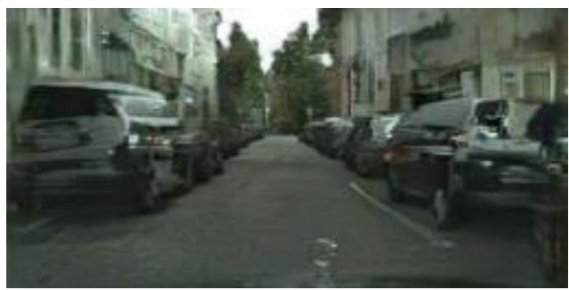
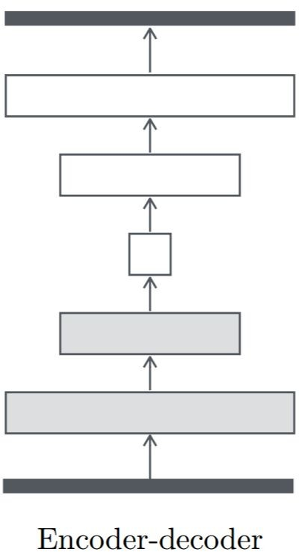
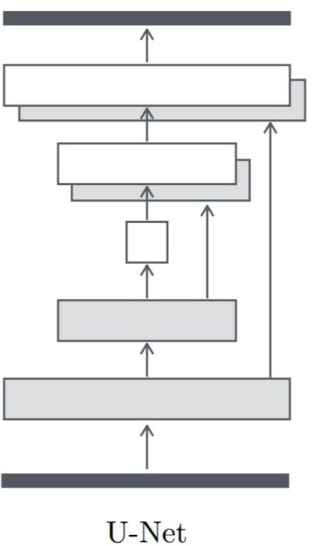
Cityscapes - Autoencoder vs U-net

Slide 45
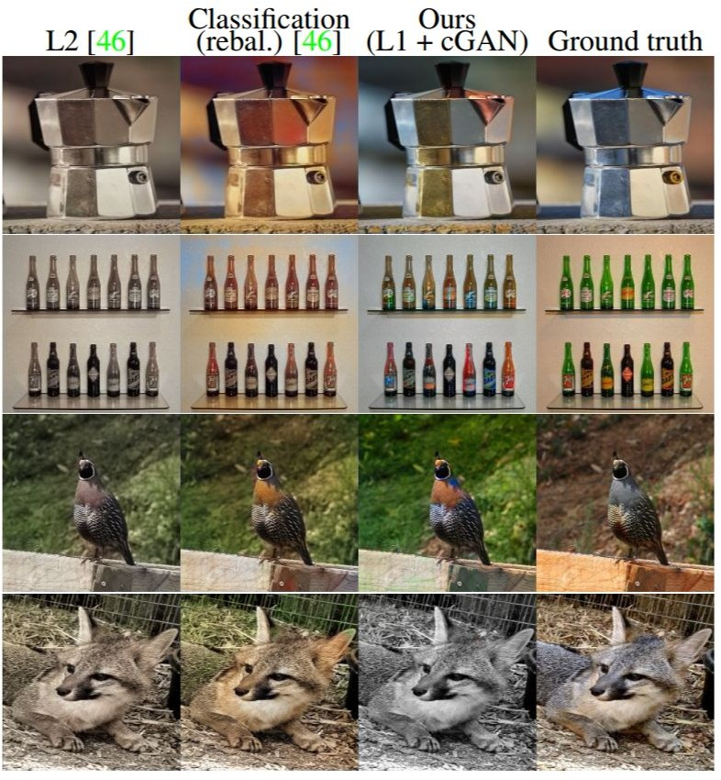
Image Colorization
 | L2 | Classifica tion (rebal.) | L1+cGAN
Labeled as real | 16.3% | 27.8% | 22.5%

Slide 46
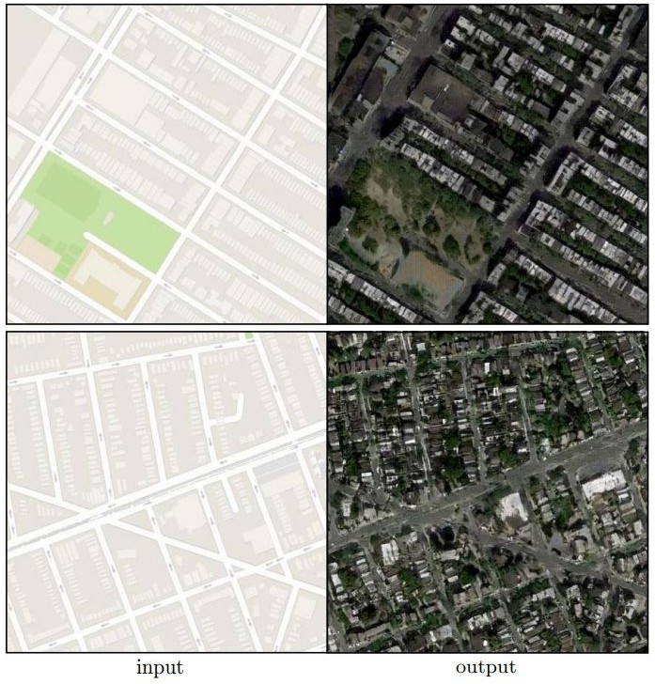
Map to Aerial
Map to Aerial
 | L1 | L1+cGAN
Labeled as real | 0.8% | 18.9%
512x512

Slide 47
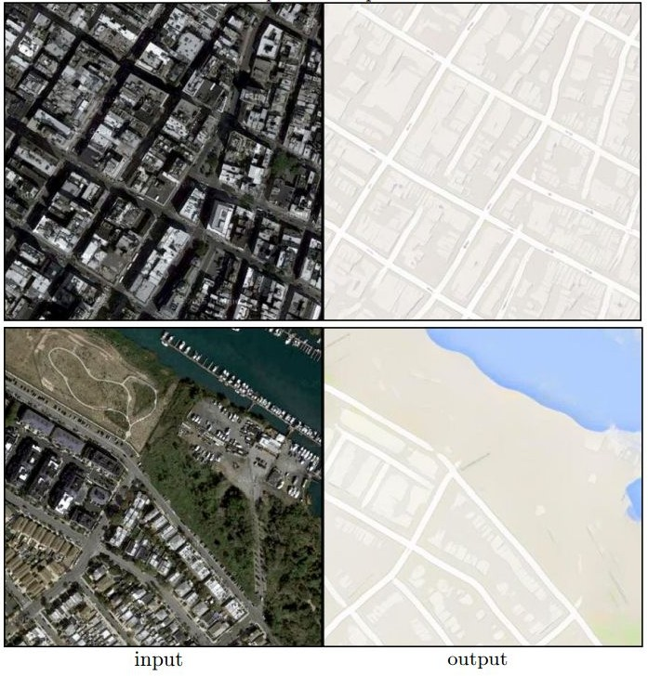
Aerial to Map
Aerial to Map
 | L1 | L1+cGAN
Labeled as real | 2.8% | 6.1%

Slide 48
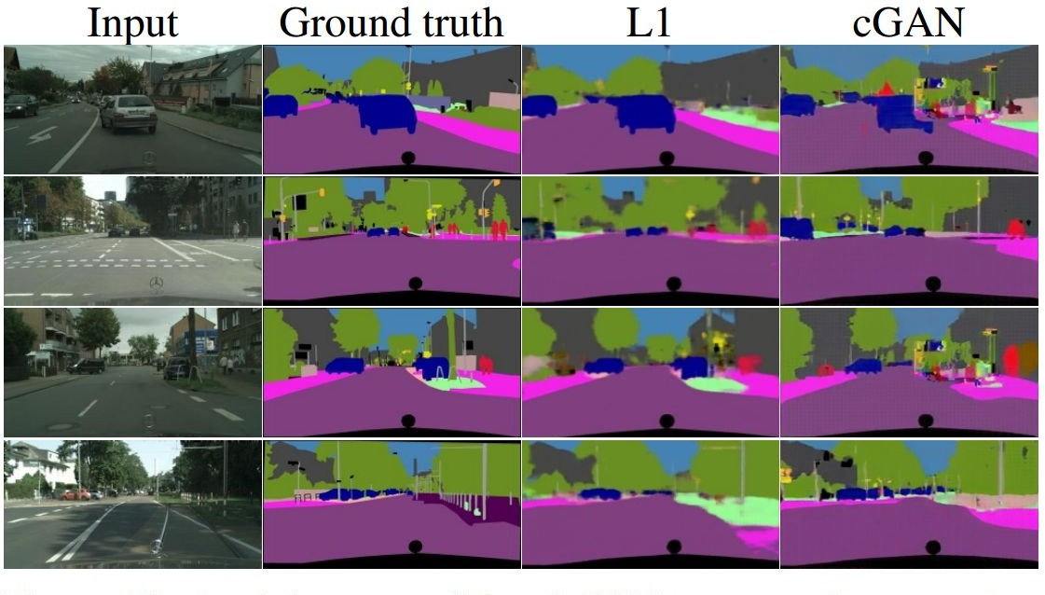
Image Segmentation
 | L1 | cGAN | L1+cGAN
Per-pixel acc. | 0.86 | 0.74 | 0.83
Per-class acc. | 0.42 | 0.28 | 0.36
Class IOU | 0.35 | 0.22 | 0.29

Slide 49
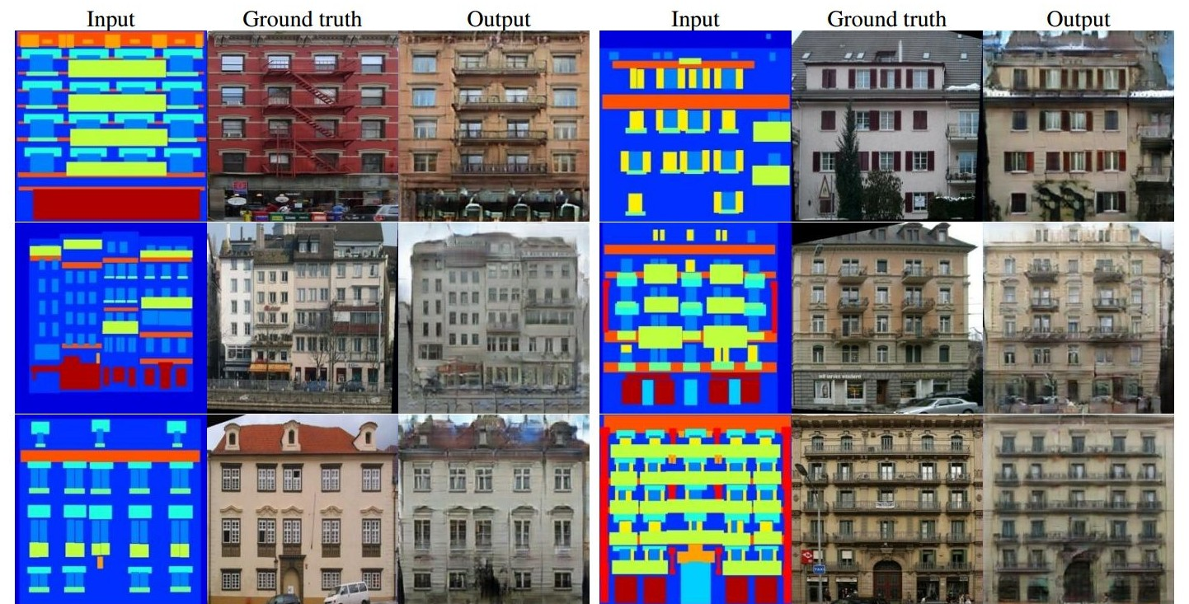
Other Experiments - Labels → Facades

Slide 50

Other Experiments - Day → Night

Slide 51

Other Experiments - Edges → Handbags

Slide 52

Other Experiments - Edges → Shoes

Slide 53

Other Experiments - Edges → Shoes

Slide 54
Conclusions
Conditional Adversarial Networks are a promising approach for many image to image translation tasks.
Using U-net as a generator has been a big improvement for forwarding low level features through the network and partially reconstructing it at the output.
Using the Patch GAN Approach we can train and generate high resolution images

