Slide 1
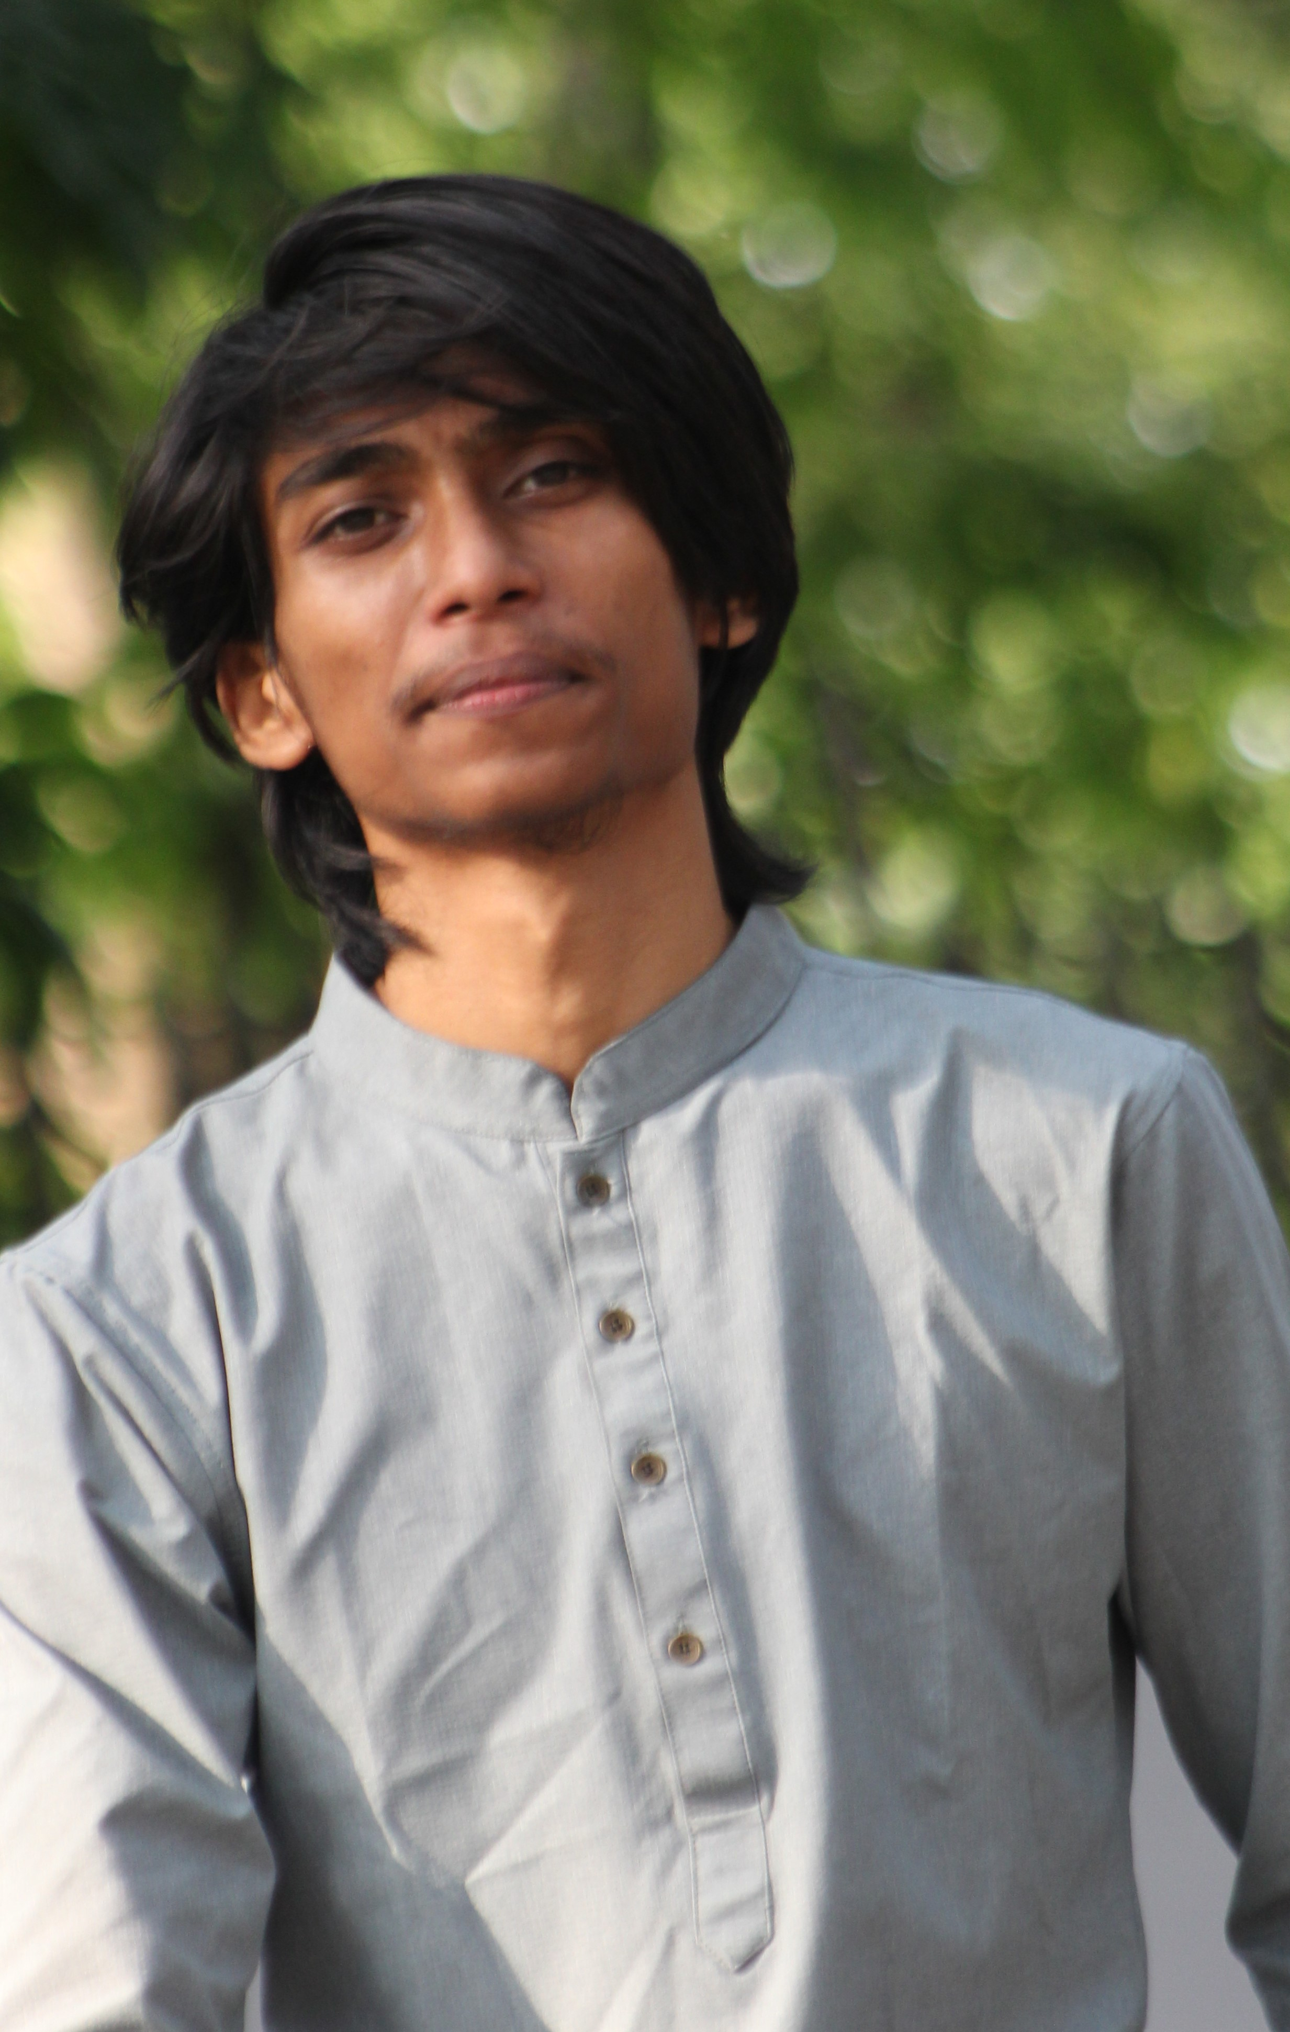
Our Team
Sakib Al Afnan
Hasibur Rahman Rakib
MD. Nahiduzzaman
Team Member
Team Leader
Team Member

Slide 2
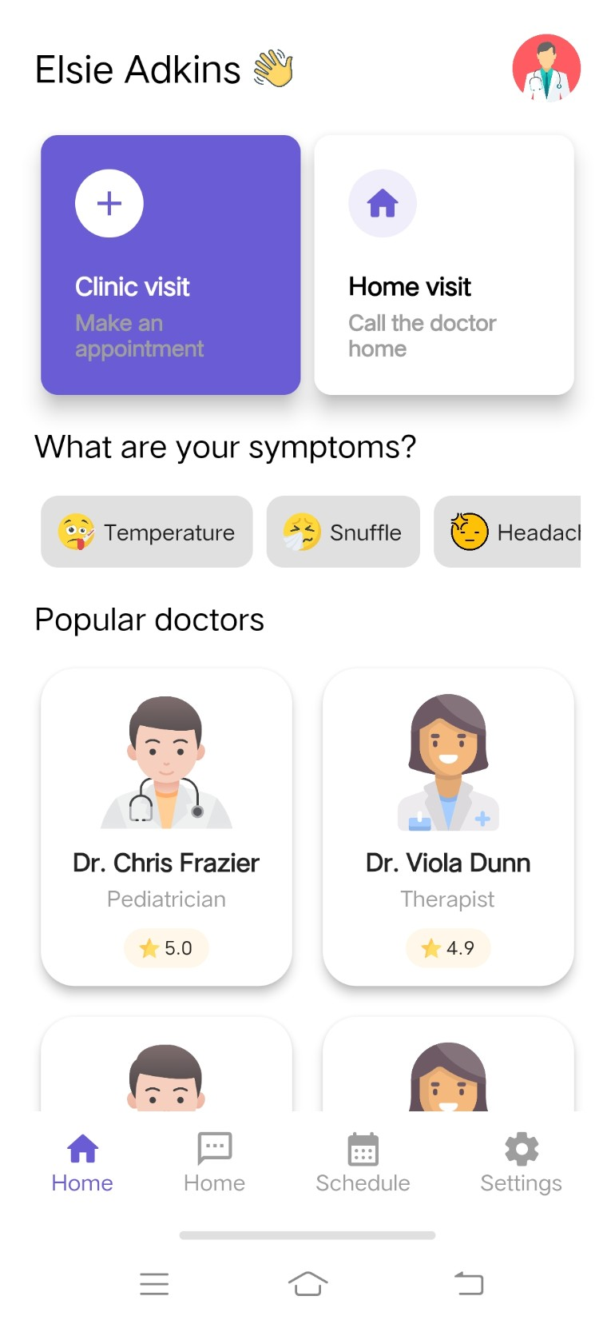

Slide 3
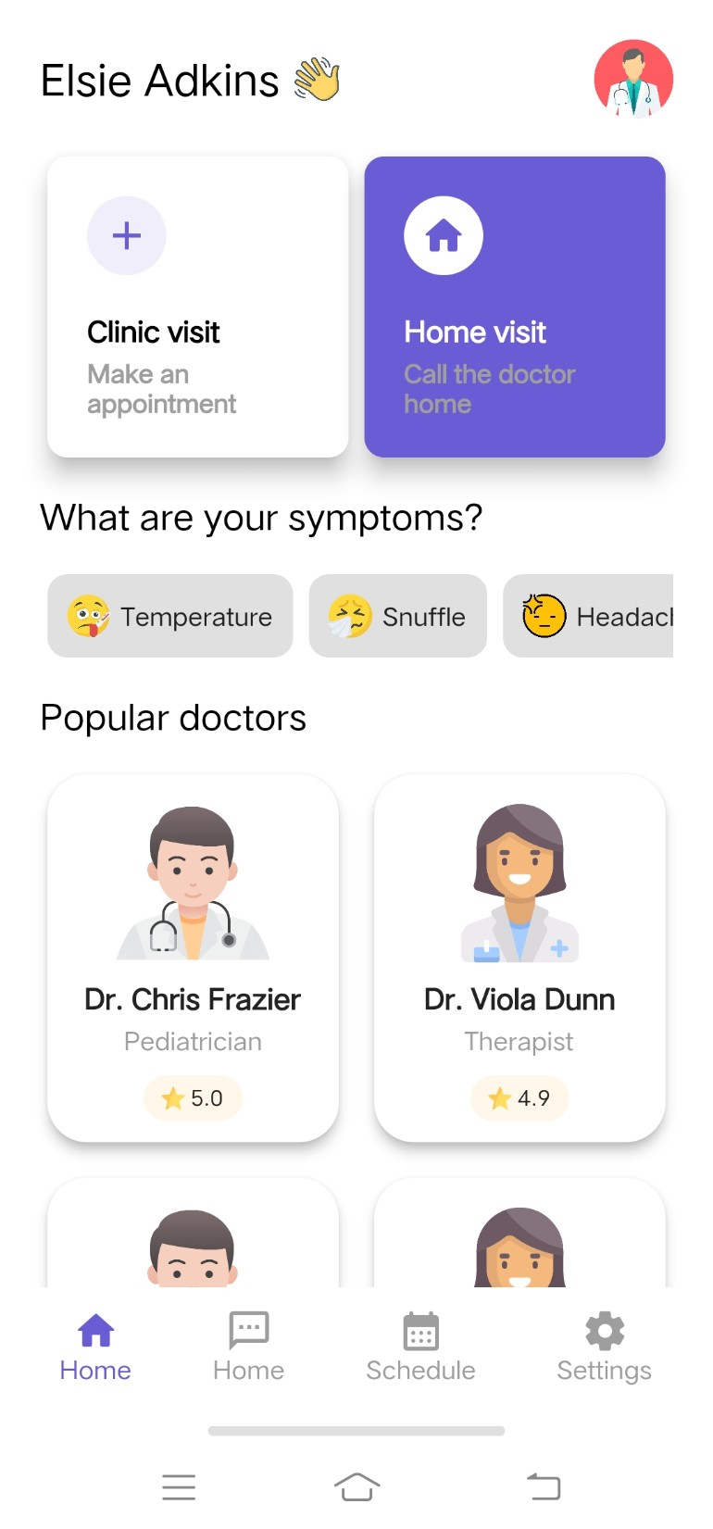

Slide 4


Slide 5
