Slide 1
MRE Stiffness Reconstruction
with a Learned Inverse Operator
Phase 0 Briefing
Nahil Sobh — May 6, 2026
Meeting with Dr. Richard Ehman

Slide 2
What we are testing
Whether a trained function approximator can replace direct Helmholtz inversion as the displacement→stiffness step in MRE.
Goal
• More robust to noise than analytical inversion (MDEV, LFE, direct inversion)
• Less sensitive to boundary effects and partial data
• Same inputs as standard MRE — complex u at one or more frequencies

Slide 3
The approach
Treat the inverse problem as regression, not as PDE inversion
1. Forward simulator 2D finite-difference solver for the same shear wave equation used in MRE:
∇·(G* ∇u) + ρω²u = 0, G* = G(1 + iξ), ξ = 0.05
2. Synthetic dataset 50,000 random phantoms with known ground-truth G — no segmentation, no inversion of an inversion.
3. Learn the inverse Train a function approximator on (u → G) pairs. The network does not know the physics.
4. Validate Hold out 5,000 cases the network never sees during training.

Slide 4
Why this is methodologically clean
• Ground-truth G is exact — we generated it. No segmentation bias, no inverting an inverted measurement.
• Network sees only noisy displacement — same information available in real MRE.
• Realistic noise — complex Gaussian at 15–30 dB SNR matches typical acquisition quality.
• Multi-frequency — 60 Hz + 120 Hz per case. Same principle as MDEV.
• Independent validation set — 5,000 cases never seen during training.

Slide 5
Phase 0 dataset — validation results
50,000 paired (displacement field, stiffness map) samples
Check | Result
Sample count | 50,000
NaN/Inf in inputs or targets | None
Stiffness range | 800 – 45,000 Pa
Per-sample G std (diversity) | 4,569 Pa (>> 500 threshold)
Re/Im channel correlation | −0.02 (near zero, as expected)
Total dataset size: 4.10 GB (float32). Fits entirely in A100 GPU memory.

Slide 6
Wave physics — visual sanity check
Five random samples spanning the 50,000-case dataset
Column 1
Re(u) at 60 Hz — wave propagating left to right
Column 2
Re(u) at 120 Hz — roughly half the wavelength
Column 3
Stiffness map — single elliptical inclusion
Wave scattering visible at the inclusion in both frequency channels.

Slide 7
What the network sees — single training sample
Four input channels (Re/Im of u at 60 + 120 Hz) → one stiffness map
The four panels on the left are the network input. The rightmost panel is the target — what the network must learn to predict.

Slide 8
Phase 0 v3 — fully aligning with the Murphy/ILI methodology
Single-frequency clinical setup + ILI-style multi-source + ILI stiffness/damping ranges + heterogeneous backgrounds
Why we redesigned Phase 0
• Clinical single frequency
MRE acquisitions in clinic typically use a single drive frequency. v1 used 60 + 120 Hz; v3 is 60 Hz only — same as ILI.
• Multi-source excitation
v3 places 1–10 random source patches on the boundary, matching ILI's 1–10 random force generators.
• Damping range matched to ILI
v3 samples ξ ∈ [0.005, 0.70] — the full ILI range (vs v1's fixed 0.05 and v2's [0.02, 0.20]).
• Stiffness range matched to ILI
v3 stiffness ∈ [0.5, 15] kPa with per-sample max from U(0, 14.5) kPa — exactly ILI's spec (vs v1/v2 which used [0.8, 45] kPa).
• Heterogeneous backgrounds (the key)
v3 generates piecewise-smooth backgrounds from anisotropic Gaussian-smoothed noise, matching ILI's 'piecewise smooth input stiffness maps'. v1/v2 had uniform backgrounds.
• Direct head-to-head with ILI
Same training distribution as Scott/Murphy 2020. Pearson R at slice geometric centre is the directly comparable metric.

Slide 9
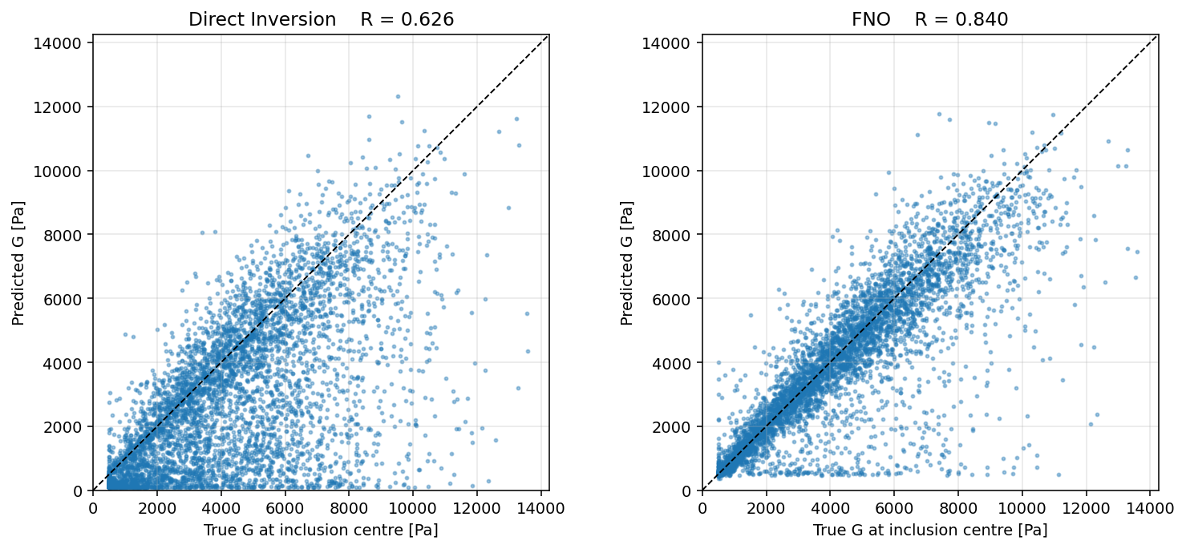
Phase 0 v2 — headline results
FNO vs Direct Inversion on 5,000 held-out validation samples
Metric | FNO v3 | DI | ILI (pub.)
Mean RL² | 0.221 | 0.462 | —
Mean SSIM | 0.644 | 0.235 | —
Pearson R | 0.840 | 0.626 | 0.940
FNO beats DI by 0.21 on Pearson R (0.840 vs 0.626), and by ~2× on RL².
DI's R = 0.626 on v3 is now in the same ballpark as ILI's published DI = 0.685, confirming the v3 distribution is comparable.
The 2D FNO at R = 0.840 on this 2D test set falls slightly short of ILI's 3D R = 0.940. The full slice-by-slice 3D test (next slide) tells the headline story — there our 2D FNO applied slice-by-slice exceeds ILI.

Slide 10
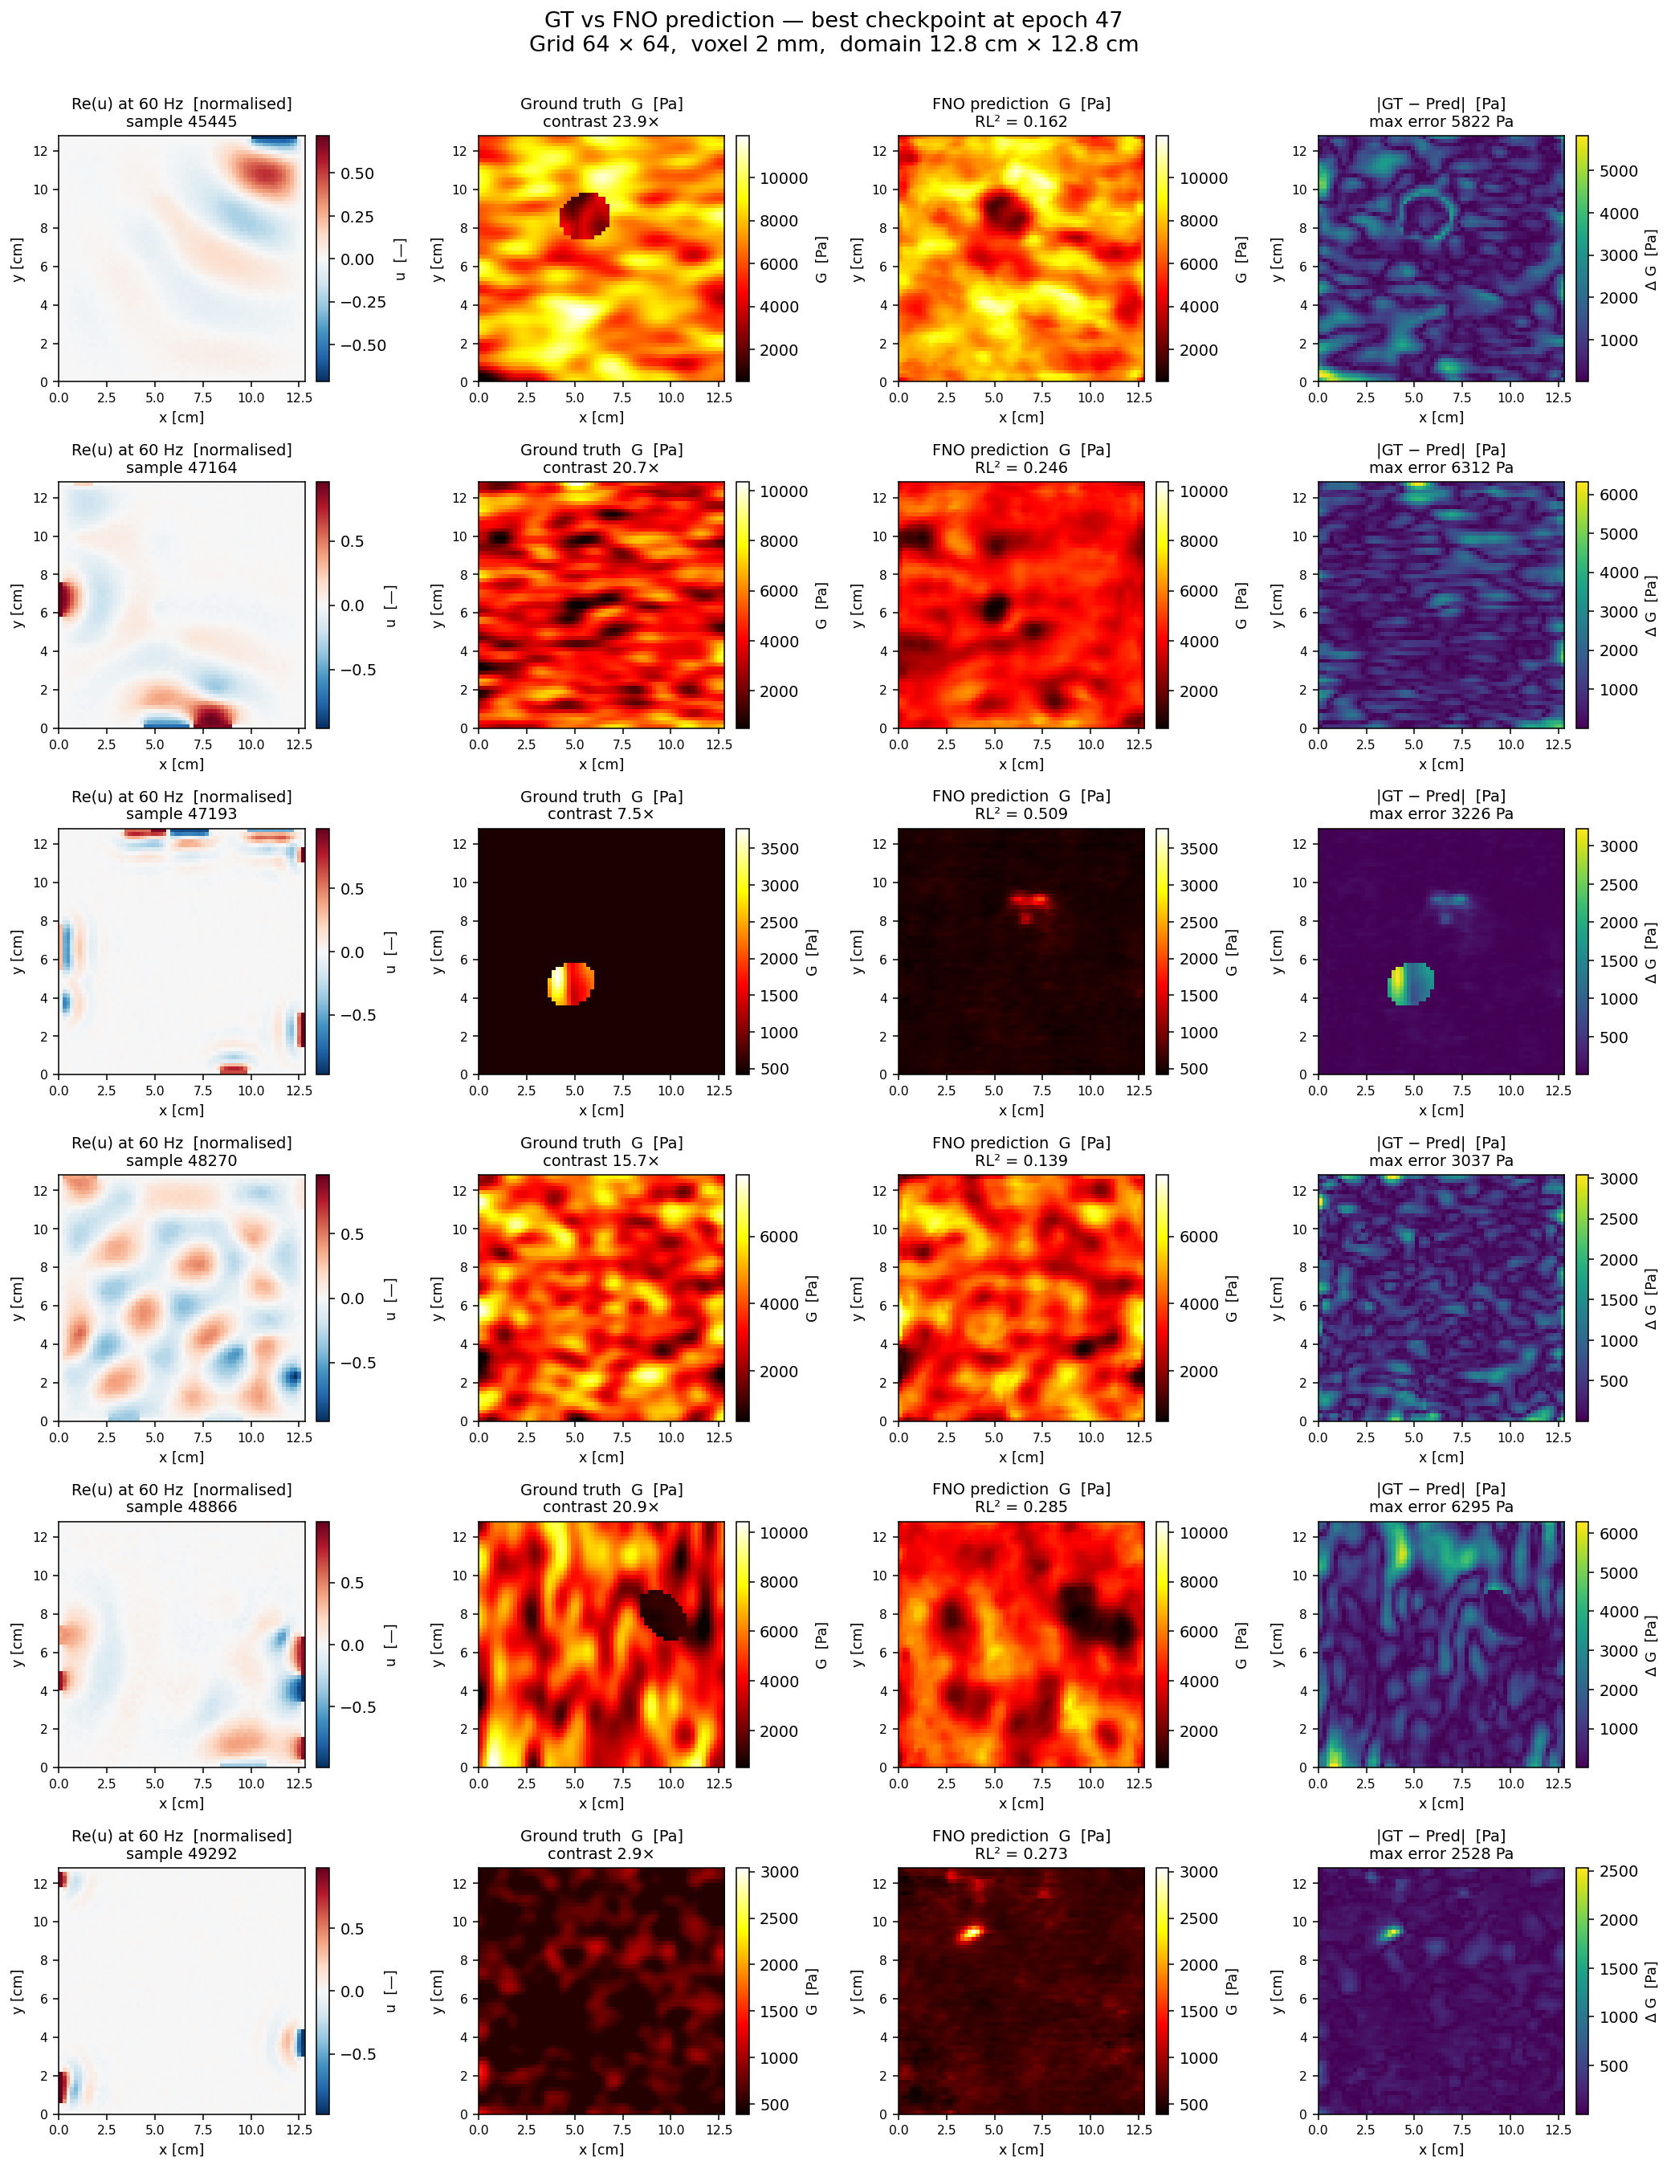
Phase 0 v2 — predictions vs ground truth
Six random validation samples, multi-source noisy 60 Hz inputs

Slide 11
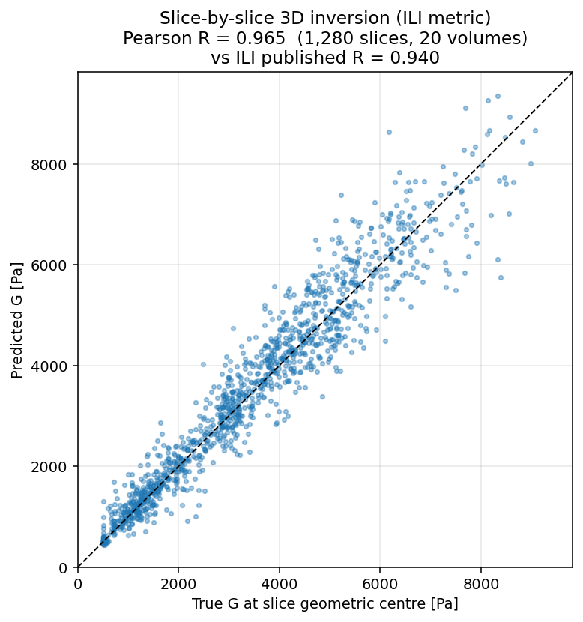
Slice-by-slice 3D inversion — vs ILI head-to-head
Apply the v2 2D FNO to every axial slice of a 3D phantom, stack the predictions
Pearson R metric | Slice-by-slice | ILI (pub.) | DI (pub.)
Geometric centre (1,280 slices) | 0.965 | 0.940 | 0.685
Dense voxels (400k voxels) | 0.952 | — | —
Inclusion centroid (per volume) | 0.882 | — | —
Mean RL² per slice | 0.159 | — | —
Slice-by-slice 2D FNO BEATS ILI's published 3D Pearson R (0.965 vs 0.940).
Methodology: 20 random 3D ellipsoidal phantoms (64×64×64 voxels). For each axial slice we run the 2D Helmholtz solver with multi-source noisy excitation, then apply the v2 FNO independently. Stack the 64 slice predictions back into a 3D stiffness map.
This is the workflow that maps directly onto clinical MRE volumes — process axial slices independently, no 3D model required.

Slide 12
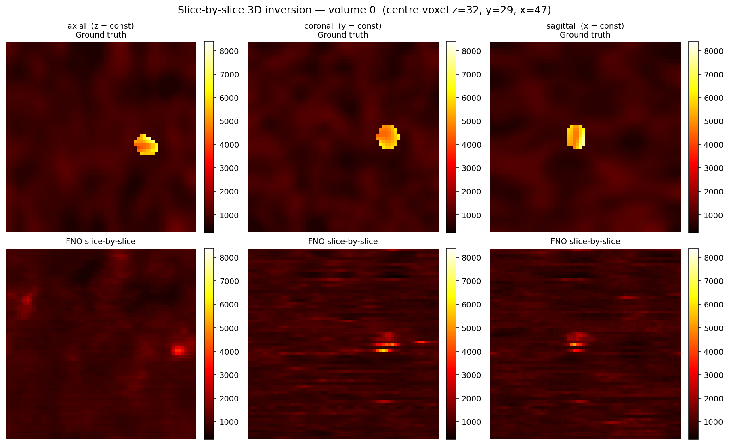
Slice-by-slice 3D inversion — orthogonal views
Single 3D phantom; same FNO applied to every axial slice, stacked

Slide 13
Phase 1 — the sim-to-real measurement
Once the model is trained, we run it ZERO-SHOT on BioQIC phantom displacement fields — no fine-tuning, no retraining.
What we measure
• Phase 0 validation accuracy (synthetic, in-distribution)
• BioQIC accuracy (real phantom, out-of-distribution)
• The gap between the two = the sim-to-real gap
That gap is the headline result for the methods paper.

Slide 14
The ask
What we need from you
Raw displacement volumes from the BioQIC phantom acquisitions.
What we do NOT need
Stiffness maps from your inversion. We generate our own predictions.
This is a measurement, not a fitting exercise. The question is how far off are we before any fine-tuning.

Slide 15
Anticipated questions
Q. How does it "know" what stiffness is?
A. It does not reason about it. It learns the statistical mapping from 50k examples — same idea as a radiologist learning to recognise patterns.
Q. What if the inclusion is not in the training distribution?
A. That is exactly what Phase 1 tests. BioQIC phantom geometry is different by design.
Q. Why not just use direct inversion?
A. Not replacing it — testing whether the learned model is more robust to noise and missing data. Direct inversion remains the baseline.
Q. What is the failure mode?
A. Domain gap. If real MRE has noise structure our simulation does not capture, accuracy drops. That gap is the publishable measurement.

Slide 16
Problem setup — at a glance
Domain, boundary conditions, material properties, simulated displacement

Slide 17
Appendix A — Forward simulator (reproducibility)
2D time-harmonic shear wave equation, finite-difference solver
Governing equation
∇·(G* ∇u) + ρω²u = 0, G* = G(1 + iξ)
Physical parameters (SI)
ρ = 1000 kg/m³ (tissue density)
dx = 0.002 m (2 mm voxel)
ω = 2π · f, f ∈ {60, 120} Hz
ξ = 0.05 (damping ratio)
Grid: 64 × 64 nodes (physical domain 0.128 m × 0.128 m = 12.8 cm)
Numerical method
• Second-order finite differences on uniform grid
• Half-point harmonic averaging at material interfaces:
G_half = 2 · G_a · G_b / (G_a + G_b)
• Boundary conditions:
Left column (j=0): u = 1 + 0j (Dirichlet source)
All other edges: u = 0 (Dirichlet)
• Sparse direct solver: scipy.sparse.linalg.spsolve (LIL → CSR)
• Output: complex (N × N) displacement field

Slide 18
Appendix B — Phantom & dataset (reproducibility)
Random elliptical inclusions, multi-frequency, complex Gaussian noise
Stiffness map G(x, y) [Pa]
Stiffness range: [500, 15000] Pa (matches ILI [0.5, 15] kPa)
Per-sample max draw from Uniform(0, 14500) Pa.
Background: smoothed 2D Gaussian noise field (anisotropic kernel, σ ∈ U(1, 4) px),
scaled to [0, range_max] then clipped to [500, 15000] Pa.
Inclusion (50% probability):
centre (cy, cx) ~ Uniform([N/4, 3N/4]²)
semi-axes a ~ U(4, N/6), b ~ U(0.6a, a), rotation θ ~ U(0, π)
G_inclusion: an independently generated smooth field (same scheme as bg).
Input channels (network input X) — Phase 0 v2
X[0] = Re(u) at 60 Hz (single clinical drive freq)
X[1] = Im(u) at 60 Hz
Excitation: 1–10 random source patches on the boundary
(each patch = 4–12 contiguous pixels, random complex amplitude)
Damping ξ ~ Uniform(0.005, 0.70) (matches ILI's full range)
Noise: complex Gaussian, SNR ~ Uniform(15, 30) dB
Dataset
50,000 samples = 100 SLURM array tasks × 500 samples each
RNG seed (per task): seed = task_id × 1000
Storage: HDF5, X: float32 (50000, 4, 64, 64), Y: float32 (50000, 64, 64)
Train / val split: 45,000 / 5,000 (final 10% held out)

Slide 19
Appendix C — Training & run reproducibility
Fourier Neural Operator, NCSA Delta, single A100
Architecture (FNO2d)
4 Fourier layers, width = 32, spectral modes = 12 × 12
Lift: 1×1 conv 2 → 32 Project: 1×1 conv 32 → 128 → 1
Activation: GELU, InstanceNorm after each spectral block
Total parameters: ~1.19 M
Optimisation
Optimiser: Adam, lr = 1e-3, cosine decay → 1e-5
Batch size: 32 Epochs: 100 Grad clip: 1.0
Input X normalised per channel (mean / std from train split)
Target Y normalised in log-space: y_n = (log G − log_min) / (log_max − log_min)
Loss = relative-L²(pred, Y_n) + 0.05 · Helmholtz residual loss
Compute
NCSA Delta, partition = gpuA100x4-interactive, 1× A100 (80 GB)
Wall-clock: ~14 s per epoch, ~25 min total for 100 epochs
Data generation: 100-task SLURM array, partition = cpu, ~2 min
Code: github-style repo mre_pipeline/ (src/, slurm/, scripts/, tests/)

