Slide 1
CMP-5027A: Analogue and Digital Electronics Traffic Light System
Group 19

Slide 2
Traffic light system : overall build

Slide 3
Segment :C
DC\BA | 00 | 01 | 11 | 10
00 | 1 | 1 | 1 | 0
01 | 1 | 1 | 1 | 1
11 | 0 | 1 | 0 | 0
10 | 1 | 1 | 1 | 1
D XOR C
D’C
DC’
B’A
D’C’BA
D’CBA
-------------
D’BA
A’B’C’D’

Slide 4
Segment :D
DC\BA | 00 | 01 | 11 | 10
00 | 1 | 0 | 1 | 1
01 | 0 | 1 | 0 | 1
11 | 1 | 1 | 0 | 1
10 | 1 | 1 | 1 | 0
DCB’A’
DCB’A
DC’B’A’
DC’B’A’
-----------------
DB’
D’CB’A
DCB’A
---------
CB’A
B.(A XOR C)
D’CBA’
DCBA’
--------
CBA’
D’C’BA
DC’BA
---------
C’BA
D’C’B’A’
D’C’BA’
----------
D’C’A’

Slide 5
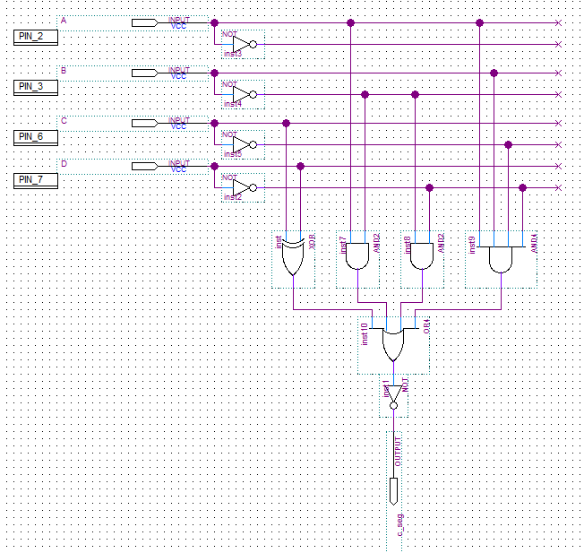
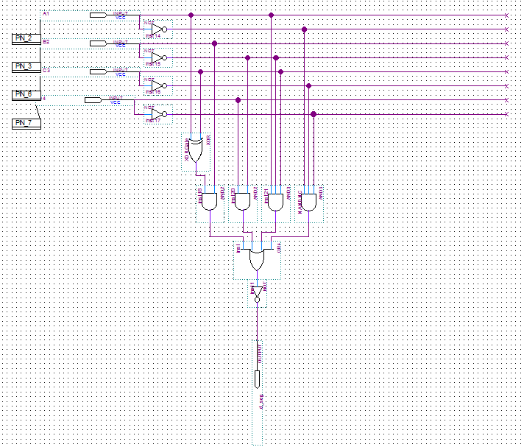
7seg: only C and D
C
D

Slide 6
DECODE STATE TRANSITION TABLE
STATE |  |  | MAIN |  |  | SIDE
C | B | A | RED | AMBER | GREEN | RED | ABER | GREEN
0 | 0 | 0 | 0 | 0 | 1 | 1 | 0 | 0
0 | 0 | 1 | 0 | 1 | 0 | 1 | 0 | 0
0 | 1 | 0 | 1 | 0 | 0 | 1 | 0 | 0
0 | 1 | 1 | 1 | 0 | 0 | 1 | 1 | 0
1 | 0 | 0 | 1 | 0 | 0 | 0 | 0 | 1
1 | 0 | 1 | 1 | 0 | 0 | 0 | 1 | 0
1 | 1 | 0 | 1 | 0 | 0 | 1 | 0 | 0
1 | 1 | 1 | 1 | 1 | 0 | 1 | 0 | 0

Slide 7
DECODER : MAIN ROAD
C\BA | 00 | 01 | 11 | 10
0 | 0 | 0 | 1 | 1
1 | 1 | 1 | 1 | 1
B
C
B + C
C\BA | 00 | 01 | 11 | 10
0 | 0 | 1 | 0 | 0
1 | 0 | 0 | 1 | 0
C’B’A
CBA
A.(CB + C’B’)
C\BA | 00 | 01 | 11 | 10
0 | 1 | 0 | 0 | 0
1 | 0 | 0 | 0 | 0
C’B’A’
C’B’A’

Slide 8
DECODER : SIDE ROAD
C\BA | 00 | 01 | 11 | 10
0 | 1 | 1 | 1 | 1
1 | 0 | 0 | 1 | 1
C’
BC
B + C’
C\BA | 00 | 01 | 11 | 10
0 | 0 | 0 | 1 | 0
1 | 0 | 1 | 0 | 0
CB’A
C’BA
A.( B XOR C )
C\BA | 00 | 01 | 11 | 10
0 | 0 | 0 | 0 | 0
1 | 1 | 0 | 0 | 0
CB’A’
CB’A’

Slide 9
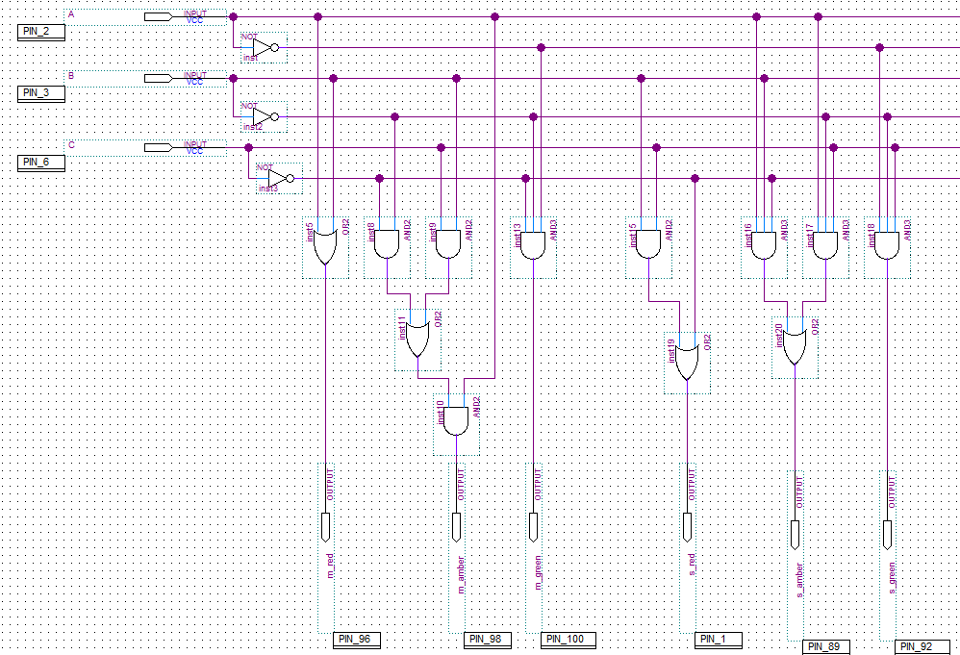
DECODER
MAIN
SIDE

Slide 10
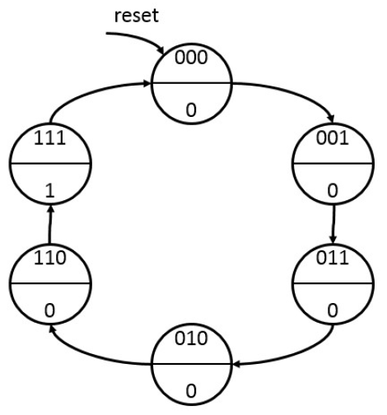
MODULO-6
CURRENT STATE |  |  | NEXT STATE |  |  | Output
Q2 | Q1 | Q0 | Q2+ | Q1+ | Q0+ | CLK_M
0 | 0 | 0 | 0 | 0 | 1 | 0
0 | 0 | 1 | 0 | 1 | 1 | 0
0 | 1 | 0 | 0 | 1 | 0 | 0
1 | 0 | 0 | X | X | X | X
1 | 0 | 1 | X | X | X | X
1 | 1 | 0 | 1 | 1 | 1 | 0
1 | 1 | 1 | 0 | 0 | 0 | 1
100
X
101
X

Slide 11
MODULO-6
Q2\Q1Q0 | 00 | 01 | 11 | 10
0 | 0 | 0 | 0 | 1
1 | X | X | 0 | 1
Q2+
100
X
Q1Q0’
Q2+ : Q1Q0’
Q2\Q1Q0 | 00 | 01 | 11 | 10
0 | 0 | 1 | 1 | 1
1 | X | X | 0 | 1
Q1+
Q1’Q0
Q1Q0’
Q2’Q1
Q1+ : Q2’Q1 + (Q1 XOR Q0)
Q2\Q1Q0 | 00 | 01 | 11 | 10
0 | 1 | 1 | 0 | 0
1 | X | X | 0 | 1
Q0+
101
X
Q1’
Q2Q1Q0’
Q0+ : Q1’ + Q2Q1Q0’

Slide 12
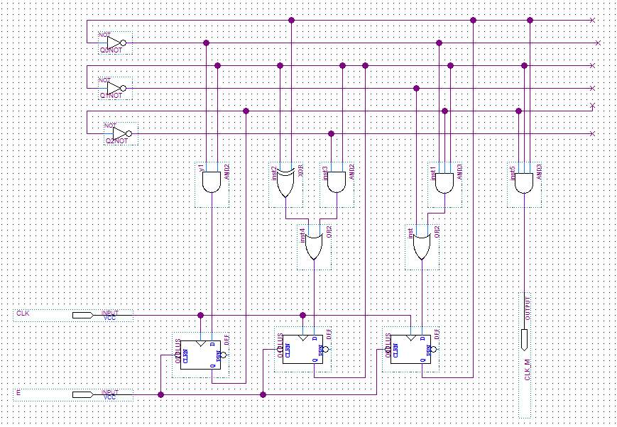
MODULO-6

Slide 13
LIGHT CONTROLLER: STATE TRANSITION DIAGRAM
000
11
001
010
011
XX
XX
XX
XX
111
110
101
100
XX
XX
1X

Slide 14
LIGHT CONTROLLER: STATE TRANSITION TABLE
CURRENT STATE |  |  | INPUT |  | NEXT STATE |  |  | OUTPUT
Q2 | Q1 | Q0 | D | CW | Q2+ | Q1+ | Q0+ | T6 | 12
0 | 0 | 0 | 0 | X | 0 | 0 | 0 | 0 | 0
0 | 0 | 0 | 1 | 0 | 0 | 0 | 0 | 0 | 0
0 | 0 | 0 | 1 | 1 | 0 | 0 | 1 | 0 | 0
0 | 0 | 1 | X | X | 0 | 1 | 0 | 0 | 0
0 | 1 | 0 | X | X | 0 | 1 | 1 | 0 | 0
0 | 1 | 1 | X | X | 1 | 0 | 0 | 1 | 0
1 | 0 | 0 | 1 | X | 1 | 0 | 1 | 0 | 0
1 | 0 | 0 | 0 | X | 1 | 0 | 0 | 0 | 0
1 | 0 | 1 | X | X | 1 | 1 | 0 | 0 | 0
1 | 1 | 0 | X | X | 1 | 1 | 1 | 0 | 0
1 | 1 | 1 | X | X | 0 | 0 | 0 | 0 | 1

Slide 15
LIGHT CONTROLLER:K-MAP (PART I)
Q2+ | Q2Q1Q0
D CW | 000 | 001 | 011 | 010 | 110 | 111 | 101 | 100
00 | 0 | 0 | 1 | 0 | 1 | 0 | 1 | 1
01 | 0 | 0 | 1 | 0 | 1 | 0 | 1 | 1
11 | 0 | 0 | 1 | 0 | 1 | 0 | 1 | 1
10 | 0 | 0 | 1 | 0 | 1 | 0 | 1 | 1
Q1.(Q2 XOR Q0)
Q2’Q1Q0
Q2Q1Q0’
Q2Q1’
Q2+ : Q1.(Q2 XOR Q0) + Q2Q1’
Q1+ | Q2Q1Q0
D CW | 000 | 001 | 011 | 010 | 110 | 111 | 101 | 100
00 | 0 | 1 | 0 | 1 | 1 | 0 | 1 | 0
01 | 0 | 1 | 0 | 1 | 1 | 0 | 1 | 0
11 | 0 | 1 | 0 | 1 | 1 | 0 | 1 | 0
10 | 0 | 1 | 0 | 1 | 1 | 0 | 1 | 0
Q2’Q1’Q0
Q1Q0’
Q2Q1’Q0
Q1+ : Q2’Q1’Q0 + Q1Q0’ + Q2Q1’Q0

Slide 16
LIGHT CONTROLLER:K-MAP (PART II)
Q0+ | Q2Q1Q0
D CW | 000 | 001 | 011 | 010 | 110 | 111 | 101 | 100
00 | 0 | 0 | 0 | 1 | 1 | 0 | 0 | 0
01 | 0 | 0 | 0 | 1 | 1 | 0 | 0 | 0
11 | 1 | 0 | 0 | 1 | 1 | 0 | 0 | 1
10 | 0 | 0 | 0 | 1 | 1 | 0 | 0 | 1
Q1.Q0’
D.Q2.Q1’.Q0’
D.CW.Q1’.Q0’
Q0+ : Q1.Q0’ + D.Q2.Q1’.Q0 + D.CW.Q1’.Q0’

Slide 17
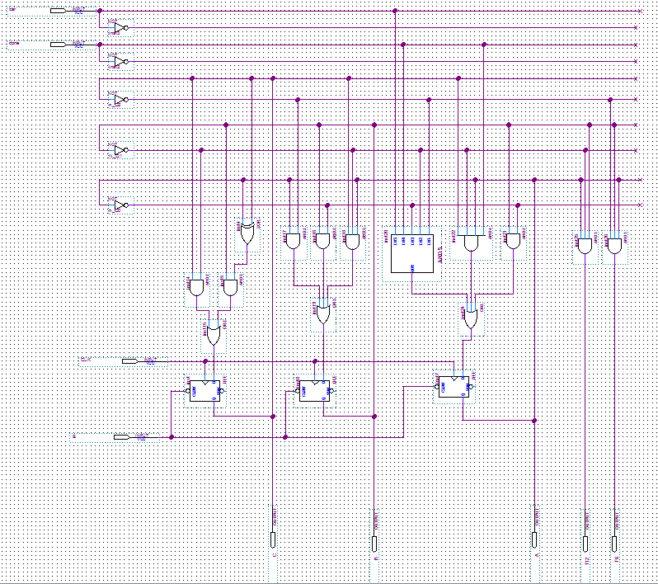
LIGHT CONTROLLER

Slide 18
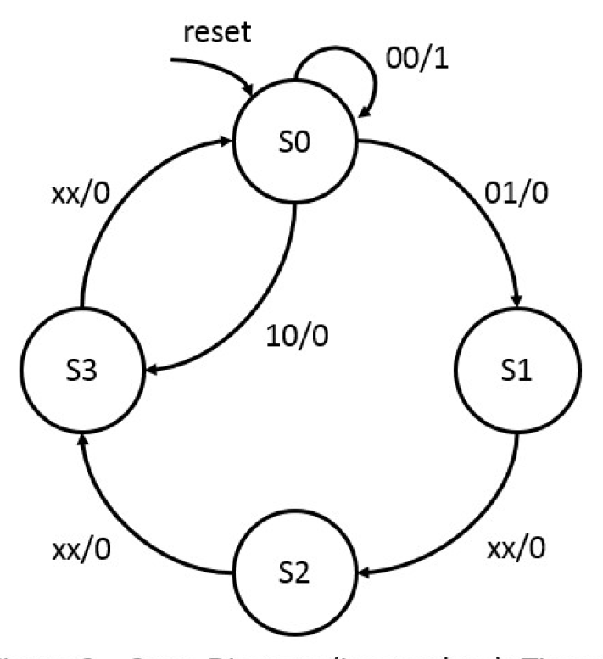

DELAY TIMER: STATE TRANSITION DIAGRAM

Slide 19
DELAY TIMER: STATE TRANSITION TABLE
CURRENT STATE |  | INPUT |  | NEXT STATE |  | OUTPUT
Q1 | Q0 | T6 | T12 | Q1+ | Q0+ | CLK_M
0 | 0 | 0 | 0 | 0 | 0 | 1
0 | 0 | 1 | 1 | 0 | 0 | 0
0 | 0 | 1 | 0 | 1 | 1 | 0
0 | 0 | 0 | 1 | 0 | 1 | 0
0 | 1 | X | X | 1 | 0 | 0
1 | 0 | X | X | 1 | 1 | 0
1 | 1 | X | X | 0 | 0 | 0

Slide 20
DELAY TIMER: K-MAP
Q1+ | Q1Q0
T6 T12 | 00 | 01 | 11 | 10
00 | 0 | 1 | 0 | 1
01 | 0 | 1 | 0 | 1
11 | 0 | 1 | 0 | 1
10 | 1 | 1 | 0 | 1
Q0+ | Q1Q0
T6 T12 | 00 | 01 | 11 | 10
00 | 0 | 0 | 0 | 1
01 | 1 | 0 | 0 | 1
11 | 0 | 0 | 0 | 1
10 | 1 | 0 | 0 | 1

Slide 21
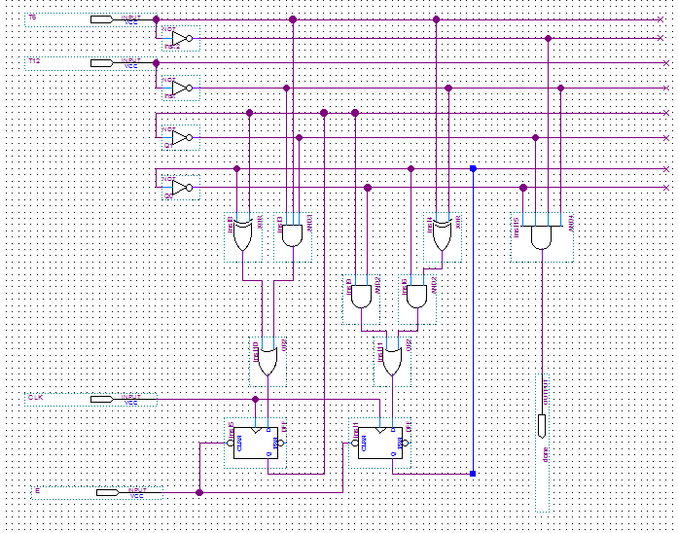
DELAY TIMER

