Slide 1


Your Personal Trader
By Nahin Hayat

Slide 2
Summary and Goals
Web application for users to use the tools created with any stock
Trade algorithm with strategy to find entry and exit points for stock to maximize profits.
Forecast future prices to tell when next entry/exit point will be

Slide 3
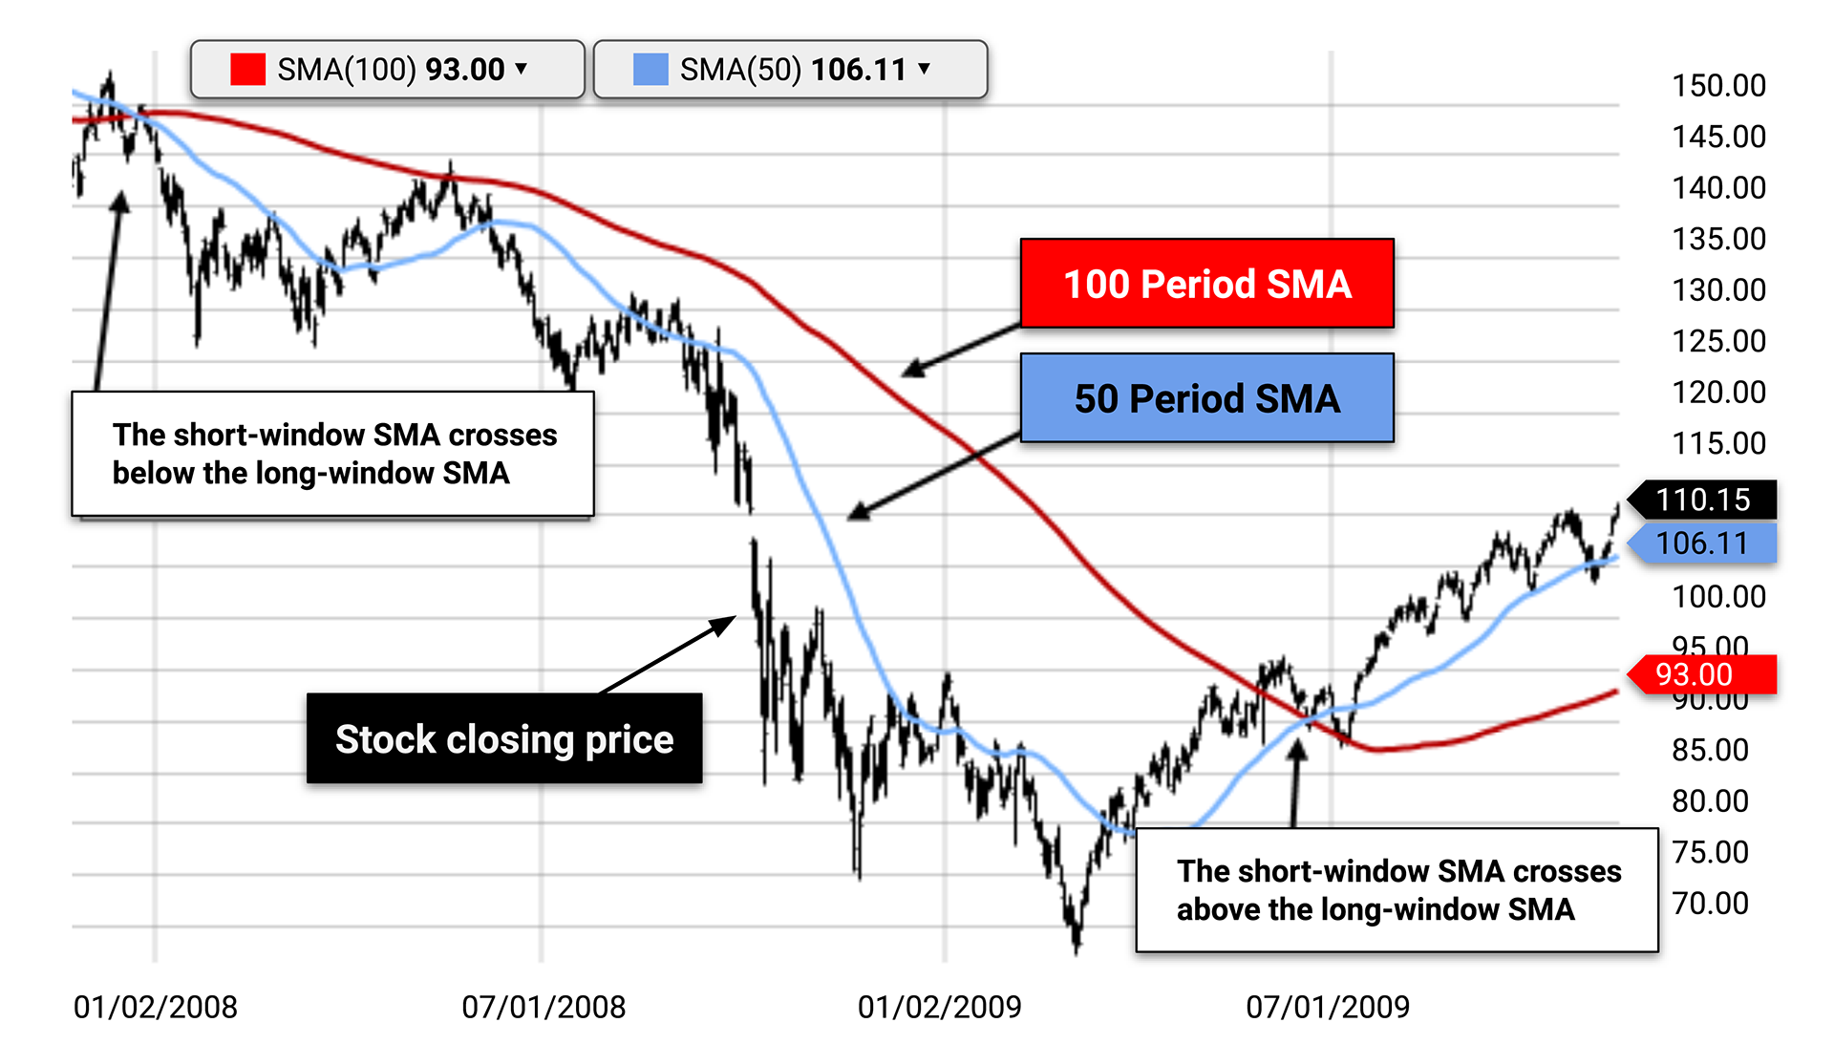
Trade Algorithm
Two SMA windows. A short window and a long window.
Entry when short window > long window
Exit when long window > short window

Slide 4
Forecasting
Time series with Prophet to predict future prices of stock
Trade Algo used on future prices to find next Entry/Exit prices and dates
The next signal in the forecasted prices is used

Slide 5
Web Application
Streamlit application, starts with input from user for stock ticker
Input is used with Yahoo Finance API to pull data for any stock
User can view historical performance with stock and strat
User can find next date/price to buy/sell

Slide 6
Demonstration

Slide 7
Next Steps/Findings:
Have a model to find which SMA windows work best for the stock user inputs
SVC model to predict signals
Integrate smart contract that allows users to make trades with at least the crypto assets directly on web application

Slide 8
Thank you!

