Slide 1
NATIONAL TELECOMMUNICATION INSTITUTE
Predictive Analysis of Bank Term-Deposit
Subscription Behaviour
An End-to-End Data Analytics Project
PYTHON • SQL • POWER BI
Prepared By: [Nahla Hefny Mahmoud] Course: [ Data Analytics Track] Instructor: [Donia Ghars Aldin] Date: July 25, 2026
Notes:
Welcome the audience. Introduce the project as an end-to-end analysis of a real bank telemarketing dataset, combining Python, SQL, and Power BI to understand and predict term-deposit subscription behaviour. Mention this is for the NTI Data Analytics course and briefly preview that the presentation covers the data, the three technical workflows, and the business recommendations that came out of the analysis.

Slide 2
INTRODUCTION
The Business Problem
A Portuguese bank ran phone-based term-deposit campaigns from 2008–2010, contacting 41,188 customers.
Marketing budgets and call-centre time are limited — calling everyone indiscriminately is inefficient.
Business question: which customers and conditions are associated with a higher chance of subscribing, and can that be predicted in advance?
This project answers that question using three complementary tools, each suited to a stage of the analytics pipeline.
PYTHON
Clean, explore & model the data
↓
SQL
Answer business questions via queries
↓
POWER BI
Build an interactive executive dashboard
Notes:
Explain the scale of the dataset (41,188 contacts over roughly two and a half years) and frame the core business problem: limited marketing resources mean the bank needs to target the right customers. Walk through the three-stage pipeline shown on the right — Python for preparation and modelling, SQL for structured business queries, Power BI for the interactive dashboard — and note that each is covered in its own section later in the deck.

Slide 3
PROJECT OBJECTIVES
What This Project Set Out to Do
01
02
03
Profile & Clean
Explore (EDA)
Model
Assess data quality and remove duplicates
Uncover patterns between attributes and subscription
Train and honestly evaluate a baseline classifier
04
05
06
Query (SQL)
Visualise (Power BI)
Recommend
Answer business questions with structured queries
Build an interactive KPI dashboard
Turn findings into data-driven business actions
Notes:
Walk through the six objectives as a checklist for the whole project: profiling and cleaning the raw data, exploring it visually, building a baseline predictive model, writing SQL queries for specific business questions, building the Power BI dashboard, and finally translating everything into recommendations. Emphasise that this presentation is structured to follow exactly this order.

Slide 4
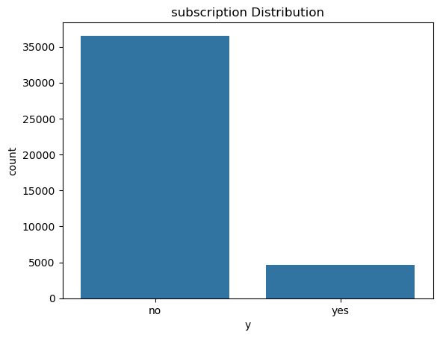
DATASET OVERVIEW
Bank-Additional-Full.csv
41,188
21
12
11.3%
Raw Records
Columns
Duplicates Removed
Subscription Rate
Key Columns
Demographics: age, job, marital, education
Financial: default, housing, loan
Campaign: contact, month, day_of_week, duration, campaign
Macro-economic: emp.var.rate, cons.price.idx, euribor3m, nr.employed
Target: y — subscribed to a term deposit? (yes/no)
Figure: Subscription (y) class distribution — highly imbalanced
Notes:
Introduce the dataset: 41,188 contacts, 21 columns, no explicit missing values but 12 duplicate rows which were removed. Point out the four KPI cards, then briefly categorise the columns into demographic, financial, campaign, and macroeconomic groups. Finish on the chart: the target class is heavily imbalanced — only about 11% of contacts subscribed — which becomes important later when we evaluate the model.

Slide 5
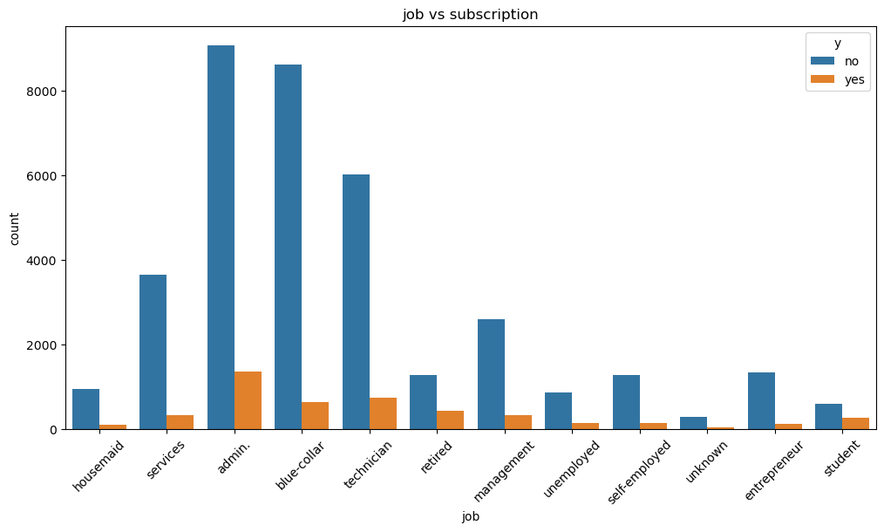
METHODOLOGY
Python Workflow
Loaded & profiled data with pandas (shape, dtypes, nulls)
Removed 12 duplicate rows (41,188 → 41,176)
Explored patterns via 9 seaborn/matplotlib charts
One-hot encoded categorical fields (20 → 53 features)
Trained a Logistic Regression baseline classifier
80/20 train-test split, random_state = 42
Figure: Job type vs. subscription outcome
Notes:
Summarise the Python side of the project. Data was loaded and profiled, 12 duplicate rows were removed, and nine exploratory charts were produced. Point at the job-vs-subscription chart on the right: administrative, blue-collar, and technician roles are contacted the most, but that doesn't necessarily mean they convert the best — that comes later in the Key Insights slide. Then mention that categorical fields were one-hot encoded into 53 numeric features and a Logistic Regression baseline model was trained on an 80/20 split.

Slide 6
METHODOLOGY
SQL Analysis
8 queries against dbo.bankadditionalfull covering counts, grouping, filtering,
HAVING, CASE-based segmentation, and ranked (TOP N) selection.
Job | Subscribed
admin. | 1,352
technician | 730
blue-collar | 638
retired | 434
management | 328
SELECT TOP 5
job,
COUNT(*) AS Subscribed_Customers
FROM dbo.bankadditionalfull
WHERE y = 1
GROUP BY job
ORDER BY Subscribed_Customers DESC;
Top 5 Job Categories by Subscribed Customers
Overall conversion: 36,548 "no" vs. 4,640 "yes" (11.3%)
Notes:
Explain that SQL was used to answer very specific business questions directly against the data, using standard techniques: counting, grouping, filtering, HAVING, CASE-based age segmentation, and ranked TOP-N selection. Walk through the featured query — the TOP 5 job categories by subscribed customers — and read off the table: admin. leads with 1,352 subscribers, followed by technician and blue-collar. Note the overall conversion split at the bottom: about 11.3% of all contacts subscribed.

Slide 7
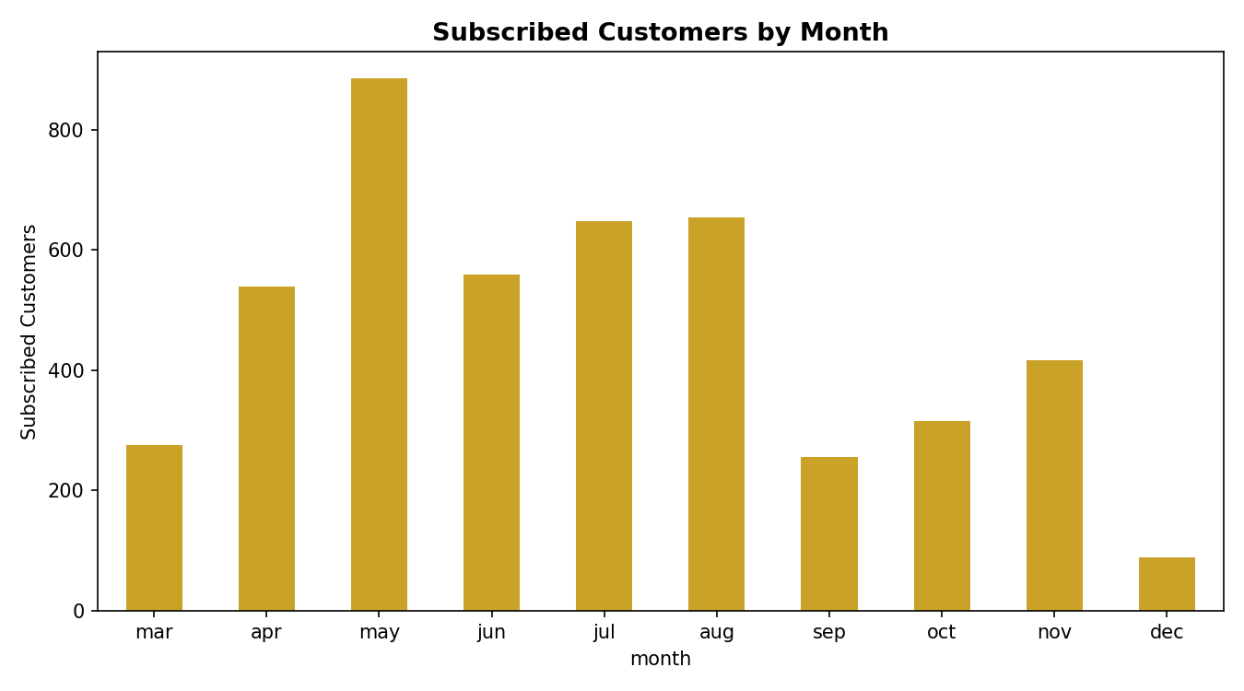
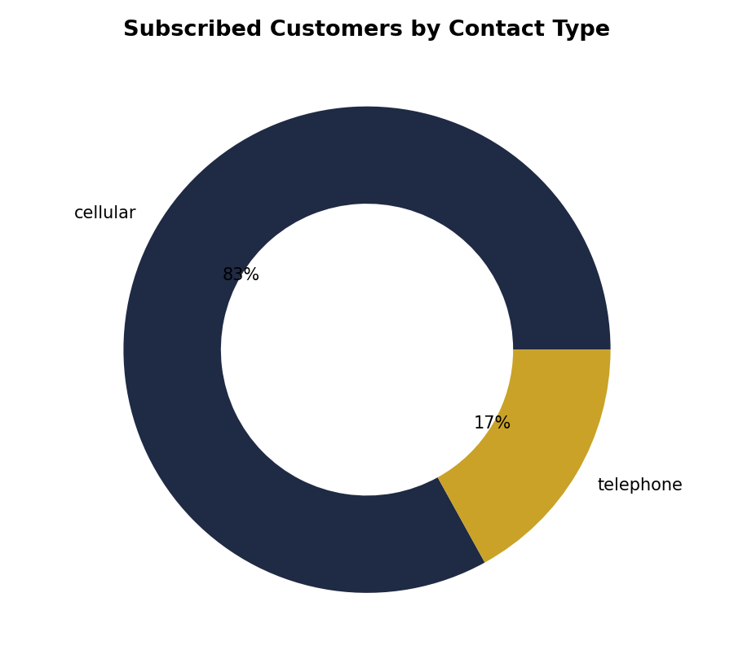
METHODOLOGY
Power BI Dashboard
41,188
4,640
11.3%
Total Customers
Subscribed Customers
Subscription Rate
Subscribed Customers by Month
Subscribed Customers by Contact Type
Notes:
Present the Power BI executive dashboard: three headline KPI cards (Total Customers, Subscribed Customers, Subscription Rate), a month/education slicer, and six chart visuals. Since Power BI Desktop isn't available to capture live screenshots, these two charts were reconstructed in Python directly from the same fields and aggregations defined inside the report file, so the patterns match exactly what the live dashboard shows. Point out the May subscription peak and the dominance of cellular contact.

Slide 8
FINDINGS
Key Insights
Segment beats volume
Channel matters
Students & retirees convert at 25–31% — 2–3× the 11.3% average — despite low contact volume.
~83% of all subscriptions came through cellular contact, not landline telephone.
Timing matters
Duration ≠ predictor
May, followed by Jul–Aug, produced the largest subscription volumes of the campaign.
Call duration correlates most with outcome, but is only known after the call — unusable for pre-call targeting.
Notes:
These are the four headline insights that emerged consistently across the Python, SQL, and Power BI analyses. Emphasise the contrast between contact volume and conversion rate — the segments contacted most (admin, blue-collar) are not the ones converting best. Flag the duration point as an important modelling caveat, not just an insight: it's the strongest correlate but can't be used for real-world targeting since it's only known after the call.

Slide 9
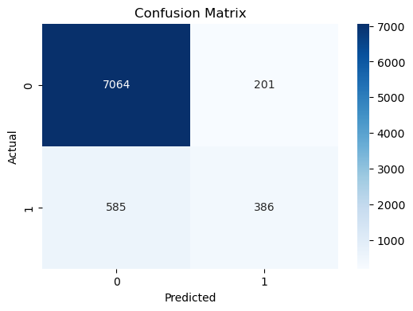
RESULTS
Predictive Model Performance
Metric | "No" | "Yes"
Precision | 0.92 | 0.66
Recall | 0.97 | 0.40
F1-score | 0.95 | 0.50
Overall accuracy: 90.46%
But recall on actual subscribers is only 40% — the model misses roughly 6 in 10 real prospects. Accuracy alone is misleading on this imbalanced (88.7% / 11.3%) dataset.
Confusion Matrix — Logistic Regression
Notes:
Present the baseline logistic regression results. The 90.46% accuracy figure looks impressive but is inflated by class imbalance — a model that always guessed 'no' would already score near 88.7%. The more important numbers are recall and precision on the minority 'yes' class: only 40% recall, meaning the model would miss about six in ten real subscribers if used as-is for campaign targeting. This sets up the recommendation slide.

Slide 10
CHALLENGES
Obstacles & How They Were Solved
Area | Challenge | Resolution
Data Cleaning | "Unknown" categories looked like missing data | Kept as a valid category rather than imputed or dropped
SQL Implementation | Queries assumed numeric y (1/0), source CSV uses text | Mapped y = 1 to "yes" and cross-checked against raw counts
Power BI Visualisation | .pbix cannot be opened outside Power BI Desktop | Parsed the report's internal layout file to recover visuals & fields exactly
Analysis | 88.7% / 11.3% class imbalance makes accuracy misleading | Reported precision, recall & F1 per class instead of accuracy alone
Notes:
Walk through the table row by row: the 'unknown' category ambiguity in cleaning, the numeric-vs-text encoding mismatch discovered in the SQL layer, the inability to open the .pbix file directly (solved by parsing its internal layout definition), and the class-imbalance challenge in evaluating the model. For each, briefly state the problem and how it was resolved.

Slide 11
RECOMMENDATIONS
Data-Driven Next Steps
Prioritise students and retirees in future campaign lists — 2–3× the average conversion rate
Shift outreach toward cellular contact; consider phasing out landline telephone calls
Concentrate campaign timing around May and the Jul–Aug window
Do not deploy the current model as-is — address class imbalance and scale features before live use
Exclude call duration from any pre-call targeting model to avoid data leakage
Extend the Power BI dashboard with a subscription-rate (not just volume) trend by month
Notes:
These six recommendations translate the findings into concrete actions. The first three are campaign-targeting changes the marketing team can act on immediately. The fourth and fifth are important guardrails on the predictive model — it needs further work on class imbalance and must not use call duration — before it should influence who actually gets called. The last is a lightweight enhancement to the existing Power BI dashboard.

Slide 12
Conclusion
A consistent story across Python, SQL, and Power BI: conversion is
segment-dependent, channel and timing matter, and the baseline model
needs further work before it can safely guide live campaign targeting.
Thank You
Questions & Discussion Welcome
Notes:
Close by restating the throughline: the same high-propensity segments (students, retirees, university-educated, cellular-contacted, spring campaigns) showed up consistently whether the question was asked in Python, SQL, or Power BI, which gives confidence the pattern is real. Thank the audience and open the floor for questions.

