Slide 1
Stop Forest Fire

Slide 2
Hello!
I am ……..
I am here to give you presentation.

Slide 3
Problem We Tackel
EDIT IN GOOGLE SLIDES
Click on the button under the presentation preview that says "Use as Google Slides Theme".
You will get a copy of this document on your Google Drive and will be able to edit, add or delete slides.
You have to be signed in to your Google account.
EDIT IN POWERPOINT®
Click on the button under the presentation preview that says "Download as PowerPoint template". You will get a .pptx file that you can edit in PowerPoint.
Remember to download and install the fonts used in this presentation (you’ll find the links to the font files needed in the Presentation design slide)

Slide 4
Forest Fire everywhere
Forest fire
Forest fire
Forest fire
Forest fire
Forest fire
Forest fire
Forest fire
Forest fire
Forest fire
Forest fire

Slide 5
“Only you can prevent forest fire“

Slide 6

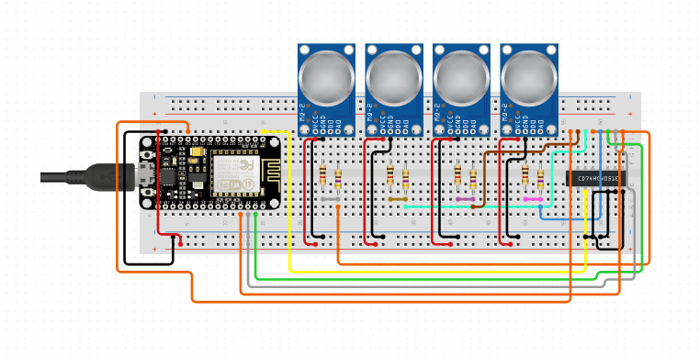

Solution design
👦👧

Slide 7
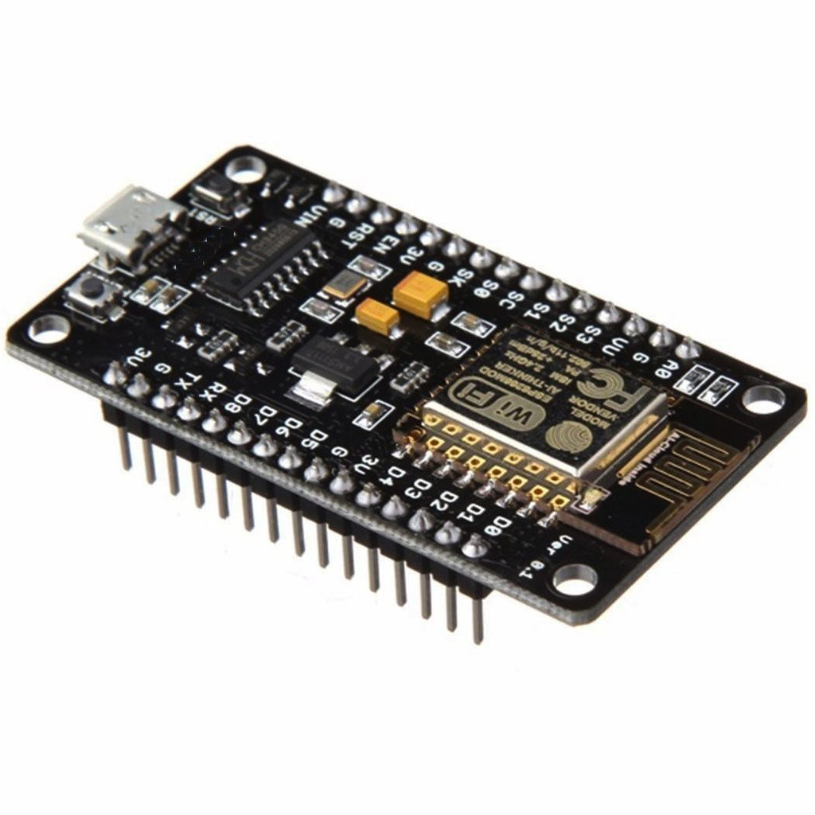
Node MCU
NodeMCU is an open-source firmware and development board that helps you to prototype your IoT product with a few Lua script lines. The development board is based on the ESP8266 WiFi chip with 10 GPIO and 1 ADC input. Each GPIO can be used as PWM, I2C, SPI and 1-Wire. Via the micro USB you can program NodeMCU.

Slide 8
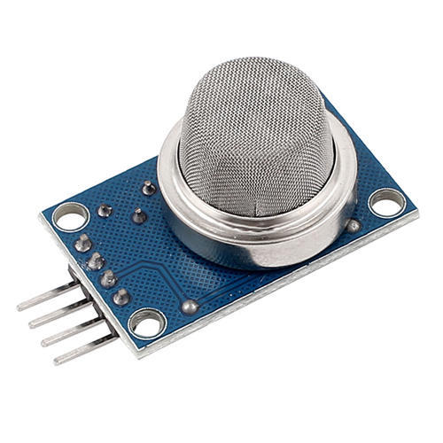
Smoke sensor
The MQ-2 Gas Sensor module is useful for gas leakage detecting in home and industry. It can detect LPG, propane, methane, alcohol, hydrogen and smoke.
size: 32mm x 22mm x 27mm/ 1.26” x 0.86” x 1.06”
Main Chip: The LM393, ZYMQ – 2 Gas Sensor
Working Voltage: DC 5 V
Great for home or factory gas leakage detection
Use for Detecting: Combustible gas such as LPG, butane, methane, alcohol, propane, hydrogen, smoke, etc.

