Slide 1


Anti-Money Laundering (AML)
DEPI Graduation Project
Under Supervision of Eng. Ahmed Essam Azab

Slide 2
Team Members
Ahmed Osama
Nahla Mohamed
Mona Osama
Rowan Amr
Adham Medhat
Mahmoud Magdy

Slide 3
Agenda
- Overview
- Data Modeling
- Get Data
- ETL Process
- SQL Queries
- Visualization

Slide 4
Overview
Developing a system to identify potential money laundering activities and suspects in financial transactions. Using SQL server for Data warehousing, SSIS for ETL Process, and Power BI for visualization.

Slide 5

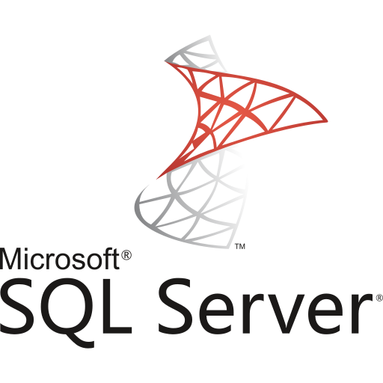
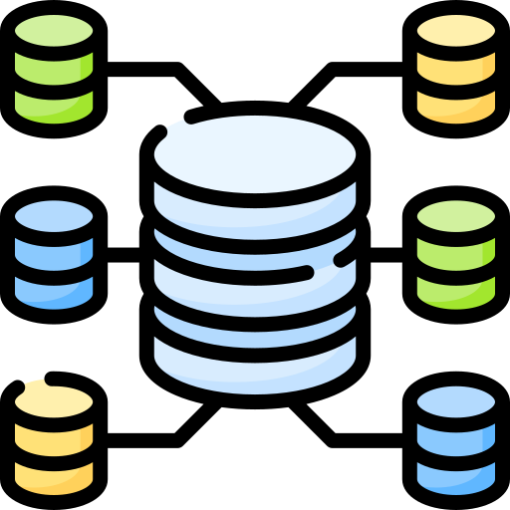
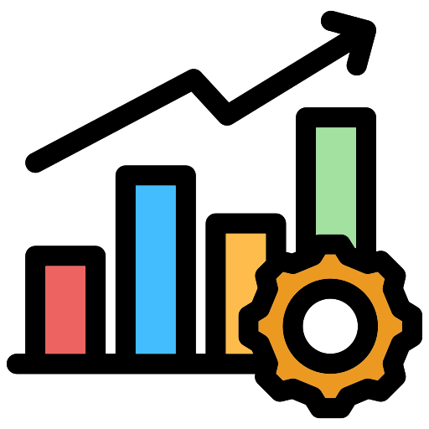

Data Source
Transform
Data Warehouse
Power BI
Extract
Load

Slide 6
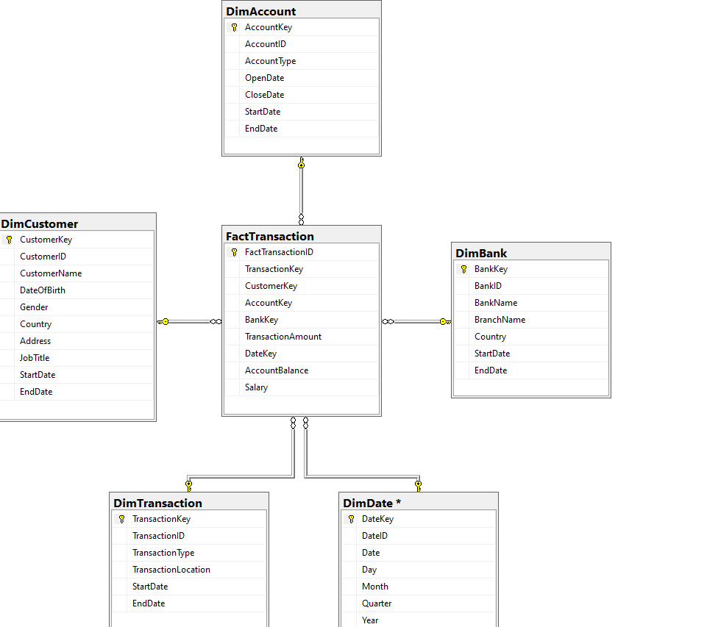
Data Modeling

Slide 7
Get Data
To support the analysis in this project, synthetic data was generated to simulate customer bank data. The generated dataset consists of 20000 records of customers information and their transactions.
We took into consideration that this this data contains customers with suspicious transactions.

Slide 8
Data Generation Process
We used Python to write scripts that generated synthetic data, which mimicked real-world transaction patterns.
Libraries we used: Pandas for creating and manipulating structured datasets efficiently, Faker for generating realistic data such as (names, addresses, … etc), allowing us to simulate customer profiles and their activities.

Slide 9
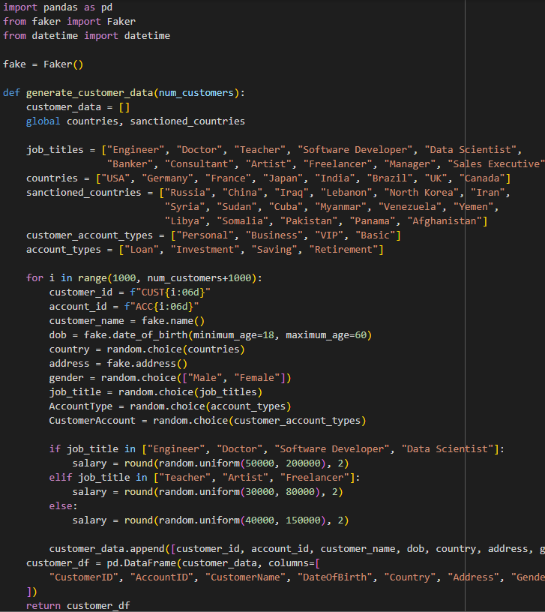
Sample of Code

Slide 10
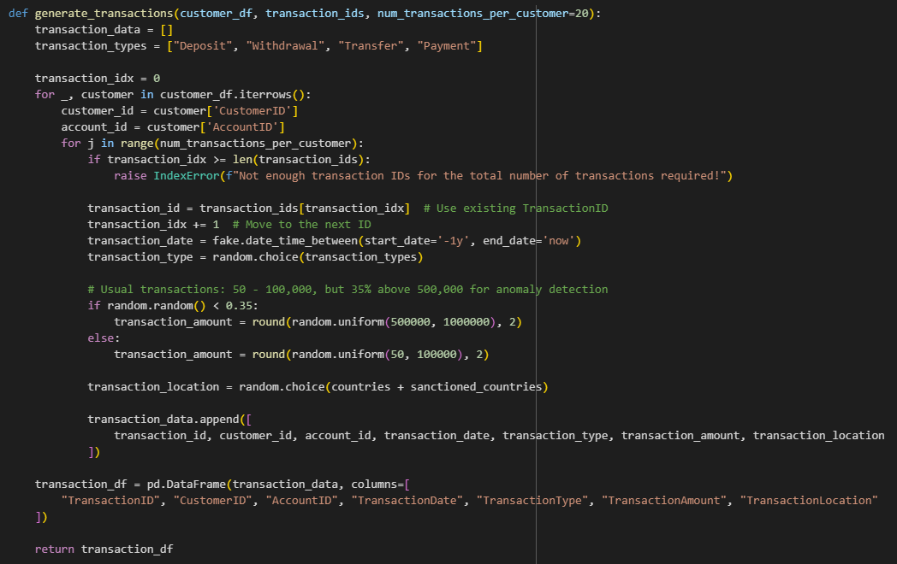
Sample of Code

Slide 11
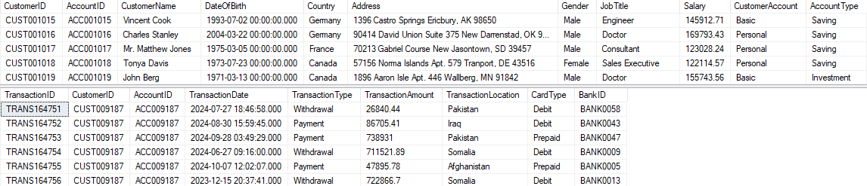
Sample of Data

Slide 12
ETL Process
After we generated the data, we saved it into a database.
We used SSIS to apply ETL process.
We extracted data from database source, then applied some transformations, then loaded data into the data warehouse.

Slide 13
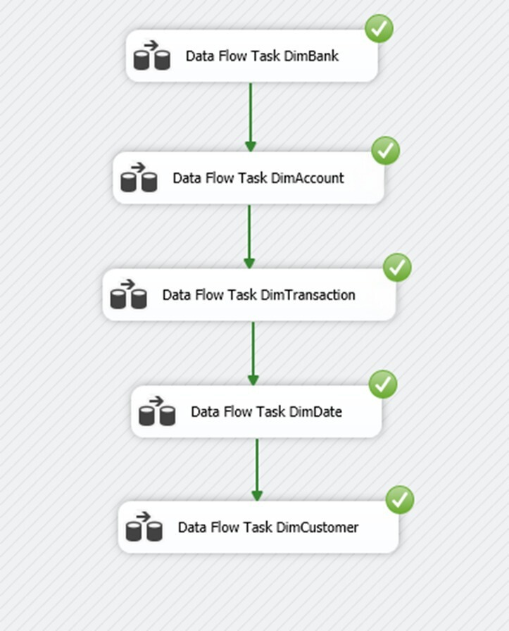
Data Flow Task For Dimensions

Slide 14
Slowly Changing Dimension
We used SCD technique to track the history of dimension records.
We created data flow task for each dimension

Slide 15
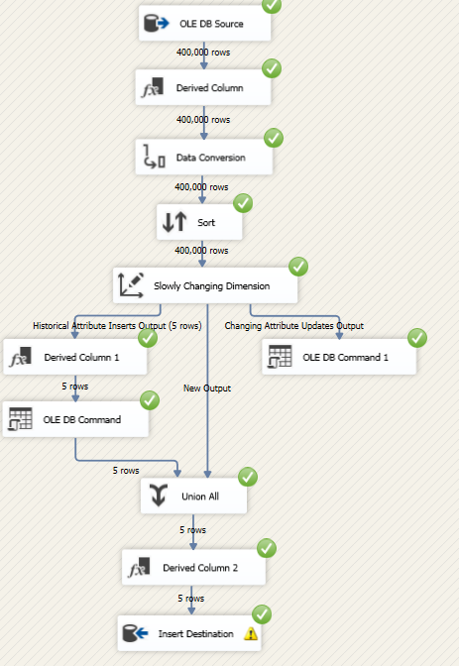
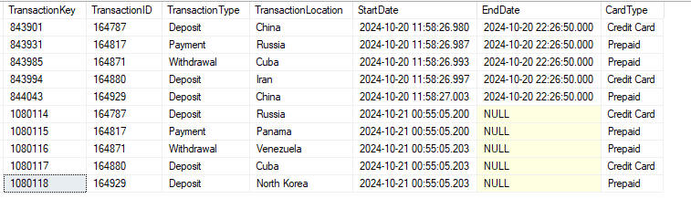
SCD For Transaction Dimension

Slide 16
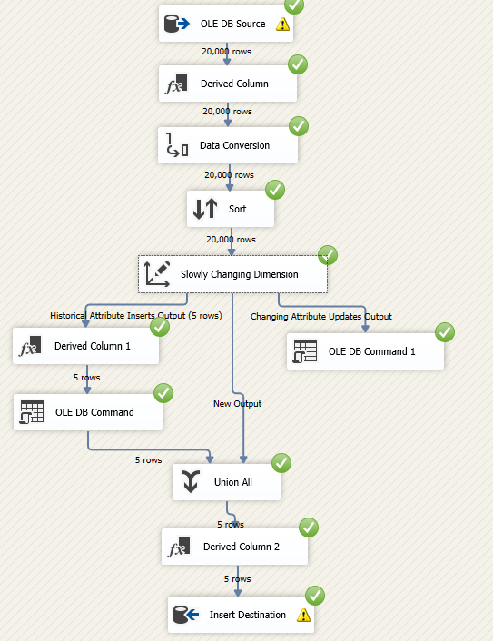
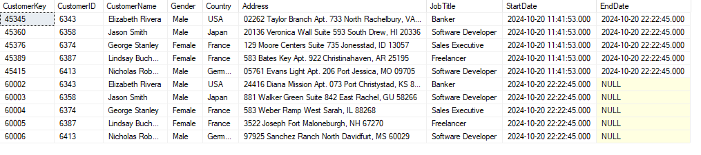
SCD For Customer Dimension

Slide 17
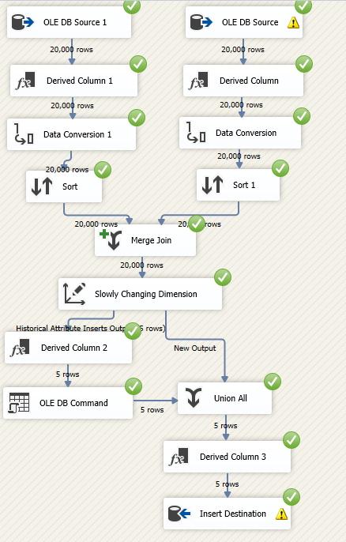
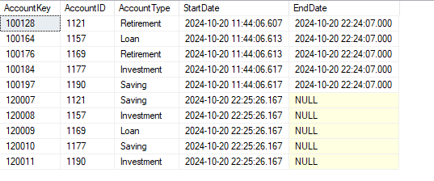
SCD For Account Dimension

Slide 18
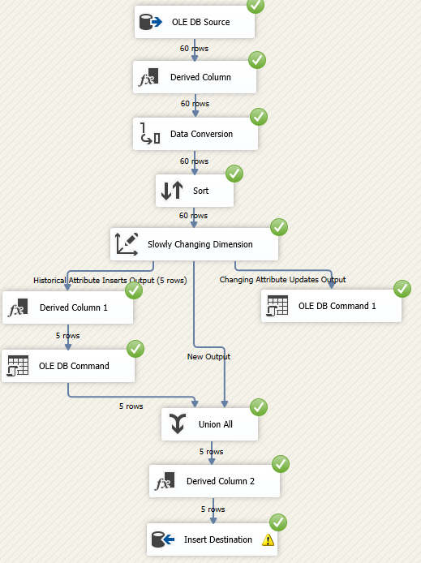
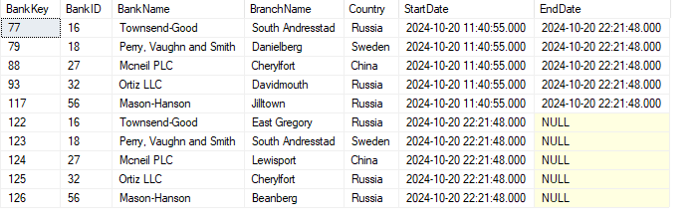
SCD For Bank Dimension

Slide 19
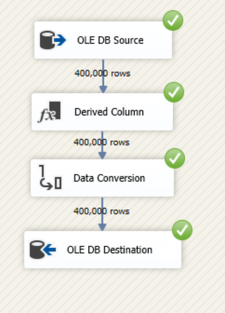
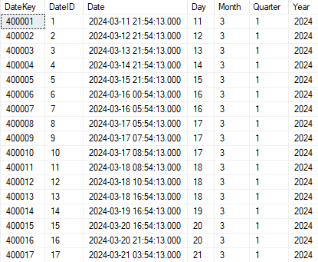
Date Dimension

Slide 20
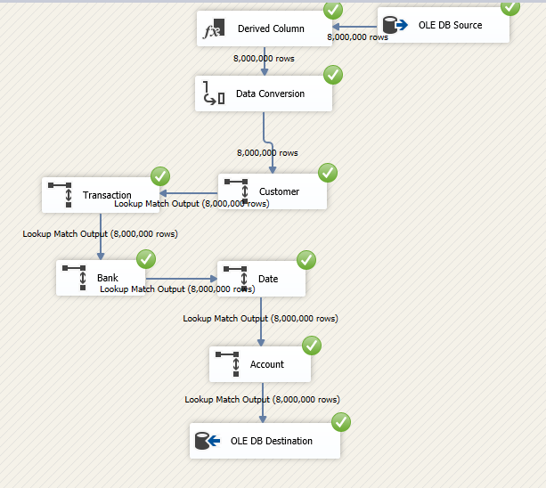
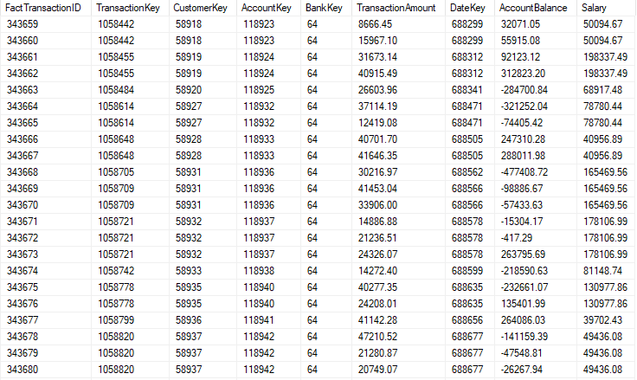
Fact Transaction

Slide 21
SQL Queries for Analysis
We applied some SQL queries to filter transactions based on specific criteria that may indicate suspicious behavior, such as unusually high transaction amounts, multiple transactions in a short time frame, or transactions from suspicious locations.

Slide 22
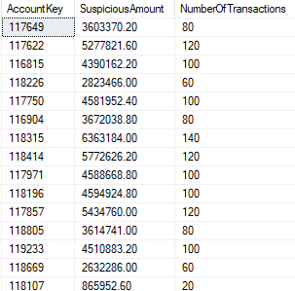

Unusual High Transaction Amounts

Slide 23
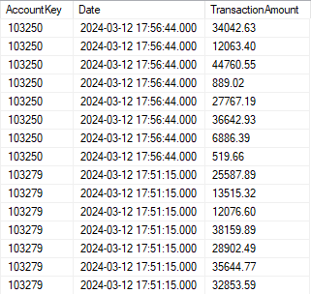
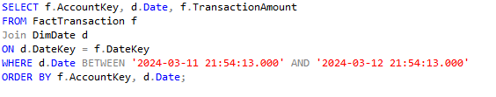
Multiple Transactions in a Short Time

Slide 24
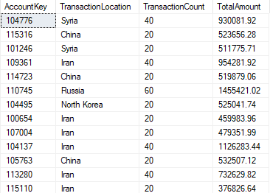
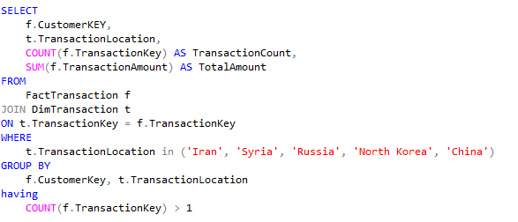
Transactions from Suspicious Locations

Slide 25
Visualization
We created an interactive Power BI dashboard to visualize key transaction metrics for suspicious accounts, such as total transaction amounts, frequency of transactions, and locations.

Slide 26
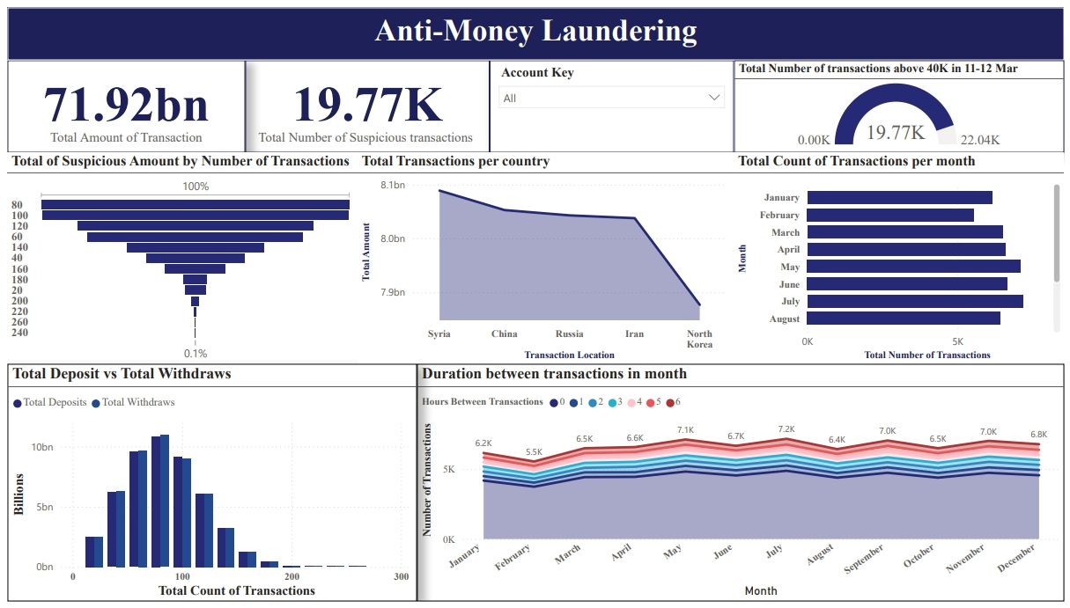

Slide 27

Questions

Slide 28

Thank You

