Slide 1
mavi
by Team #44
Ali Hagverdiyev
Ervin Mahmudov
Nargiz Ahmedova
Nazrin Eyyubova

Slide 2
AGENDA
Industry Brief
Company Brief
The Main Challenge
Recommendations
Overall Financial Impact

Slide 3
AGENDA
Industry Brief
Company Brief
The Main Challenge
Recommendations
Overall Financial Impact

Slide 4
Industry
Company
Challenge
Recos
Financials
Turkish Market

Slide 5
Industry
Company
Challenge
Recos
Financials
Turkish Market
11%
2.5%

Slide 6
Industry
Company
Challenge
Recos
Financials
Global Average Price: $26.32
Global Market

Slide 7
AGENDA
Industry Brief
Company Brief
The Main Challenge
Recommendations
Overall Financial Impact

Slide 8
AGENDA
Industry Brief
Company Brief
The Main Challenge
Recommendations
Overall Financial Impact

Slide 9
Industry
Company
Challenge
Recos
Financials
Aggressive Store Expansion
387
retail stores
30%
annual growth rate

Slide 10
AGENDA
Industry Brief
Company Brief
The Main Challenge
Recommendations
Overall Financial Impact

Slide 11
AGENDA
Industry Brief
Company Brief
The Main Challenge
Recommendations
Overall Financial Impact

Slide 12
Industry
Company
Challenge
Recos
Financials
Growth Patterns of 2008 – 2015 for MAVI
Revenue : 30 %
EBITDA: 40 %
Like - for – like sales : 15% per year
How to maintain these figures?

Slide 13
Industry
Company
Challenge
Recos
Financials
Local Concentration vs. International Expansion
Moving Upmarket vs. Moving Downmarket

Slide 14
Industry
Company
Challenge
Recos
Financials
Local Concentration vs. International Expansion
Moving Upmarket vs. Moving Downmarket

Slide 15
Industry
Company
Challenge
Recos
Financials
Local Market Saturation Threats
International Expansion
Insufficient Global Presence
Europe as destination

Slide 16
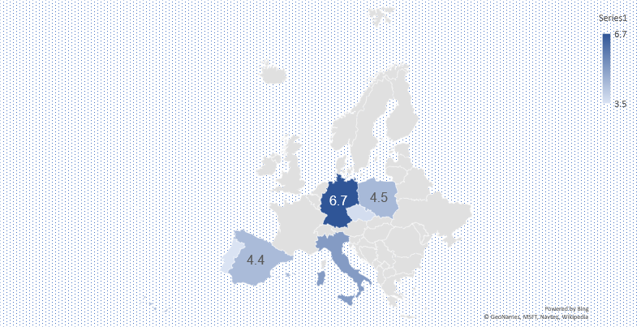
Industry
Company
Challenge
Recos
Financials
Country Scorings
Constraints:
Market Size
GDP per capita
Level of competition
Economic stability
Tax

Slide 17
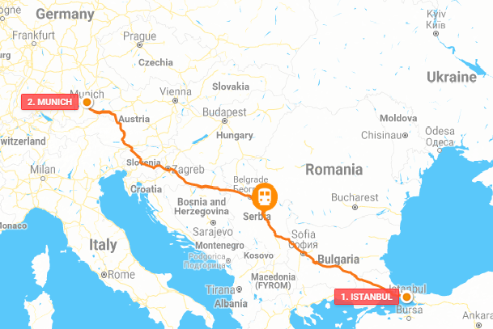
Industry
Company
Challenge
Recos
Financials
Germany
Functional: Perfect Fit

Slide 18
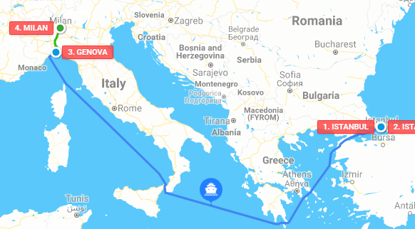
Industry
Company
Challenge
Recos
Financials
Italy
Lifestyle: Mavi-terranean

Slide 19
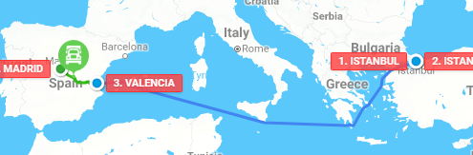
Industry
Company
Challenge
Recos
Financials
Spain
Lifestyle: Mavi-terranean

Slide 20
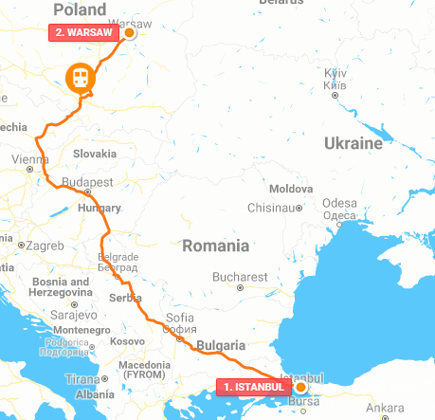
Industry
Company
Challenge
Recos
Financials
Poland
Functional: Perfect Fit

Slide 21
Industry
Company
Challenge
Recos
Financials
Local Concentration vs. International Expansion
Moving Upmarket vs. Moving Downmarket

Slide 22
Industry
Company
Challenge
Recos
Financials
Local Concentration vs. International Expansion
Moving Upmarket vs. Moving Downmarket

Slide 23
Industry
Company
Challenge
Recos
Financials
Repositioning: Upmarket
Store Location Optimization: From 387 to 150
Employee Strategy: Less employees but higher salaries
2.5 % in volume
11% in value
Less harsh competition
Selling to premium segment

Slide 24
Industry
Company
Challenge
Recos
Financials
Repositioning: Upmarket
3.7 billion TL in 2020

Slide 25
Industry
Company
Challenge
Recos
Financials
Repositioning: New Brand in Downmarket
Introducing new brand to fast fashion segment

Slide 26
Industry
Company
Challenge
Recos
Financials
Repositioning
Initial Investment
50 million TL
NPV: 30.8 million TL
IRR: 25%

Slide 27
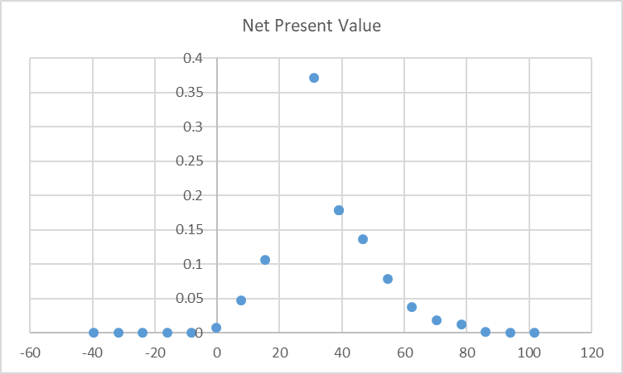
Industry
Company
Challenge
Recos
Financials
Repositioning
Marcole Simulation

Slide 28
AGENDA
Industry Brief
Company Brief
The Main Challenge
Recommendations
Overall Financial Impact

Slide 29
AGENDA
Industry Brief
Company Brief
The Main Challenge
Recommendations
Overall Financial Impact

Slide 30
Industry
Company
Challenge
Recos
Financials
Net Financial Impact
International
Local
Growth Maintained!
50% average annual growth
30% average annual growth

Slide 31


