Slide 1

Collateral Damage: Effects of the Japanese Bank Crisis on Real Activity in the United States
By JOE PEEK AND ERIC S. ROSENGREN
Presented by
Mohamed Elshiekh and Nargiz Ahmadova
Empirical Banking and Finance
June 21st , 2022
Notes:
Published in March 2000 in The American Economic Review

Slide 2
Structure
Introduction and Overview
Introduction and Overview
1
Sample, Data, and Limitation
2
Transmission: Methodology and Results
3
Real Effects: Methodology and Results
4
Conclusion
5

Slide 3
Introduction and Overview
1
Independent loan supply disruption Real economic activity
Notes:
Uses the Japanese banking crisis as a natural experiment
○ Between 1989 and 1992 the Nikkei stock index loses more than half its value
○ Reduced bank capital
○ Regulation is instantiated in the late 1980s which limits the capital ratio
➔ Banks which were highly active in the US real estate loan markets reduce their lending
◆ Provides loan supply shock which is effectively exogenous
Corroborated by previous study (Peek and Rosengren 1997)

Slide 4
Introduction and Overview
1
Gaps in the literature:
No adequate separation between loan supply and loan demand
No persuasive establishment of the link between bank lending and economic activity
Notes:
Uses the Japanese banking crisis as a natural experiment
○ Between 1989 and 1992 the Nikkei stock index loses more than half its value
○ Reduced bank capital
○ Regulation is instantiated in the late 1980s which limits the capital ratio
➔ Banks which were highly active in the US real estate loan markets reduce their lending
◆ Provides loan supply shock which is effectively exogenous
Corroborated by previous study (Peek and Rosengren 1997)

Slide 5
Introduction and Overview
1
Economic activity=β0+ β1LoanSupplyShock+ β2X+e
Natural Experiment from Japan
}
Notes:
Uses the Japanese banking crisis as a natural experiment
○ Between 1989 and 1992 the Nikkei stock index loses more than half its value
○ Reduced bank capital
○ Regulation is instantiated in the late 1980s which limits the capital ratio
➔ Banks which were highly active in the US real estate loan markets reduce their lending
◆ Provides loan supply shock which is effectively exogenous
Corroborated by previous study (Peek and Rosengren 1997)

Slide 6
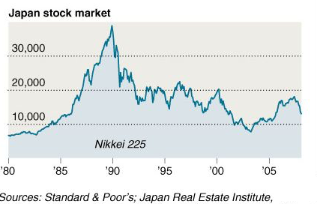
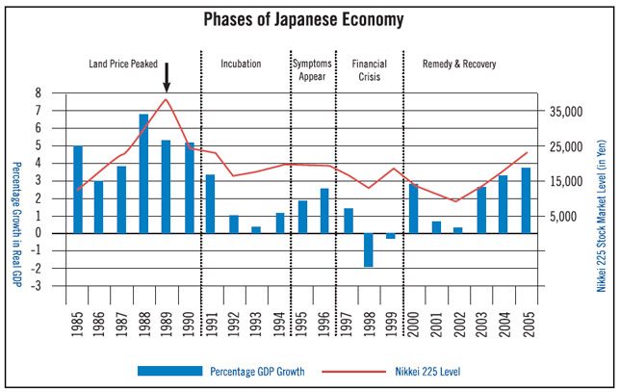
Japanese real-estate crisis
Introduction and Overview
1
Notes:
Uses the Japanese banking crisis as a natural experiment
○ Between 1989 and 1992 the Nikkei stock index loses more than half its value
○ Reduced bank capital
○ Regulation is instantiated in the late 1980s which limits the capital ratio
➔ Banks which were highly active in the US real estate loan markets reduce their lending
◆ Provides loan supply shock which is effectively exogenous
Corroborated by previous study (Peek and Rosengren 1997)

Slide 7
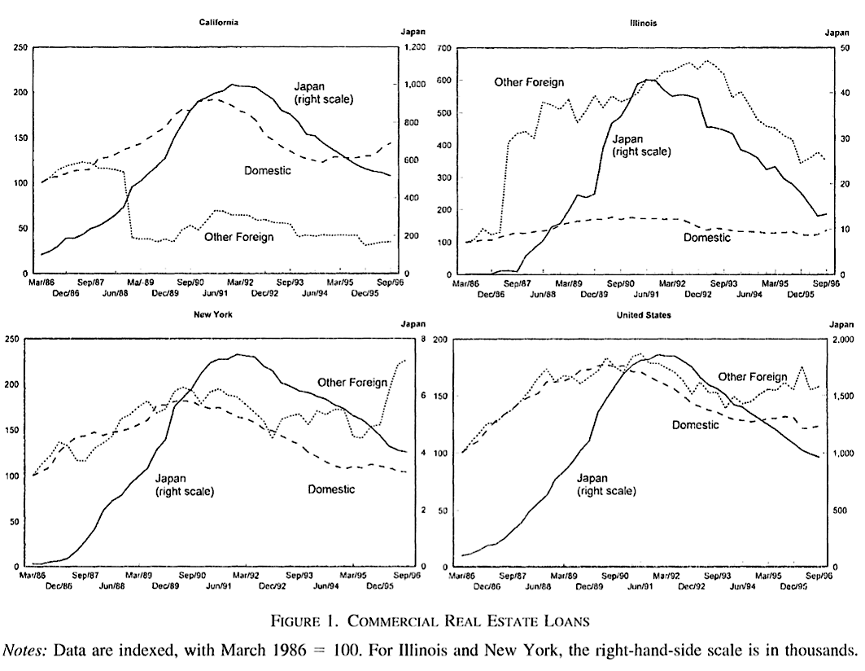
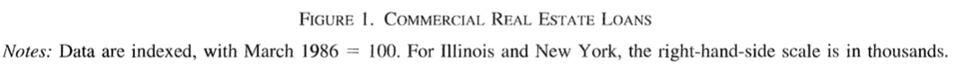
Japanese real estate crisis as an exogoenous loan supply shock
Introduction and Overview
1
Notes:
The dramatic declines in Japanese equity and commercial real estate prices in the early 1990's put strong downward pressure on the capital positions of Japanese banks.
In responding to these domestic shocks by reducing theirlending in the United States, Japanese banks have provided a natural experiment to test the extent to which a loan supply shock can affect real eco- nomic activity.
Because the shock was external to U.S. credit markets, yet connected through the substantial penetrationof U.S. commercial real estate loan markets byJapanese banks, this event allows us to identify an exogenous loan supply shock and ultimately link that shock to construction activity in major commercialreal estate markets in the United States.
Because the shock was external to U.S. credit markets, yet connected through the substantial penetration of U.S. commercial real estate loan markets by Japanese banks, this event allows us to identify an exogenous loan supply shock and ultimately link that shock to construction activity in major commercial real estate markets in the United States.
Using a panel data set that exploits the variation across geographically distinct commercial real estate markets in the United States, both in the degree of Japanese bank penetration and in local demand conditions, we are able to clearly identify a loan supply shock and to closely link that shock to real economic activity, a combi- nation that has eluded most previous studies. We find that the retrenchment of Japanese lending had a substantial impact on U.S. real estate activity, indicating that alternative financing was not easily obtained, at least for some borrowers. This is consistent both with the idiosyncratic nature of many commercial real estate loans, which require lender understanding of the borrower and project, and with the major retreat by Japanese banks from their large penetrations in specific U.S. commercial real estate market.

Slide 8
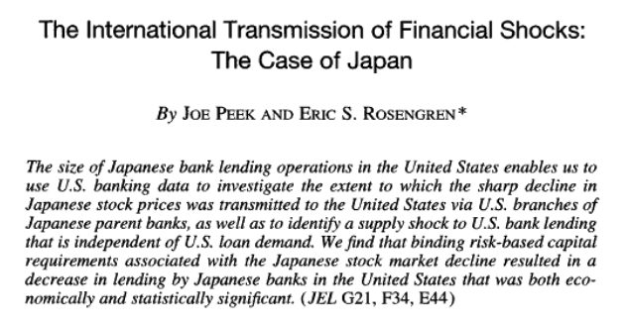
Transmission of Financial Crisis
Peek and Rosengren 1997
1
Notes:
Uses the Japanese banking crisis as a natural experiment
○ Between 1989 and 1992 the Nikkei stock index loses more than half its value
○ Reduced bank capital
○ Regulation is instantiated in the late 1980s which limits the capital ratio
➔ Banks which were highly active in the US real estate loan markets reduce their lending
◆ Provides loan supply shock which is effectively exogenous
Corroborated by previous study (Peek and Rosengren 1997)

Slide 9
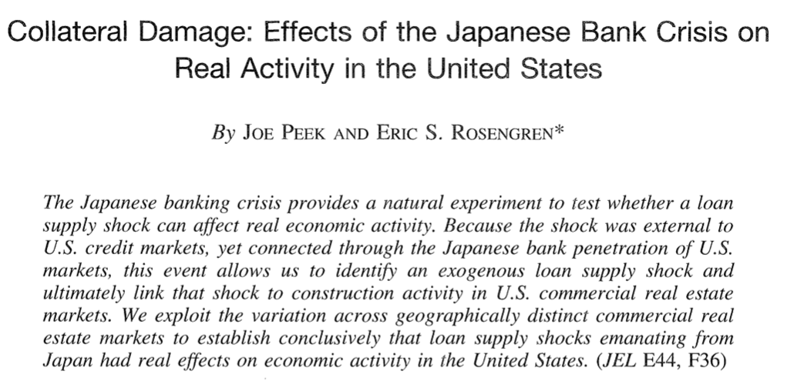
Notes:
● Links an independent loan supply shock to real economic activity in the US
●

Slide 10
Study Questions
Introduction and Overview
1
1
Transmission
2
Real Effects
Are stock market and real estate problems in Japan transmitted to the U.S. commercial real estate (CRE) markets in the form of reduced lending?
Did the reduction in Japanese lending have an effect on real activity in U.S. CRE markets?
Notes:
Peek & Rosengren (2000) estimate two models to estimate effect of Japanese Bank Crisis on Real Activity in the U.S.
Transmission of Japanese Shocks to U.S. CRE Lending
Are stock market and real estate problems in Japan transmitted to the U.S. commercial real estate (CRE) markets in the form of reduced lending?
Real Effects of Declines in Japanese CRE Lending
Did the reduction in Japanese lending have an effect on real activity in U.S. CRE markets?

Slide 11
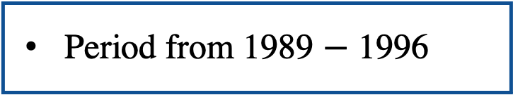
Sample and data
2
Panel date set
Cross-Section
Time-Series
Sample: 3 real-estate markets in the US; California, New York, and Illinois
Semi-annual
Period from 1989 $−$ 1996
all large domestic banks with commercial real-estate loans in the portfolios and Japanese branches
Notes:
Data - Any Problems?
● Aggregation
○ Real estate loans are not disaggregated by type, so authors use total real estate loans
■ May be losing some of the idiosyncrasies in individual real estate sectors
○ Japanese branches in Los Angeles and San Francisco are consolidated into single California
entity ● Sample size
○ 1989 to 1996 semiannually
○ Only 14 cross-sections
○ For example, the rate of non-performing loans may suffer from inaccuracy
● Ideal world
○ More cross sections:
Include more data from before 1989 (less ideal)
Increase frequency of measurement (monthly, if not daily)

Slide 12
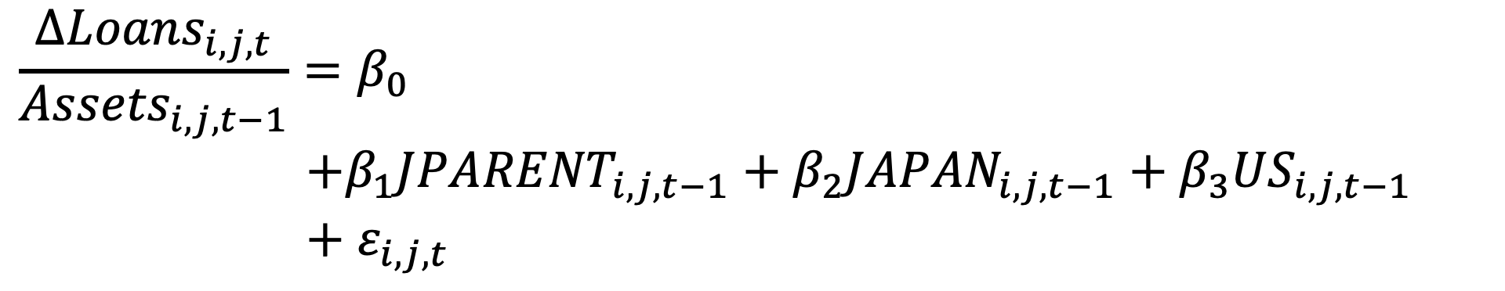
Transmission
3
Estimation Equation
$$\frac{∆{Loans}_{i,j,t}}{{Assets}_{i,j,t−1}}=β_{0}$$
$$+β_{1}{JPARENT}_{i,j,t−1}+β_{2}{JAPAN}_{i,j,t−1}+β_{3}{US}_{i,j,t−1}$$
$+$ $ε_{i,j,t}$
The change in total commercial real estate loans divided by the beginning-of-period assets held by that bank in that state
Notes:
● 4 variables about U.S. economy and banking
1) risk-based capital ratio
0 for Japanese branches: They rely of Japanese parent banks’ capital.
Share of nonperforming CRE loans
3) logarithm of assets
ratio of loans to assets
→ Controlling for influence of local circumstances in the U.S.

Slide 13
Transmission
3
Estimation Equation
$$\frac{∆{Loans}_{i,j,t}}{{Assets}_{i,j,t−1}}=β_{0}$$
$$+β_{1}{JPARENT}_{i,j,t−1}+β_{2}{JAPAN}_{i,j,t−1}+β_{3}{US}_{i,j,t−1}$$
$+$ $ε_{i,j,t}$
the ratio of nonperforming loans to risk-weighted assets
dummy variable indicating the period during which nonperforming loans were available
risk-based capital ratio
Notes:
Change in CRE loans in the U.S.
of banking institution i
in state j
from period t - 1 to period t (six-month-periods)

Slide 14
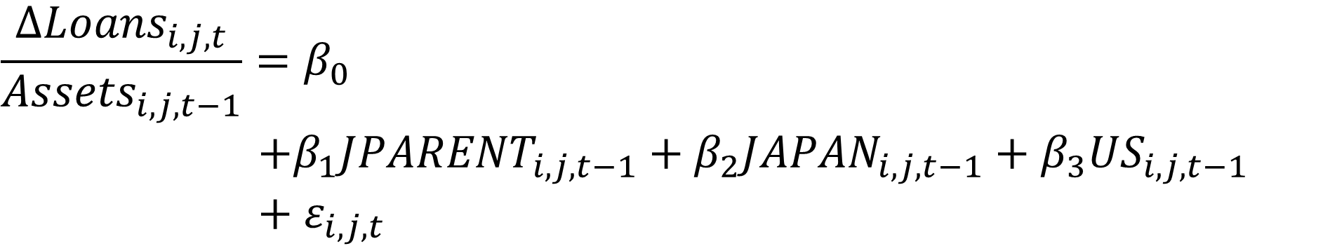
Transmission
3
Estimation Equation
$$\frac{∆{Loans}_{i,j,t}}{{Assets}_{i,j,t−1}}=β_{0}$$
$$+β_{1}{JPARENT}_{i,j,t−1}+β_{2}{JAPAN}_{i,j,t−1}+β_{3}{US}_{i,j,t−1}$$
$+$ $ε_{i,j,t}$
Dummy variable that has a value of (1) for Japanese-owned banks and (0) otherwise
Foreign direct investment (FDI) by Japanese companies in the United States over the prior six-month period
Notes:
Change in CRE loans in the U.S.
of banking institution i
in state j
from period t - 1 to period t (six-month-periods)

Slide 15
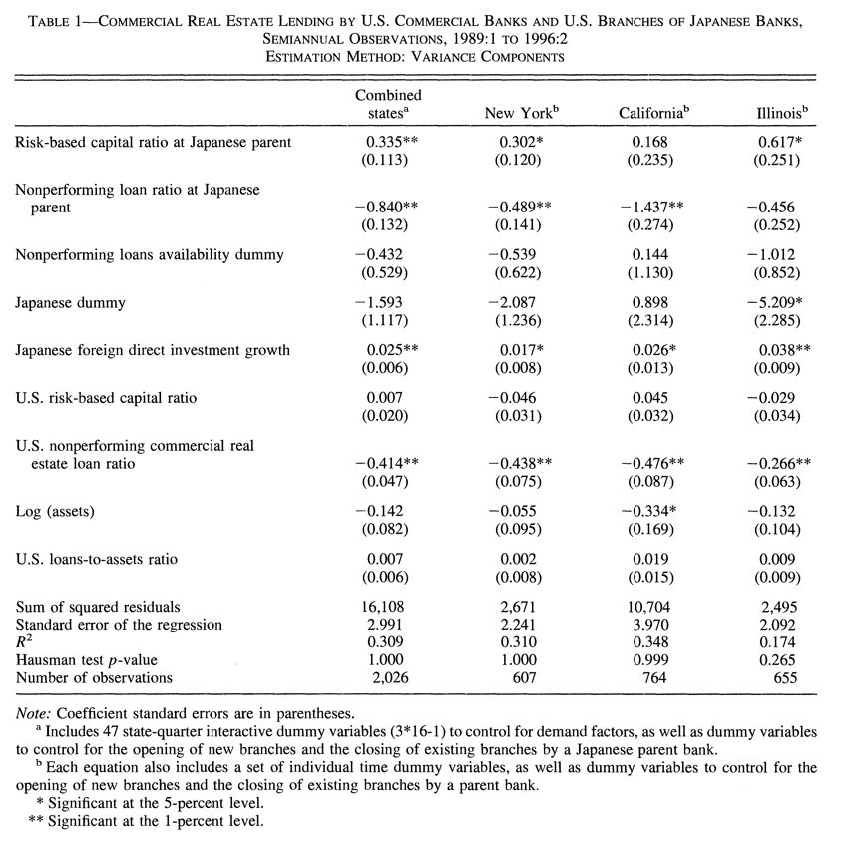
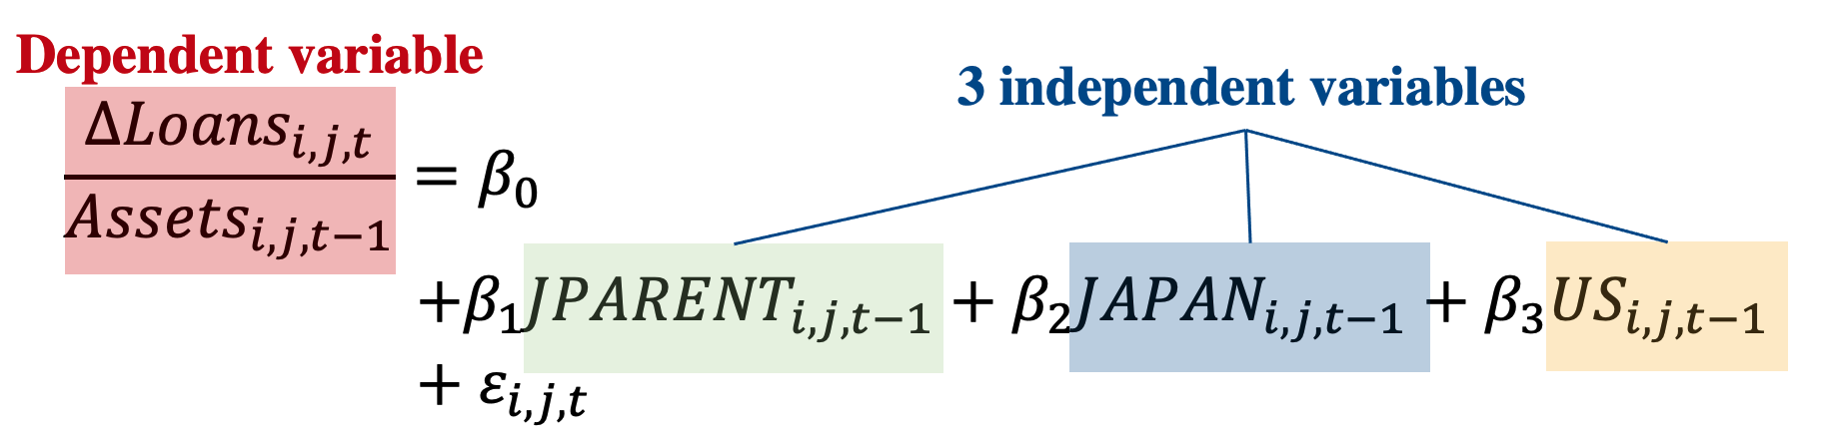
Transmission
3
Empirical Results

Slide 16
Transmission
3
Empirical Result
It has been established that stock market and real estate problems in Japan were transmitted to U.S. commercial real estate markets in the form of reduced lending by Japanese bank affiliates
Notes:
Effects of parent bank risk-based capital ratio are smaller than the ones of non-performing loan ratio.
○ part of nonperforming loans are actually reflected in a lower capital ratio ○ Possible explanation: Non-performing loans are underreported in Japan
● Overall: Similarities between different states indicate robustness of results.

Slide 17
Structure
Introduction and Overview
1
Sample, Data, and Limitation
2
Transmission: Methodology and Results
3
Real Effects: Methodology and Results
Real Effects: Methodology and Results
4
Conclusion
5

Slide 18
Study Questions
Introduction and Overview
1
Study Questions
1
Transmission
2
Real Effects
Are stock market and real estate problems in Japan transmitted to the U.S. commercial real estate (CRE) markets in the form of reduced lending?
Did the reduction in Japanese lending have an effect on real activity in U.S. CRE markets?
Notes:
Peek & Rosengren (2000) estimate two models to estimate effect of Japanese Bank Crisis on Real Activity in the U.S.
Transmission of Japanese Shocks to U.S. CRE Lending
Are stock market and real estate problems in Japan transmitted to the U.S. commercial real estate (CRE) markets in the form of reduced lending?
Real Effects of Declines in Japanese CRE Lending
Did the reduction in Japanese lending have an effect on real activity in U.S. CRE markets?

Slide 19
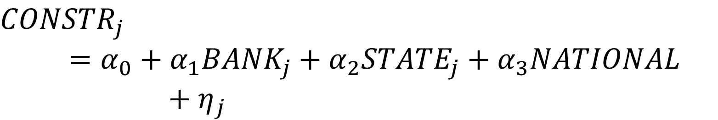
Real Effect
4
Estimation Equation
$${CONSTR}_{j}=α_{0}+α_{1}{BANK}_{j}+α_{2}{STATE}_{j}+α_{3}NATIONAL$$
$+$ $η_{j}$
The value, the number, and the square footage of total new construction projects in state j
Percentage change in employment in the construction industry in state j
Notes:
Real Effects of Declines in Japanese Commercial Real Estate Lending
Dependent variable:
● Four alternative measures of construction activity (always on the state level)
○ value, number, and square footage of total new construction projects (per Capita)
● Annualized percentage change in employment in the construction industry
→ Heterogeneity of effects?

Slide 20
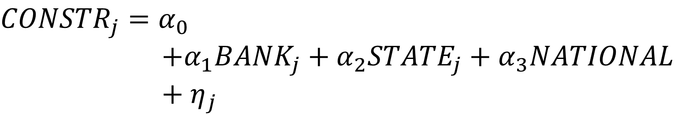
Real Effect
4
Estimation Equation
$${CONSTR}_{j}=α_{0}$$
$$+α_{1}{BANK}_{j}+α_{2}{STATE}_{j}+α_{3}NATIONAL$$
$+$ $η_{j}$
Change in commercial real estate loans by Japanese banks
Object of Interest
The ratio of nonperforming commercial real estate loans for all banks
Notes:
● 4 control variables for local demand conditions
→ Which other factors could have led to changes in construction activity in the CRE market?

Slide 21
Real Effect
4
Estimation Equation
$${CONSTR}_{j}=α_{0}+α_{1}{BANK}_{j}+α_{2}{STATE}_{j}+α_{3}NATIONAL$$
$+$ $η_{j}$
Change in commercial real estate loans held by all branches and subsidiaries of Japanese banks in state Object of Interest
The ratio of nonperforming commercial real estate loans for all domestically owned commercial banks plus foreign-owned bank affiliates in the state j
Notes:
Real Effects of Declines in Japanese Commercial Real Estate Lending
Dependent variable:
● Four alternative measures of construction activity (always on the state level)
○ value, number, and square footage of total new construction projects (per Capita)
● Annualized percentage change in employment in the construction industry
→ Heterogeneity of effects?

Slide 22
Real Effect
4
Estimation Equation
$${CONSTR}_{j}=α_{0}$$
$$+α_{1}{BANK}_{j}+α_{2}{STATE}_{j}+α_{3}NATIONAL$$
$+$ $η_{j}$
Vacancy rate
State’s population growth rate per year
Unemployment rate
Growth of state personal income per capita
Notes:
● 4 control variables for local demand conditions
→ Which other factors could have led to changes in construction activity in the CRE market?

Slide 23
Real Effect
4
Estimation Equation
$${CONSTR}_{j}=α_{0}$$
$$+α_{1}{BANK}_{j}+α_{2}{STATE}_{j}+α_{3}NATIONAL$$
$+$ $η_{j}$
Level of the Michigan consumer sentiment index
Interest rate of 30-year-fixed-mortgage
Annualized CPI inflation rate
Notes:
● 4 control variables for local demand conditions
→ Which other factors could have led to changes in construction activity in the CRE market?

Slide 24
Real Effect
4
Estimation Equation
$${CONSTR}_{j}=α_{0}+α_{1}{BANK}_{j}+α_{2}{STATE}_{j}+α_{3}NATIONAL$$
$+$ $η_{j}$
Change in commercial real estate loans held by all branches and subsidiaries of Japanese banks in state object of interest
! Change in lending by Japanese banks may reflect shocks to the demand as well as supply of real estate credit
Notes:
Real Effects of Declines in Japanese Commercial Real Estate Lending
Dependent variable:
● Four alternative measures of construction activity (always on the state level)
○ value, number, and square footage of total new construction projects (per Capita)
● Annualized percentage change in employment in the construction industry
→ Heterogeneity of effects?

Slide 25
Real Effect
4
Instrumental Variables
Change in commercial real estate loans held by all branches and subsidiaries of Japanese banks in state object of interest
Criteria: Variables reflecting loan supply effects emanating from Japan
      Average risk based capital ratio for Japanese parent bank (1)
      (0,1) dummy indicating the period for which data (1) is available
      Annualized percentage change in Japanese commercial and land prices
* Two lagged values each of a set of variables are included
Notes:
Real Effects of Declines in Japanese Commercial Real Estate Lending
Dependent variable:
● Four alternative measures of construction activity (always on the state level)
○ value, number, and square footage of total new construction projects (per Capita)
● Annualized percentage change in employment in the construction industry
→ Heterogeneity of effects?

Slide 26
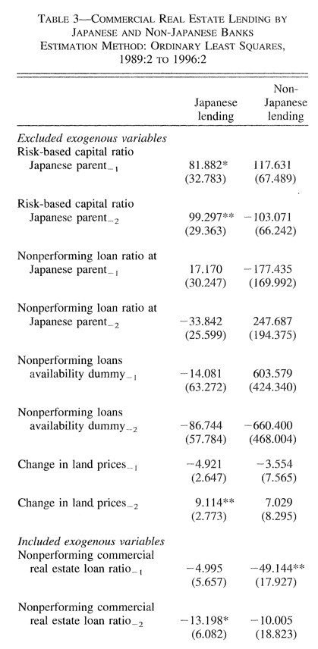
Real Effect
4
First Stage Regression

Slide 27
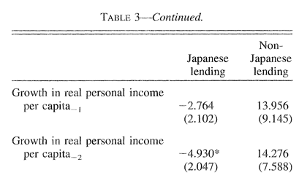
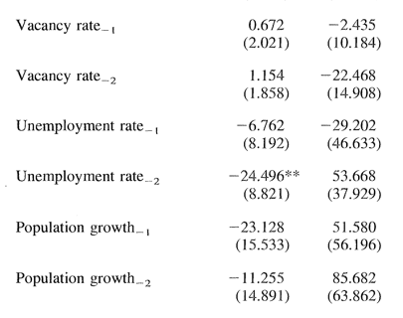
Real Effect
First Stage Least Squares
4

Slide 28
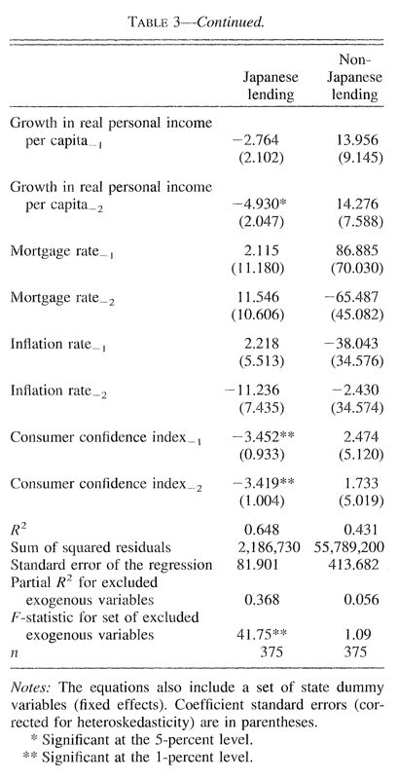
Real Effect
4
First Stage Least Squares: Relevance Test

Slide 29
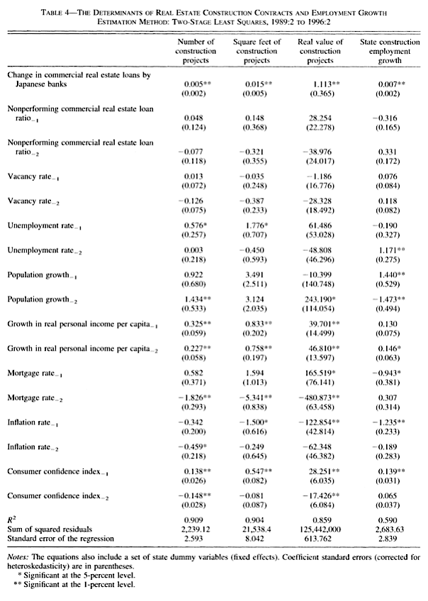
Real Effect
4
Second Stage Regression

Slide 30
Real Effect
4
Interpretation
 | Number of constr. projects | Square feet of constr. projects | Real value of constr. projects | State const. employmetgrowth
Change in commercial real estate loans by Japanese banks | 0.005*** (0.002) | 0.015** (0.005) | 1.113** (0.365) | 0.007** (0.002)
On average, one unit decrease in the commercial real estate loans by Japanese banks (divided by state population and the GDP investment structures price deflator) decreases number of construction projects in the that state by 0.005.
$100 decline in loans by Japanese banks operating in a given state corresponds with a decline of $111.30 in construction activity in that state.

Slide 31
Real Effect
4
Interpretation
 | Number of constr. projects | Square feet of constr. projects | Real value of constr. projects | State const. employmetgrowth
Change in commercial real estate loans by Japanese banks | 0.005*** (0.002) | 0.015** (0.005) | 1.113** (0.365) | 0.007** (0.002)
$100 decline in loans by Japanese banks operating in a given state corresponds with a decline of $111.30 in construction activity in that state

Slide 32
Real Effect
4
Results
2SLS: Two-Stage-Least-Square Estimation
If endogeneity exits
Explanatory Variable
Relevenace
Exogeneity
Dependent Variable
Instrument
Relevance:
F-Statistic = 41.725 > 10 → indicates that hypothesis, that the loan supply effects are zero can be rejected
Instruments seems to be relevant
Exogeneity:
Estimation shows that Japanese-related instruments are not correlated with CRE lending by non-Japanese banks.
F-statistic of change in CRE loans held by non-Japanese banks are not significant on Japanese-related instruments (F =1.09)
Notes:
Relevance:
○ F-Statistic = 41.725 > 10 → indicates that hypothesis, that the loan supply effects are zero can be rejected
○ Instruments seems to be relevant
Exogeneity?
● Estimation shows that Japanese-related instruments are not correlated with CRE lending by non-Japanese banks.
○ F-statistic of change in CRE loans held by non-Japanese banks are not significant on Japanese-related instruments (F =1.09)

Slide 33
Structure
Introduction and Overview
1
Sample, Data, and Limitation
2
Transmission: Methodology and Results
3
Real Effects: Methodology and Results
4
Conclusion
Conclusion
5

Slide 34
Study Questions
Introduction and Overview
Conclusion
1
5
1
Transmission
2
Real Effects
Sharp decrease in the equity and real estate prices in the early 1990s in Japan resulted in a decline in commercial lending by Japanese banks in the U.S.
Are stock market and real estate problems in Japan transmitted to the U.S. commercial real estate (CRE) markets in the form of reduced lending?
Did the reduction in Japanese lending have an effect on real activity in U.S. CRE markets?
This had significant effects on real economic activity in the U.S.

Slide 35
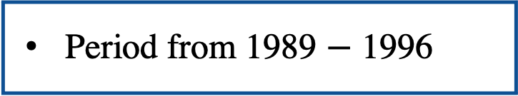
Limitations
Sample, data, and Limitation
Conclusion
2
5
Panel date set
Cross-Section
Time-Series
Semi-annual
Sample: 3 real-estate markets in the US; California, New York, and Illinois
5. Frequency
1. Not random
2. Sample Size
Period from 1989 $−$ 1996
6. Time-period
4. Non-performing loan rate
all large domestic banks with commercial real-estate loans in the portfolios and Japanese branches
3. Aggregation
Notes:
● Possible Shortcomes of the Paper:
○ Relatively small sample size
○ Non-performing loans are possibly underreported
Aggregation
○ Real estate loans are not disaggregated by type, so authors use total real estate loans
■ May be losing some of the idiosyncrasies in individual real estate sectors
○ Japanese branches in Los Angeles and San Francisco are consolidated into single California entity
● Sample size
○ 1989 to 1996 semiannually
○ Only 14 cross-sections
○ For example, the rate of non-performing loans may suffer from inaccuracy
● Ideal world
○ More cross sections:
■ Include more data from before 1989 (less ideal)
■ Increase frequency of measurement (monthly, if not daily)
● Sample is not random
○ Authors select the US states with the highest Japanese real estate market penetration
● Non-performing loan rate
○ Statistic was not reported until 1993
○ After 1993 tends to be underreported

Slide 36
Real Effect
4
Instrument
Peek and Rosengren included two lagged values each of a set of variables reflecting loan supply effects emanating from Japan.
Intuition:
Alternatives:
Notes:
Exogenous: lagged variables that reflect a loan supply effect
● Endogenous: loan supply shock
● Are the used instruments valid?
○ Instruments should be:
■ Relevant
● Problem occurs when instruments are only weakly correlated with the endogenous variable ("weak" instrument). This is usually checked by an F-test in the first stage of the 2SLS regression.
■ Exogenous
● Valid instrument correlates with endogenous variable and with dependent variable, but not the error term.
● IVs should be good to estimate the effect of the loan supply shock transmitted by Japanese banks to U.S. CRE loan markets but not for CRE loans by non-Japanese banks

Slide 37
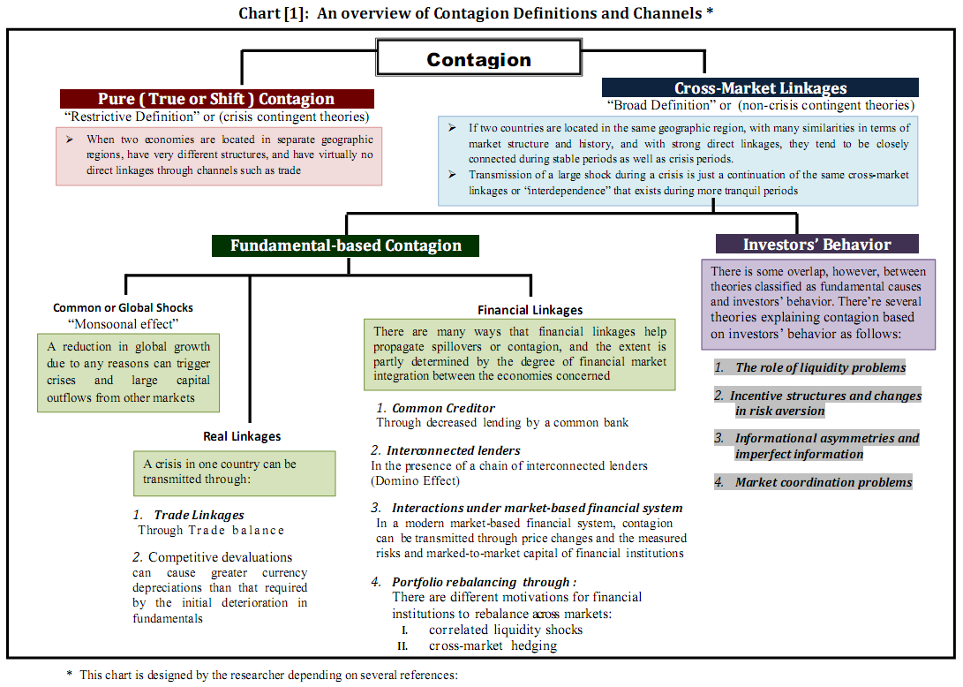
Alternative Methodologies
5
* This chart is designed by the researcher depending on several references:
Masson (1999), Calvo and Reinhart (1998), Kaminsky and Reinhart (1999), Forbes and Rigobon (2002), Dornbush, Park and Claessens (2000), Pritsker (2001), Moser (2003), Claessens and Forbes (2004), Cheung, Chi-sang , and Szeto (2009), and Hwang, Kim and In (2010)

Slide 38
Event Study Methodology
Estimation Window
Event Window
Post-Event Window
T₀
T₁
0
T₂
T₃

Slide 39
Collateral Damage: Effects of the Japanese Bank Crisis on Real Activity in the United States
By JOE PEEK AND ERIC S. ROSENGREN
Presented by
Mohamed Elshiekh Nargis Ahmadova
Empirical Banking and Finance
June 21st , 2022
Notes:
Published in March 2000 in The American Economic Review

Slide 40
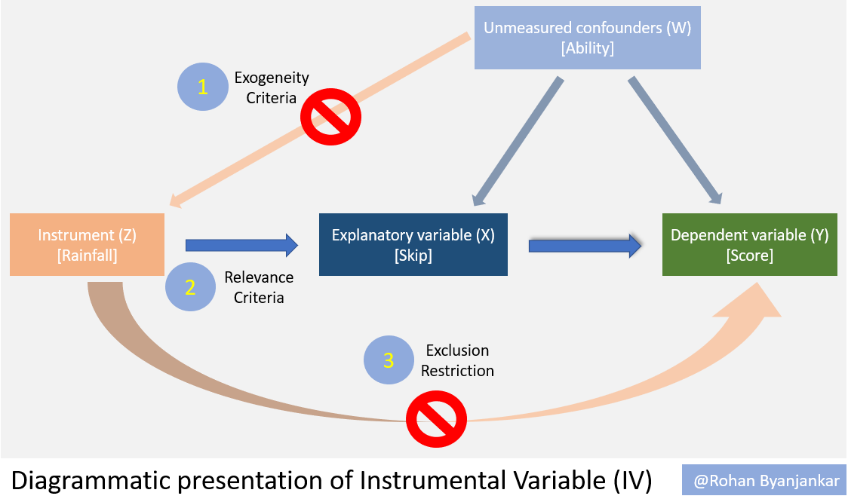
Real Effect
4
2SLS: Two-Stage-Least-Square Estimation
Notes:
Exogenous: lagged variables that reflect a loan supply effect
● Endogenous: loan supply shock
● Are the used instruments valid?
○ Instruments should be:
■ Relevant
● Problem occurs when instruments are only weakly correlated with the endogenous variable ("weak" instrument). This is usually checked by an F-test in the first stage of the 2SLS regression.
■ Exogenous
● Valid instrument correlates with endogenous variable and with dependent variable, but not the error term.
● IVs should be good to estimate the effect of the loan supply shock transmitted by Japanese banks to U.S. CRE loan markets but not for CRE loans by non-Japanese banks

