Slide 1
Studying Traffic Signs Classification Using PCA
Naveed Ahmed
Dept. of Engineering Cybernetics
NTNU, Trondheim

Slide 2
Objectives
Problem Statement
Apply Background Knowledge
Decide on Centering and Scaling
Perform a PCA
Find the latent variables
Are there any outliers?
Conclusion

Slide 3
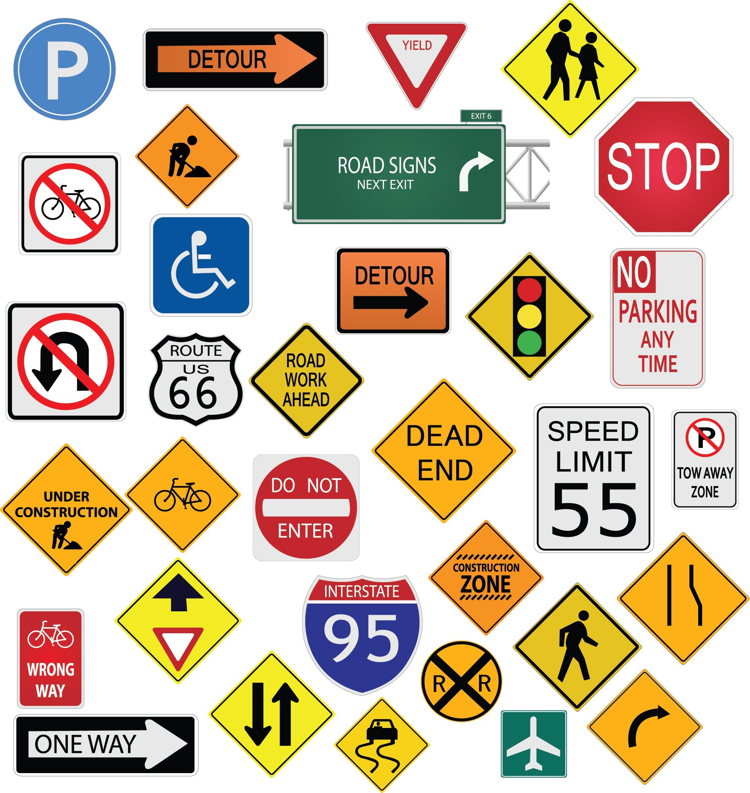
Problem Statement
Large number of Traffic Signs
Traffic Signs Identification Automation
Application in SDCs
Faster, Robust and Accurate!
Techniques
Image Processing Based
DL/ML/NN Based
Cybernetics Based
Inspired from MNIST/Fashion MNIST
A very small subset is analyzed for this course

Slide 4
About the Dataset
There is one directory for each of the 43 classes (0000 - 00042). Each directory contains the corresponding training images and one text file with annotations. Separate directory for testing dataset.
Image format and naming
The images are in PPM format (RGB color). Files are numbered in two parts: XXXXX_YYYYY.ppm
The first part, XXXXX, represents the track number. All images of one class with identical track numbers originate from one single physical traffic sign.
The second part, YYYYY, is a running number within the track. The temporal order of the images is preserved.
Classes Description shown in next slide.

Slide 5
Classes Description
Class ID | Class Description |  | Class ID | Class Description
0 | Speed limit (20km/h) |  | 22 | Bumpy road
1 | Speed limit (30km/h) |  | 23 | Slippery road
2 | Speed limit (50km/h) |  | 24 | Road narrows on the right
3 | Speed limit (60km/h) |  | 25 | Road work
4 | Speed limit (70km/h) |  | 26 | Traffic signals
5 | Speed limit (80km/h) |  | 27 | Pedestrians
6 | End of speed limit (80km/h) |  | 28 | Children crossing
7 | Speed limit (100km/h) |  | 29 | Bicycles crossing
8 | Speed limit (120km/h) |  | 30 | Beware of ice/snow
9 | No passing |  | 31 | Wild animals crossing
10 | No passing for vehicles over 3.5 metric tons |  | 32 | End of all speed and passing limits
11 | Right-of-way at the next intersection |  | 33 | Turn right ahead
12 | Priority road |  | 34 | Turn left ahead
13 | Yield |  | 35 | Ahead only
14 | Stop |  | 36 | Go straight or right
15 | No vehicles |  | 37 | Go straight or left
16 | Vehicles over 3.5 metric tons prohibited |  | 38 | Keep right
17 | No entry |  | 39 | Keep left
18 | General caution |  | 40 | Roundabout mandatory
19 | Dangerous curve to the left |  | 41 | End of no passing
20 | Dangerous curve to the right |  | 42 | End of no passing by vehicles over 3.5 metric tons
21 | Double curve

