Slide 1



RFI Monitoring in Support of Safety-Critical Multi-Band GNSS-based Systems
Aiden Morrison SINTEF Digital Trondheim, Norway aiden.morrison@sintef.no | Nadezda Sokolova SINTEF Digital Trondheim, Norway nadia.sokolova@sintef.no | Naveed Ahmed Department of Engineering Cybernetics, NTNU Trondheim, Norway naveed.ahmed@ntnu.no (Presenting Author)

Slide 2
Presentation Outline
Objective
Background and Motivation
GBAS Approach Service Types (GASTs)
System Design Overview
Experiment Scenarios
RFI Data Analysis
Proposed Design Improvments
Conclusion

Slide 3
Objective
Discuss the RFI monitoring module design
Discuss the system capabilities
Present the experimental work performed for system performance verification
Characterize the obtained results
Propose improvements in the current design

Slide 4
Background and Motivation
Q1) How often can we expect to encounter RFI in general?
Q2) How often can we expect to encounter RFI with specific spectral characteristics?
L1 only, L5 only, L1+L5 simultaneously, others
Q3) How are the power levels distributed?
Short range impact only, or wide area denial
Q4) Modulation characteristics
Narrowband, wideband (shaped noise, single-chirp, multi-chirp, etc.), continuous wave (CW)
An RFI monitoring setup helps to answer the above questions while
enhancing the resiliency of the system.

Slide 5

GBAS Approach Service Types (GASTs)
Single European Sky ATM* Research - Joint Undertaking (SESAR - JU) lays out the framework to define, develop and deploy the systems to increase ATM performance and build (Europe’s) intelligent air transport system keeping in view the safety, connectivity between cities/countries, climate change, innovation.
GSAT describes the level of service provided by a specific GBAS facility.
GSAT-D defines requirements for the single frequency augmentation
GSAT-F defines requirements for the dual frequency augmentation
GNSS Frequency Bands for GSAT-F
GPS : L1(1575.42 MHz) and L5(1176.45 MHz)
Galileo : E1(1575.42 MHz) and E5a(1176.45 MHz)
*ATM – Air Traffic Management
Notes:
What is GAST-C and GAST-D?
The GBAS Approach Service Type (GAST) is a nomenclature which describes the level of service provided by a specific GBAS facility. GAST-C and GAST-D define requirements based on single-frequency augmentation. GAST-C is intended to support precision approach operations in CAT-I minima and GAST-D for CAT-III minima. Note, a combination of factors determines the flight minimums authorized for a specific approach and aircraft.

Slide 6
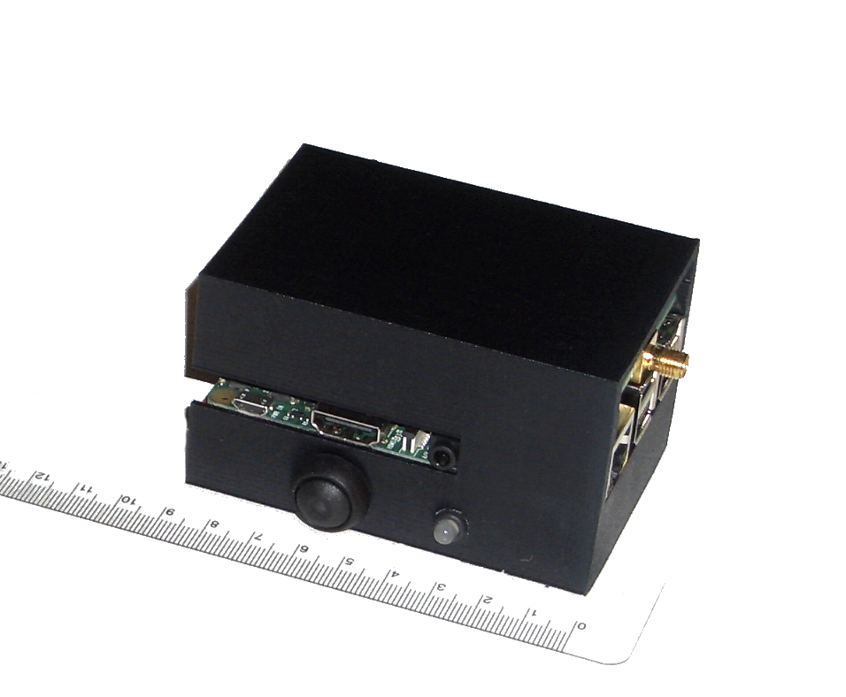
System Design Overview
Small and compact module
Needs only power and antenna connections
Embedded computer based on cheap Raspberry Pi 3 board
Raw RF samples are
Amplified using LNA
Filtered using BPF
Down-converted using Mixers
Digitized using FPGA I/O differential pair
Stored in the SD card
Raw files represent 21.6 or 24 MHz of spectrum
Packed to 1-bit quantization during collection and storage after which they are unpacked to standard 8-bit integers for post-processing.

Slide 7
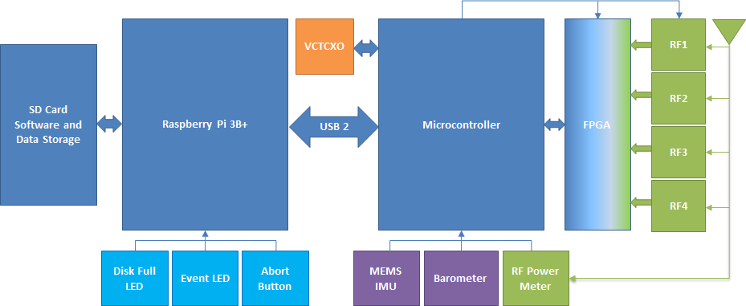





System Design
Color Coding
RF Elements
Digital
subsystems
User interface
elements
Voltage
Feedback
Controlled TCXO
Peripheral
MEMS Sensors
Direction of signal
processing flow
Notes:
RF blocks include LNA for amplification, band pass filters for rejecting out of band signals, splitters, and mixers for downconversion.
FPGA performs multiple tasks, such as
single bit quantization,
deriving multiple clocks from a single 24 MHz clock source,
selecting 2 channel or 4 channel operation,
selection of sampling rate,
packetizing 8 bit source width (four channels of I/Q at 1 bit quantization) to 16 bit words for handling by the system controller.
Microcontroller/system controller (Microchip PIC32 uc)
synchronizes the RF samples with secondary sensors
Time stamping the data coming from different sources
Monitoring software is running on the Raspberry pi 3 and saving the results in the attached SD card

Slide 8
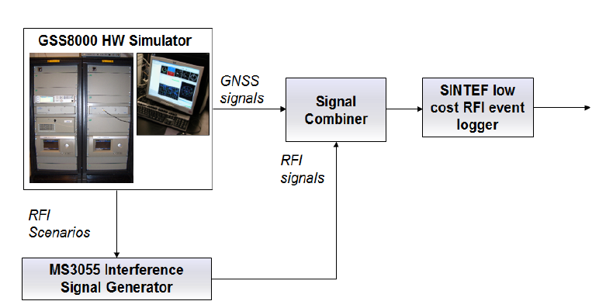

Experimental Setup (Simulated signals)

Slide 9







Experimental Setup (Live signals)
Test site using the developed RFI event logger
Vehicle borne jammer
Static jammer
Tests were carried out in a valley located outside the local urban center.
For tests, different types of jammers (chirp, pulsed, CW) were installed in the car.

Slide 10
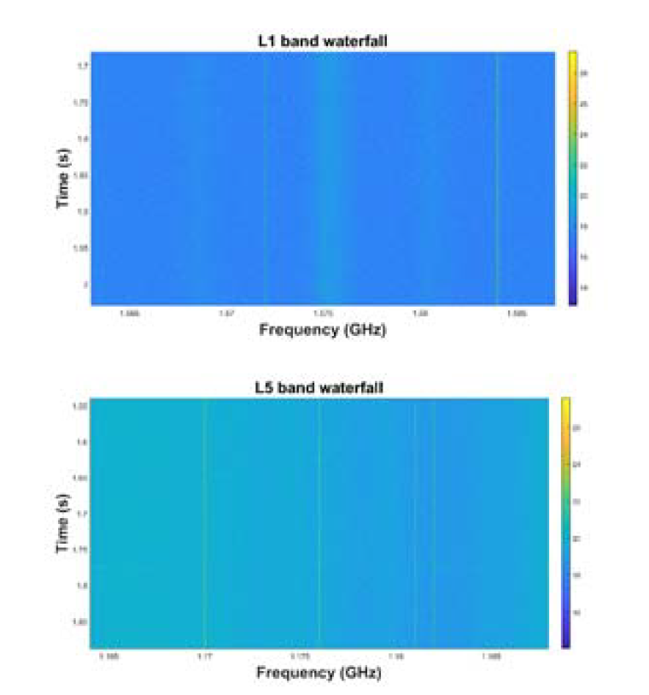
Experimental Results
Multiple events of 90 seconds are recorded and analyzed
RFI event logger stores data as 1 bit and for processing, the computer reads them as 8-bit integers
Graphical illustration using waterfall plot
Displays intensity of RF energy at each frequency level for the streaming 90s duration
Waterfall plot example of the GPS L1 and L5 bands in the absence of interference

Slide 11
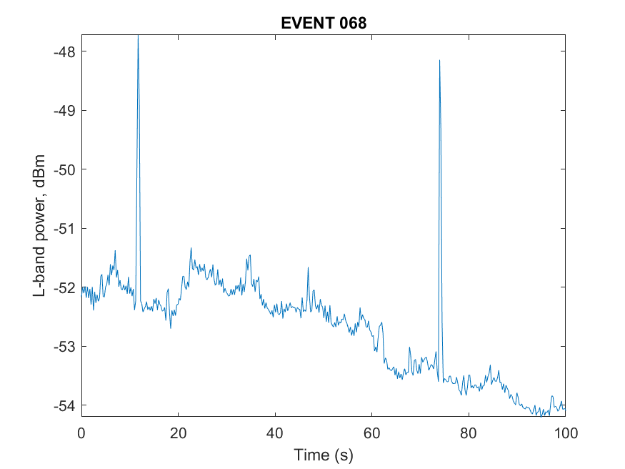
Analysis of waterfall plots
Power levels at the RFI Module’s input
Interference free
case
Random spikes
due to noise in
RF components
Spikes can be
detected and
removed by setting
a time based trigger
Able to acquire/track

Slide 12
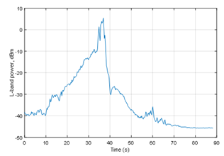
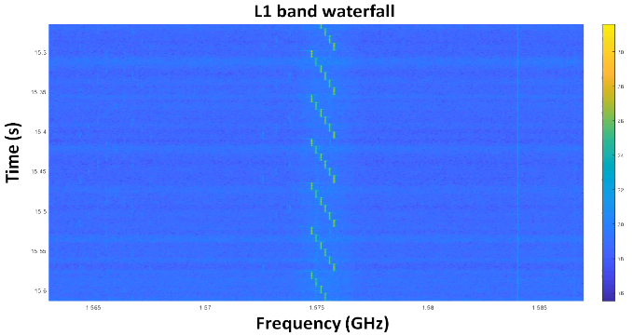
Analysis of waterfall plots
Power levels at the RFI Module’s input
Dynamic Stepped CW
jammer targeting L1
A series of linear chirps
Each sweep takes around 50 ms and spans a range of
about *** MHz
centered around L1
(1.575 GHz)

Slide 13
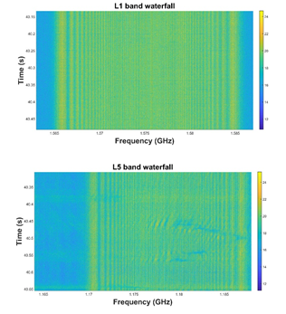
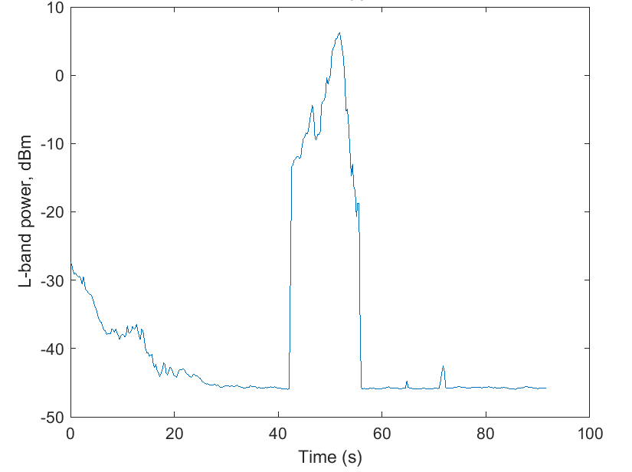
Analysis of waterfall plots
Power levels at the RFI Module’s input
Jamming impacting both
L1 and L5 signals
Impacted spectrum include
main lobes of both L1 and L5
Power Levels show the
power excursion are
longer than 3 seconds
(detection period of an
alarm)
Wideband pulse jammer
Unable to acquire/track
the satellites

Slide 14
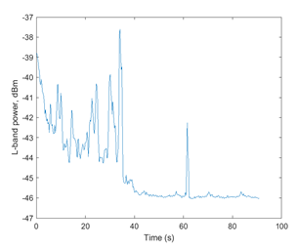
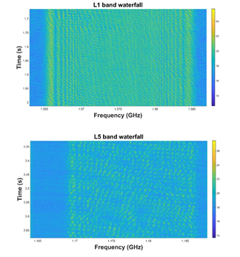
Analysis of waterfall plots
Power levels at the RFI Module’s input
Same scenario but RFI emitted is positioned at substantial distance from the RFI monitor
Abrupt pulsating variations due to unknown factors
Again L1 and L5 seem to be
affected but this time L5 does
not seem to be as adversely
affected as L1
Receiver might be able to
acquire/track the satellites

Slide 15
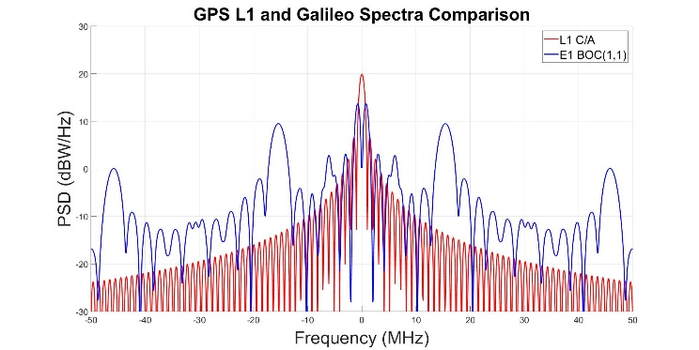
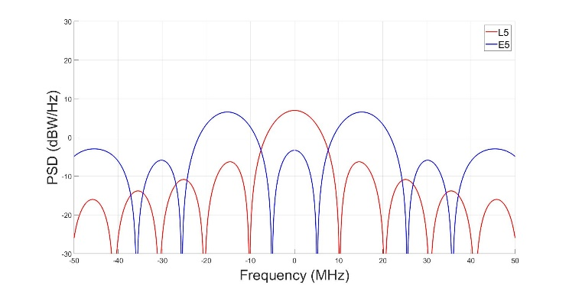
Effects of RFI on GPS and Galileo signals
Different Modulation Schemes used in GPS and Galileo
GPS : BPSK
Galileo : BOC(1,1), AltBOC
The spectrum of most of the interfering signals (Continuous Wave Interference (CWI)) are zero-centered
Zero Notch in Galileo E1 spectrum
Spacing between side lobes in Galileo E5 spectrum
Waterfall plots help in assessing the nature and extent of the effect on either GNSS signal

Slide 16
Single Bit Quantization Effects
Current design supports single bit quantization
The differential I/O pair of FPGA quantizes the down-converted GNSS signals
Advantages | Disadvantages
Simplifies the design | Reduces the available dynamic range
Does not require an external ADC | Output saturates during RFI
Works well under normal conditions | Design considerations for balanced power lines
Generally speaking, it is advised
to have 1 or 2 bits more than required in the RFI design to detect the RFI events without saturating the ADC.

Slide 17
Proposed Improvements in the future design
RF architecture changes
Mitigate the false alarm by having the low and high bands
Independent Power Meter
Band Selectivity using the SAW filter
Quantization and bandwidth changes
4-bit In-phase &Quadrature (I&Q) Quantization
Sampling Rate = 55 MHz
Accommodating Galileo E6 and Beidou B3 signals
Compute Platform and storage changes
To cater high BW requirement, quad core ARM based CPU with support for USB 3.0 (high speed/throughput) and PCI express based solid state storage devices
Notes:
W

Slide 18
Conclusion
Presented a brief design review of a low cost RFI event monitor/data logger
Discussed the tests (both in-lab(simulated signals) and out-of-lab(live signals)) performed in order to verify its performance
Analyzed the results using waterfall plots to characterize RFI signals
Proposed improvements in the future design

Slide 19
Thank you for your attention.
Q&A

