Slide 1

Impact of RFI on Receiver’s Front End
PhD Seminars in Radio Systems (TT8211)
Naveed Ahmed
PhD Candidate (Department of Engineering Cybernetics)

Slide 2
Overview
Goals of Navigation
Radio Spectrum Investigation
Unintentional Sources of RFI
Front End
Purpose in the GPS Receiver
Fully Functional FE
Effects of Interference on
LNA
Band Pass Filter
AGC/ADC
Conclusion

Slide 3
Goals of Navigation
A Navigation System should provide:
ACCURACY – Difference between estimated and actual PVT
INTEGRITY – Reliability of the measurement and alerting the user if it is not reliable
CONTINUITY – Uninterrupted provision of accurate results
AVAILABILITY – Duration of the time when the system gives PVT with desired Accuracy, Integrity and Continuity
Navigation
Accuracy
Integrity
Continuity
Availability
RFI affects one of our more goals!

Slide 4
Radio Spectrum Investigation
Applications that use near GPS/Galileo bands
Satellite Communication in L band
Terrestrial Applications in UHF band [0.3-3 GHz]
Cellular Communication (GSM1800)¹
Amateur radio (1240–1325 MHz)
Aircrafts surveillance such as DME & TACAN (960-1215 MHz)
Digital Audio/Radio Broadcasting (1452–1492 MHz)
GPS L1
1575.42 MHz
Galileo E1
GPS L2 – 1227.60 MHz
GPS L5
1176.45 MHz
Galileo E5a
DME/TACAN
Amateur Radio
DAB
GSM Uplink
GSM Downlink
1.000 1.050 1.100 1.150 1.200 1.250 1.300 1.350 1.400 1.450 1.500 1.550 1.600 1.650 1.700 1.750 1.800 1.850 1.900 1.950 (GHz)
¹Uplink - 1710.2 – 1784.8 Downlink - 1805.2 – 1879.8
Notes:
The harmonics of the bands and spectrum leakages due to substandard/outdated components usually become the cause of interference for the GPS/Galileo signals.
The DME/TACAN systems consist of an airborne interrogator and a ground-based transponder that emits high-power pulsed signals that constitute a threat to GNSS receivers.
DME and TACAN provide range measurements of the aircraft with respect to a ground reference station.

Slide 5
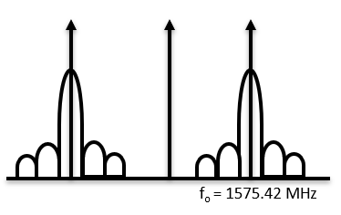
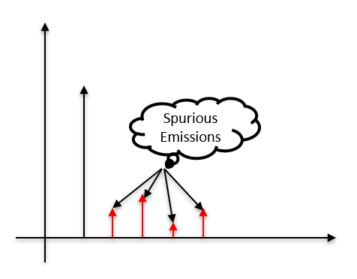
Unintentional Sources of RFI
Out of band Emissions/Interference
f_{int} < (f_{GNSS} − B_{GNSS}/2) or f_{int} > (f_{GNSS} + B_{GNSS}/2)
Higher order harmonics
Oscillations from repeater systems
Cell phone jammers
Some GSM jammers may contain GPS jammers too!
Bad FE LNA – to be discussed later
Notes:
Oscillation is a well known phenomenon that is observed when the repeaters are places very close to each other.
As a result the signals of one antenna is also picked by another antenna resulting in oscillations.
So, as a preventive measure repeaters should be places at adequate distances.

Slide 6
Purpose of FE
FE is the first and foremost block in the receiver architecture after antenna
Its purpose is to provide “proper signal” for acquisition/tracking.
Received signal is very weak, analog and/or noisy
An ideal FE should
Amplify the signal for processing
Filter out the signal to extract the useful signals
Down-convert the signal to intermediate frequency
Digitize/Sample the downconverted signals
Mitigate Multipath and interference (Not implemented in all FEs!)
Antenna discussion is out of scope because Antenna design is not job of GNSS engineers!

Slide 7
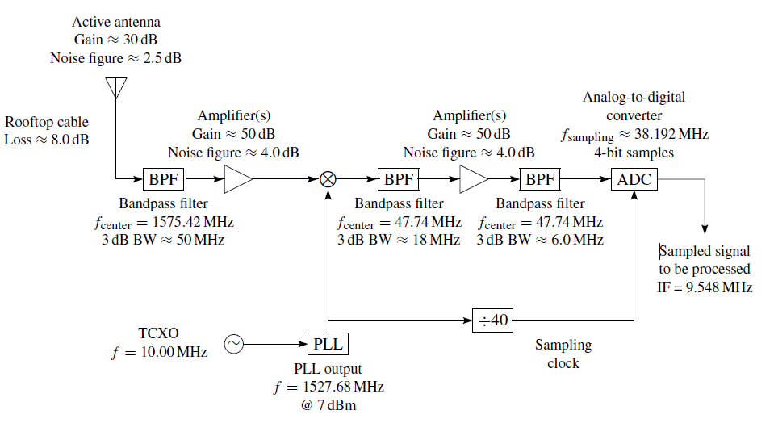
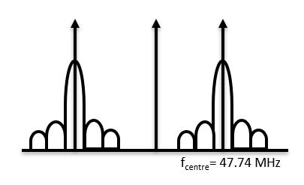
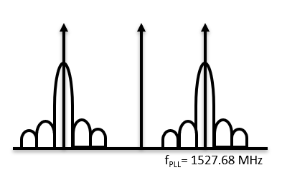
Fully Functional GPS L1 FE BD
Some high end FEs have AGC along with ADC
Notes:
Noise Figure (NF) or
Noise Factor (F) measures
degradation of SNR caused
by com ponents, defined as $F= \frac{{(SNR)}_{i}}{{(SNR)}_{o}}$
Friis Formula gives the

Slide 8
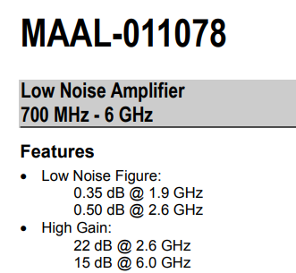
Pre-Amplification Using LNA
The received signal has power ~ -160dBW or 10⁻¹⁶ W
Signal must be amplified prior to downconversion
LNA amplifies the signal depending on the requirement
Typical LNA gain is around 20-35 dB
Characteristic of a good LNA
High Gain (>>1)
Low NF (≈1 or 0 dB)
Wideband (But it can also amplifies noise!)
Notes:
Noise Figure is a measure of degradation of SNR and for any component is defined as ratio of SNR at input to SNR at output

Slide 9
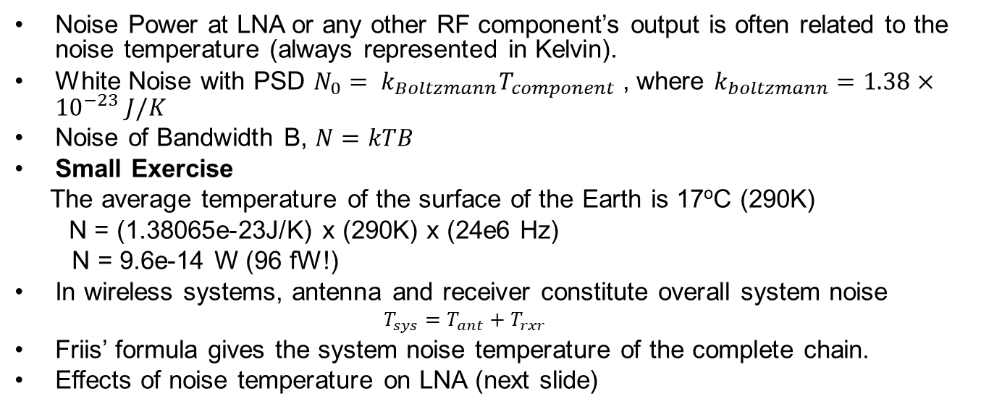
Noise Temperature
Noise Power at LNA or any other RF component’s output is often related to the noise temperature (always represented in Kelvin).
White Noise with PSD $N_{0}= k_{Boltzmann}T_{component}$ , where $k_{boltzmann}=1.38×{10}^{−23} J/K$
Noise of Bandwidth B, $N=kTB$
Small Exercise
The average temperature of the surface of the Earth is 17ºC (290K)
N = (1.38065e-23J/K) x (290K) x (24e6 Hz)
N = 9.6e-14 W (96 fW!)
In wireless systems, antenna and receiver constitute overall system noise
$$T_{sys}=T_{ant}+T_{rxr}$$
Friis’ formula gives the system noise temperature of the complete chain.
Effects of noise temperature on LNA (next slide)
Notes:
Ideally, white noise has infinite bandwidth but in practice, we consider it uniform desired range of frequency.
Friis formula takes into account the gains, NF and the noise temeperature of differenct components in the RF chain.

Slide 10
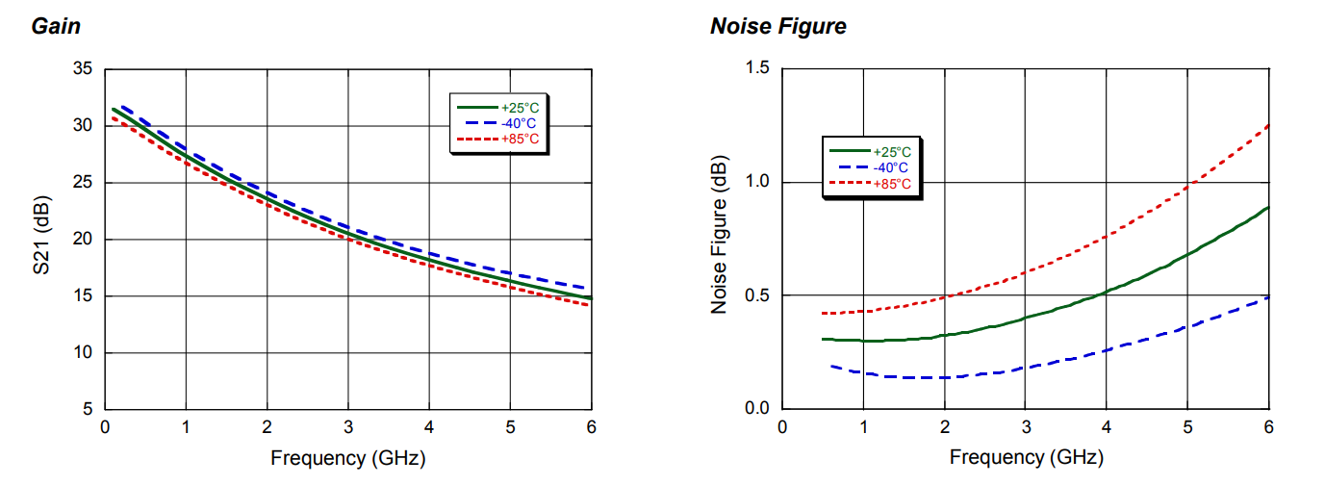
Effects of Noise (Temperature) on LNA
Performance Degradation at high temperatures.
Effects of noise and interfering signals
Notes:
S21 normally the transmission coefficient in the two port network, s11/s22 are reflection coefficients, whereas s12/s21 are transmission coefficients.

Slide 11
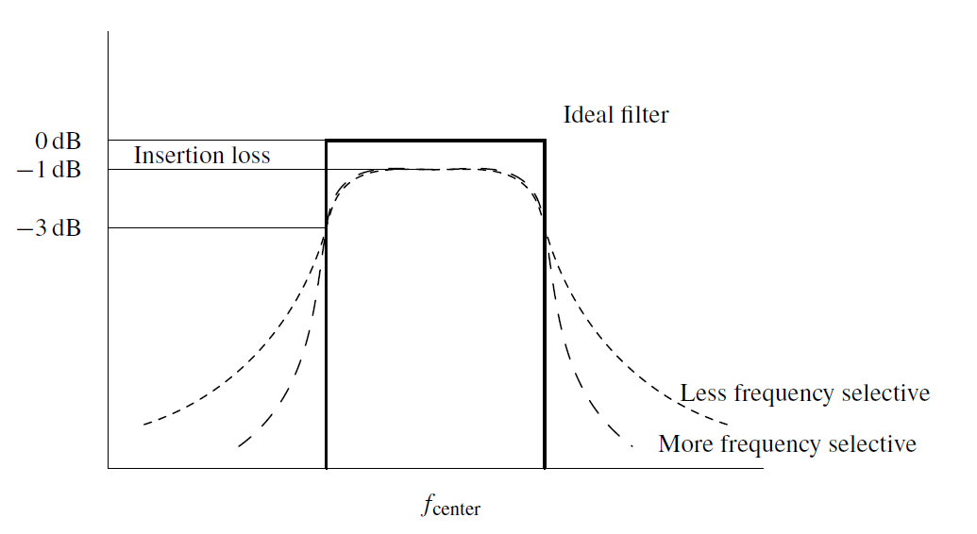
Effects on Bandpass Filter
Every FE manufacturer
designs filter differently,
resulting in differing roll-offs and consequently more or less entry of RFI signals.

Slide 12
AGC/ADCs in Front End Module
Digitize the down-converted signals for acquisition/tracking
Most of the FEs have 1-4 bits on chip ADC (works well in RFI-Free)
External ADCs also used in some cases
AGC adaptively controls the ADC Gain
Less bits
Advantage :
Fast Acquisition
Disadvantage
Prone to RFI (Discussed later)
More bits
Advantage
Immunity to RFI (Discussed later)
Disadvantage
Slow Acquisition
Front End Module | ADC Configuration
Zarlink GP2015 | 2-Bits (1-bit sign, 1-bit mag)
Maxim MAX2745 | 1-Bit
SiGe Semiconductor SE4110L | 2-Bits (1-bit sign, 1-bit mag)
NemeriX NJ1006 | 2-Bits (1-bit sign, 1-bit mag)
Texas Instruments TRF5101 | 4-Bits

Slide 13
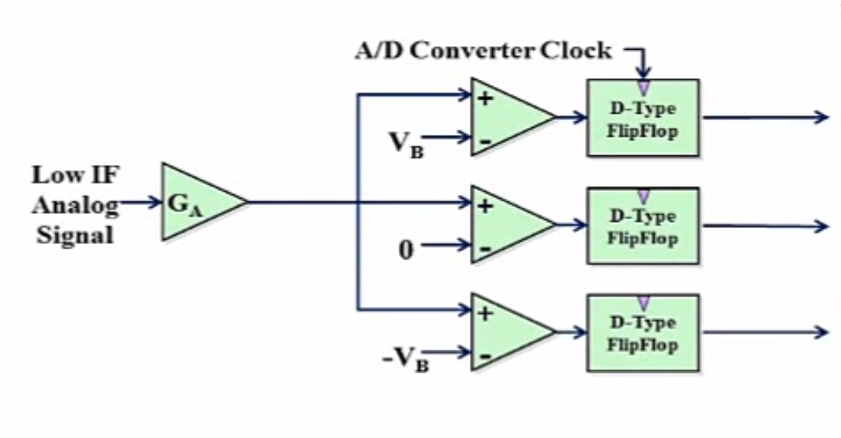
ADC without AGC
ADC Output :
No Interference
ADC Output :
Interference
0 | 1 | 0
1 | 1 | 0
0 | 0 | 1
0 | 0 | 0
1 | 0 | 1
1 | 0 | 0
1 | 1 | 1
1 | 1 | 1
1 | 1 | 1
1 | 1 | 0
1 | 1 | 1
1 | 1 | 1
Problem:
In case of interference, because of the empowering interference signal that is usually of higher power, the ADC tends to saturate making all the bits to 1.

Slide 14
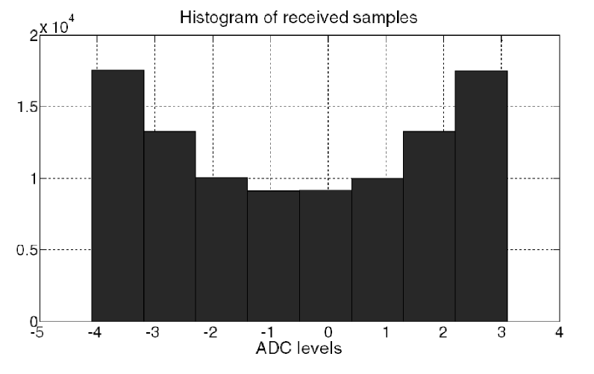
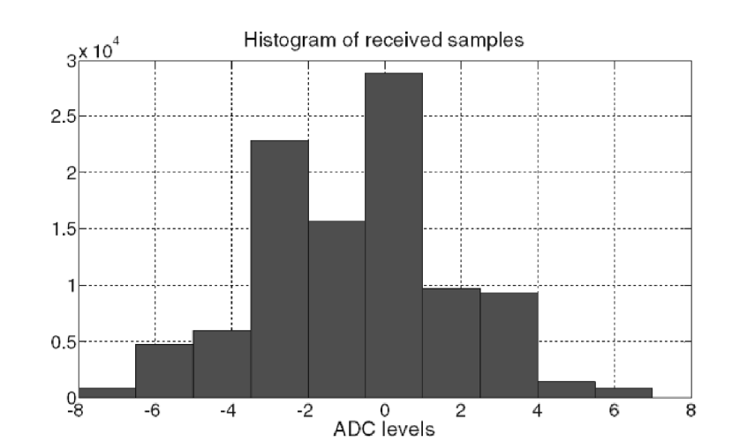
Statistical Distribution of ADC Samples
Without AGC (CW Present)
With AGC

Slide 15
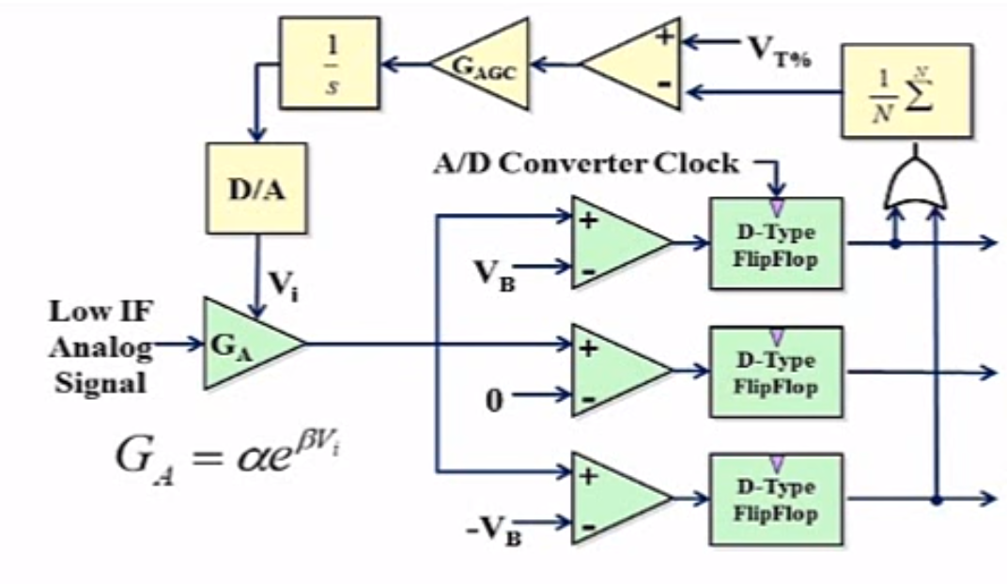
Adaptive ADC with AGC
Solutions:
Use more ADC bits – not a viable solution always
The final amplifier in many GNSS frontend
designs is a VGA with a
feedback signal resulting
from processing
implemented after the
ADC

Slide 16
Conclusion
Spectrum Investigation
Identification of RFI Sources
Front End Architecture
Effects of Interference
LNA
BPF
ADC

Slide 17
Thank you for your attention!
Questions?

Slide 18
Comments about the presentation
Add reference to the information/figures/plots
Include slide regarding types of interference
Next time…
Countermeasure techniqeus
Using sensors
Modification in current receiver design

