Slide 1

DigiSentiments
Team 2 - Tahiti
Jaime Bunay, Mohan Nilavar, Booker Sessoms

Slide 2




Project Goals
Develop a tool that can predict volatility for cryptocurrencies.
Analyze publications for sentiment analysis.
Use Machine Learning to make a prediction.

Slide 3
Our Approach
Track down historical crypto data.
Research crypto news outlets and Social Media
Use network specific meta as additional features for predictions( retweets / reddit comments )

Slide 4
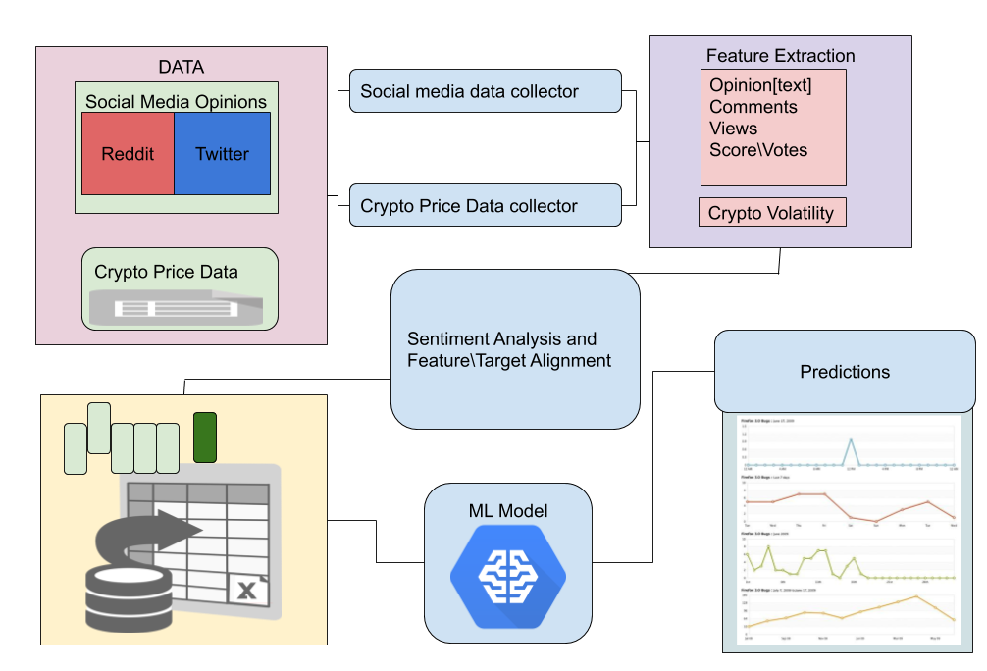

Slide 5







Data & APIs
NewsAPI
Crypto Control API
Crypto Sheets (Google/Sheets)
CryptoCompare
Reddit API
Praw API (Reddit Wrapper)
Twitter API
PushShift
GetOldTweets API/Command-Line

Slide 6
Data Exploration
Challenges:
Retrieving Historical Data
Quantity Limits
Using multiple APIs
Normalizing sentiments across social media platforms
Standardizing crypto volatility

Slide 7
Revised Approach
Using Reddit for our S.A. proved to be very complicated.
uncertainty on how to compute ( rich features, multilayered comments.)
Multiple APIs are needed to retrieve the data.
News Sentiments on crypto , though written by an individual, tend to be publisher biased .
The Twitter platform is much more straightforward
Simple feature set
Built in text size limitation
Straightforward API ( using only one. )

Slide 8
Model 1. Training:
LSTM Keras Sequential Model
30 Day Volatility as target.
Number of Units 20
Epochs 40
Batchsize 20

Slide 9
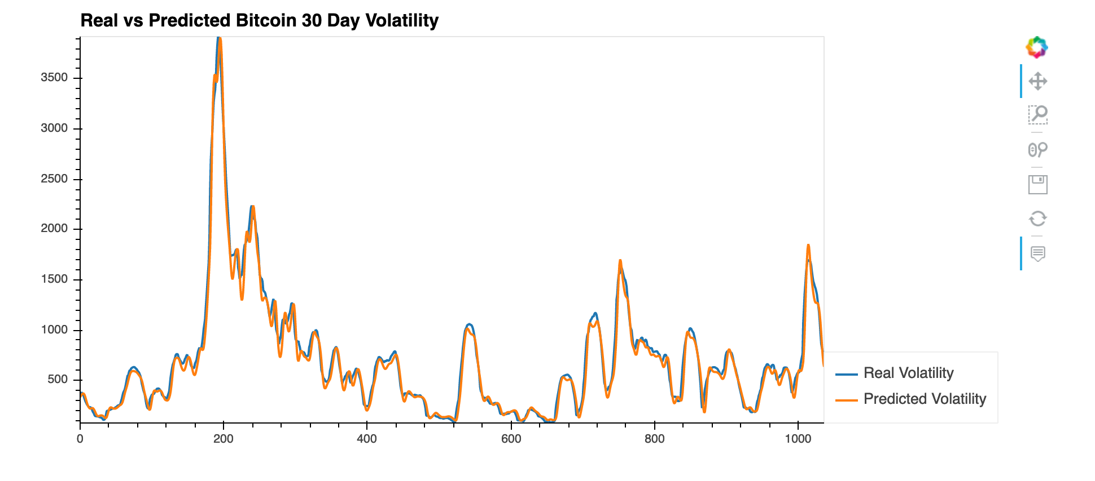
Model Evaluation with Training Data
LSTM Keras Tensorflow

Slide 10
Model 2. Training:
LSTM Keras Sequential Model
30 Day Rolling Volatility as target
Window Size 30
3 Feature Columns
5 Input Layers
300 epochs
Batchsize 30
.

Slide 11
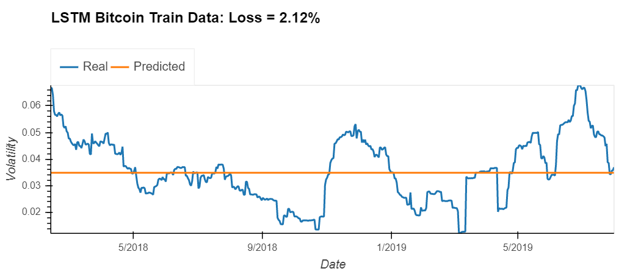
Model Evaluation with Training Data

Slide 12
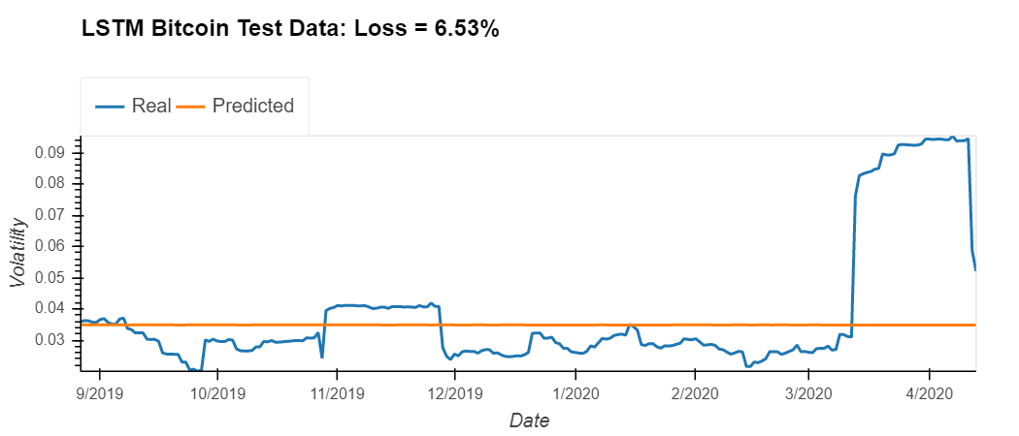
Model Evaluation with Test Data

Slide 13
Model 3. Training:
LSTM Keras Sequential Model
30 Day Rolling Volatility as target
Window Size = 1
3 Feature Columns
5 Input Layers
100 epochs
Batchsize 30
.

Slide 14
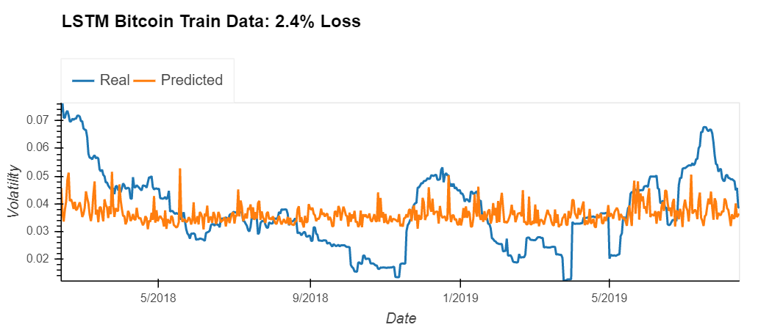
Model Evaluation with Training Data

Slide 15
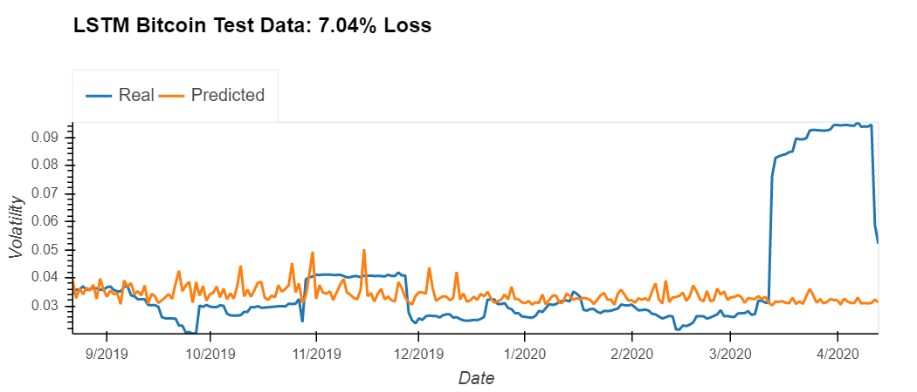
Model Evaluation with Test Data

Slide 16
Model 4 Training:
LSTM Keras Sequential Model
30 Day Rolling Volatility as target
Window Size = 15
3 Feature Columns
6 Input Layers
150 epochs
Batchsize 15
.

Slide 17
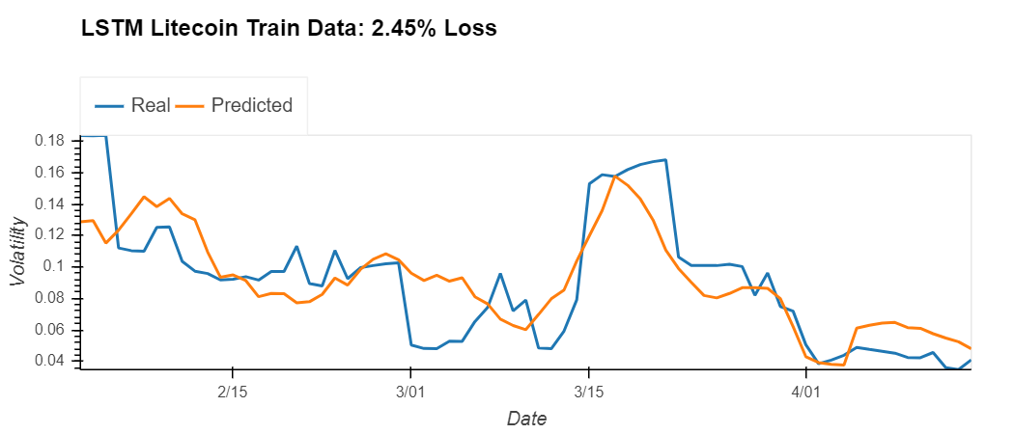
Model Evaluation with Training Data

Slide 18
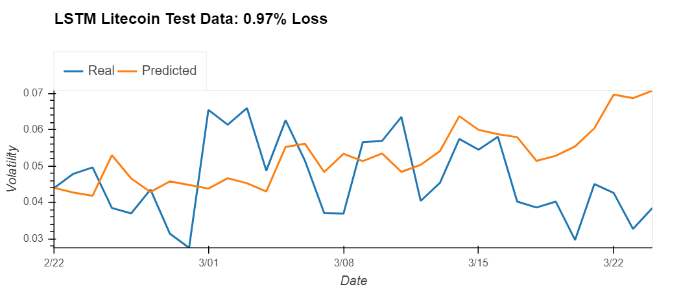
Model Evaluation with Test Data

Slide 19
Postmortem
Need sophisticated data collection scripts to hunt out and scrape the data for large scope projects.
Using sentiment as a secondary feature seems appropriate for stocks\securities.
There isn’t enough historical data available on cryptocurrency compared to stocks and/or securities.

Slide 20
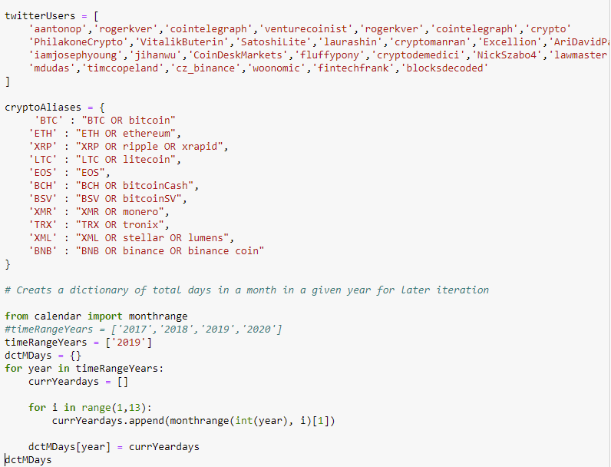
Data Gathering Challenges using free tools.
GetOldTweets.py part1

Slide 21
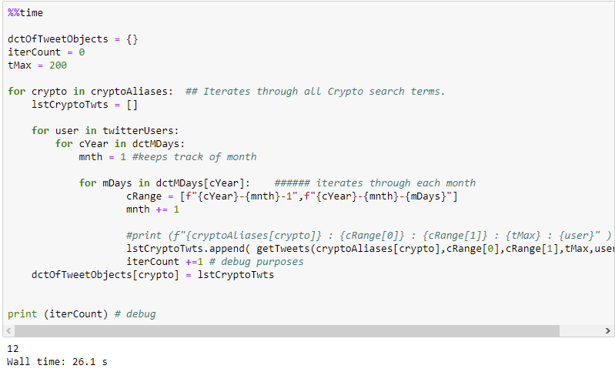
GetOldTweets.py part2

Slide 22
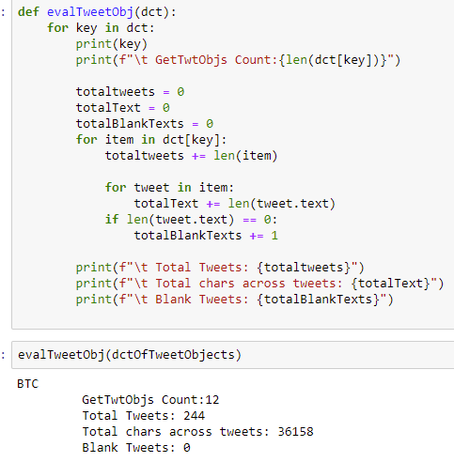
GetOldTweets.py part3

