Slide 1
11KCHBB APP
Use the app with confidence
B B
COMPANY
OPERATIONS
A practical guide for members, NCOs, squad leaders, officers, administrators and quartermasters.
Tutorial • August 2026

Slide 2
START HERE
02
The app is organised around four work hubs
Start with the hub that matches what you want to do.
1
2
3
4
HOME
PEOPLE
PROGRAMME
MANAGE
Priorities, notifications and quick actions
Members, awards, attendance and progress
Meetings, duties, resources and notices
Requests, stock, accounts and reports
The Senior / Junior switch stays at the top of navigation.
Only pages allowed for your role appear.

Slide 3
ACCOUNT SETUP
03
Sign in once, then secure your account
Temporary passwords are only for the first login.
1
Enter your email and temporary password
Use the details created by an administrator.
Good practice
• Sign out on shared devices
• Never share temporary or new passwords
• Contact an officer/admin if the wrong profile appears
2
Create a new private password
Choose at least 10 characters and do not share it.
3
Review your linked profile
Report incorrect details through a correction request.

Slide 4
NAVIGATION
04
Choose the section before you begin
The selected section controls the records and tools you see.
Senior
Junior
Desktop
Use the left sidebar and contextual tabs.
1
Select Senior or Junior
2
Open a work hub
Mobile
Use the five bottom buttons. Open More for secondary tools.
3
Choose the page from the top tabs

Slide 5
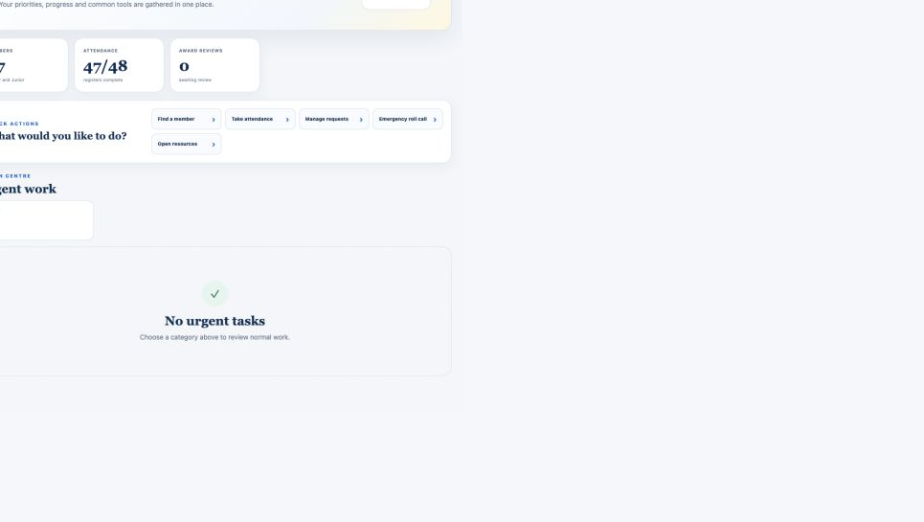
HOME
05
Home shows what needs your attention
Counts and tasks update automatically after work is completed.
Use Home to
• Open urgent tasks
• Read notifications
• Jump to common actions
• Open resources
Tip: a task disappears when the underlying work is completed.

Slide 6
MEMBERS
06
Members can track progress without changing official records
Your account only shows your own data and permitted resources.
MY PROGRESS
Attendance percentage and award status
MY REQUESTS
Award applications and uniform requests
MY ITEMS
Uniforms and awards issued to you
RESOURCES
Documents available to your role
Official records are read-only

Slide 7
NCO & SQUAD LEADER
07
Squad staff work within their assigned squad
The server blocks cross-squad access even if someone changes the URL.
Members
View and update the full details of assigned squad members.
Attendance
Take and correct attendance for the assigned squad.
Awards
View member awards and submit personal applications; no award editing.
Approvals
Review permitted squad work; final decisions stay with officers/admins.

Slide 8
ATTENDANCE
08
Complete each register in one clear pass
Future meetings never reduce a member’s attendance percentage.
1
Select the meeting
The nearest applicable meeting is selected automatically.
Attendance status
Filter and mark members
GREEN
YELLOW
2
Use squad search, Mark all present, or individual status buttons.
Completed
Needs attention
3
Check the summary
Green means complete; yellow means missing or incomplete details.

Slide 9
AWARDS
09
Every award follows a visible review trail
A submission starts In progress and updates the member’s matrix after a decision.
1
2
3
4
SUBMIT
›
REVIEW
›
DECIDE
›
AWARD
Member or NCO applies
Officer checks evidence
Approve or reject with notes
Matrix reflects final status
Administrators may archive or delete old submissions. Officers can edit a review result when needed.

Slide 10
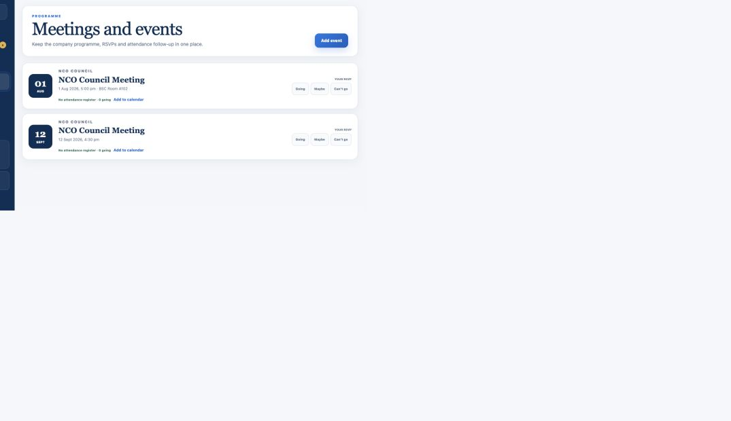
PROGRAMME
10
Programme keeps company activities in one place
Events, parade plans, duties, committees, resources and notices share the same hub.
Common actions
• RSVP to an event
• Add an event to your calendar
• View duty assignments
• Read resources and announcements

Slide 11
QUARTERMASTER
11
Uniform requests and stock use one connected flow
Every issue and return stays linked to a member and the audit history.
PENDING
APPROVED
READY
ISSUED
→
→
→
Review request
Reserve stock
Notify collection
Confirm handover
Use Stock Centre to search items, issue or return stock, review low stock and see member holdings.
Defective stock cannot be issued.

Slide 12
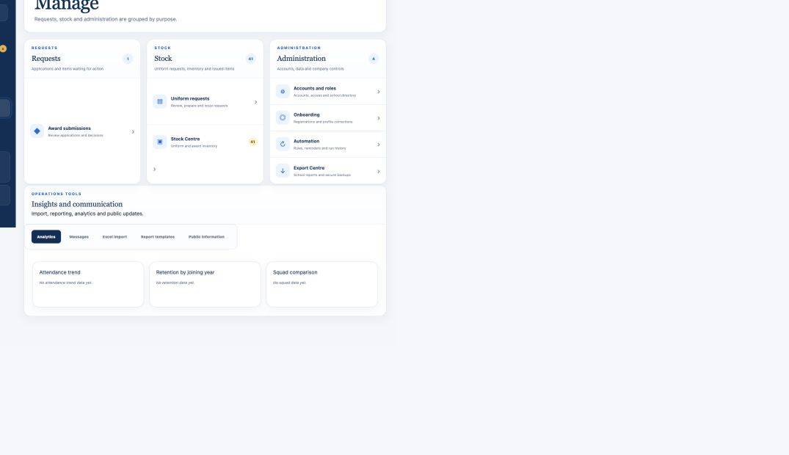
ADMINISTRATION
12
Admins control access without recreating accounts
Roles, squads, temporary access and custom permissions can be changed safely.
Admin checklist
1. Create or link the account
2. Assign role and squad
3. Add custom access only when needed
4. Set an expiry for temporary access
5. Confirm the success message

Slide 13
CONTROLS
13
Reports and audit tools keep work accountable
Exports follow permissions and record who created them.
EXPORT CENTRE
AUDIT HISTORY
AUTOMATION
School reports omit contact, parent and emergency details.
Shows who changed profiles, attendance, awards, roles and stock.
Creates reminders and action items—but never approves official decisions.
Before exporting, choose the correct section, school, squad and reporting year.

Slide 14
SAFE USE
14
The safest action is the one you can verify
Pause when the role, member, section or result does not look right.
DO
Read the success message before pressing again.
DO
Check Senior / Junior and the member or squad.
DO
Use correction requests for official profile errors.
DON’T
Share passwords, screenshots or exports unnecessarily.
When in doubt: stop, take a screenshot, and contact an officer or administrator.

Slide 15
YOU’RE READY
Five habits make the app easy
1
Choose the correct section
Need help?
2
Start from the right hub
Contact your officer or administrator with the page name and a screenshot.
3
Open only work assigned to your role
4
Wait for the success confirmation
5
Sign out on shared devices

