Slide 1


Unlock Hidden Value

Slide 2
Advantia Health
IMPACT CASE STUDY

Slide 3
The Challenge
THE CLIENT:
RELATIONSHIP VIA:
A Leading Healthcare Provider
Portfolio company of a leading healthcare-focused private equity firm
A fast-growing womens health platform backed by the private equity sponsor had expanded to more than 60 clinics but was still purchasing supplies and services in a highly decentralized manner. Disparate AP systems, fragmented vendor relationships, and limited procurement resources left nearly $19 million in spend unmanaged—constraining margins and operational efficiency targets.
Our Approach
• Conducted comprehensive spend analysis across 15 categories to identify high-impact opportunities • Led data-driven negotiations with incumbent suppliers to optimize existing relationships • Implemented competitive RFP processes where appropriate to secure best-in-class terms • Created a sustainable procurement governance model for ongoing category management

Slide 4
Key Levers
Value Delivered
Optimized existing supplier relationships by leading data-driven incumbent supplier negotiations
Employed competitive processes where appropriate to secure best-in-class commercial terms
Created a model to assess procurement synergies for ongoing and future M&A
$1.2M
in annual run-rate savings across 10 categories with 3x ROI on consulting fees
$1.2M
in annual run-rate savings
Our Differentiators
Optimized existing supplier relationships by leading data-driven incumbent supplier negotiations
Employed competitive processes where appropriate to secure best-in-class commercial terms
$300K

Slide 5
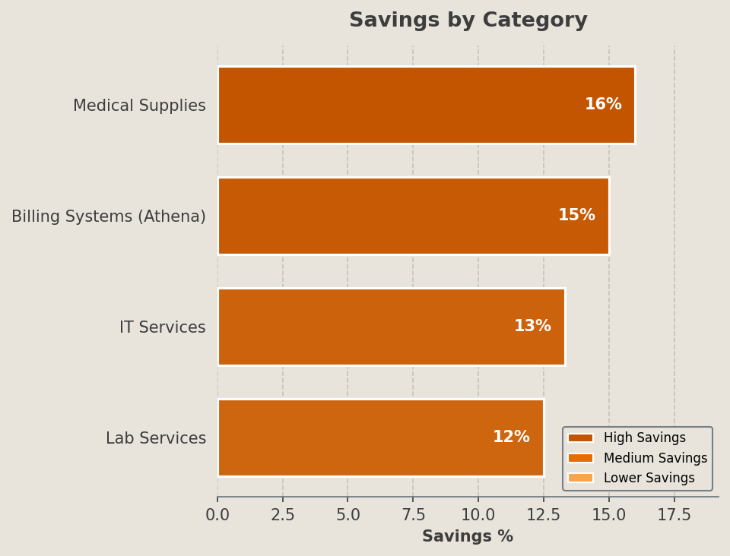
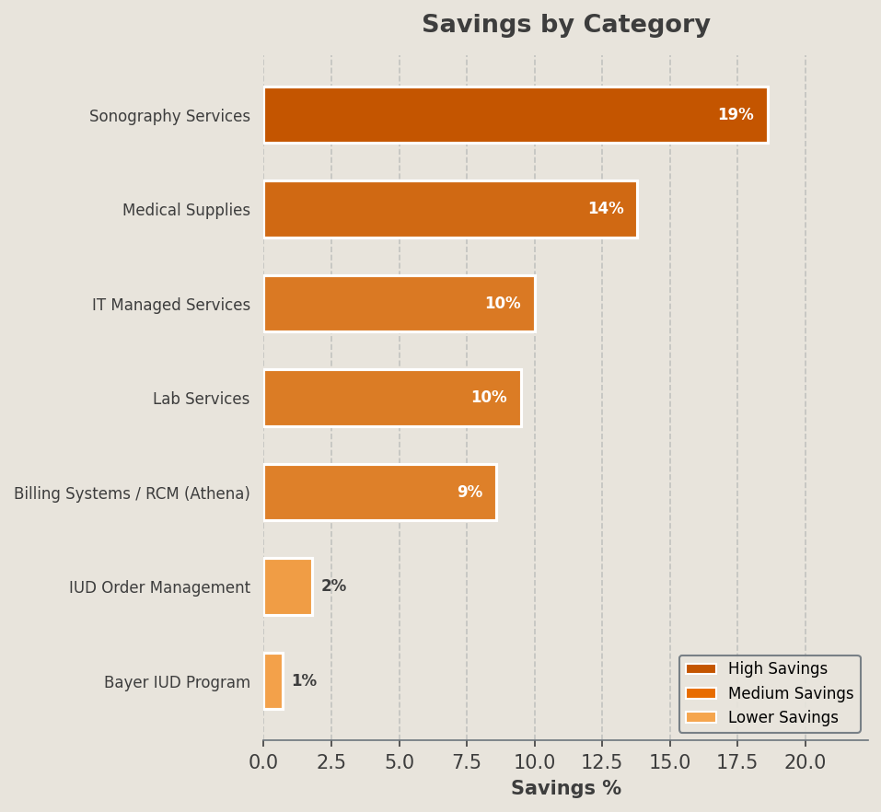
Selected Category Outcomes
Category | Incumbent Vendors | Awarded Vendors | % Savings | Key Lever(s)
Medical Supplies | Medline, Henry Schein | McKesson (consolidated) | 16.0% | Vendor consolidation, GPO pricing
Billing Systems (Athena) | Athenahealth | Athenahealth (renegotiated) | 15.0% | Benchmark renegotiation
IT Services | Multiple vendors | TechCorp | 13.3% | Competitive RFP
Lab Services | LabCorp | LabCorp (renegotiated) | 12.5% | BAFO rounds

