Slide 1


Unlock Hidden Value

Slide 2
Advantia Health
IMPACT CASE STUDY

Slide 3
The Challenge
THE CLIENT:
RELATIONSHIP VIA:
A Leading Healthcare Provider
Portfolio company of a leading healthcare-focused private equity firm
A fast-growing womens health platform backed by the private equity sponsor had expanded to more than 60 clinics but was still purchasing supplies and services in a highly decentralized manner.
Our Approach
• Conducted comprehensive spend analysis across 15 categories • Led data-driven negotiations with incumbent suppliers • Implemented competitive RFP processes where appropriate • Created a sustainable procurement governance model

Slide 4
Key Levers
Value Delivered
Optimized existing supplier relationships by leading data-driven incumbent supplier negotiations
Employed competitive processes where appropriate to secure best-in-class commercial terms
Created a model to assess procurement synergies for ongoing and future M&A
$716K
in annual run-rate savings across 7 categories with 3
$716K
in annual run-rate savings
Our Differentiators
Optimized existing supplier relationships by leading data-driven incumbent supplier negotiations
Employed competitive processes where appropriate to secure best-in-class commercial terms
$225K

Slide 5
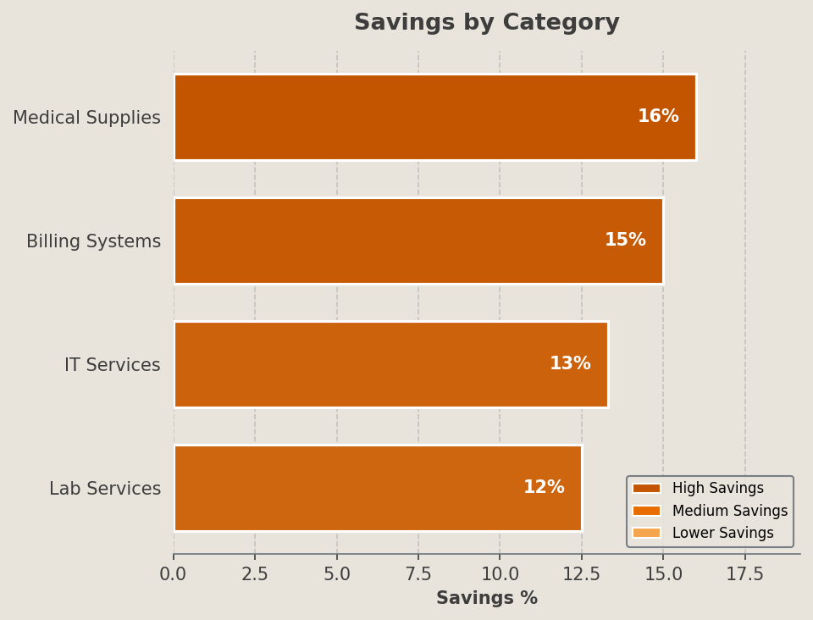
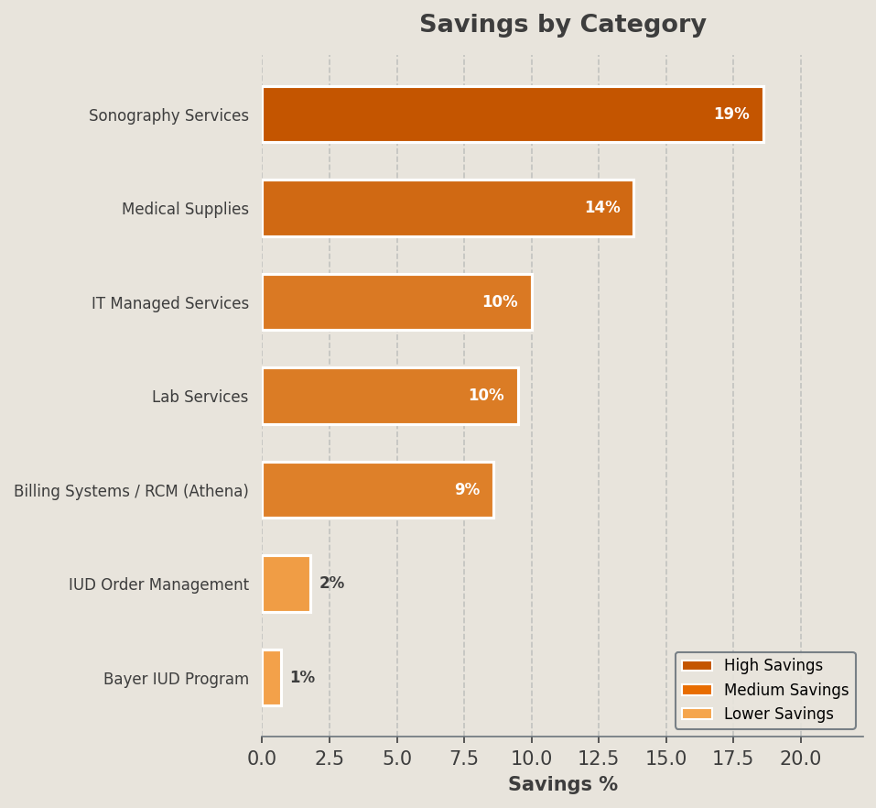
Selected Category Outcomes
Category | Incumbent Vendors | Awarded Vendors | % Savings | Key Lever(s)
Medical Supplies | Medline | McKesson | 16.0% | Consolidation
Billing Systems | Athena | Athena (renegotiated) | 15.0% | Renegotiation
IT Services | Multiple | TechCorp | 13.3% | RFP
Lab Services | LabCorp | LabCorp | 12.5% | BAFO

