Slide 1


Unlock Hidden Value

Slide 2
Advantia Health
IMPACT CASE STUDY

Slide 3
The Challenge
THE CLIENT:
RELATIONSHIP VIA:
A Leading Healthcare Provider
A leading healthcare-focused private equity firm
A fast-growing womens health platform had expanded to more than 60 clinics but was still purchasing in a decentralized manner.
Our Approach
• Spend analysis • Negotiations • RFP processes • Governance model

Slide 4
Key Levers
Value Delivered
Optimized existing supplier relationships by leading data-driven incumbent supplier negotiations
Employed competitive processes where appropriate to secure best-in-class commercial terms
Created a model to assess procurement synergies for ongoing and future M&A
$716K
in annual savings with 3
$716K
in annual run-rate savings
Our Differentiators
Optimized existing supplier relationships by leading data-driven incumbent supplier negotiations
Employed competitive processes where appropriate to secure best-in-class commercial terms
3.2x ROI

Slide 5
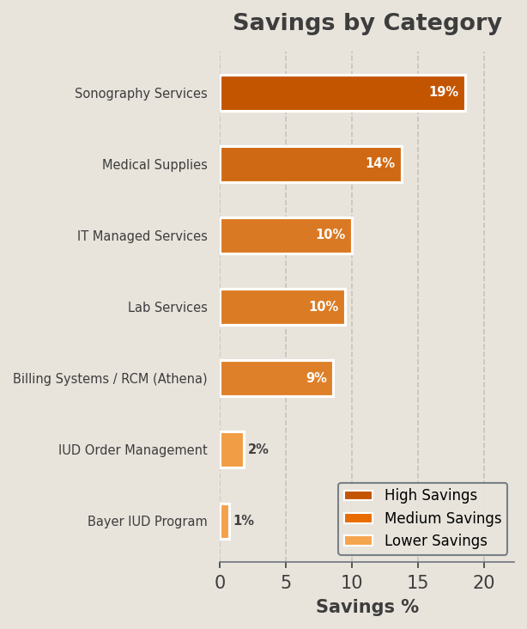
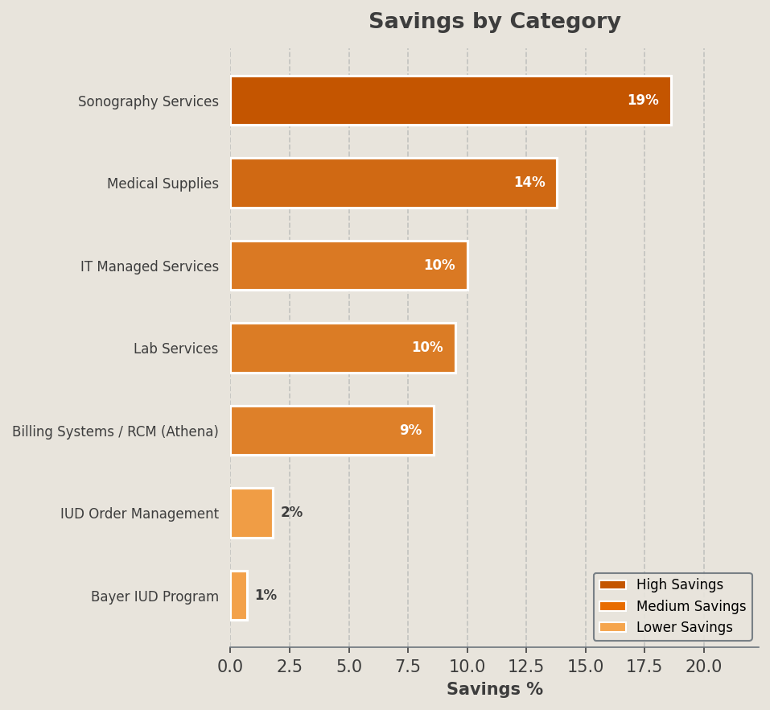
Selected Category Outcomes
Category | Incumbent Vendors | Awarded Vendors | % Savings | Key Lever(s)
Billing Systems / RCM (Athena) | Athenahealth | Athenahealth (renegotiated) | 8.6% | Renegotiation
Medical Supplies | Medline | McKesson | 13.8% | RFP
Sonography Services | IT Imaging | In-house | 18.6% | Make vs buy
IUD Order Management | Bayer | Bayer | 1.8% | Policy
Lab Services | LabCorp | LabCorp | 9.5% | BAFO
IT Managed Services | DAG Tech | Consolidated | 10.0% | RFP
Bayer IUD Program | Bayer | Bayer | 0.7% | Rebate

