Slide 1


Unlock Hidden Value

Slide 2
Advantia Health
IMPACT CASE STUDY

Slide 3
The Challenge
THE CLIENT:
RELATIONSHIP VIA:
A Leading Healthcare Provider
A leading healthcare-focused private equity firm
A fast-growing womens health platform had expanded to more than 60 clinics.
Our Approach
• Spend analysis • Negotiations • RFP processes • Governance model

Slide 4
Key Levers
Value Delivered
Optimized existing supplier relationships by leading data-driven incumbent supplier negotiations
Employed competitive processes where appropriate to secure best-in-class commercial terms
Created a model to assess procurement synergies for ongoing and future M&A
$716K
in annual savings with 3
$716K
in annual run-rate savings
Our Differentiators
Optimized existing supplier relationships by leading data-driven incumbent supplier negotiations
Employed competitive processes where appropriate to secure best-in-class commercial terms
3.2x ROI

Slide 5
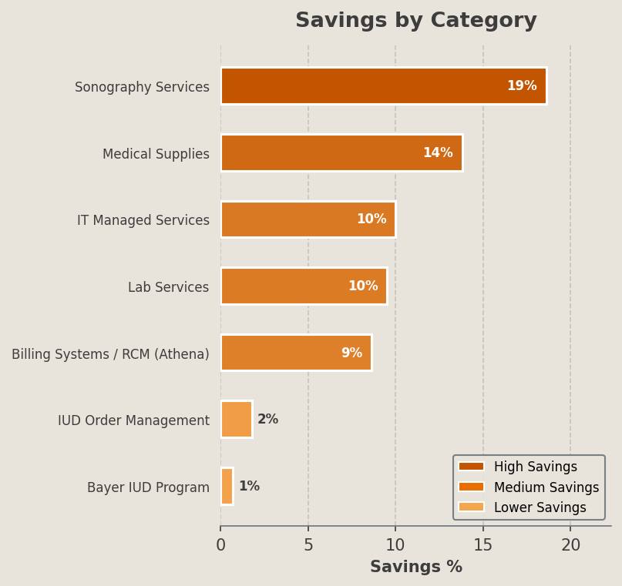
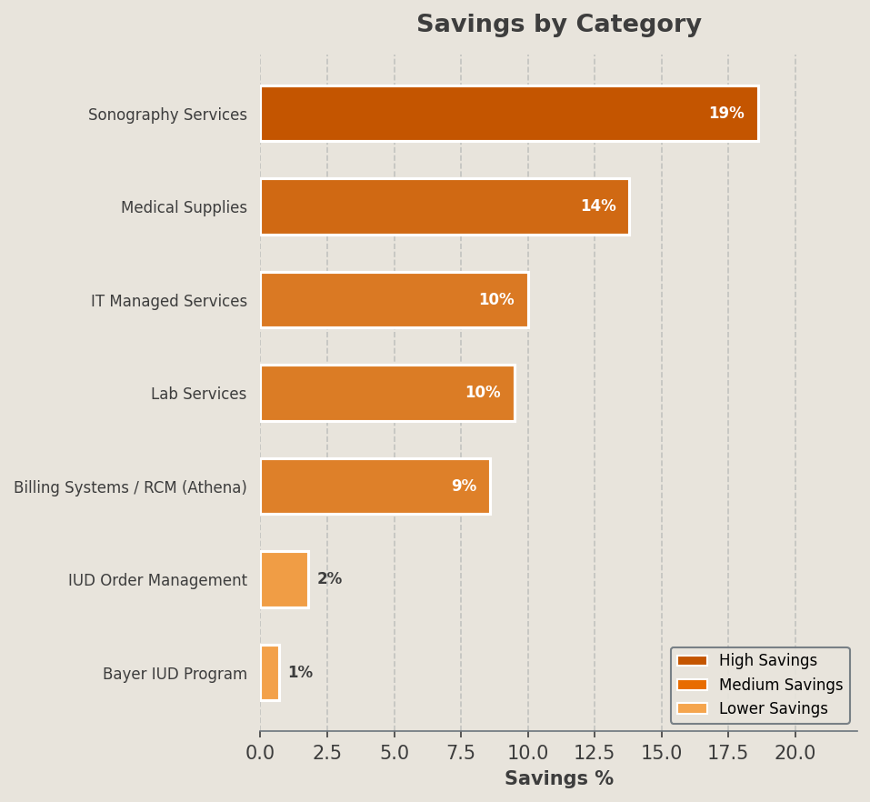
Selected Category Outcomes
Category | Incumbent Vendors | Awarded Vendors | Key Lever(s)
Billing Systems / RCM (Athena) | Athenahealth | Athenahealth (renegotiated) | Benchmark-driven renegotiation
Medical Supplies | Medline | McKesson | Competitive RFP
Sonography Services | IT Imaging | In-house | Make vs buy analysis
IUD Order Management | Bayer | Bayer | Policy enforcement
Lab Services | LabCorp | LabCorp | RFQ with BAFO
IT Managed Services | DAG Tech | Consolidated | Benchmarking, RFP
Bayer IUD Program | Bayer | Bayer | Supplier rebate

