Slide 1

CREDICARE :
Preventing Financial Distress Before It Becomes a Crisis
How banks identify early warning signs and help customers avoid debt, defaults, and financial exclusion.

Slide 2

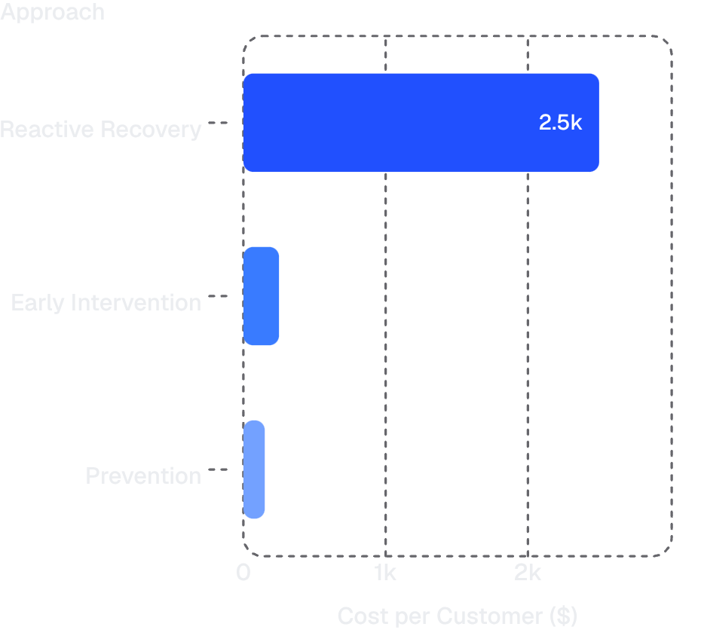
The Hidden Crisis: 90% Show Warning Signs 90 Days Early
Predictable, Not Inevitable
Most defaults are predictable — but banks react instead of prevent.
Reactive Recovery Costs More
Reactive recovery loses 40–60% of loan value after the fact.
Prevention costs 10x less than reactive recovery — the math is undeniable.
Early Intervention Works
Early action stabilizes 85% of at-risk customers before crisis hits.

Slide 3




Four Early Warning Signals
Spending Volatility
Savings Collapse
Sudden spikes in discretionary purchases signal loss of financial control.
Emergency fund depleting rapidly leaves customers dangerously exposed.
Debt Acceleration
Payment Stress
Multiple new borrowing requests in quick succession signal deepening stress.
Missed or late EMI payments are the clearest signal that crisis is near.

Slide 4
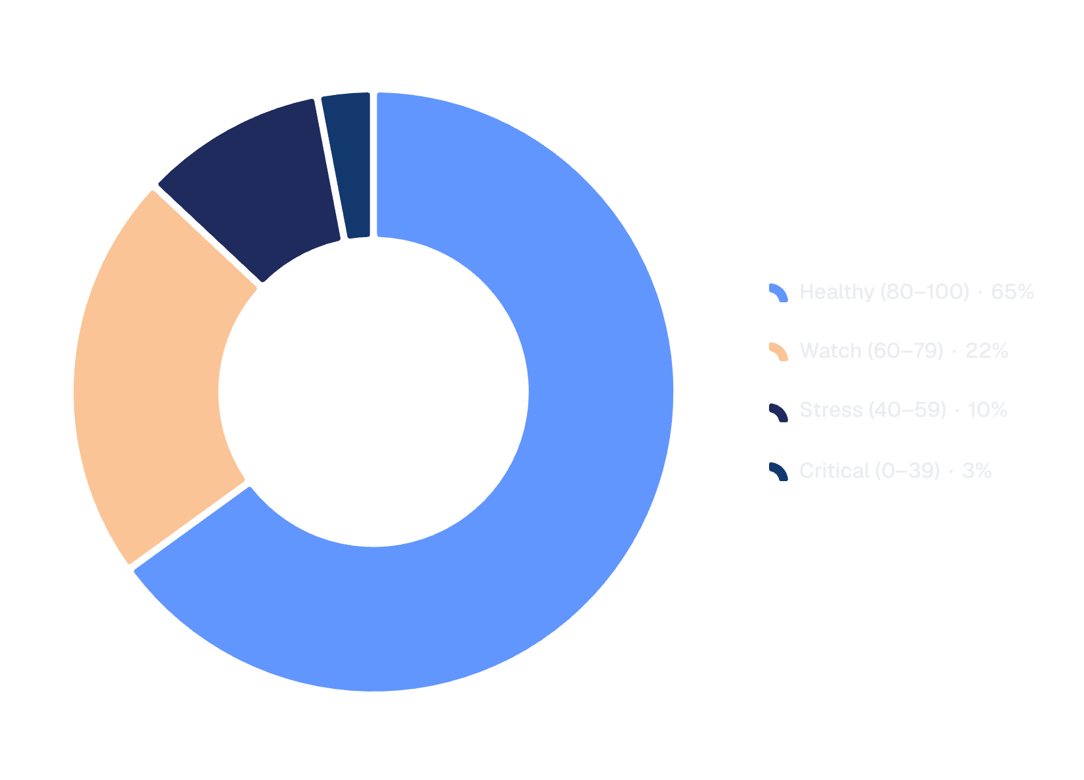

Financial Health Score: Real-Time Risk Detection
One Dashboard. Total Visibility.
The Financial Health Score tracks income, expenses, debt, and credit behavior in real time — giving banks and customers a unified picture of financial wellness.
A 90-day forecast catches problems before they compound.
Healthy 80–100
Watch 60–79
Stress 40–59
Critical 0–39
On track, low risk
Early drift detected
Intervention needed now
Crisis imminent

Slide 5
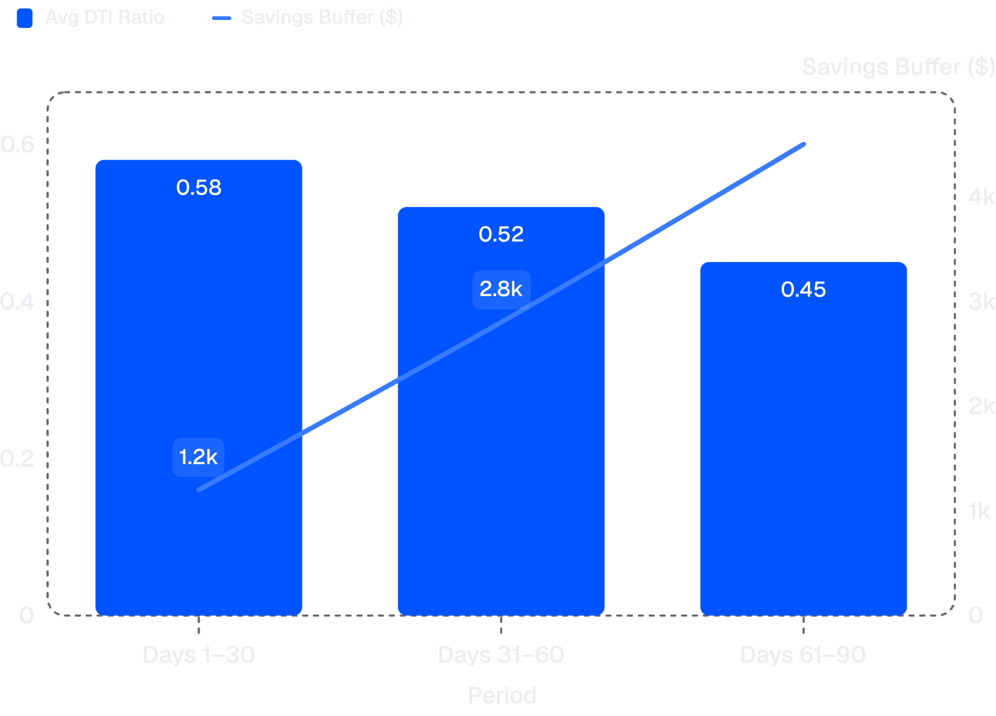
From "No" to "Ready": Personalized Roadmaps
Turning Rejection Into a Plan
The explainable readiness engine reveals the exact barriers holding customers back — high DTI, low savings, excess debt load — and converts them into actionable milestones.
30-60-90 day improvement milestones with measurable actions
Customers see the path to financial readiness, not just rejection
Every step is tracked, adjusted, and celebrated
Structured intervention shows measurable improvement across every 30-day window.

Slide 6

Invisible Expenses: ₹70K Annual Leak
₹43,800
Daily Coffee
₹120/day adds up to a staggering annual drain
₹8,388
Streaming Subs
₹699/month in subscriptions quietly compounds
₹18,000
Impulse Buys
₹1,500/month in unplanned purchases
₹70,188
Total Annual Leak
Enough to prevent one default entirely

Slide 7
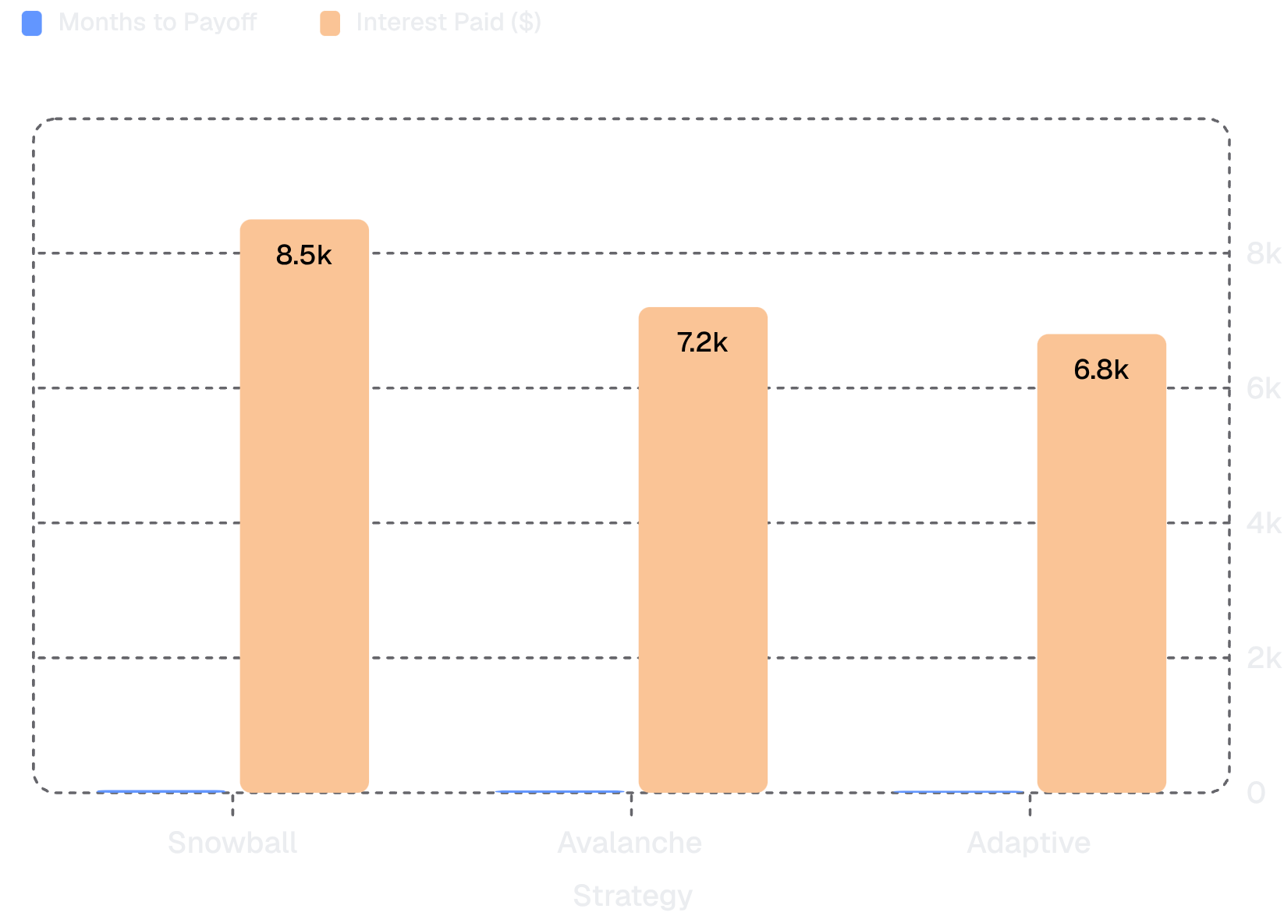

Adaptive Debt Recovery: 30 Months vs 40
Not All Payoff Plans Are Equal
❄️ Snowball
🏔️ Avalanche
40 months — High psychological wins, but slowest and most expensive overall.
35 months — Lowest interest cost, requires strict discipline to sustain.
⚡ Adaptive
30 months — Balances speed and sustainability. The clear winner.
Adaptive strategy reduces payoff time by 25% while keeping motivation intact.

Slide 8

What-If Simulation & Emergency Mode
Virtual Financial Twin
Emergency Stabilization Mode
Test any scenario in a risk-free environment before making real decisions:
When crisis strikes, a 48-hour survival plan activates instantly with optimized budget allocation:
"What if my income drops 20%?"
"Can I afford this purchase right now?"
"How does this loan affect my 90-day outlook?"
62%
23%
15%
Essentials
Debt Minimums
Flexible Spend

Slide 9



The Impact: Prevention Over Recovery
85%
60%
10x
Customers Stabilized
Loss Reduction
Cost Savings
At-risk customers who recover with early intervention
Loan value saved vs reactive recovery approach
Per customer through prevention vs recovery
Financial Inclusion
Customer Trust
Systemic Resilience
Customers avoid exclusion and build credit responsibly — turning crisis prevention into long-term opportunity.
Banks that prevent crises earn loyalty. Proactive care transforms transactional relationships into lifelong partnerships.
A portfolio of financially stable customers means lower NPAs, reduced provisions, and stronger institutional health.

Slide 10



The Path Forward: See Risk. Act Before Crisis.
Banks that shift from reactive recovery to predictive intervention build customer trust, enable financial stability, and create a safety net that catches people before they fall.
Nahulan Raja
Abhinav S
Yashwanth J
Next Steps: Turn Early Signals Into Lasting Stability
Detect risk early and intervene before distress escalates
Protect customer relationships with timely, personalized support
Reduce losses while building a more resilient loan portfolio
Let’s build a future where prevention becomes the default. Reach out to explore how early intervention can help your customers stay financially healthy and your institution stay stronger.

