Slide 1

CSE 830:
Design & Theory of Algorithms
Asymptotic Notation
Dr. Charles Ofria

Slide 2

The RAM Model
Notes:
Fixed time == 1 time unit.
Algorithms are so fundamental to computer science because they can be studied in a machine and language independent way.
Count steps.
Now, lets look at how we can use this.

Slide 3
The RAM Model
Each "simple" operation (+, -, =, if, call) takes 1 time step.
Loops and subroutine calls are not simple. They depend upon the size of the data and the contents of a subroutine.
Each memory access takes 1 step.
This model is the basis of Asymptotic Notation
Notes:
Fixed time == 1 time unit.
Algorithms are so fundamental to computer science because they can be studied in a machine and language independent way.
Count steps.
Now, lets look at how we can use this.

Slide 4
Insertion Sort
One way to sort an array of n elements is to start with empty list and then insert each element in the proper, ordered position:
    a₁ ≤ a₂ ≤ … ≤ a_{k} | a_{k+1} ≤ … ≤ a_{n}
At each stage, the inserted element leaves a sorted list, and after n insertions contains exactly the right elements. Thus the algorithm must be correct.
But how efficient is it?
Notes:
Insertion sort is an algorithm that you’ve all heard of… and most of you have probably written.
It provides a good example to analyze in more depth.

Slide 5

Measuring Time Complexity
Notes:
For most problems, even when you fix the number of inputs, there are simple instances and more challenging instances. For example, the Travalling Salesman Problem is normally a hard problem BUT if all of the cities fall in a straight line its easy!
So, for any algorithm we can consider three different functions to describe it:
Do we focus on the hardest instances?
Do we focus on the easiest instances?
or Do we average over all instances?
What are each of these like in practice?

Slide 6
Measuring Time Complexity
Best-case complexity is determined by the minimum number of steps taken on any instance of size n.
Notes:
For most problems, even when you fix the number of inputs, there are simple instances and more challenging instances. For example, the Travalling Salesman Problem is normally a hard problem BUT if all of the cities fall in a straight line its easy!
So, for any algorithm we can consider three different functions to describe it:
Do we focus on the hardest instances?
Do we focus on the easiest instances?
or Do we average over all instances?
What are each of these like in practice?

Slide 7
Measuring Time Complexity
Best-case complexity is determined by the minimum number of steps taken on any instance of size n.
Average-case complexity is determined by the average number of steps taken across all instances of size n.
Notes:
For most problems, even when you fix the number of inputs, there are simple instances and more challenging instances. For example, the Travalling Salesman Problem is normally a hard problem BUT if all of the cities fall in a straight line its easy!
So, for any algorithm we can consider three different functions to describe it:
Do we focus on the hardest instances?
Do we focus on the easiest instances?
or Do we average over all instances?
What are each of these like in practice?

Slide 8
Measuring Time Complexity
Best-case complexity is determined by the minimum number of steps taken on any instance of size n.
Average-case complexity is determined by the average number of steps taken across all instances of size n.
Worst-case complexity determined by the maximum number of steps taken on any instance of size n.
Notes:
For most problems, even when you fix the number of inputs, there are simple instances and more challenging instances. For example, the Travalling Salesman Problem is normally a hard problem BUT if all of the cities fall in a straight line its easy!
So, for any algorithm we can consider three different functions to describe it:
Do we focus on the hardest instances?
Do we focus on the easiest instances?
or Do we average over all instances?
What are each of these like in practice?

Slide 9
Measuring Time Complexity
Best-case complexity is determined by the minimum number of steps taken on any instance of size n.
Average-case complexity is determined by the average number of steps taken across all instances of size n.
Worst-case complexity determined by the maximum number of steps taken on any instance of size n.
Too easy to cheat!
Notes:
For most problems, even when you fix the number of inputs, there are simple instances and more challenging instances. For example, the Travalling Salesman Problem is normally a hard problem BUT if all of the cities fall in a straight line its easy!
So, for any algorithm we can consider three different functions to describe it:
Do we focus on the hardest instances?
Do we focus on the easiest instances?
or Do we average over all instances?
What are each of these like in practice?

Slide 10
Measuring Time Complexity
Best-case complexity is determined by the minimum number of steps taken on any instance of size n.
Average-case complexity is determined by the average number of steps taken across all instances of size n.
Worst-case complexity determined by the maximum number of steps taken on any instance of size n.
Too easy to cheat!
Too hard to calculate!*
*Usually
Notes:
For most problems, even when you fix the number of inputs, there are simple instances and more challenging instances. For example, the Travalling Salesman Problem is normally a hard problem BUT if all of the cities fall in a straight line its easy!
So, for any algorithm we can consider three different functions to describe it:
Do we focus on the hardest instances?
Do we focus on the easiest instances?
or Do we average over all instances?
What are each of these like in practice?

Slide 11

Measuring Time Complexity
Best-case complexity is determined by the minimum number of steps taken on any instance of size n.
Average-case complexity is determined by the average number of steps taken across all instances of size n.
Worst-case complexity determined by the maximum number of steps taken on any instance of size n.
Too easy to cheat!
Too hard to calculate!*
*Usually
Easy to calculate!* and gives guarantees
*Usually
Notes:
For most problems, even when you fix the number of inputs, there are simple instances and more challenging instances. For example, the Travalling Salesman Problem is normally a hard problem BUT if all of the cities fall in a straight line its easy!
So, for any algorithm we can consider three different functions to describe it:
Do we focus on the hardest instances?
Do we focus on the easiest instances?
or Do we average over all instances?
What are each of these like in practice?

Slide 12
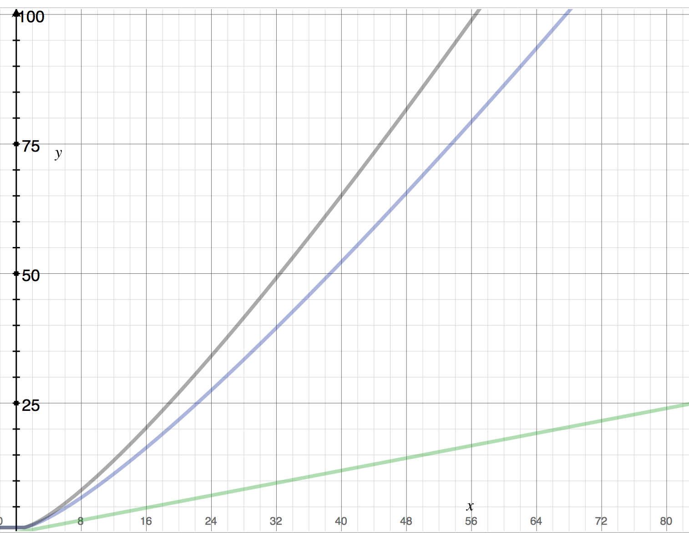
Worst Case
Average Case
Run time
Best Case
N
Notes:
Sweeping generalization:
For MOST algorithms Average case grows in a similar way to Worst case. As such, Worst case is fast to calculate AND provides useful information.
Let’s look at an example…

Slide 13
Exact Analysis
Count the number of times each line will be executed:
Num Exec.
for i = 2 to n (n-1) + 1
  key = A[i] n-1
  j = i - 1 n-1
  while j > 0 AND A[j] > key ?
    A[j+1] = A[j] ?
    j = j -1 ?
  A[j+1] = key n-1
Notes:
Let’s see if we can use the RAM model to figure out how long insertion sort takes.
[ quickly explain pseudo code ]
Now, how many times does each line run?
A single element is sorted on its own, so we start the loop at element 2.
We run the outer loop n-1 times, plus one extra test of the ”for” statement to identify that we’re done.
But how many times is the inner loop run? Let’s first simulate it to get some numbers…

Slide 14
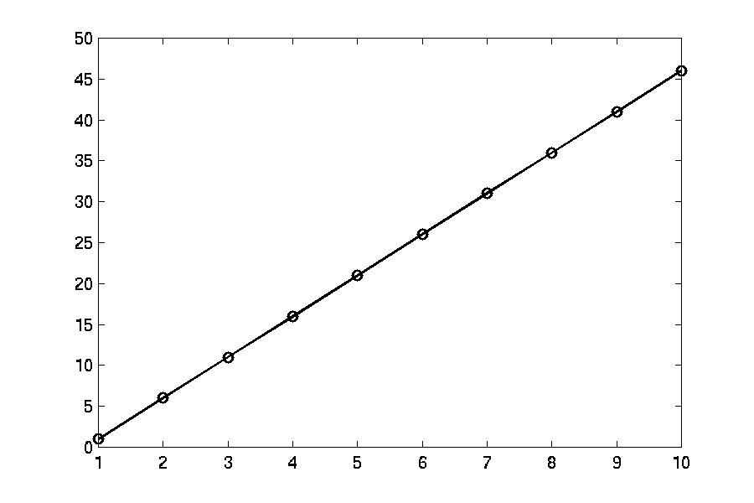
Best Case
Notes:
Best case is linear – when does it occur?
When the numbers are already sorted!

Slide 15
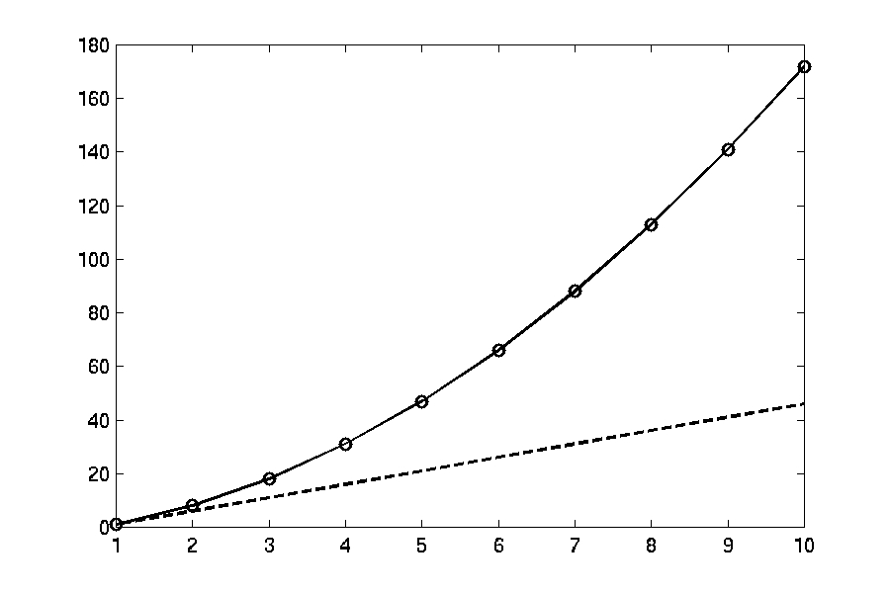
Worst Case
Notes:
When does worst case occur?
When reverse sorted!

Slide 16
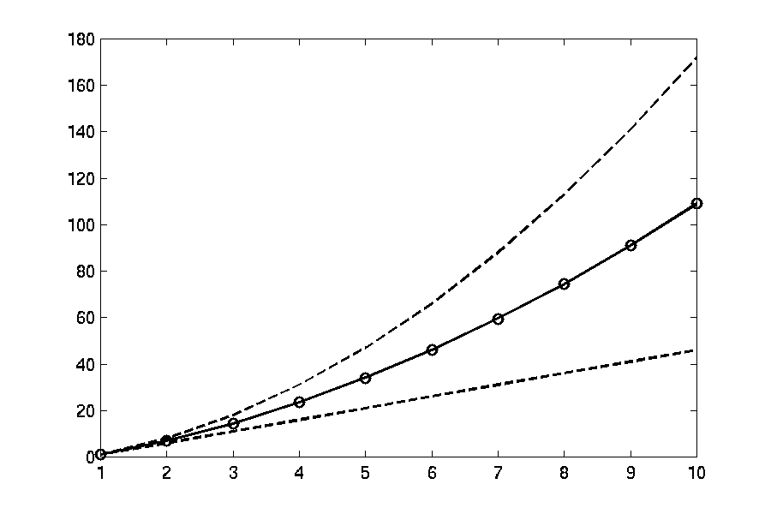
Average Case
Notes:
Average case can be calculated by brute force – we look at all of the possible combinations.
The average case looks to be right in between the others, but we’re working with small n. Perhaps if we zoom out…

Slide 17
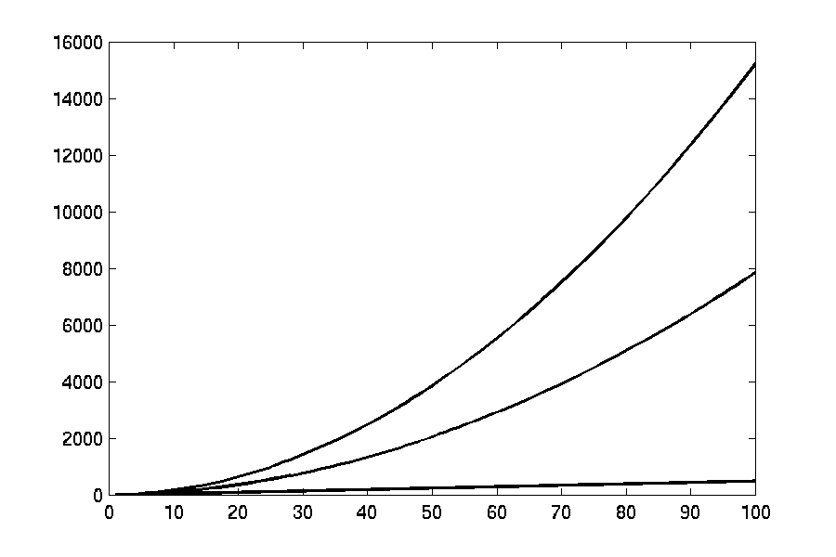
Average Case (Zoom Out)
Notes:
Now it’s more clear that the best case is really low, but the average case moves with the worst case.

Slide 18
1: for i = 2 to n
2: key = A[i]
3: j = i - 1
4: while j > 0 AND A[j] > key
5: A[j+1] = A[j]
6: j = j -1
7: A[j+1] = key
[3] [7] [4] [9] [4]
1: i = 3
2: key = 4
3: j = 2
4: (while true!)
5: A[3] = A[2]
[3] [7] [7] [9] [4]
6: j = 1
4: (while false!)
7: A[2] = 4
[3] [4] [7] [9] [4]
1: i = 4
2: key = 9
3: j = 3
4: (while false!)
7: A[4] = 9
[3] [4] [7] [9] [4]
1: i = 5
2: key = 4
3: j = 4
4: (while true!)
5: A[5] = A[4]
[3] [4] [7] [9] [9]
6: j = 3
4: (while true!)
5: A[4] = A[3]
[3] [4] [7] [7] [9]
6: j = 2
4: (while false!)
7: A[3] = 4
[3] [4] [4] [7] [9]
[3] [7] [4] [9] [4]
1: i = 2
2: key = 7
3: j = 1
4: ( while false! )
7: A[2] = 7
[3] [7] [4] [9] [4]
Notes:
Let’s get an intuitive feel for how this algorithm works.
[ I tend to go through this pretty quickly, or perhaps skip. ]

Slide 19
Analyzing Insertion Sort
Num Exec.
for i = 2 to n (n-1) + 1
  key = A[i] n-1
  j = i - 1 n-1
  while j > 0 AND A[j] > key n-1 to n(n-1)/2+n-1
    A[j+1] = A[j] 0 to n(n-1)/2
    j = j -1 0 to n(n-1)/2
  A[j+1] = key n-1
Worst Case Complexity: ³/₂n² + ⁷/₂n - 4
Notes:
With a bit more information, we can calculate the worst case complexity more exactly.

Slide 20
Divide & Conquer
Notes:
We are, of course, interested in building FAST algorithms. So let’s explore one powerful technique “Divide and Conquer”
Can we use this to speed up the times for Insertion sort?
What if we split the problem up into two groups, sorted each of them, and the merged the two sorted lists back together?
Since insertion sort grows with n^2, that means doing it twice, each on input half the size should take only half the time (n^2 / 4 + n^2 / 4)
Then merge is linear time.
Let’s look at this “Divided insertion sort” algorithm in practice.

Slide 21
Divide & Conquer
Divide the problem into smaller problems, often even if they are all the same.
Notes:
We are, of course, interested in building FAST algorithms. So let’s explore one powerful technique “Divide and Conquer”
Can we use this to speed up the times for Insertion sort?
What if we split the problem up into two groups, sorted each of them, and the merged the two sorted lists back together?
Since insertion sort grows with n^2, that means doing it twice, each on input half the size should take only half the time (n^2 / 4 + n^2 / 4)
Then merge is linear time.
Let’s look at this “Divided insertion sort” algorithm in practice.

Slide 22
Divide & Conquer
Divide the problem into smaller problems, often even if they are all the same.
Conquer the individual pieces, recursively if they are just smaller versions of the main problem.
Notes:
We are, of course, interested in building FAST algorithms. So let’s explore one powerful technique “Divide and Conquer”
Can we use this to speed up the times for Insertion sort?
What if we split the problem up into two groups, sorted each of them, and the merged the two sorted lists back together?
Since insertion sort grows with n^2, that means doing it twice, each on input half the size should take only half the time (n^2 / 4 + n^2 / 4)
Then merge is linear time.
Let’s look at this “Divided insertion sort” algorithm in practice.

Slide 23
Divide & Conquer
Divide the problem into smaller problems, often even if they are all the same.
Conquer the individual pieces, recursively if they are just smaller versions of the main problem.
Combine the results into a solution for the main problem.
Notes:
We are, of course, interested in building FAST algorithms. So let’s explore one powerful technique “Divide and Conquer”
Can we use this to speed up the times for Insertion sort?
What if we split the problem up into two groups, sorted each of them, and the merged the two sorted lists back together?
Since insertion sort grows with n^2, that means doing it twice, each on input half the size should take only half the time (n^2 / 4 + n^2 / 4)
Then merge is linear time.
Let’s look at this “Divided insertion sort” algorithm in practice.

Slide 24
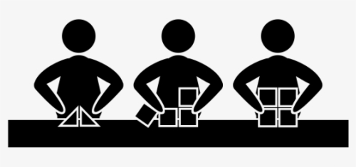
Divide & Conquer
Divide the problem into smaller problems, often even if they are all the same.
Conquer the individual pieces, recursively if they are just smaller versions of the main problem.
Combine the results into a solution for the main problem.
Notes:
We are, of course, interested in building FAST algorithms. So let’s explore one powerful technique “Divide and Conquer”
Can we use this to speed up the times for Insertion sort?
What if we split the problem up into two groups, sorted each of them, and the merged the two sorted lists back together?
Since insertion sort grows with n^2, that means doing it twice, each on input half the size should take only half the time (n^2 / 4 + n^2 / 4)
Then merge is linear time.
Let’s look at this “Divided insertion sort” algorithm in practice.

Slide 25
Insertion Sort
Worst Case
Average Case
Best Case
Notes:
Now it’s more clear that the best case is really low, but the average case moves with the worst case.

Slide 26
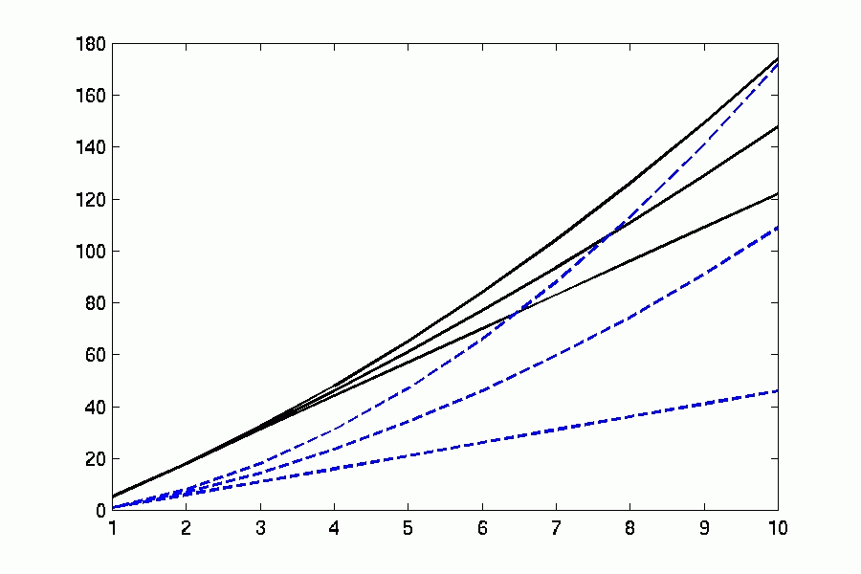
Divided Insertion Sort
Worst
Average
Best
Sort first half, then second half, then merge.
Notes:
Divided insertion sort is at the top, solid black lines.
Not really looking too good! But this is for small n, so let’s zoom out.

Slide 27
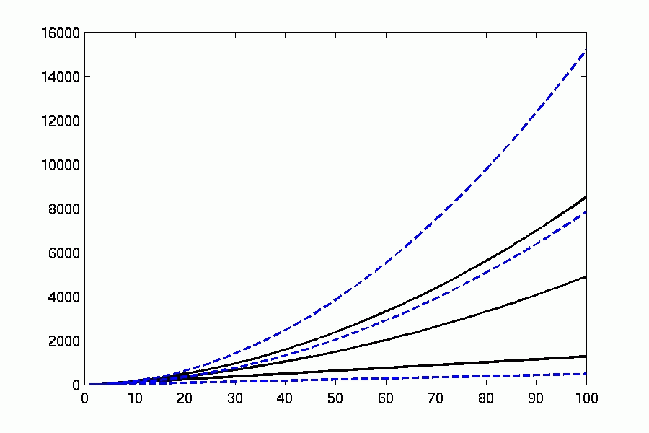
Divided Insertion Sort
Worst
Average
Best
Can we do better?
Notes:
Much better! In fact, now our worst case time is pretty close to where average case was before.
But can we do better? Why do we divide just once? What if we recursively called Divided Insertion Sort each time, until the list had only a single element to sort?
You’ve probably heard of this algorithm too…

Slide 28
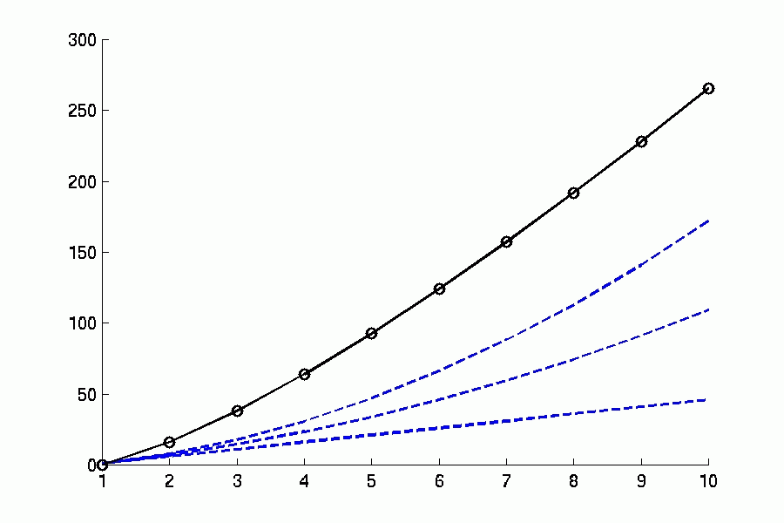
Merge Sort
Notes:
Note that since we always divide all the way down and merge all the way back up, we only have a single time graph – best case and worst case arethe same.
It’s not looking good yet, but again we should zoom out.

Slide 29
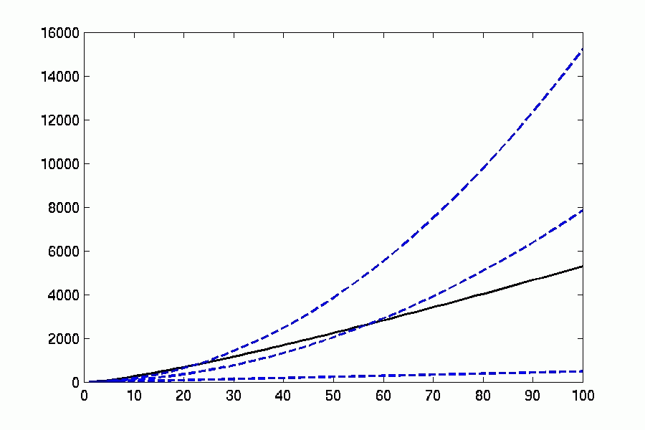
Merge Sort
Notes:
Looking a bit better when we zoom out to n=100…. Let’s keep going…

Slide 30
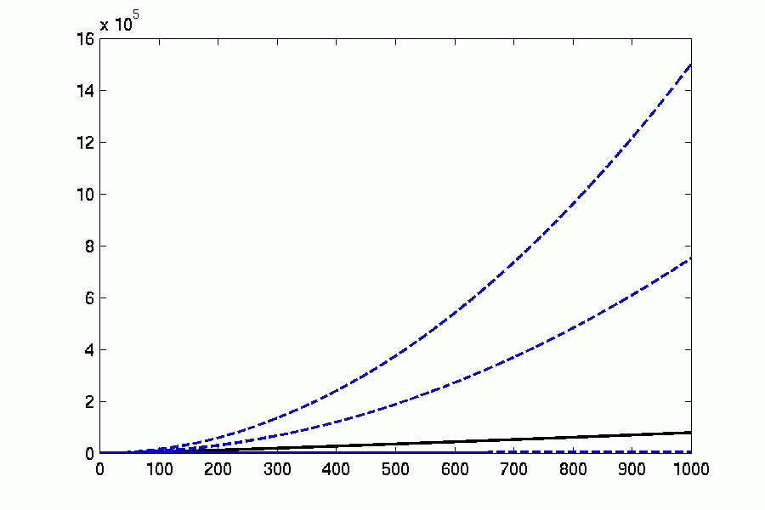
Merge Sort
Notes:
At n = 1000, we see that merge sort does MUCH better than insertion sort.
But how to we actually compare these values in a meaningful way?

Slide 31
Exact Analysis is Hard!
Notes:
What can we really say about this function?
We’re more interested in how fast a function increases than what its exact value is.
As long as the exact speeds are reasonable for small n, it is more important to see what happens as n increases.
But this function jumps around too much!!!
ALMOST N-Squared…. ALMOST.

Slide 32
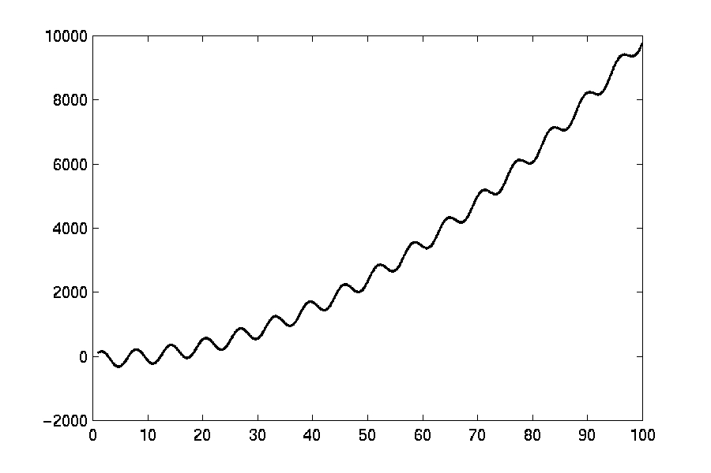
Exact Analysis is Hard!
Notes:
What can we really say about this function?
We’re more interested in how fast a function increases than what its exact value is.
As long as the exact speeds are reasonable for small n, it is more important to see what happens as n increases.
But this function jumps around too much!!!
ALMOST N-Squared…. ALMOST.

Slide 33
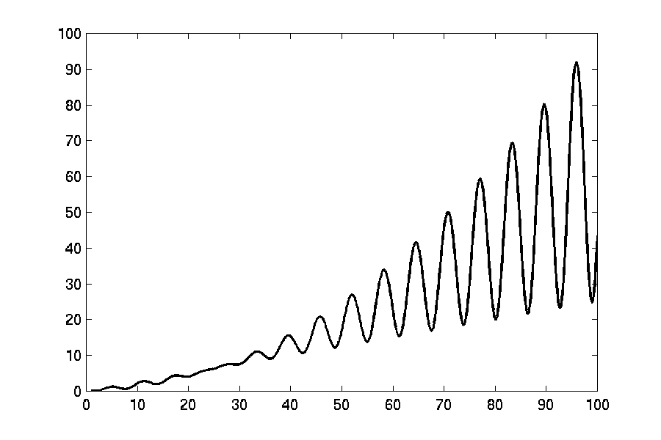
Even Harder Exact Analysis
Notes:
Sometimes functions oscillate making it really challenging to simply say anything like “this looks like X”
So we’re going to use asymptotic notation to BOUND the function growth.

Slide 34
Bounding Functions
g(n) = O(f(n)) means C × f(n) is an Upper Bound on g(n)
g(n) = Ω(f(n)) means C × f(n) is a Lower Bound on g(n)
g(n) = Θ(f(n)) means C₁ × f(n) is an Upper Bound on g(n)
and C₂ × f(n) is a Lower Bound on g(n)
These bounds hold for all inputs beyond some threshold n₀.
Notes:
This is called Asymptotic or Big-O notation.
Big-O is what we use most; it just makes the promise that a function won’t grow faster than the one we are providing.
Big-Omega promises that a function won’t grow slower than the one we’re providing (this is used most often in proofs that faster algorithms are not possible…)
Big-Theta is also called a TIGHT bound – it means that we know asymptotically how a function will grow for sure (upper and lower bounds)
NOTE: This bounds only have to hold past a specified point AND there is a constant factor out front. It’s okay if they cross at the beginning, as long as you can say that after a certain, fixed point, they will never cross again.

Slide 35
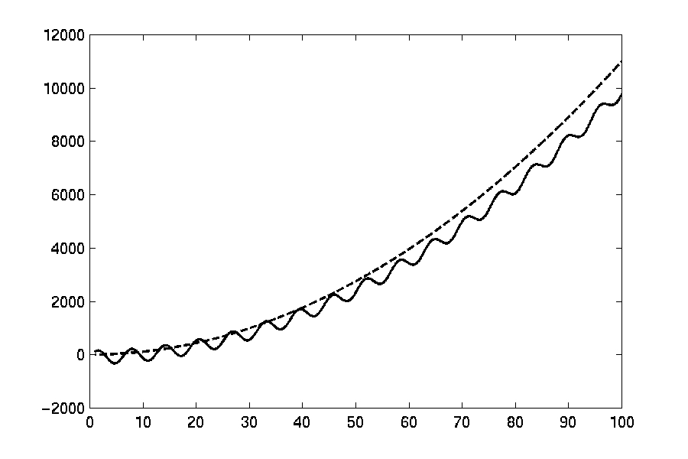
O(f(n))
Notes:
Big-O is an UPPER bound.

Slide 36
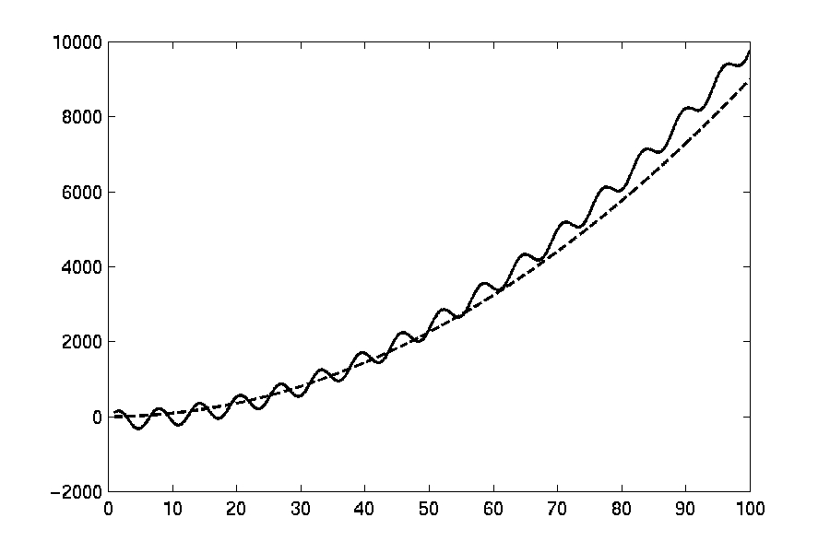
Ω(f(n))
Notes:
Big-Omega is a LOWER bound.
(point out that the functions cross at the beginning, but that is OKAY as long as they never cross again after some fixed point.

Slide 37
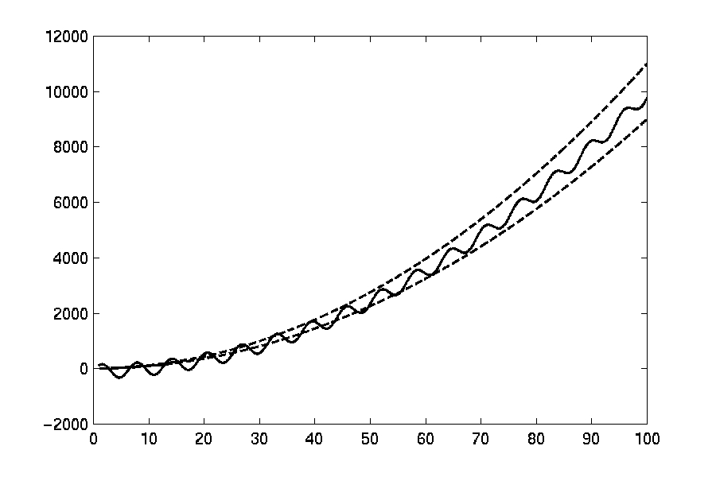
Θ(f(n))
Notes:
Big-Theta is a TIGHT bound (with different constants out front, it can either be an upper bound or a lower bound.)

Slide 38
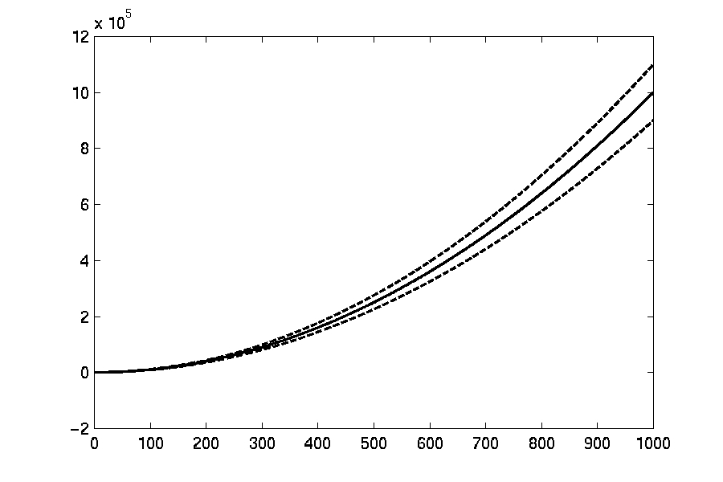
Θ(f(n))
Notes:
Zooming out, we can see that these bounds will hold forever.

Slide 39
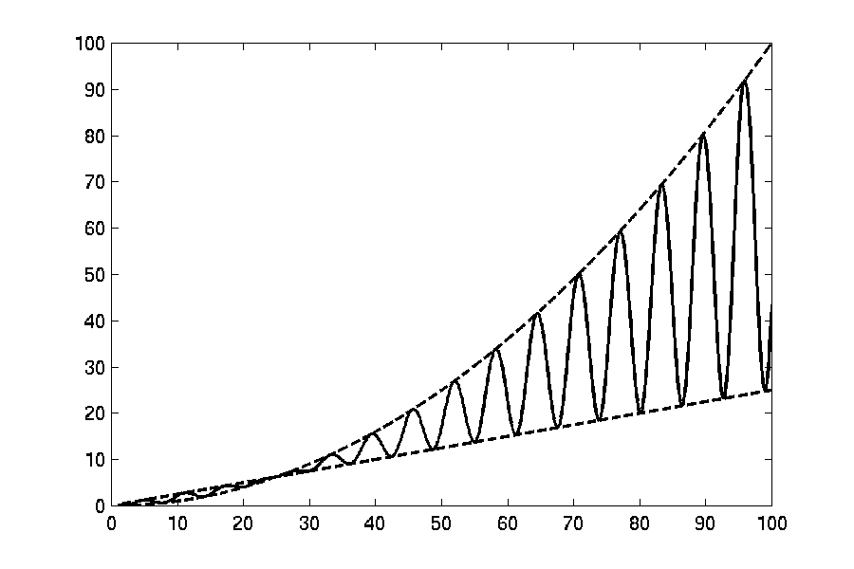
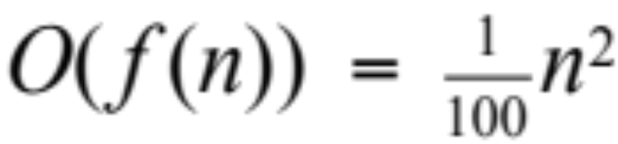
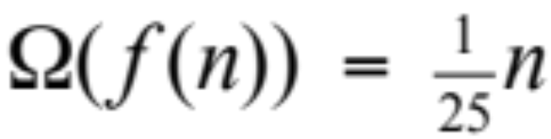
O(f(n)) and Ω(f(n))
Notes:
And even crazy functions that oscillate can at least be bounded at the top and bottom, teaching you about the nature of the function.

Slide 40
Example Function
f(n) = 3n² - 100n + 6
Notes:
Lets look at some more algebraic examples.

Slide 41
What does all this mean?
3n² - 100n + 6 = O(n²) because 3n² > 3n² - 100n + 6
3n² - 100n + 6 = O(n³) because 0.0001n³ > 3n² - 100n + 6
3n² - 100n + 6 ≠ O(n) because c × n < 3n² when n > c
3n² - 100n + 6 = Ω(n²) because 2.99n² < 3n² - 100n + 6
3n² - 100n + 6 ≠ Ω(n³) because 3n² - 100n + 6 < n³
3n² - 100n + 6 = Ω(n) because 10¹⁰! n < 3n² - 100n + 6
3n² - 100n + 6 = Θ(n²) because both O and Ω
3n² - 100n + 6 ≠ Θ(n³) because O only
3n² - 100n + 6 ≠ Θ(n) because Ω only
Notes:
[ I usually do this part on the blackboard ]
f(n) = 3n² - 100n + 6

Slide 42
Common Complexities
Complexity 10 20 30 40 50 60
n 1×10⁻⁵ sec 2×10⁻⁵ sec 3×10⁻⁵ sec 4×10⁻⁵ sec 5×10⁻⁵ sec 6×10⁻⁵ sec
n² 0.0001 sec 0.0004 sec 0.0009 sec 0.016 sec 0.025 sec 0.036 sec
n³ 0.001 sec 0.008 sec 0.027 sec 0.064 sec 0.125 sec 0.216 sec
n⁵ 0.1 sec 3.2 sec 24.3 sec 1.7 min 5.2 min 13.0 min
2^{n} 0.001sec 1.0 sec 17.9 min 12.7 days 35.7 years 366 cent
3^{n} 0.59sec 58 min 6.5 years 3855 cent 2×10⁸cent 1.3×10¹³cent
log₂ n 3×10⁻⁶ sec 4×10⁻⁶ sec 5×10⁻⁶ sec 5×10⁻⁶ sec 6×10⁻⁶ sec 6×10⁻⁶ sec
n log₂ n 3×10⁻⁵ sec 9×10⁻⁵ sec 0.0001 sec 0.0002 sec 0.0003 sec 0.0004 sec
Notes:
But what do these growth rates mean in practice?
Clearly exponentials look pretty bad!
And logs look pretty good!
Let’s graph these…

Slide 43
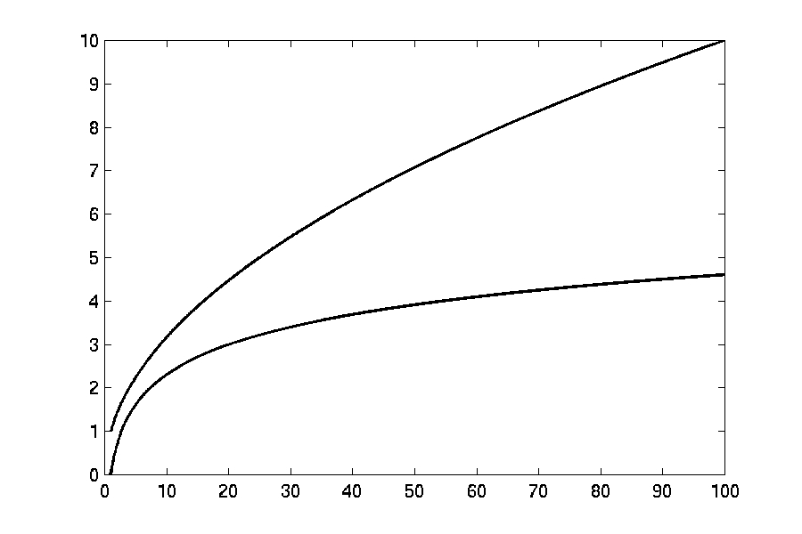
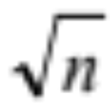
Complexity Graphs
log(n)
Notes:
Log is excellent. If you double your number of inputs, your time rises by a constant amount.
Square root doesn’t look too bad either… sub-linear is nice!

Slide 44
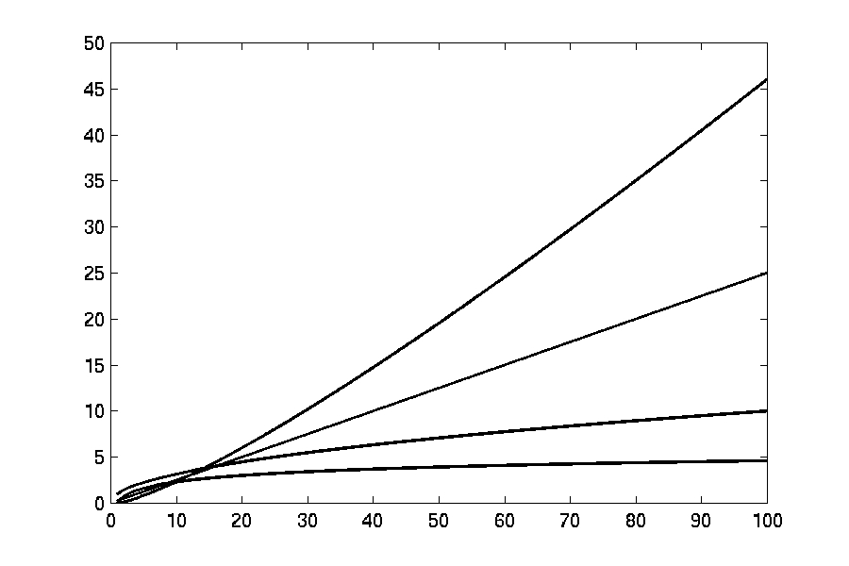

Complexity Graphs
n log(n)
n
log(n)
Notes:
Adding on n and nlogn.
Technically n log n is worse, but in the scheme of things it’s not THAT MUCH worse than n.

Slide 45
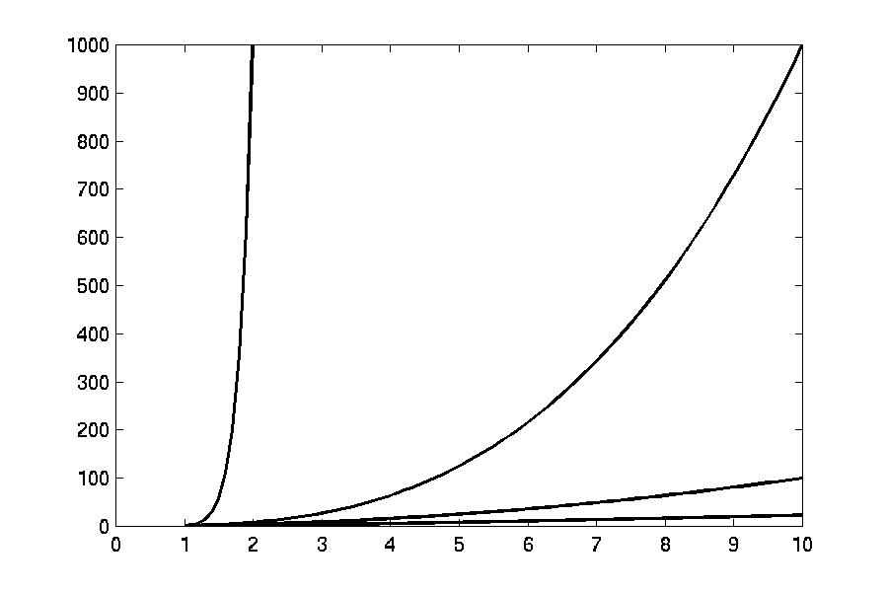
Complexity Graphs
n¹⁰
n³
n²
n log(n)
Notes:
The other functions get dwarfed by polynomials…. n^10 looks pretty bad, for example.

Slide 46
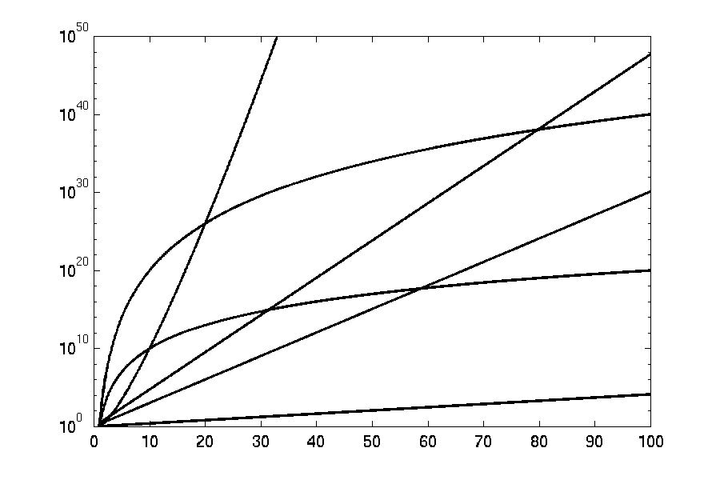
Complexity Graphs (log scale)
3^{n}
n^{n}
n²⁰
2^{n}
n¹⁰
1.1^{n}
Notes:
But exponentials are even worse.
NOTE: We shifted to a log scale.
Suddenly the others are so slow that n^10 looks downright pleasant.

