Slide 1
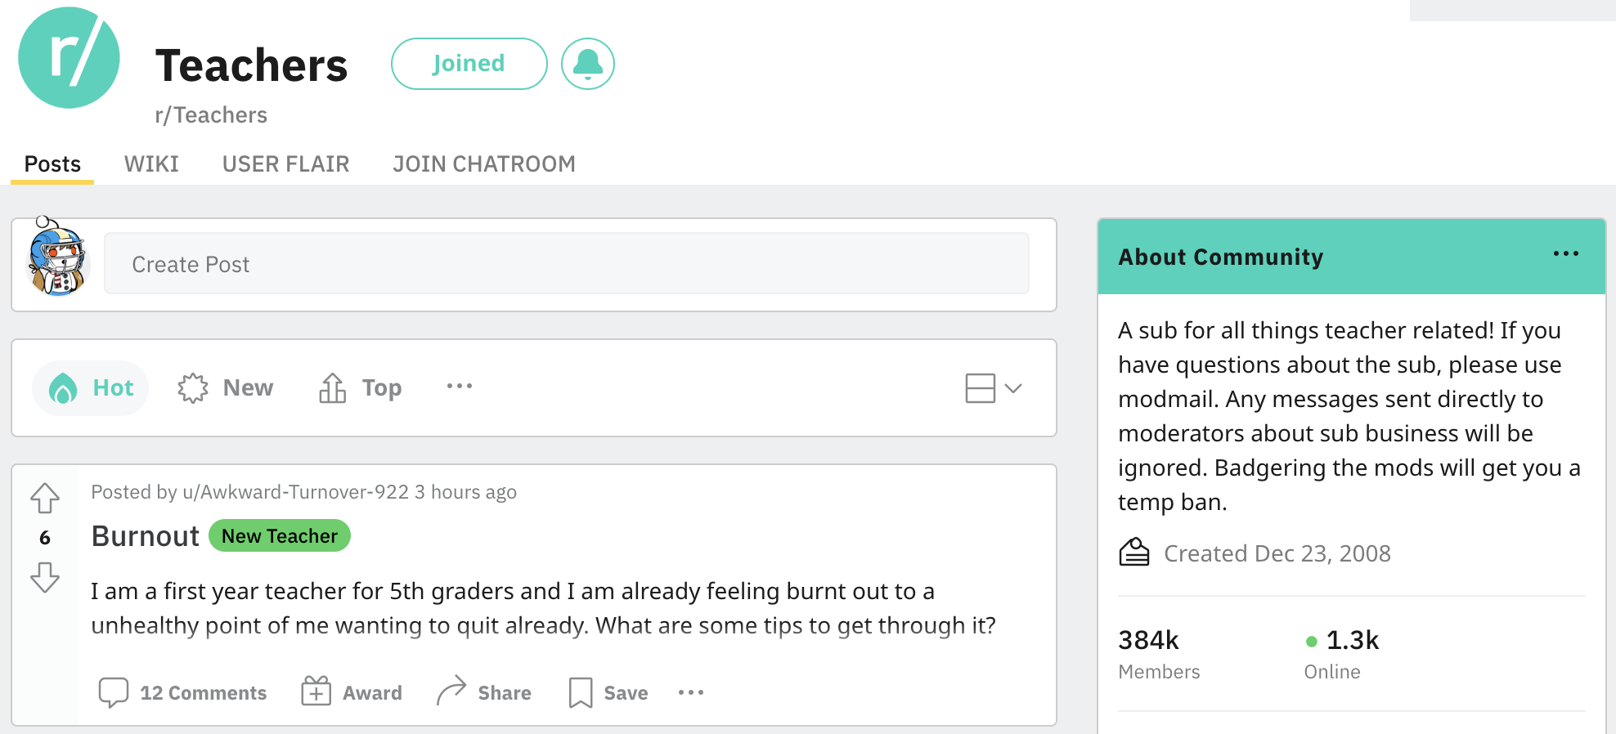

Slide 3


Slide 4
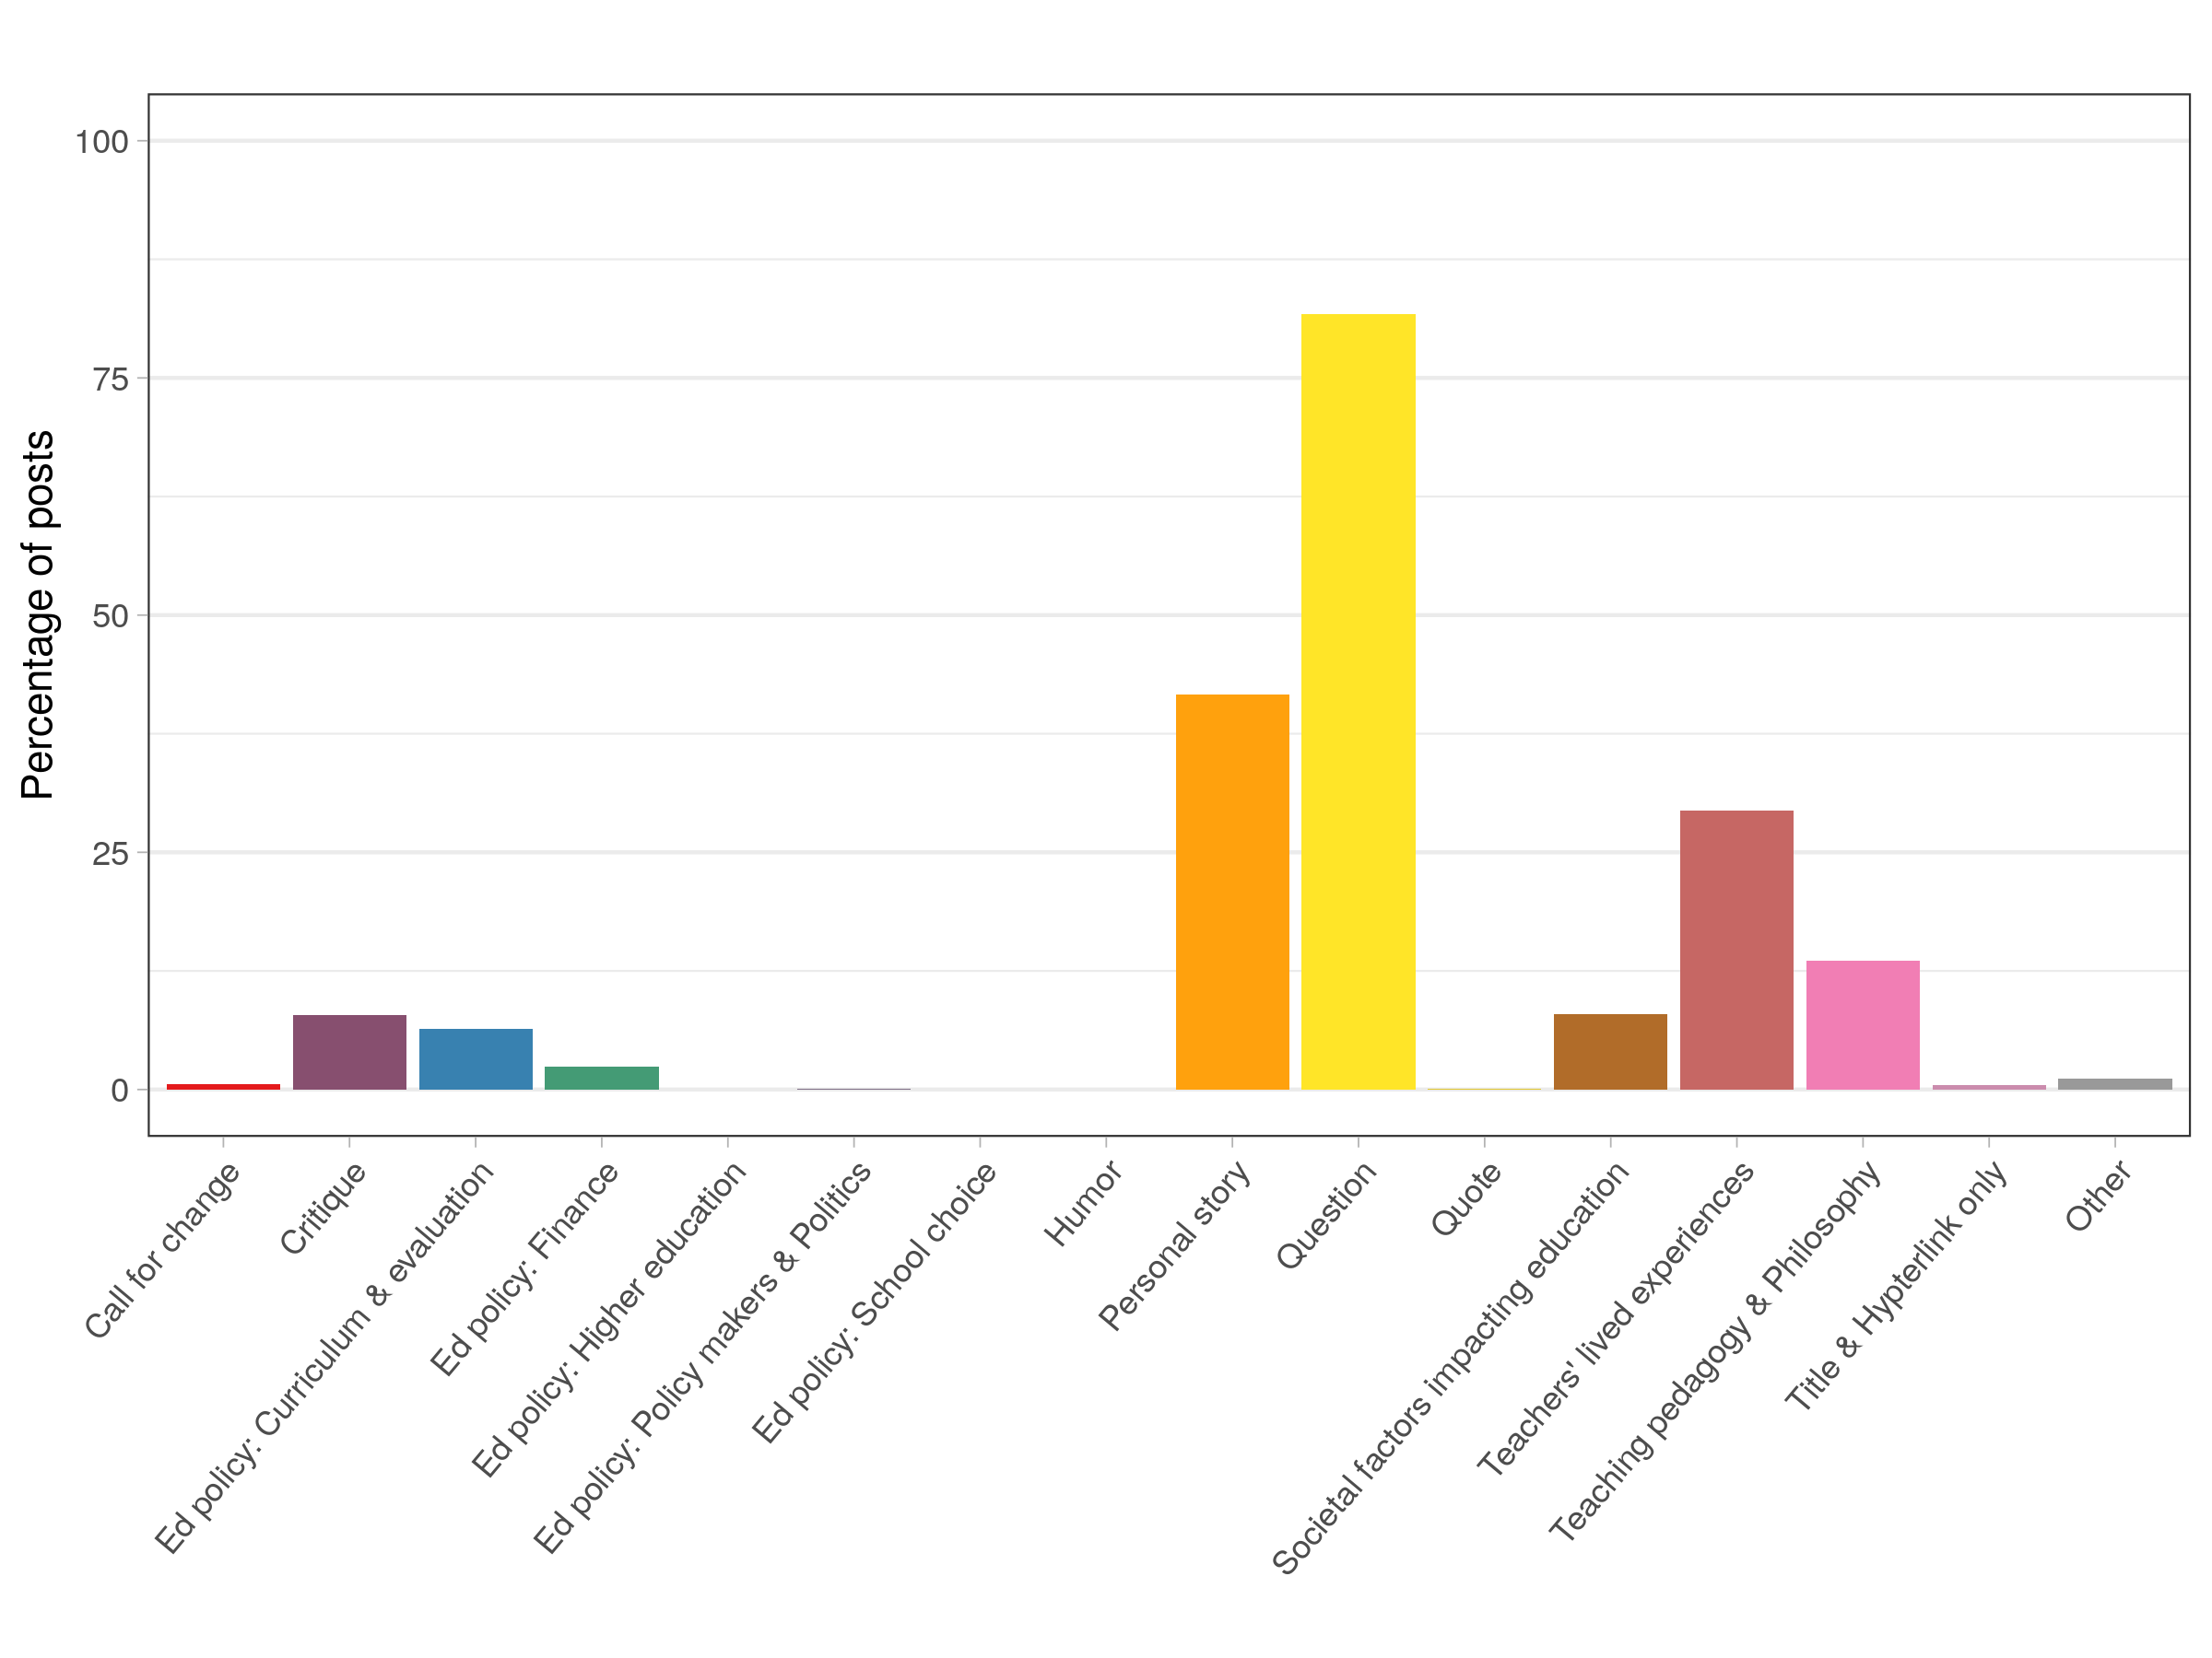
Questions: 82%
Teachers’ lived experiences: 30%
Personal story: 42%

Slide 5
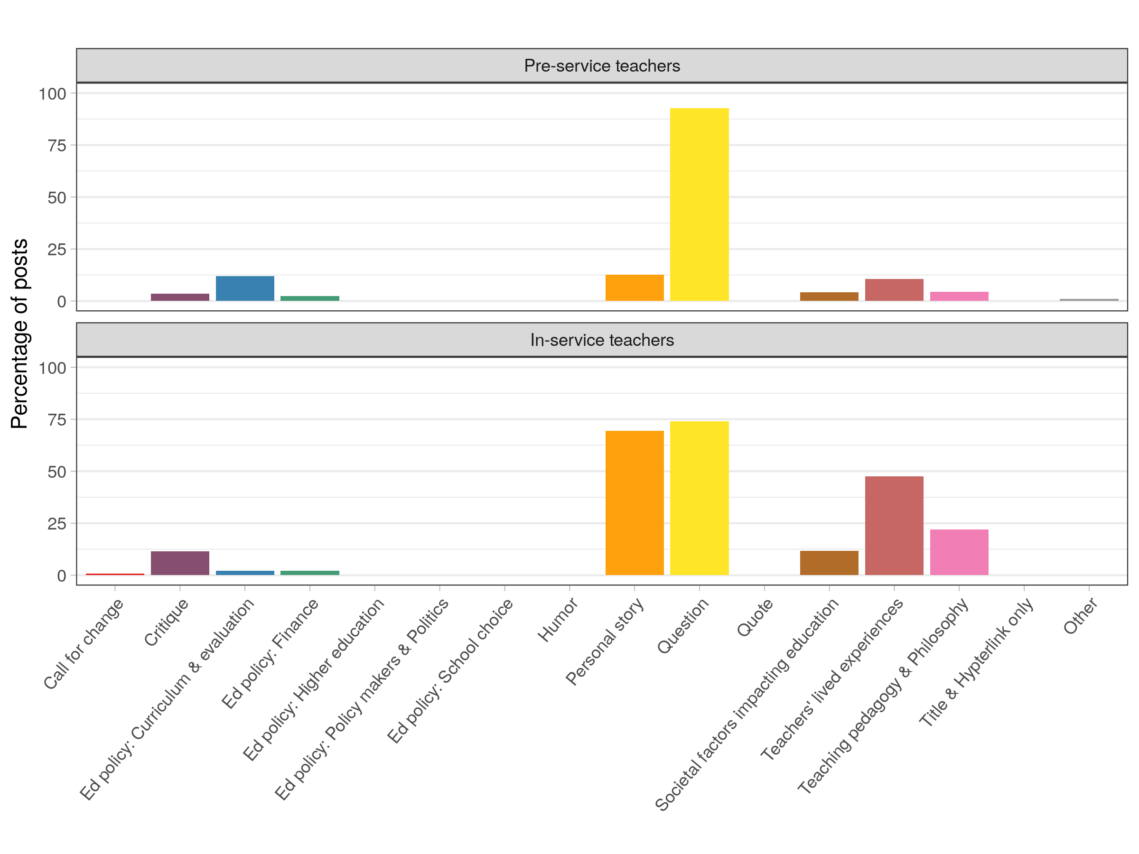

Slide 6
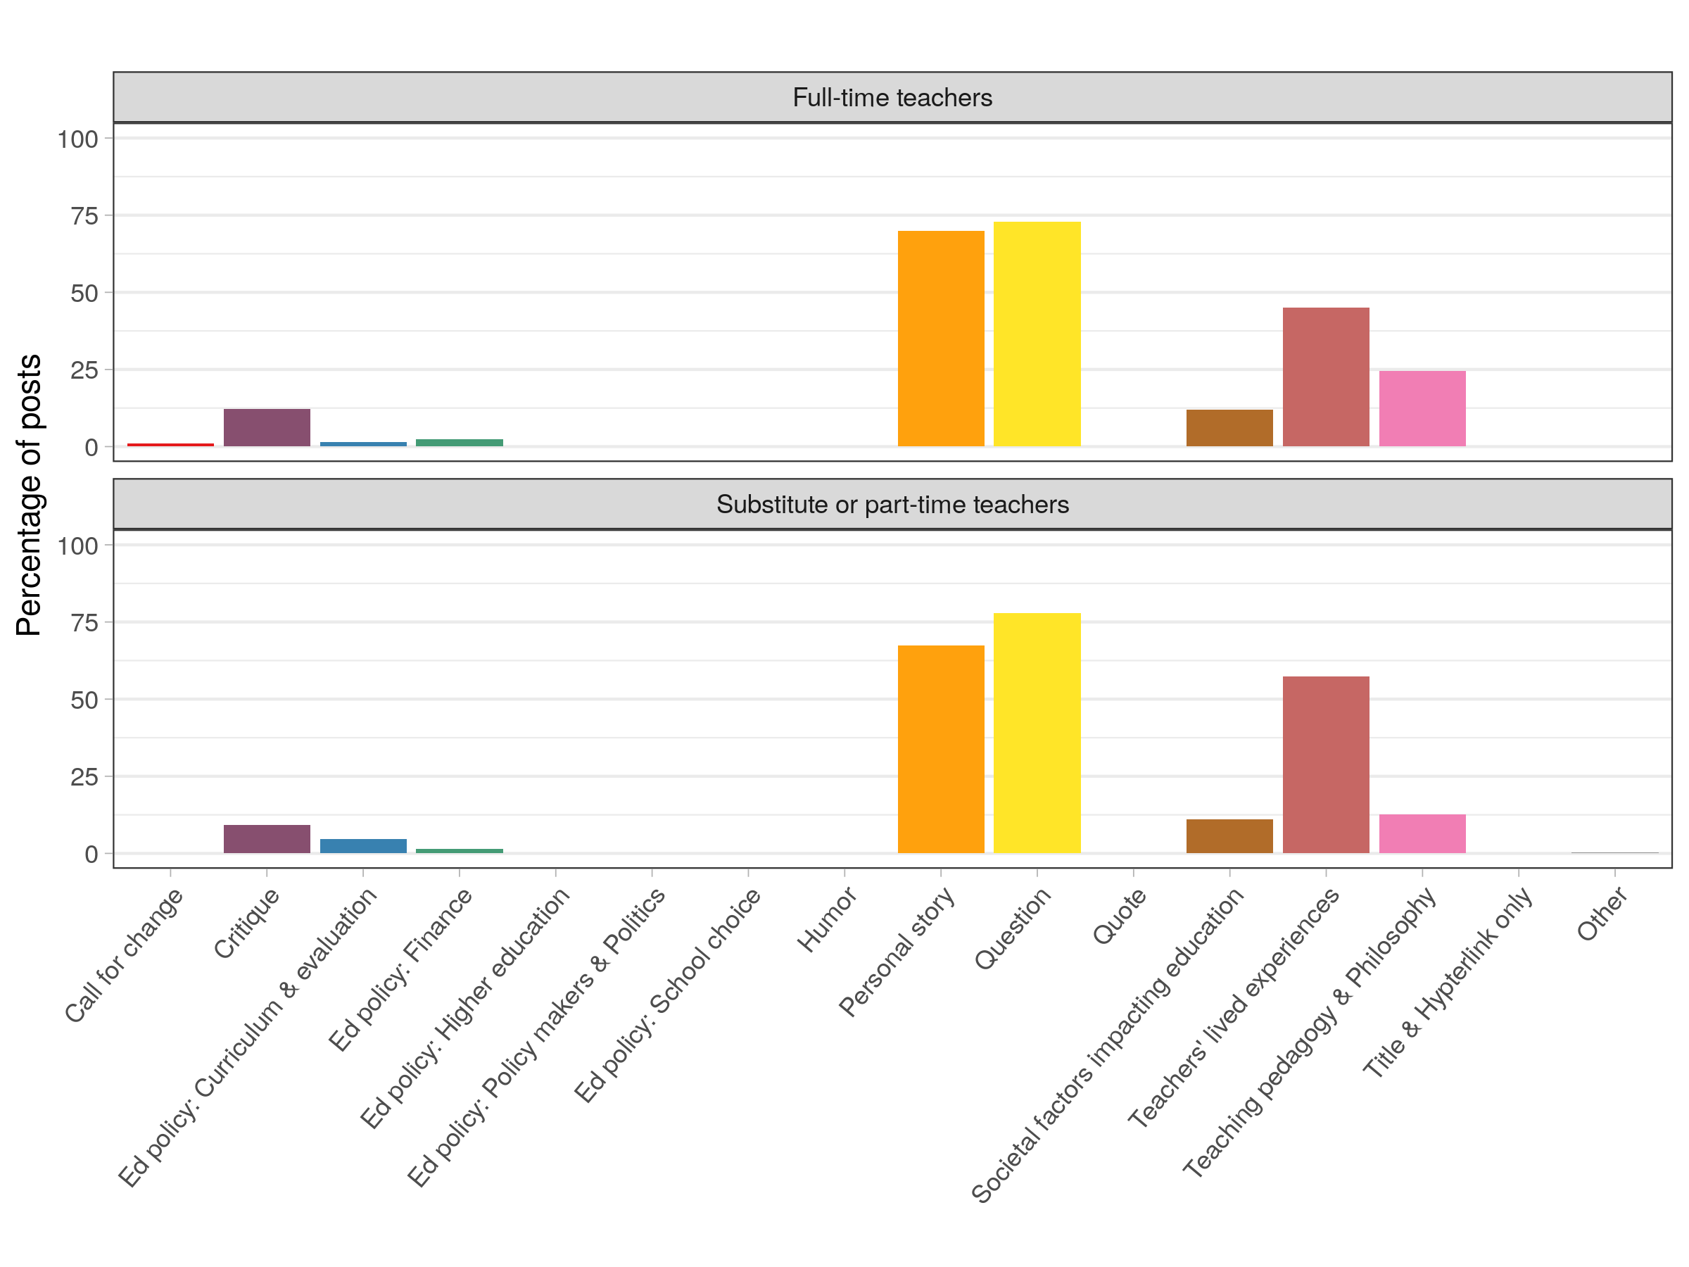

Slide 7
Reddit
R
r/Teachers
New Teacher
…
…
…
r/education
…
…
r/MathEd
…

