Slide 1

AICT Lab Final Project
FastBite – Web Development & Data Analysis Project Showcase
Group Members
Dawood Mahmood CS-185
Waleed Mahmood CS-181
Musab Hussnain CS-206
Abdul Hadi CS-218
Nahyaan Ahmad Mustafa CS-205

Slide 2
OBJECTIVES
Make a word report covering all the steps involved in the process
Make an animation video to summarize the project
Upload source files on GitHub Repositories
Analyze Business’ mock Data using Excel
Design an attractive easy to use User Interface
Develop a functional multi-page website using HTML & CSS

Slide 3
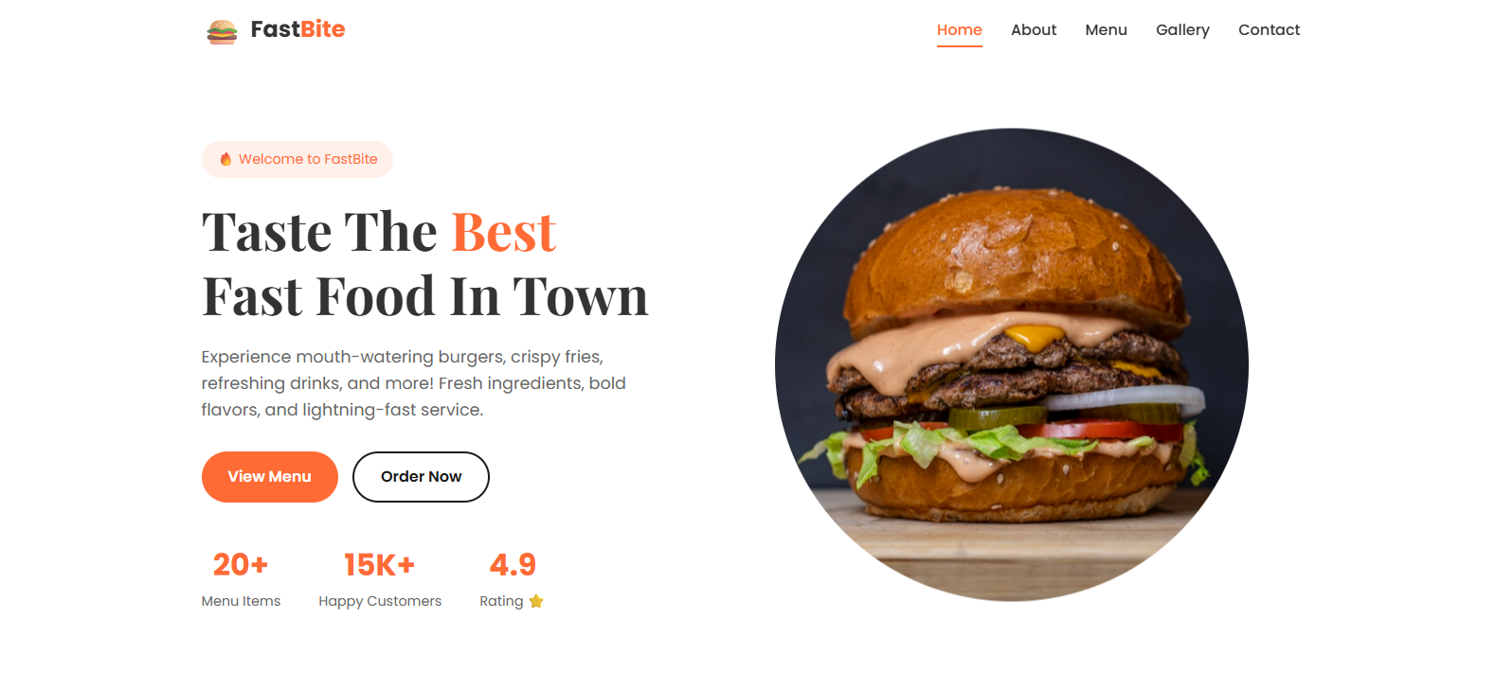
Home Page

Slide 4
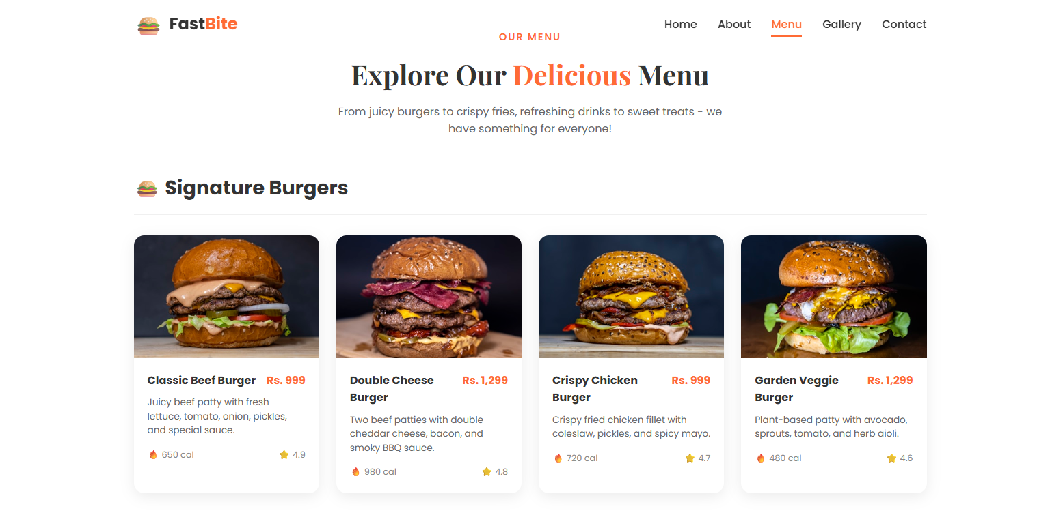
Products Page

Slide 5

About Us Page

Slide 6
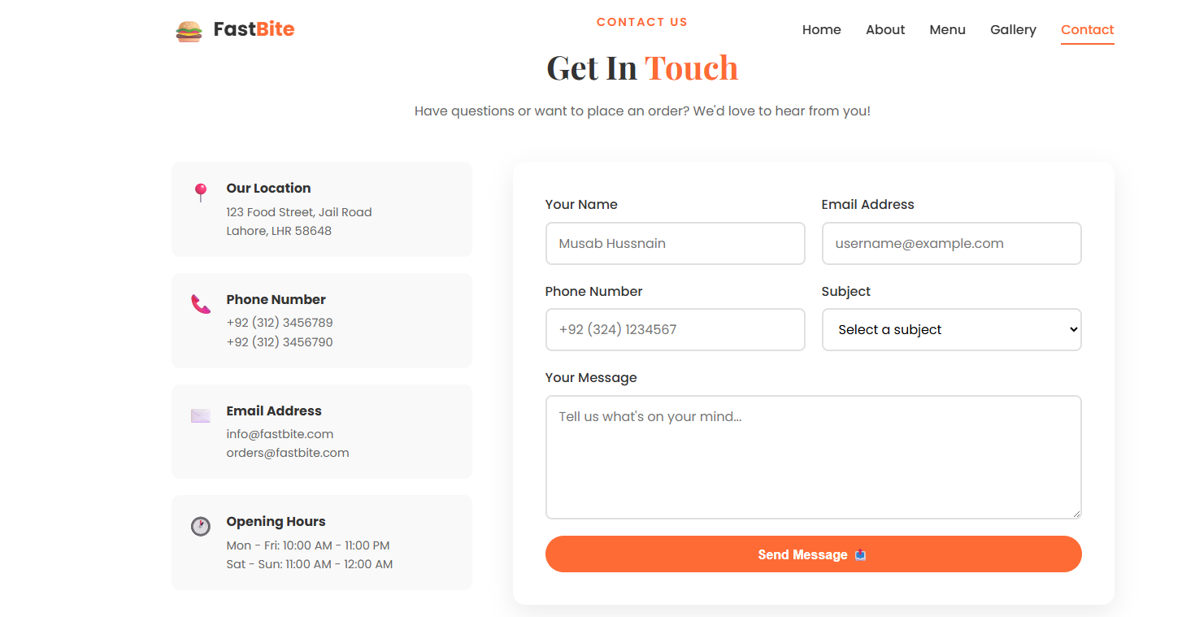
Contact Page

Slide 7


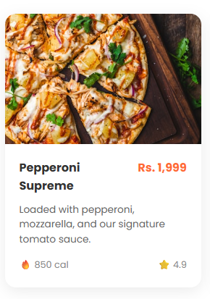
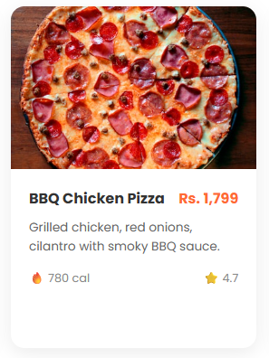
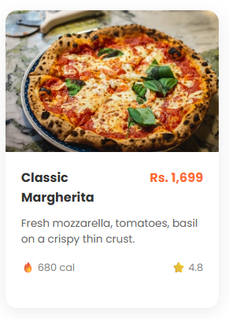

Slide 8

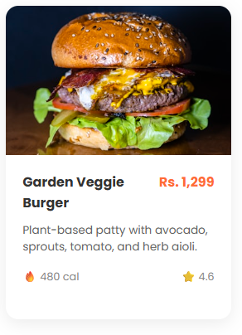
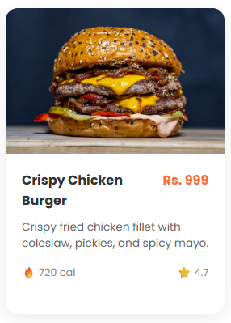
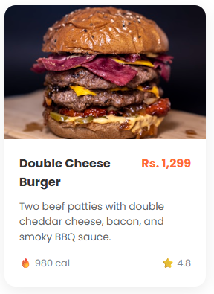
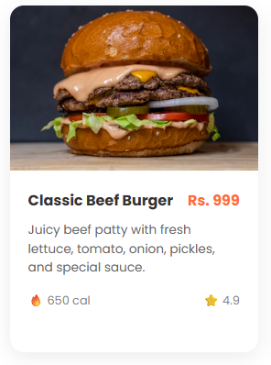

Slide 9

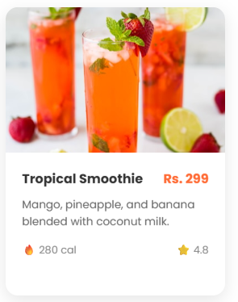
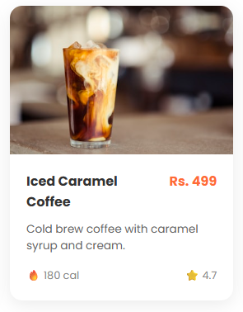
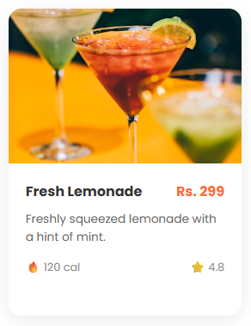
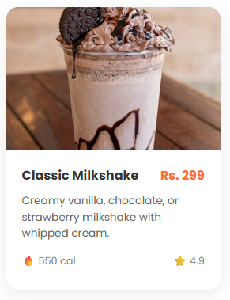

Slide 10

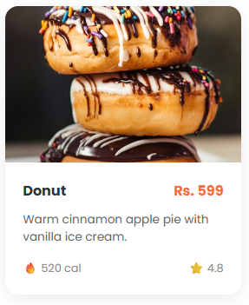
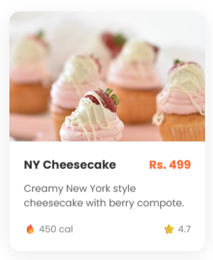
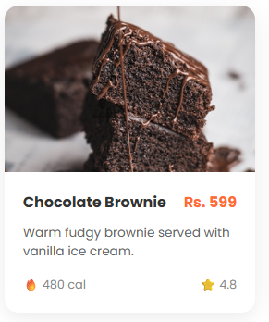
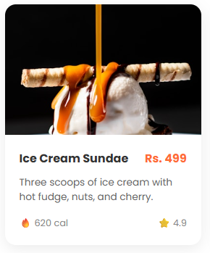

Slide 11
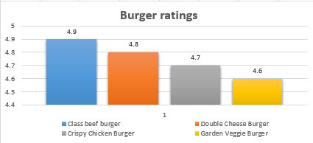
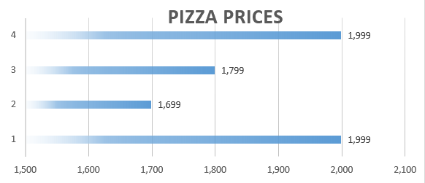
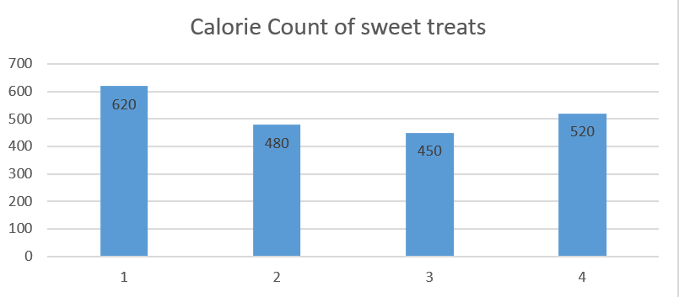
Chart Instances from Excel

Slide 12
GitHub Repository Links
Dawood Mahmood
Link
Waleed Mahmood
Link
Abdul Hadi
Link
Musab Hussnain
Link
Nahyaan Ahmad Mustafa
Link

Slide 13
THE END

