Slide 1
AI Competition for Predicting Delinquency of Credit Card Users

Slide 2


Competition Description
AI Competition for Predicting Delinquency of Credit Card Users
Goal: Develop an algorithm to predict the degree of delinquency of users by viewing credit card user data
- Classification Problem
- Submissions are evaluated using multi-class logarithmic loss.
- Data Leakage Rule

Slide 3
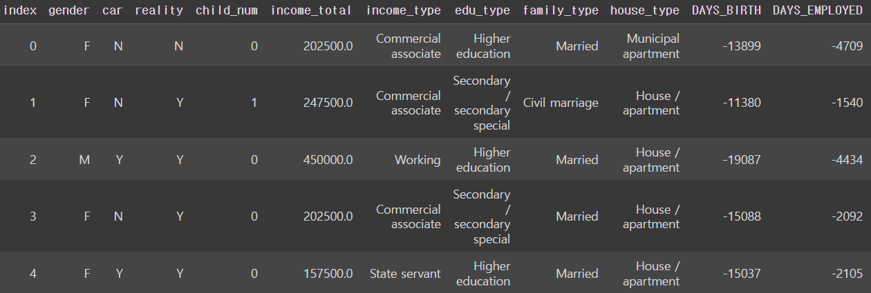
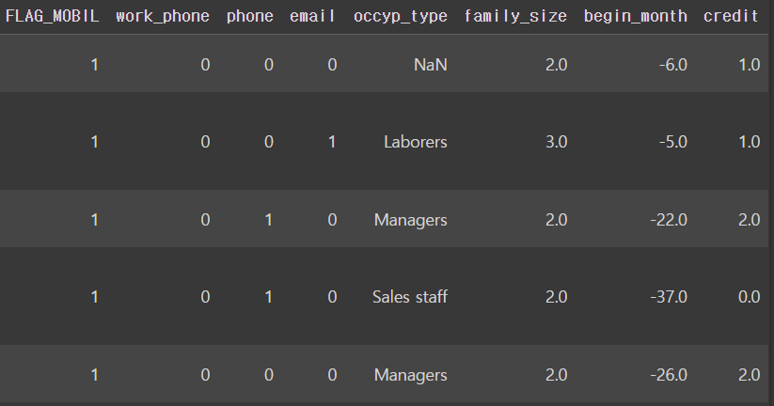
Credit Card User Data
Columns: gender, car, reality, child_num, income_total, income_type, edu_type, family_type, house_type, days_birth, days_employed, flag_mobil, work_phone, phone, email, occup_type, family_size, begin_month, credit
Credit is based on user's credit card payment overdue
→ Value we have to predict based on the features

Slide 4
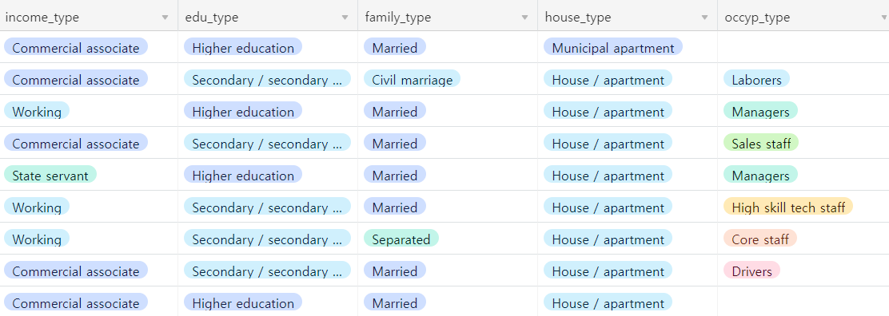
Categorical Data
Income type : Commercial associate, Working, State servant, Pensioner, Student
Education type: Higher education, Secondary / secondary special, Incomplete higher, Lower secondary, Academic degree
Family type: Married, Civil marriage, Separated, Single / not married, Widow
House type: Municipal apartment, House / apartment, With parents, Co-op apartment, Rented apartment, Office apartment
Occupation type: Laborers, Managers, Sales staff, High skill tech staff, Core staff, Drivers, etc..

Slide 5
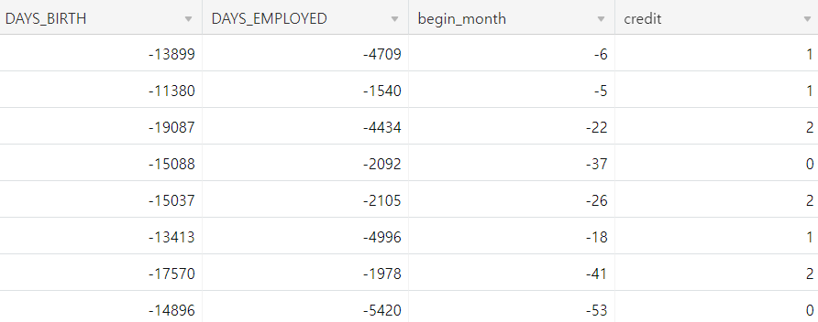
Numerical Data
Date of birth: Inverse counting from 0 at the time of data collection
Business Start Date: Reverse counting from 0 at the time of data collection
Credit card issue month: Reverse counting from 0 at the time of data collection
Credit: Credit based on user's credit card payment overdue
→ Lower means higher credit card users

Slide 6
THANK YOU

