Slide 1

Machine learning BREAST CANCER PREDICTION MODEL
Autor: Merzić Naida
Mentor: prof. Dr. Mirsad Hadžikadić

Slide 2


Agenda
About topic
About dataset
Algorithm
Workflow
Demo

Slide 3




Breast cancer
Breast cancer is a complex disease. There are several subtypes of breast cancer and many options for treatment. While many people may have similar diagnoses or are prescribed similar treatments, no two people’s experiences are exactly the same.
In 2020, there were 2.3 million women diagnosed with breast cancer and 685 000 deaths globally.
We all know how serious this disease is and how much the prediction about it can be important.

Slide 4
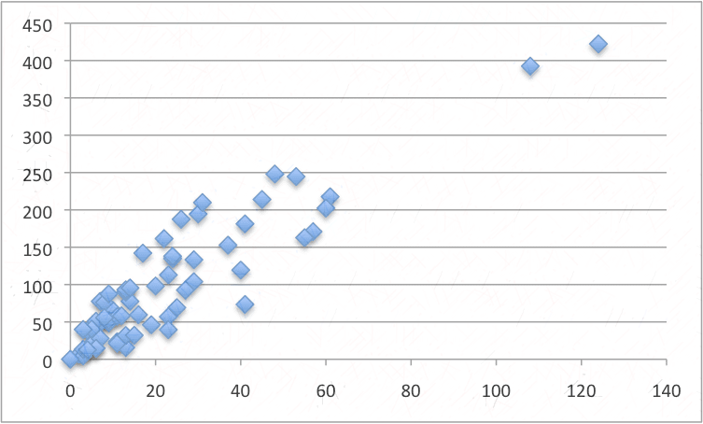
DATASET
Dataset is derived from Fine needle aspiration. FNA is a type of biopsy procedure, a thin needle is inserted into an area of abnormal appearing tissue or body fluid. As with other types of biopsies, the sample collected during fine needle aspiration can help make a diagnosis or rule out conditions such as cancer. In the dataset we have column named diagnosis which is represented with 0 if the tumor is malignant and with 1 if it is bening.
I imported dataset from sklearn, but it can be downloaded from Kaggle as well.
569 different rows (people)
31 different columns (30 input and 1 target feature)
Prediction subject : human (ABT table contains one row per person)
Target feature : label column, 1/0 = malignant/bening

Slide 5
workflow
Importing the dependencies
Data collection and data process means dragging the raw data through some preprocessing steps till it comes to our machine learning model
Getting some further informations about data
Loading data into pandas data frame to be more readable ( tabulator view)
Checking null values
Checking the distribution of target value
Separating the feature and target
Spliting the data into training and testing one
Model Training
Model Evaluation
Building a Predictive System

Slide 6
Logistic regression
Logistic Regression represent a classification algorithm in machine learning that uses one or more independent variables to determine an outcome.
RULE: it will have only two possible outcomes.
The best one when it comes to binary classification
Quantitatively explains the factors leading to classification.
Logistic Regression is used for categorical variables like Yes/No, True/False, 0/1, so we are using it due to our outcome result, if the tumor is malignant or bening, zero or one.

Slide 7
DEMO

