Slide 1
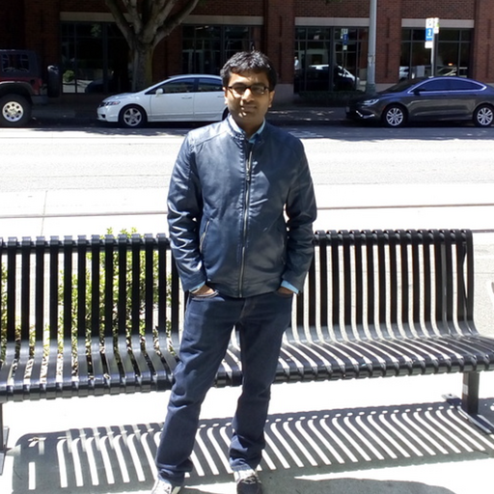
Session no. 1
Cloud Computing
Aditya Goel
https://www.linkedin.com/in/aditya-goel-6702612a/

Slide 2
Course Objectives
The course aims at:
CO1 | Students will learn the fundamental ideas behind Cloud Computing, the evolution of the paradigm, its applicability; benefits, as well as current and future challenges;
CO2 | Students will learn the basic idea and principles in Cloud infrastructure management
CO3 | Students will learn about cloud components Compute, Storage and Networking technologies
CO4 | Students will learn a variety of programming models and develop working experience

Slide 3
Modular Structure
Module # | Module name
1 | Introduction to Cloud Computing
2 | Virtualization Techniques and Types
3 | Infrastructure as a Service
4 | Platform as a Service and SaaS
5 | Managing Virtual Resources on the Cloud: Provisioning and Migration
6 | Capacity management and Scheduling in cloud computing
7 | Issues and Challenges : Availability, Multi-Tenancy, Security and SLA
8 | Application Development and Deployment

Slide 4
Evaluation Scheme
Item | Name | Type | Duration | Weight | Day, Date, Session, Time
EC-1 | Quiz – 1 & 2 (5 marks each) | Online | 2 days | 10 Marks | TBA
 | Experiential learning Assignment-I | Take Home | 15-20 days | 30 Marks | TBA
EC-2 | Mid-Semester Test (Topics in Session Nos. 1 to 8) | Open Book | ~2 hours | 30 Marks | Per Programme schedule
EC-3 | Comprehensive Exam (All topics (Session Nos. 1 to 16)) | Open Book | ~3 hours | 30 Marks | Per Programme schedule

Slide 5
Pedagogy
Sl No | Name | Type | Duration | No. of Sessions
1 | Class lectures | Online | 2.00 hr | 16 (as per calendar)

Slide 6
Introduction to Cloud Computing, services and deployment models
Agenda
  Introduction to Cloud Computing – Origins and Motivation
  3-4-5 rule of Cloud Computing
  Types of Clouds and Services
  Cloud Infrastructure and Deployment

Slide 7
Distributed Computing
In distributed computing a program is split up into parts that run simultaneously on multiple computers communicating over a network
PROBLEM INSTRUCTION SET
TASK 2
T
A
S
K
5
TASK 4
TASK 1
TASK 5
T 2
T4
T1
T3
T5

Slide 8
Distributed Computing
Consider If There Are n Systems Connected In A Network, Then We Can Split One Program Into n Different Tasks And Compute Them Concurrently.

Slide 9
Why do we need Distributed Computing?
Computation requirements are ever increasing
Silicon based (sequential) architectures reaching their limits in processing capabilities (clock speed) as they are constrained by.
Significant development in networking technology is paving a way for network-based cost-effective parallel computing.
The parallel processing technology is mature and is being exploited commercially.

Slide 10
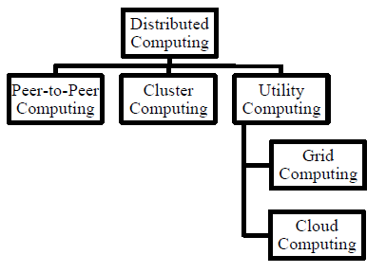
Distributed computing models

Slide 11
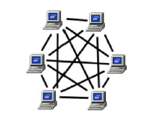
Peer-to-peer computing
In a P2P system,
Every node acts as both a client and a server, providing part of the system resources.
Peer machines are simply client computers connected to the Internet.
All client machines act autonomously to join or leave the system freely.
This implies that no master-slave relationship exists among the peers.
No central coordination or no central database is needed.

Slide 12
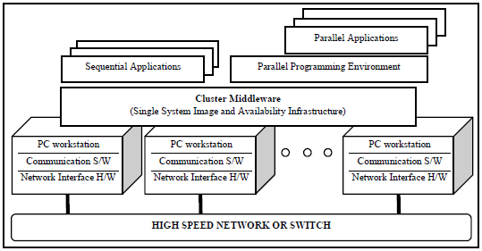
Cluster computing
In a cluster computing,
comprises a set of independent or stand-alone computers and a network interconnecting them.
It works cooperatively together as a single integrated computing resource.
A cluster is local in that all of its component subsystems are supervised within a single administrative domain, usually residing in a single room and managed as a single computer system

Slide 13
Utility computing
Based on a service provisioning model, where users (consumers) pay providers for using computing power only when they need to.
Utility computing focuses on a business model, by which customers receive computing resources from a paid service provider.
All grid/cloud platforms are regarded as utility service providers

Slide 14
Grid computing
Grid computing enables coordinated resource sharing and problem solving in dynamic, multi-institutional virtual organizations.
Grid is often constructed across LAN, WAN, or Internet backbone networks at regional, national, or global scales. Enterprises or organizations present grids as integrated computing resources.

Slide 15
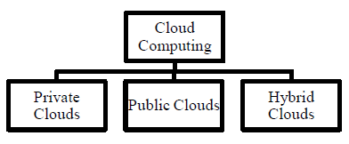
Cloud computing
Cloud computing is a computing paradigm that involves outsourcing of computing resources with the capabilities of expendable resource scalability, on-demand provisioning with little or no up-front IT infrastructure investment costs.

Slide 16
Motivation
Powerful multi-core processors
Web Scale Problems
Web 2.0 and Social Networking
Information Explosion
Mobile Web
Explosion of domain applications
General purpose graphic processors
Proliferation of devices
Superior software methodologies
Wider bandwidth for communication
Virtualization leveraging the powerful hardware
Notes:
RL 1.1

Slide 17
What is Cloud Computing?
Cloud Computing is a general term used to describe a new class of network based computing that takes place over the Internet,
basically a step on from Utility Computing
a collection/group of integrated and networked hardware, software and Internet infrastructure (called a platform).
Using the Internet for communication and transport provides hardware, software and networking services to clients
These platforms hide the complexity and details of the underlying infrastructure from users and applications by providing very simple graphical interface or API (Applications Programming Interface).

Slide 18
What is Cloud Computing cont.…
Self-service
Commodity pricing
Transparent scalability
Shared infrastructure

Slide 19






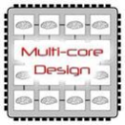
Technology Advances
Cloud applications: data-intensive, compute-intensive, storage-intensive
Bandwidth
WS
Services interface
Web-services, SOA, WS standards
VM0
VM1
VMn
Storage Models: S3, BigTable, BlobStore, ...
Virtualization: bare metal, hypervisor. …
Multi-core architectures
64-bit processor

Slide 20
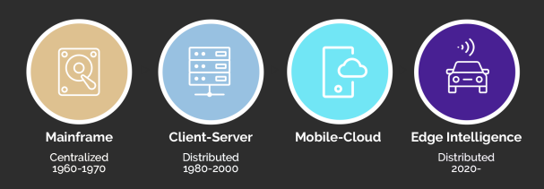
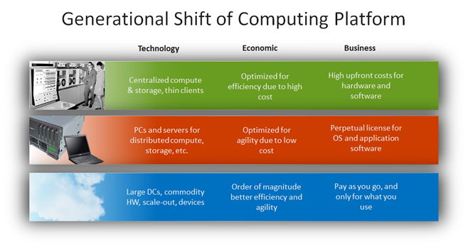
Evolution of Computing
http://blogs.technet.com/b/yungchou/archive/2011/03/03/chou-s-theories-of-cloud-computing-the-5-3-2-principle.aspx

Slide 21
Cloud computing is the on-demand delivery of IT resources over the Internet with pay-as-you-go pricing. Instead of buying, owning, and maintaining physical data centers and servers, you can access technology services, such as computing power, storage, and databases, on an as-needed basis from a cloud provider like Amazon Web Services (AWS). – AMAZON
Cloud computing is on-demand access, via the internet, to computing resources—applications, servers (physical servers and virtual servers), data storage, development tools, networking capabilities, and more—hosted at a remote data center managed by a cloud services provider (or CSP). The CSP makes these resources available for a monthly subscription fee or bills them according to usage. – IBM
Simply put, cloud computing is the delivery of computing services—including servers, storage, databases, networking, software, analytics, and intelligence—over the Internet (“the cloud”) to offer faster innovation, flexible resources, and economies of scale. You typically pay only for cloud services you use, helping you lower your operating costs, run your infrastructure more efficiently, and scale as your business needs change. – MICROSOFT
Cloud computing is the act of running workloads within clouds—which are IT environments that abstract, pool, and share scalable resources across a network. Neither cloud computing nor clouds are technologies unto themselves.
Cloud computing is an act—the function of running a workload in a cloud.
Clouds are environments—places where applications run.
Technologies are things—software and hardware used to build and use clouds. - REDHAT

Slide 22
Cloud Computing: Definition
The US National Institute of Standards (NIST) defines cloud computing as follows:
Cloud computing is a model for enabling ubiquitous, convenient, on-demand network access to a shared pool of configurable computing resources (e.g., networks, servers, storage, applications, and services) that can be rapidly provisioned and released with minimal management effort or service provider interaction.
Notes:
RL 1.2

Slide 23
3-4-5 rule of Cloud Computing
NIST specifies 3-4-5 rule of Cloud Computing
3 cloud service models or service types for any cloud platform
4 deployment models
5 essential characteristics of cloud computing infrastructure

