Slide 1
Session-2
Cloud Computing
Aditya Goel

Slide 2
Cloud computing is the on-demand delivery of IT resources over the Internet with pay-as-you-go pricing. Instead of buying, owning, and maintaining physical data centers and servers, you can access technology services, such as computing power, storage, and databases, on an as-needed basis from a cloud provider like Amazon Web Services (AWS). – AMAZON
Cloud computing is on-demand access, via the internet, to computing resources—applications, servers (physical servers and virtual servers), data storage, development tools, networking capabilities, and more—hosted at a remote data center managed by a cloud services provider (or CSP). The CSP makes these resources available for a monthly subscription fee or bills them according to usage. – IBM
Simply put, cloud computing is the delivery of computing services—including servers, storage, databases, networking, software, analytics, and intelligence—over the Internet (“the cloud”) to offer faster innovation, flexible resources, and economies of scale. You typically pay only for cloud services you use, helping you lower your operating costs, run your infrastructure more efficiently, and scale as your business needs change. – MICROSOFT
Cloud computing is the act of running workloads within clouds—which are IT environments that abstract, pool, and share scalable resources across a network. Neither cloud computing nor clouds are technologies unto themselves.
Cloud computing is an act—the function of running a workload in a cloud.
Clouds are environments—places where applications run.
Technologies are things—software and hardware used to build and use clouds. - REDHAT

Slide 3
Cloud Computing: Definition
The US National Institute of Standards (NIST) defines cloud computing as follows:
Cloud computing is a model for enabling ubiquitous, convenient, on-demand network access to a shared pool of configurable computing resources (e.g., networks, servers, storage, applications, and services) that can be rapidly provisioned and released with minimal management effort or service provider interaction.
Notes:
RL 1.2

Slide 4
3-4-5 rule of Cloud Computing
NIST specifies 3-4-5 rule of Cloud Computing
3 cloud service models or service types for any cloud platform
4 deployment models
5 essential characteristics of cloud computing infrastructure

Slide 5
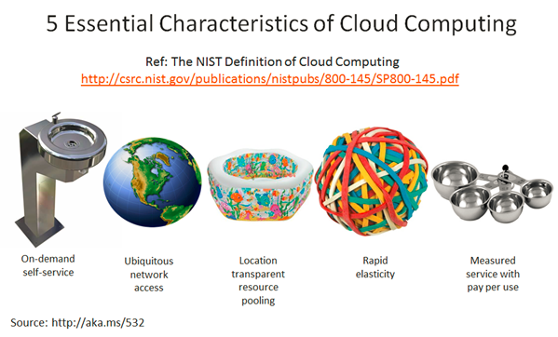
Characteristics of Cloud Computing
On demand self-service
Broad network access
Resource pooling
Rapid elasticity
Measured service

Slide 6
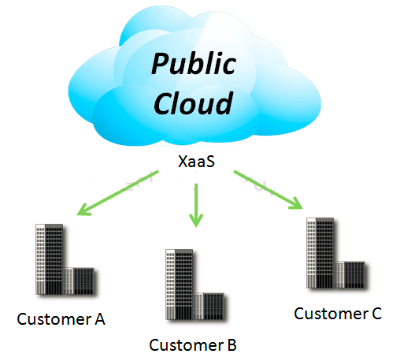
4 Deployment Models
1. Public Cloud
Mega-scale cloud infrastructure is made available to the general public or a large industry group and is owned by an organization selling cloud services.
Notes:
XaaS is Anything as a service
[http://www.definethecloud.net/cloud-types/]

Slide 7
Public Cloud
Key characteristics of the public cloud:
Scalability
Cost effectiveness
Reliability
Flexibility
Location Independence
On demand computing
Pay per use pricing
broad network access
Resource pooling
Examples:
AWS
Microsoft Azure
Google Cloud Platform (GCP)
Alibaba

Slide 8
Public Cloud
Advantage of public cloud:
It helps organizations to have less investment and maintenance costs
User demands can be easily met with scalability
less resource wastage
High reliability
Disadvantages of public cloud:
As the cloud infrastructure is actually owned and controlled by others, the controls for the user are limited.
It is difficult to deploy regulations like HIPAA and PCI DSS in a public cloud and often demands a hybrid solution.
There may be data privacy issues
Limited control on the infrastructure configurations

Slide 9
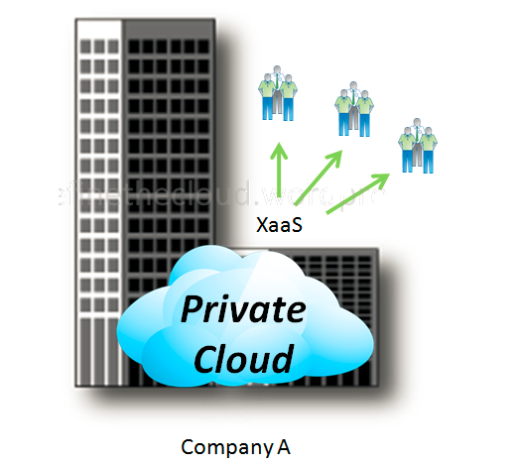
4 Deployment Models
2. Private Cloud
The cloud infrastructure is operated solely for an organization. It may be managed by the organization or a third party and may exist on premise or off premise.

Slide 10
Private Cloud
Key characteristics/Benefits of Private Cloud:
Predictable server usage
Improved resource utilization
Reduced costs
Increased security
Regulatory compliance
Flexibility
Drawback: Cost and accountability of managing the private cloud - Company’s IT department
Need the same staffing, management, and maintenance expenses as traditional datacenter ownership

Slide 11
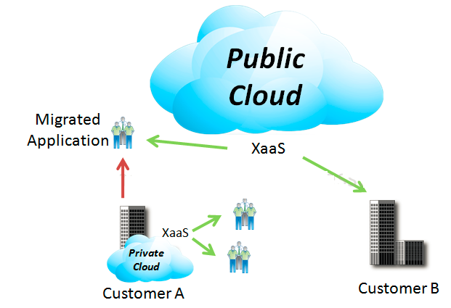
4 Deployment Models
3. Hybrid Cloud
The cloud infrastructure is a composition of two or more clouds (private or public) that remain unique entities but are bound together by standardized or proprietary technology that enables data and application portability

Slide 12
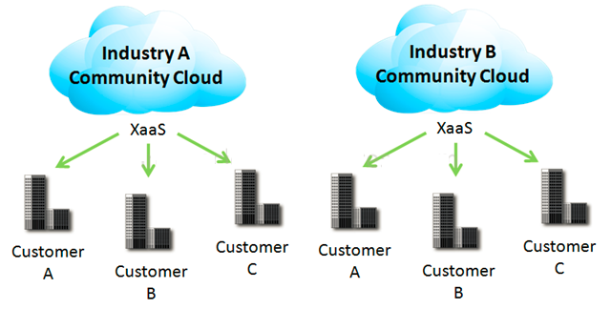
4 Deployment Models
4. Community Cloud
Community Clouds are when an ‘infrastructure is shared by several organizations and supports a specific community that has shared concerns (e.g., mission, security requirements, policy, and compliance considerations).
It may be managed by the organizations or a third party and may exist on premise or off premise’ according to NIST.

Slide 13
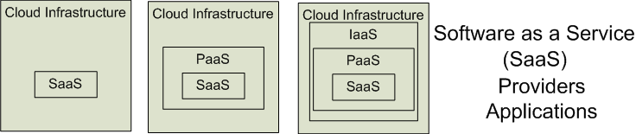

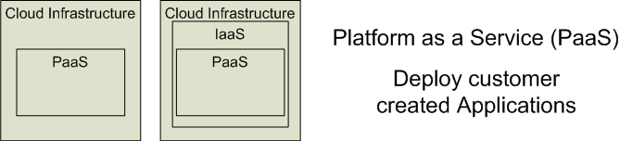

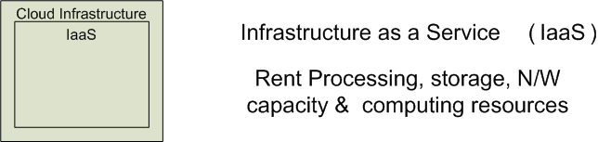


3 Cloud Service Models
Software as a Service (SaaS)
Platform as a Service (PaaS)
Infrastructure as a Service (IaaS)
SalesForce CRM
LotusLive
Google App Engine
Notes:
RL 1.3

Slide 14
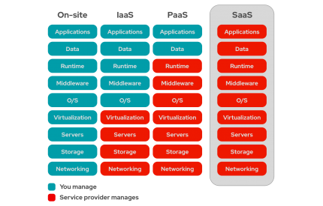
Software as a Service (SaaS)
Software as a service features a complete application offered as a service on demand.
A single instance of the software runs on the cloud and services multiple end users or client organizations.
E.g. salesforce.com , Google Apps

Slide 15
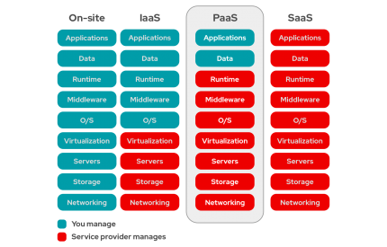
Platform as a Service
Platform as a service encapsulates a layer of software and provides it as a service that can be used to build higher-level services.
2 Perspectives for PaaS :-
Producer:- Someone producing PaaS might produce a platform by integrating an OS, middleware, application software, and even a development environment that is then provided to a customer as a service.
Consumer:-Someone using PaaS would see an encapsulated service that is presented to them through an API. The customer interacts with the platform through the API, and the platform does what is necessary to manage and scale itself to provide a given level of service.

Slide 16
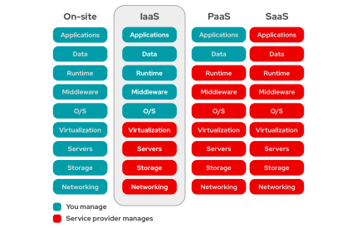
Infrastructure as a Service
Infrastructure as a service delivers basic storage and computing capabilities as standardized services over the network.
Servers, storage systems, switches, routers , and other systems are pooled and made available to handle workloads that range from application components to high-performance computing applications.

Slide 17
Cloud Infrastructures
Key Technology is Virtualization
App
App
App
App
App
App
OS
OS
OS
Operating System
Hypervisor
Hardware
Hardware
Traditional Stack
Virtualized Stack
Virtualization plays an important role as an enabling technology for datacentre implementation by abstracting compute, network, and storage service platforms from the underlying physical hardware
Notes:
Virtualization is simulating a hardware platform, operating system, storage device or network resources

Slide 18
Cloud Providers Characteristics
Provide on-demand provisioning of computational resources
Use virtualization technologies to lease these resources
Provide public and simple remote interfaces to manage those resources
Use a pay-as-you-go cost model, typically charging by the hour
Operate data centers large enough to provide a seemingly unlimited amount of resources to their clients

Slide 19
Management of Virtualized Resources
Distributed Management of Virtual Machines
Reservation-Based Provisioning of Virtualized Resources
Provisioning to Meet SLA Commitments
Notes:
Distributed Management of Virtual Machines
Managing VMs need to set up custom software environments for VMs, setting up and managing networking for interrelated VMs, and reducing the various overheads involved in using VMs. Thus, VI managers must be able to efficiently orchestrate all these different tasks.
Reservation-Based Provisioning of Virtualized Resources
Determination of the demand for resources is known beforehand so that the computational resources must be available at exactly that time to process the data produced by the equipment
Provisioning to Meet SLA Commitments
IaaS clouds can be used to deploy services that will be consumed by users other than the one that deployed the services. cloud providers are typically not directly exposed to the service semantics or the SLAs that service owners may contract with their end users. The capacity requirements are, thus, less predictable and more elastic.

Slide 20
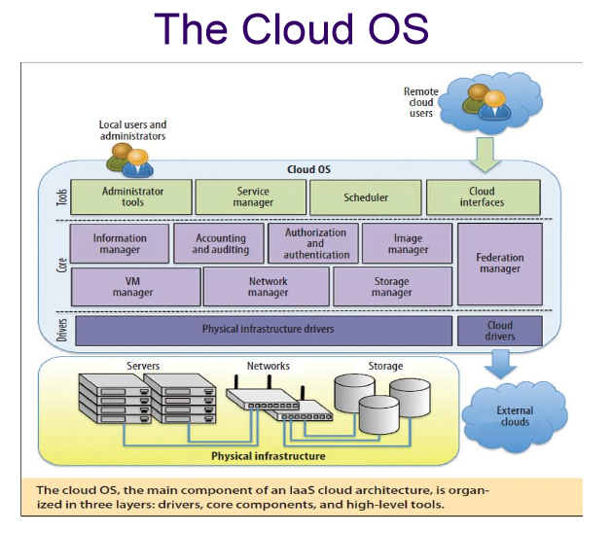
The cloud operating system is responsible for:
1. managing the physical and virtual infrastructure,
2. orchestrating and commanding service provisioning and deployment
3. providing federation capabilities for accessing and deploying virtual resources in remote cloud infrastructures

Slide 21



Value of Cloud
Value Delivered | From Traditional | From Cloud
Design and Release Application | Months | Weeks/Days
Test Provisioning | Weeks | 20 Minutes
Change Management | Months | Days or Hours
Install Database | 1 Day | 12 Minutes
Install Operating System | 1 Day | 30 Seconds
Service Provisioning | Weeks/Days | Hours/Minutes

Slide 22
Thank You.

