Slide 1
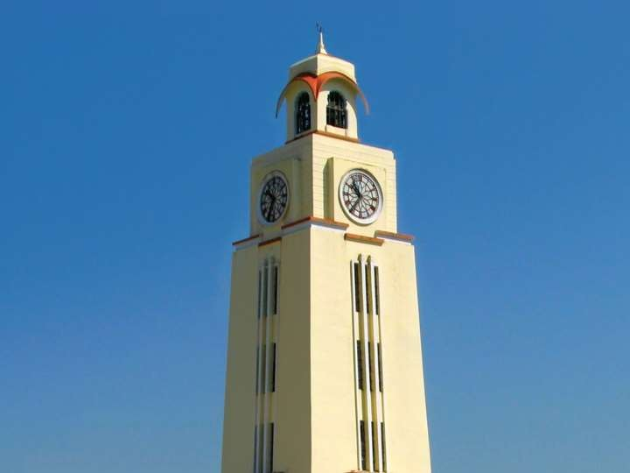

Cloud Computing
CC ZG527
BITS Pilani
Aditya Goel
1

Slide 2
Agenda
Virtualization Techniques and Types
Introduction to Virtualization
Use & demerits of Virtualization
Types of Virtualization
- Examples
Types of Hypervisors
2
2
BITS Pilani

Slide 3
Technology made cloud possible
Key Technology is Virtualization
App
App
App
App App
App
OS
OS
OS
Operating System
Hypervisor
Hardware
Hardware
Virtualization plays an important role:
as an enabling technology for datacentre implementation
abstract compute, network, and storage service platforms from the underlying physical hardware
BITS Pilani, Deemed to be University under Section 3 of UGC Act, 1956

Slide 4
Importance of Virtualization in Cloud Computing
Cloud can exist without Virtualization, although it will
be difficult and inefficient.
Cloud makes notion of “Pay for what you use”, “infinite availability- use as much you want”.
These notions are practical only if we have
  lot of flexibility
  efficiency in the back-end
This efficiency is readily available in Virtualized
Environments and Machines
BITS Pilani

Slide 5
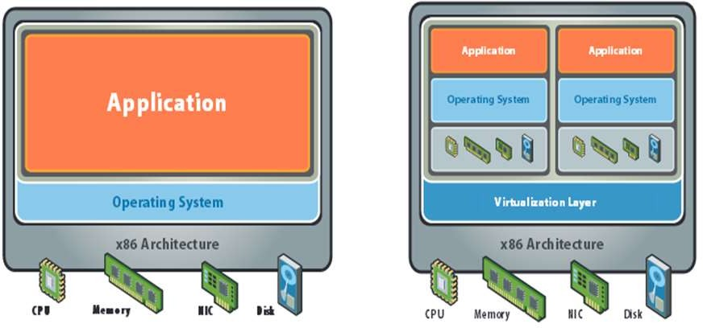
What is Virtualization?
BITS Pilani

Slide 6
What does Virtualization do?
Virtualization allows multiple operating system instances to run concurrently on a single computer
Each “guest” OS is managed by a Virtual Machine Monitor (VMM), also known as a hypervisor.
Because the virtualization layer sits between the guest and the hardware,
  it can control the guests’ use of CPU, memory, and storage
  allows a guest OS to migrate from one machine to another
BITS Pilani

Slide 7
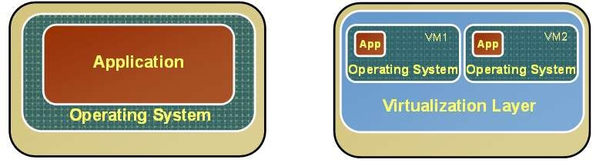
Changes after Virtualization
Before Virtualization
Single OS image per machine
Software and hardware tightly coupled
Running multiple applications on same machine often creates conflict
Underutilized resources
Inflexible and costly
infrastructure
After Virtualization
Hardware-independence
of operating system and applications
Virtual machines can be provisioned to any system
Can manage OS and application as a single unit by encapsulating them into virtual machines
BITS Pilani

Slide 8
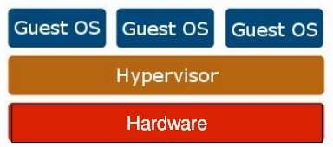
Virtualization Architecture
OS assumes complete control of the underlying hardware.
Virtualization architecture provides this illusion through a hypervisor/VMM.
Hypervisor/VMM is a software layer which:
  Allows multiple Guest OS (Virtual Machines) to run simultaneously on a single physical host
  Provides hardware abstraction
  Multiplexes underlying hardware resources
BITS Pilani

Slide 9
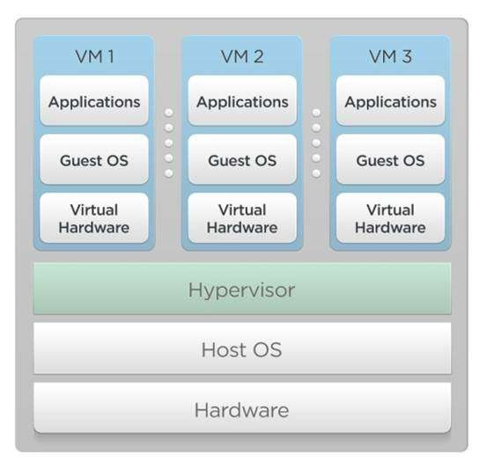
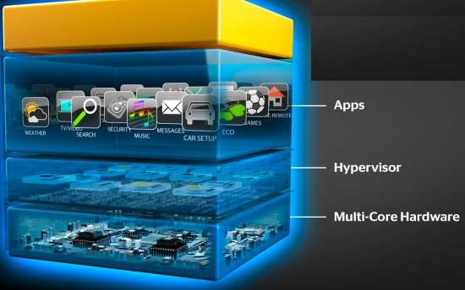
Hypervisor
A layer of software that generally provides virtual partitioning capabilities which runs directly on hardware.
Sometimes referred to as a “bare metal” approach.
BITS Pilani

Slide 10
Hypervisor Design Goals
Isolation
  Security isolation
  Fault isolation
  Resource isolation
Reliability
  Minimal code base
  Strictly layered design
Scalability
  Scale to large number of cores
  Large memory systems
BITS Pilani

Slide 11
How Hypervisor goals are achieved?
Partitioning Kernel
  “Partition” is isolation boundary
  Few virtualization functions; relies on virtualization stack
Very thin layer of software
  Microkernel
  Highly reliable
  Basis for smaller Trusted Computing Base (TCB)
No device drivers
  Drivers run in a partition
Well-defined interface
  Allow others to create support for their OSes as guests
BITS Pilani

Slide 12
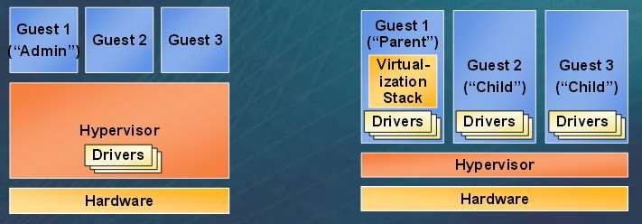
Hypervisor
Monolithic versus Microkernelized
Monolithic hypervisor
  Simpler than a modern kernel, but still complex
  Contains its own drivers
model
Microkernelized hypervisor
  Simple partitioning functionality
  Increase reliability and minimize lowest level of the TCB
  No third-party code
  Drivers run within guests
12
BITS Pilani

Slide 13
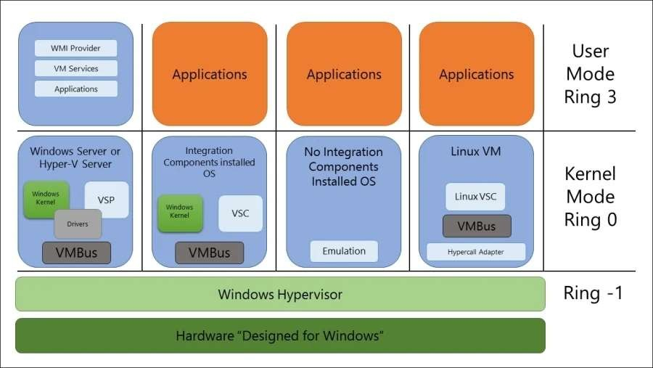
Hyper-V as a Microkernel Type 1 Hypervisor
BITS Pilani

Slide 14

Hyper-V as a Microkernel Type 1 Hypervisor
Application tries to send a request to the hardware, the kernel is
responsible for interpreting this call.
As this OS is running on an Enlightened Child Partition (Means that IC is installed), the Kernel will send this call to the Virtual Service Client (VSC) that operates as a synthetic device driver.
The VSC is responsible for communicating with the Virtual
Service Provider (VSP) on the parent partition, through VMBus
The VMBus will then be able to communicate with the hardware for the VM. The VMBus, a channel-based communication, is actually responsible for communicating with the parent partition and hardware.
VMBus to access the hardware, it will communicate directly with a component on the Hypervisor called hypercalls.
The hypercalls are then redirected to the hardware. Only the
parent partition can actually access the physical processor and memory.
BITS Pilani

Slide 15
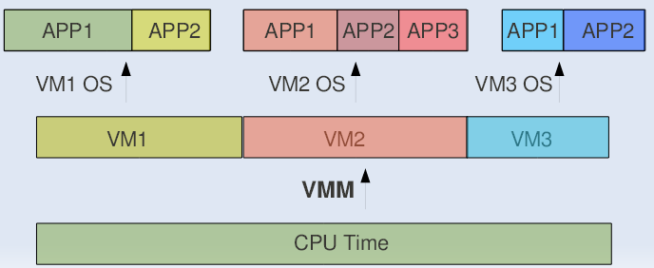
CPU Virtualization
VMM or Hypervisor provides a virtual view of CPU to
VMs.
In multi processing, CPU is allotted to the different processes in form of time slices by the OS.
Similarly VMM or Hypervisor allots CPU to different VMs.
BITS Pilani

Slide 16
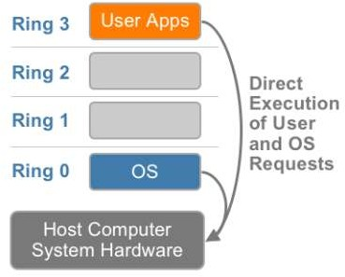
CPU Virtualization
x86 architecture offers four levels of privilege known as Ring 0, 1, 2 and 3 to operating systems and applications to manage access to the computer hardware
Virtualizing the x86 architecture requires placing a virtualization layer under the operating system (which expects to be in the most privileged Ring 0)
Some sensitive instructions can’t effectively be virtualized as they have different semantics when they are not executed in Ring 0
BITS Pilani

Slide 17
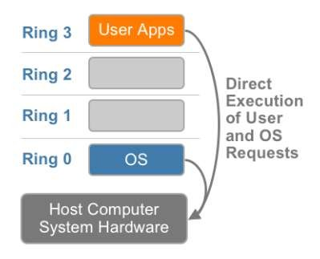
Approaches to CPU Virtualization
Three techniques now exist for handling sensitive and privileged instructions to virtualize the CPU on the x86 architecture:
Full virtualization using binary translation
OS assisted virtualization or para-virtualization
Hardware assisted virtualization
BITS Pilani

Slide 18
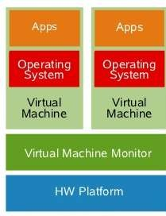
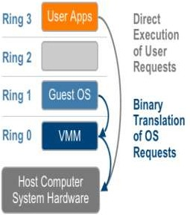
Full Virtualization using Binary Translation
Vmware(Full Virtualization) can virtualize any x86 operating system using a combination of
  binary translation
  direct execution techniques
User level code is directly executed on the processor for
high performance virtualization
Kernel code is translated to replace non-virtualizable instructions with new sequences of instructions
This combination of binary translation and direct execution provides Full Virtualization
Guest OS is fully abstracted (completely decoupled) from the underlying hardware by the virtualization layer
Flexibility: one could run a RISC-based OS as a guest on an Intel-based host.
BITS Pilani

Slide 19
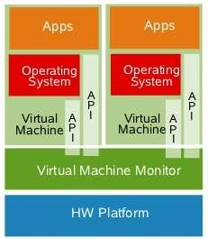
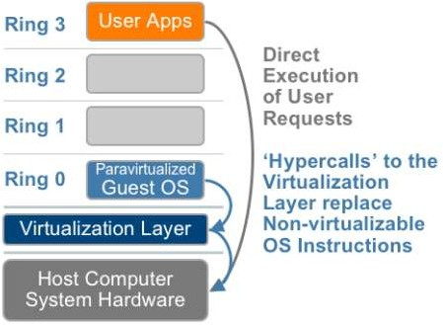
ParaVirtualization
Paravirtualization involves modifying the OS kernel to replace non-virtualizable instructions with hypercalls
Hypercalls communicate directly with the virtualization layer
The hypervisor also provides hypercall interfaces
for other critical kernel operations such as: .
.memory management
.interrupt handling
.time keeping
Paravirtualization cannot support unmodified operating systems
Compatibility and portability is poor
Ex: open-source Xen
BITS Pilani

Slide 20
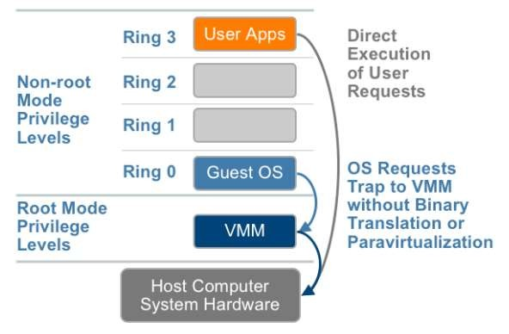
Hardware Assisted Virtualization
Intel Virtualization Technology (VT-x) and AMD’s AMD-V
which both target privileged instructions with a new CPU
execution mode feature that allows the VMM to run in a new root mode below ring 0
Privileged and sensitive calls are set to automatically trap to
the hypervisor, removing the need for either binary
translation or paravirtualization.
Underlying hardware provides special CPU instructions to aid virtualization
BITS Pilani

Slide 21
Types of Hypervisors
For Industry-standard x86 systems, the two approaches
typically used with software-based partitioning are
  Hosted
  Bare-metal architectures
A hosted approach provides partitioning services on top of a standard operating system and supports the broadest range of hardware configurations.
In contrast, a hypervisor architecture is the layer of software installed on a clean x86-based system (hence it is often
referred to as a “bare metal” approach).
  Since it has direct access to the hardware resources, a hypervisor is more efficient than hosted architectures, enabling greater scalability, robustness and performance
BITS Pilani

Slide 22
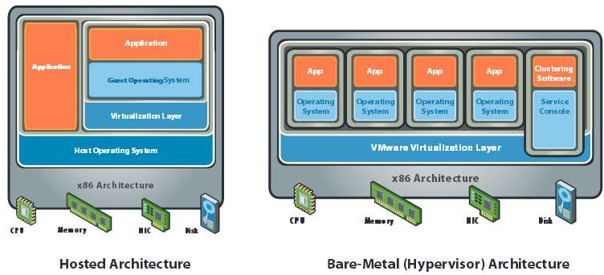
x86 Hardware Virtualization
BITS Pilani

Slide 23
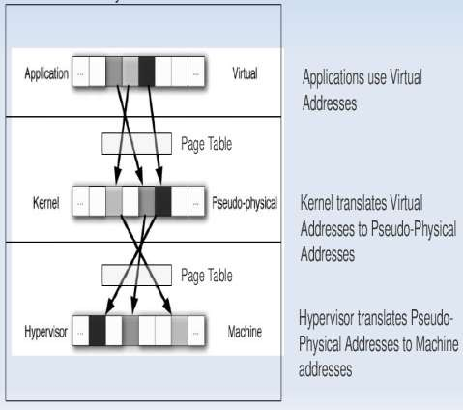
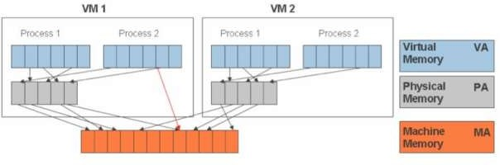
Memory Virtualization
In Multiprogramming there is a single level of
indirection maintained by Kernel.
In case of Virtual Machines there is one more level of indirection maintained by VMM
BITS Pilani

Slide 24
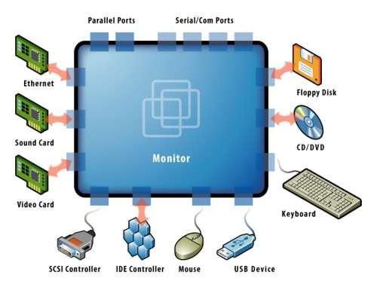
Device and IO Virtualization
This involves managing the routing of I/O requests between virtual devices and the shared physical hardware
Virtual NICs and switches create virtual networks between virtual machines without the network traffic consuming bandwidth on the physical network
The hypervisor virtualizes the physical hardware and presents each
virtual machine with a standardized set of virtual devices
These virtual devices effectively emulate well-known hardware and translate the virtual machine requests to the system hardware
BITS Pilani

Slide 25
Advantages of Virtualization
Instant provisioning - fast scalability
Live Migration is possible
Load balancing and consolidation in a Data Center is possible.
Low downtime for maintenance
Virtual hardware supports legacy operating systems efficiently
Security and fault isolation
BITS Pilani

Slide 26
Issues to be aware of
Software licensing
IT training
Hardware investment
BITS Pilani

Slide 27
Issues(technical) to be aware of
Performance can be a concern, especially for in-band deployments, where the virtualization controller or appliance can become a bandwidth bottleneck.
Interoperability among vendor products is still evolving.
Failure of the virtualization device, leading to loss of the mapping table.
BITS Pilani

Slide 28
Summary
Virtualization is Key to Exploiting Trends
Allows most efficient use of the compute resources
  Few apps take advantage of 16+ CPUs and huge memory as well as virtualization
  Virtualization layer worries about NUMA, not apps
Maximize performance per watt across all servers
  Run VMs on minimal # of servers, shutting off the others
  Automated, live migration critical:
    Provide performance guarantees for dynamic workloads
    Balance load to minimize number of active servers
Stateless, Run-anywhere Capabilities
  Shared network and storage allows flexible mappings
  Enables additional availability guarantees
BITS Pilani

Slide 29
End of Session 3
BITS Pilani

