Slide 1


Cloud Computing
Session 6 - IaaS
BITS Pilani
1

Slide 2


IaaS
Really, what is iaas???
BITS Pilani

Slide 3
Cloud computing defined
Cloud computing is the on-demand delivery of compute power, database, storage, applications, and other IT resources via the internet with pay-as- you-go pricing.

Slide 4
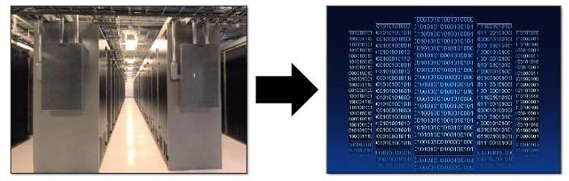
Infrastructure as a Software
Cloud computing enables you to stop thinking of your infrastructure as hardware, and instead think of(and use) it as software.

Slide 5
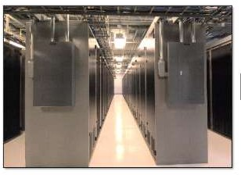
Traditional computing model
Infrastructure as hardware
Hardware solutions:
  Require space, staff,
physical security, planning, capital expenditure
  Have a long hardware procurement cycle
  Require you to
provision capacity by guessing theoretical maximum peaks

Slide 6
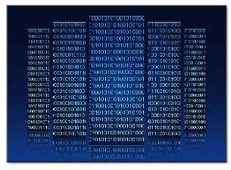
Cloud computing model
Infrastructure as software
Software solutions:
  Are flexible
  Can change more
quickly, easily, and
cost-effectively than hardware solutions
  Eliminate the undifferentiated heavy-lifting tasks

Slide 7

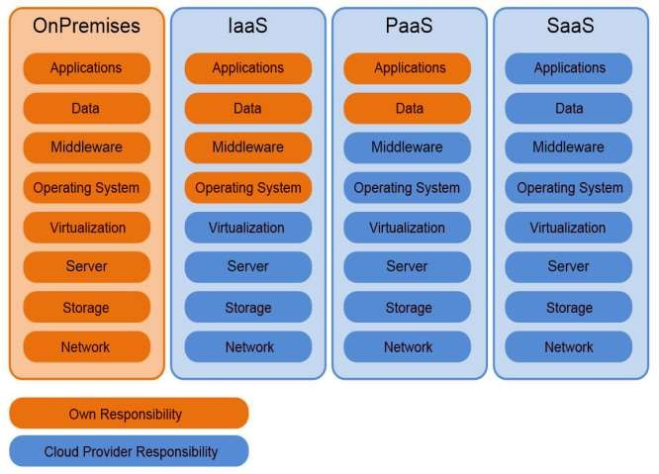
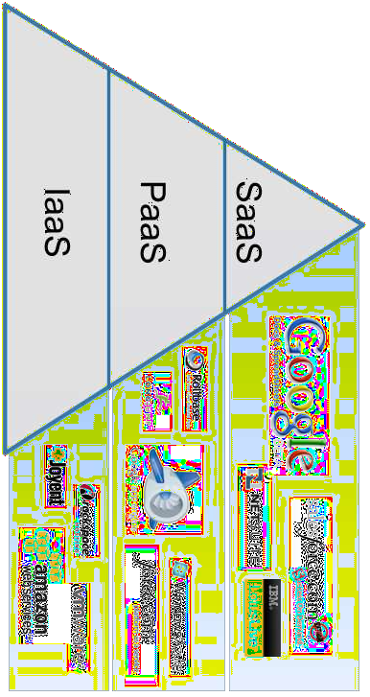
heard of 3 models of Cloud Computing?
Yes, Yes, IaaS, PaaS and SaaS
BITS Pilani

Slide 8
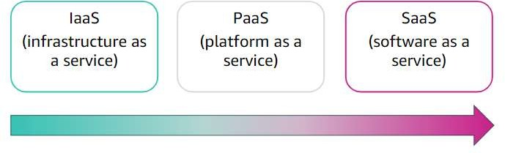
Cloud service models
More control over IT resources
Less control over IT resources

Slide 9
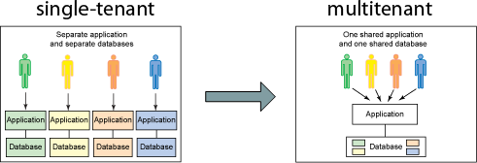
Key concepts of IaaS
Cloud bursting: The process of off-loading tasks to the cloud during
times when the most compute resources are needed
Multi-tenant computing
Resource pooling: Pooling is a resource management term that refers to the grouping together of resources (compute(cpu), network(bandwidth), storage) for the purposes of maximizing advantage and/or minimizing risk to the users
Hypervisor
BITS Pilani

Slide 10
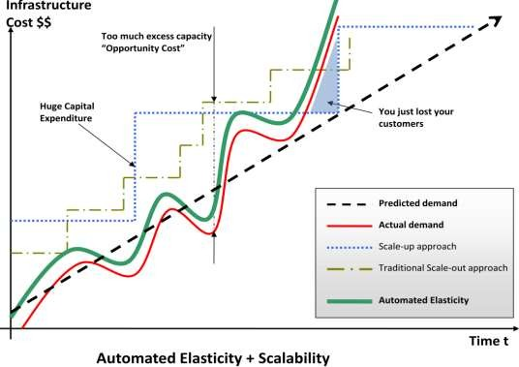
Two primary facets that make IaaS special
Elasticity:
Wikipedia: “In cloud computing, elasticity is defined as the degree to which a system (or a particular cloud layer) autonomously adapts its capacity to workload over time”
OR simply put “Ability of a system to expand or contract its dedicated resources to meet the demand”
&
Virtualization
BITS Pilani

Slide 11
The value of IaaS
For businesses, the greatest value of IaaS is through a concept known as cloudbursting—the process of off- loading tasks to the cloud during times when the most compute resources are needed.
To take advantage of IaaS in this capacity, IT departments must be able to build and implement the software that handles the ability to re-allocate processes to an IaaS cloud.
There are four important considerations to build and implement software that can manage such reallocation processes.
BITS Pilani

Slide 12
4 considerations:
Developing for a specific vendor's proprietary IaaS could
prove to be a costly mistake
The complexity of well-written resource allocation software is significant and do not come cheap
What will you be sending off to be processed in the cloud? Sending data such as personal identities, financial information, and health care data put an organization's compliance at risk
Understand the dangers of shipping off processes that are
critical to the day-to-day operation of the business.
http://www.ibm.com/developerworks/cloud/library/cl-cloudservices1iaas/
BITS Pilani

Slide 13
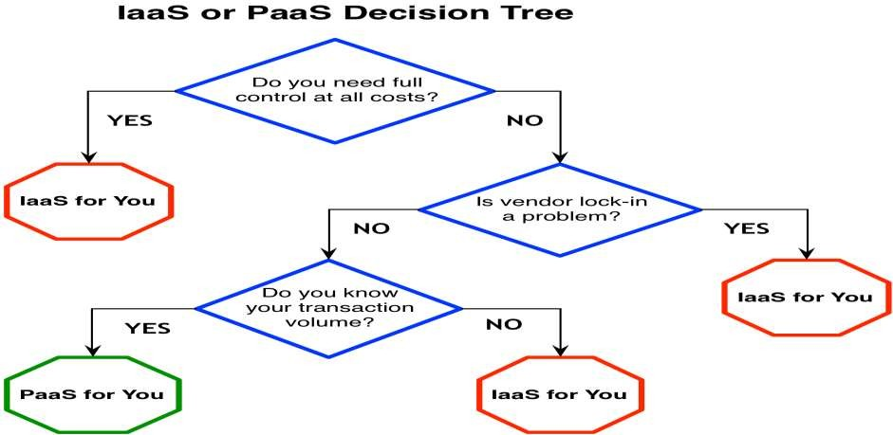
How to Decide – IaaS or PaaS?
BITS Pilani

Slide 14
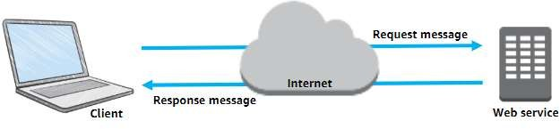
What are web services?
A web service is any piece of software that makes itself available over the internet
Uses a standardized format for the request and the response of
an Application Programming Interface(API) interaction
  Extensible Markup Language (XML)
  JavaScript Object Notation (JSON)

Slide 15
Amazon Web Services
Amazon Web Services Cloud
AWS is a secure cloud platform that offers a broad set of global cloud-based products
Provides highly reliable and scalable infrastructure for deploying web-scale solutions
With minimal support and administration costs(pay as you go, for as long as you use them
More flexibility than own infrastructure, either on-
premise or at a datacentre facility
AWS services work together like building blocks
BITS Pilani

Slide 16
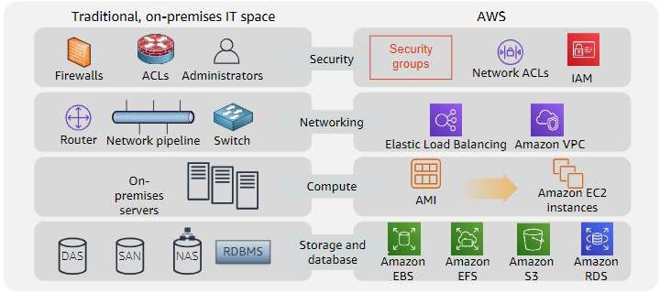
Similarities between AWS and traditional IT

Slide 17
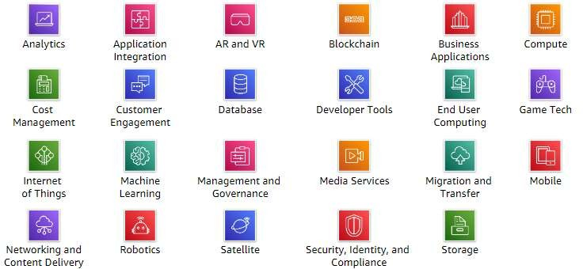
Categories of AWS services

Slide 18
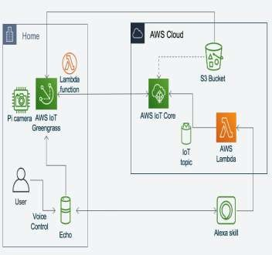
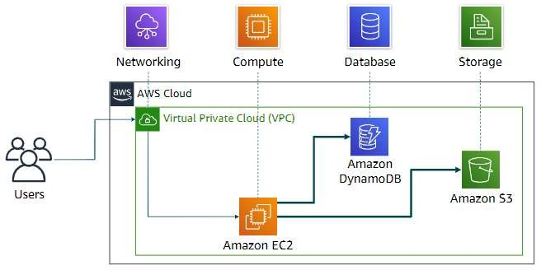
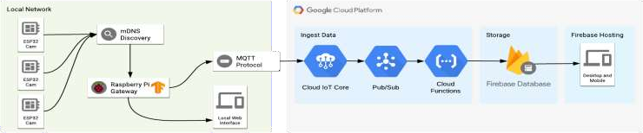
Simple solution example

Slide 19
Three ways to interact with AWS
AWS Management Console
  Easy-to-use graphical interface
Command Line Interface (AWS CLI)
  Access to services by discrete commands or scripts
Software Development Kits (SDKs)
  Access services directly from your code (such as Java, Python, and others)

Slide 20
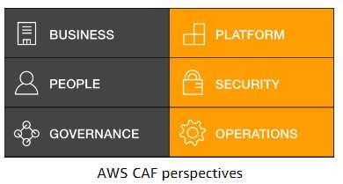
Moving to the AWS Cloud
–The AWS Cloud Adoption Framework (AWS CAF)
AWS CAF provides guidance and best practices to help organizations build a comprehensive approach to cloud computing across the organization and throughout the IT lifecycle to accelerate successful cloud adoption.
AWS CAF is organized into six perspectives.
Perspectives consist of sets of capabilities.

Slide 21
AWS Global Infrastructure
https://aws.amazon.com/about-aws/global- infrastructure/#AWS_Global_Infrastructure_Map

Slide 22
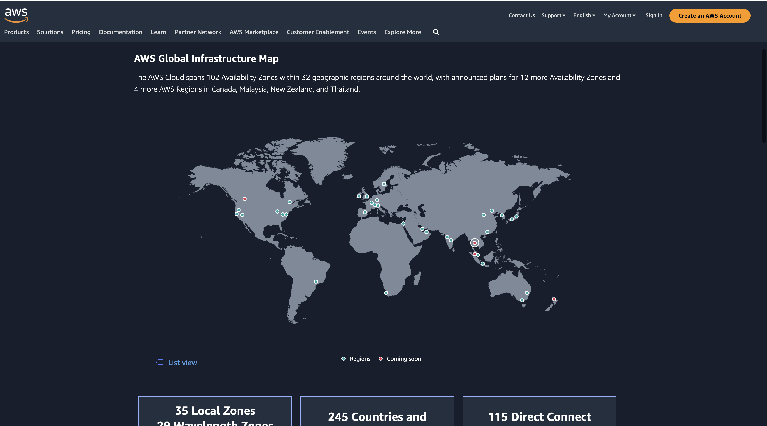

Slide 23
AWS Regions
An AWS Region is a geographical area.
  Data replication across Regions is controlled by you.
  Communication between Regions uses AWS backbone
network infrastructure.
Each Region provides full redundancy and connectivity to the network.
A Region typically consists of two or more Availability Zones.
https://aws.amazon.com/about-aws/global-
infrastructure/regions_az/?p=ngi&loc=2

Slide 24
Selecting a Region
Data governance, legal requirements
Determine the right Region for your service, applications, and data based on these factors
Proximity to customers (latency)
Services available within the Region
Costs (vary by Region)

Slide 25
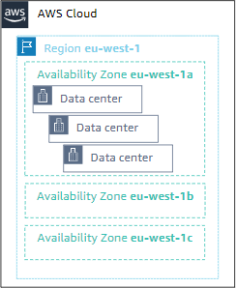
Availability Zones
Each Region has multiple Availability Zones.
Each Availability Zone is a fully isolated
partition of the AWS infrastructure.
  Availability Zones consist of discrete data centers
  They are designed for fault isolation
  They are interconnected with other Availability Zones by using high- speed private networking
  AWS recommends replicating data and resources across Availability Zones for resiliency

Slide 26
AWS data centers
AWS data centers are designed for security.
Data centers are where the data resides and data processing occurs.
Each data center has redundant power, networking, and connectivity, and is housed in a separate facility.
A data center typically has 50,000 to 80,000 physical servers.

Slide 27
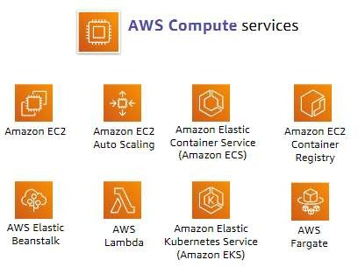
Compute service

Slide 28
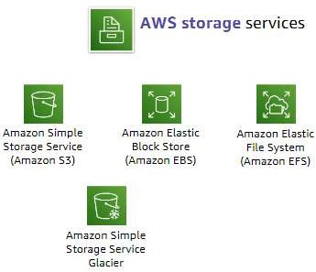
Storage service

Slide 29
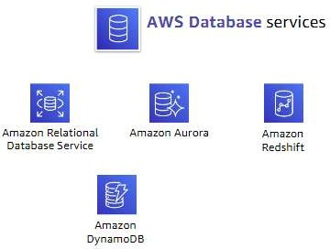
Database service

Slide 30
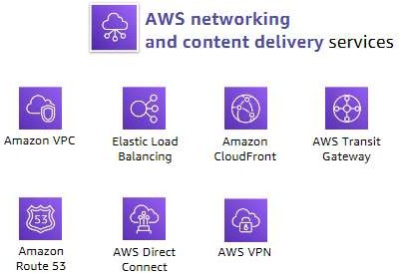
Networking and content delivery service

Slide 31
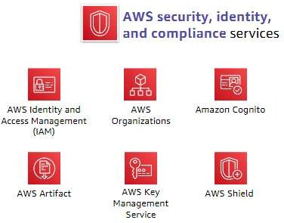
Security, identity, and compliance service

Slide 32
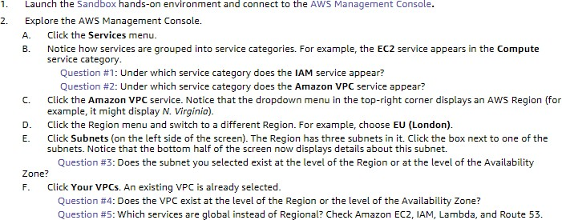
AWS Management
Hands-on activity: Console

Slide 33
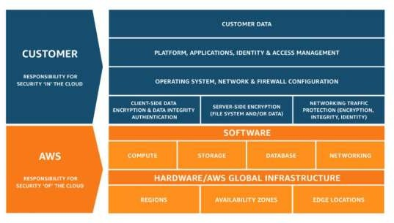
AWS shared responsibility model

Slide 34
AWS shared responsibility model
AWS operates, manages, and controls the components from the software virtualization layer down to the physical security of the facilities where AWS services operate.
AWS is responsible for protecting the infrastructure that runs all the services that are offered in the AWS Cloud.
This infrastructure is composed of the hardware, software, networking, and facilities that run the AWS Cloud services

Slide 35
AWS shared responsibility model
The customer is responsible for the encryption of data at rest and data in transit.
The customer should also ensure that the network is configured for security and that security credentials and logins are managed safely.
The customer is responsible for the configuration of security groups and the configuration of the operating system that run on compute instances that they launch (including updates and security patches)

Slide 36
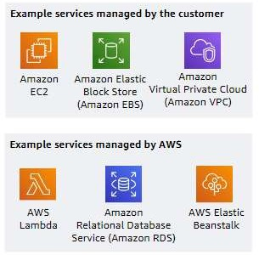
Service characteristics and security responsibility
IaaS
  Customer has more flexibility over configuring networking and storage settings
  Customer is responsible for managing more aspects of the security
  Customer configures the access controls
PaaS
  Customer does not need to manage the underlying infrastructure
  AWS handles the operating system, database patching, firewall configuration, and disaster recovery
  Customer can focus on managing code or data

Slide 37
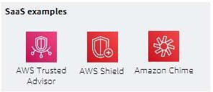
Service characteristics and security responsibility
SaaS
  Software is centrally hosted
  Licensed on a subscription model or pay-as-
you-go basis
  Services are typically accessed via web browser, mobile app, or application programming interface (API)
  Customers do not need to manage the
infrastructure that supports the service

Slide 38
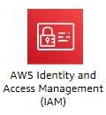
AWS Identity and Access Management (IAM)
Use IAMto manage access to AWS resources–
  A resource is an entity in an AWS account that you can
work with
  Example resources; An Amazon EC2 instance or an Amazon S3 bucket
Example–Control who can terminate Amazon EC2 instances
Define fine-grained access rights –
  Who can access the resource
  Which resources can be accessed and what can the
user do to the resource
  How resources can be accessed •IAM is a no-cost AWS account feature

Slide 39




IAM: Essential components
A person or application that can authenticate with an AWS account
A collection of IAM users that are granted identical authorization
The document that defines which resources can be accessed and the level of access to each resource
Useful mechanism to grant a set of permissions for making AWS service requests

Slide 40
Authenticate as an IAM user to gain access
Programmatic access
  Authenticate using:
    Access key ID
    Secret access key
  Provides AWS CLI and AWS SDK access
AWS Management Console access
  Authenticate using:
    12-digit Account ID oralias
    IAM user name
    IAM password
  If enabled, multi-factor authentication (MFA)prompts for an authentication code

Slide 41
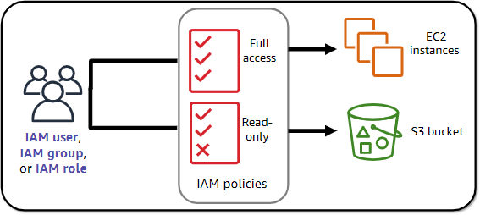
Authorization: What actions are permitted

Slide 42
IAM: Authorization
Assign permissions by creating an IAM policy.
  Permissions determine which resources and operations are allowed:
  All permissions are implicitly denied by default.
  If something is explicitly denied, it is never allowed.
Best practice: Follow the principle of least privilege.
Note: The scope of IAM service configurations is global.
Settings apply across all AWS Region

Slide 43
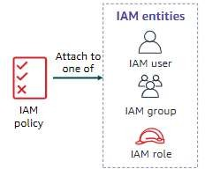
IAM policies
An IAM policy is a document that defines permissions
– Enables fine-grained access control
Two types of policies –identity-based and resource-
based
Identity-based policies –
  Attach a policy to any IAM entity
  An IAM user, an IAM group, or an IAM role
Policies specify:
  Actions that maybe performed by the entity
Actions that may notbe performed by the
entity
– A single policy can be attached to multiple entities
– A single entity can have multiple policies attached
to it
Resource-based policies
– Attached to a resource (such as an S3 bucket)

Slide 44
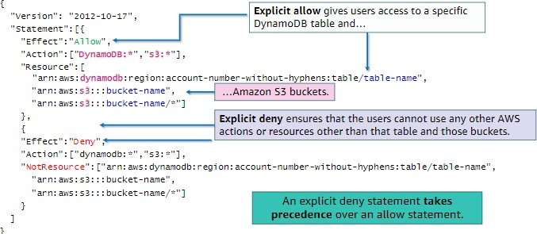
IAM policy example

Slide 45
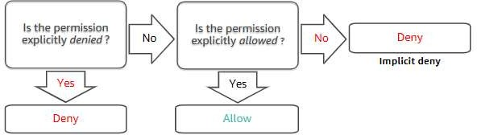
IAM permissions
How IAM determines permissions:

Slide 46
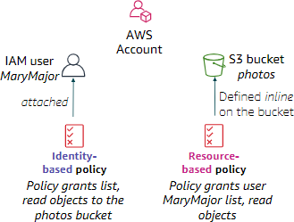
Resource-based policies
Identity-based policies are attached to a user, group, or role
Resource-based policies are attached to
a resource (not to a user, group or role)
Characteristics of resource-based policies –
  Specifies who has access to the resource and what actions they can perform on it
  The policies are in line only, not managed
Resource-based policies are supported
only by some AWS services

Slide 47
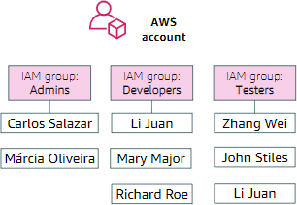
IAM groups
An IAM group is a collection of IAM users
A group is used to grant the same permissions to multiple users
Permissions granted by attaching IAM policy or policies to the group
A user can belong to multiple groups
There is no default group
Groups cannot be nested

Slide 48
IAM roles
An IAM role is an IAM identity with specific permissions
Similar to an IAM user
  Attach permissions policies to it
Different from an IAM user
  Not uniquely associated with one person
  Intended to be assumable by a person, application, or service
Role provides temporary security credentials
Examples of how IAM roles are used to delegate access –
  Used by an IAM user in the same AWS account as the role
  Used by an AWS service—such as Amazon EC2—in the same
account as the role
  Used by an IAM user in a different AWS account than the role

Slide 49
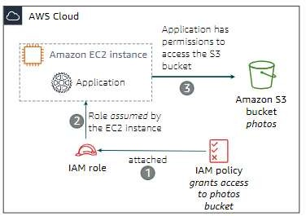
Example use of an IAM role
Scenario:
  An application that runs on an EC2 instance needs access to an S3 bucket
Solution:
  Define an IAM policy that grants access to the S3 bucket.
  Attach the policy to a role
  Allow the EC2 instance to assume the role

Slide 51
IaaS for you
Thanks, I feel so “Clouded” now
BITS Pilani

Slide 52
