Slide 1
GraphQL
Introduction to GraphQL
Rodrigo Prates
github.com/rodrigocprates
08/2019

Slide 2
Agenda
Introduction
How it works
Core Concepts
REST vs GraphQL
Architecture use cases
Running sample
Tools & Ecosystem
Conclusions

Slide 3
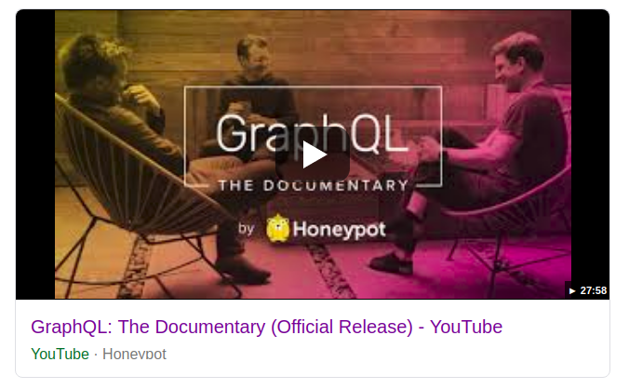
Introduction
https://www.youtube.com/watch?v=783ccP__No8

Slide 4
Introduction
GraphQL is a query language for APIs and a runtime for fulfilling those queries with your existing data. GraphQL provides a complete and understandable description of the data in your API, gives clients the power to ask for exactly what they need and nothing more, makes it easier to evolve APIs over time, and enables powerful developer tools.

Slide 5
Introduction
Created by Facebook in 2012 to solve data fetching challenges on their native mobile apps
Open sourced in 2015
Language agnostic
Alternative to REST architecture style to design APIs
Used in production by big companies like GitHub, Facebook, Paypal..

Slide 6







Who is using GraphQL?
See https://graphql.org/users/

Slide 7
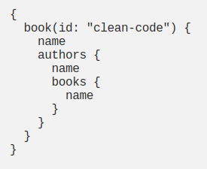
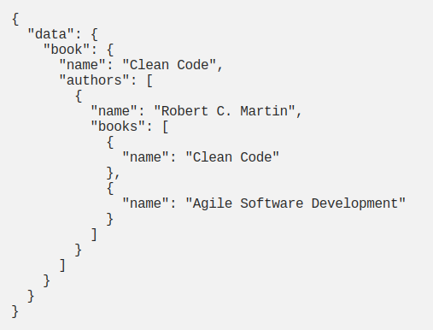
How it works
Client Request
Server Response (JSON)

Slide 8


How it works
Front end guy
Back end guy

Slide 9
Core Concepts
Schema: defines the API structure/contract itself - Core concept
Type: definition of a model (Person, Band, Document..)
Scalar types (default): Int, Float, Boolean, String, ID and custom scalar types
Query: definitions to query data (fetch)
Mutation: definition to mutate data (create, update, delete..)

Slide 10
Four important aspects
Specification: schema specifies the API contract.
Strongly Typed: all types and relationships are defined in schema.
Introspective: client can query details about the schema.
Hierarchical: query and response have same structure.

Slide 11
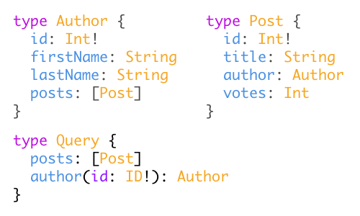
Schema definition
To define a schema we use a Schema Definition Language (SDL)

Slide 12
Operation types
There are three types of operations in a GraphQL service:
Query: a read-only fetch
Mutation: a write followed by a fetch
Subscription: a long‐lived request that fetches data in response to source events

Slide 13
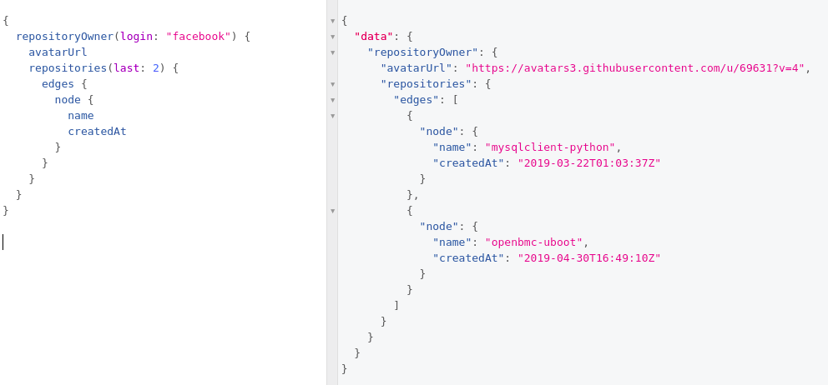
Query operation type - github graphQL API

Slide 14
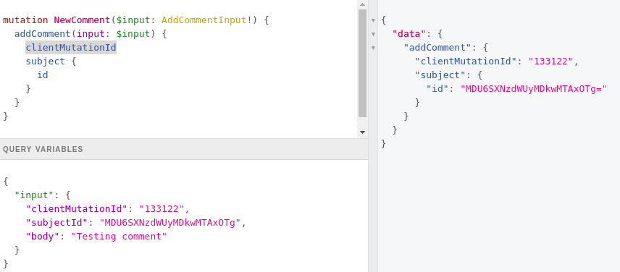
Mutation operation type - github graphQL API

Slide 15
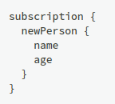
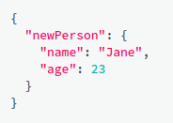
Subscription operation type
Client call
< connection opened >
Server response
whenever a new mutation is performed that creates a new Person, the server sends the information about this person over to the client

Slide 16
REST
vs
GraphQL
ways to fetch data

Slide 17
USE CASE:
For a given blog API, get:
person name, only posts title and name of last 3 followers

Slide 18
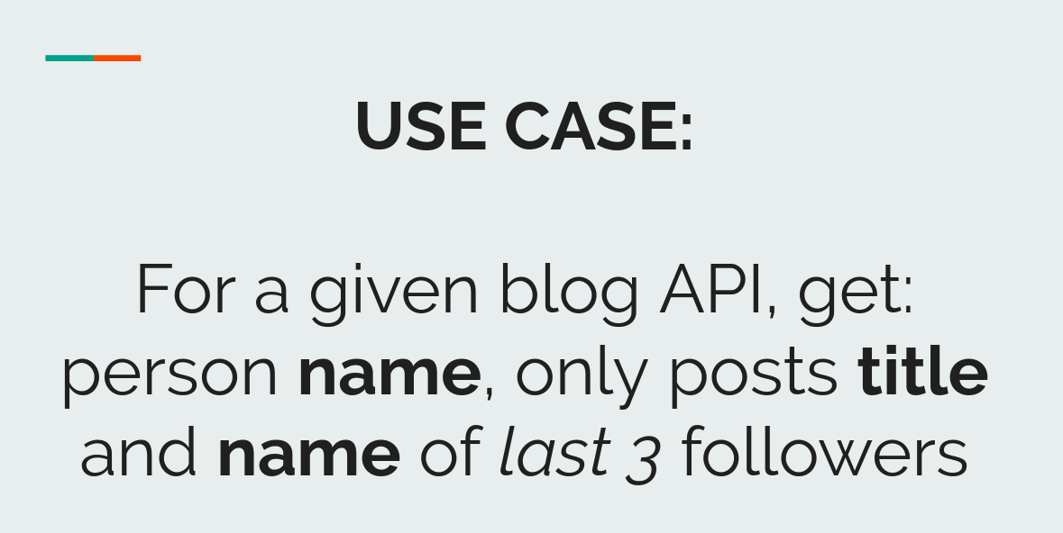
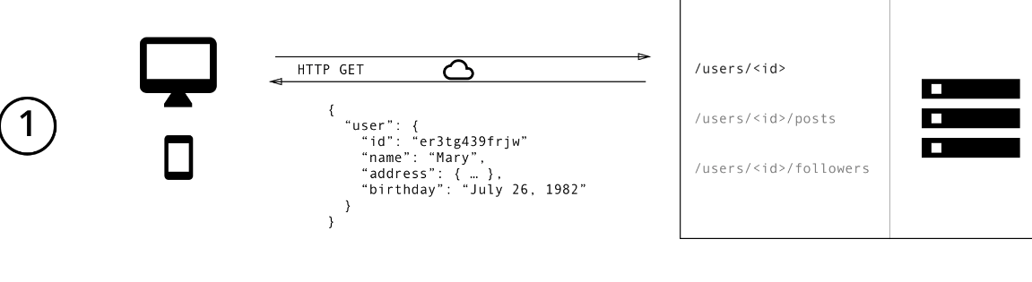
REST way to fetch data

Slide 19
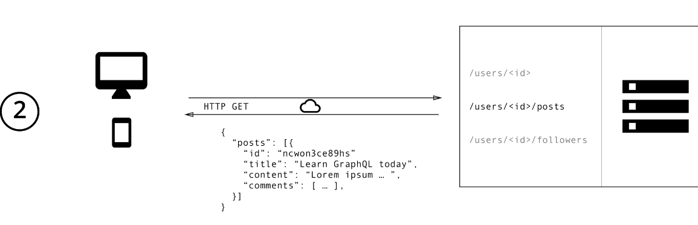
REST way to fetch data

Slide 20
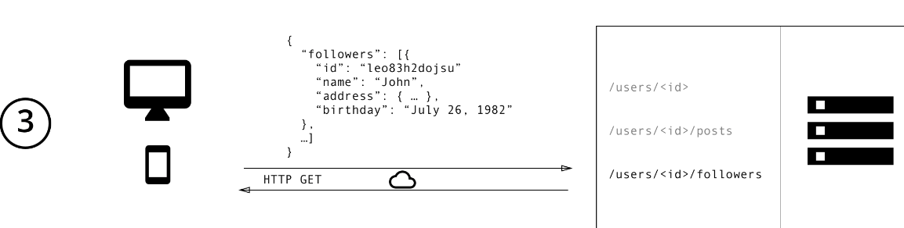
REST way to fetch data

Slide 21
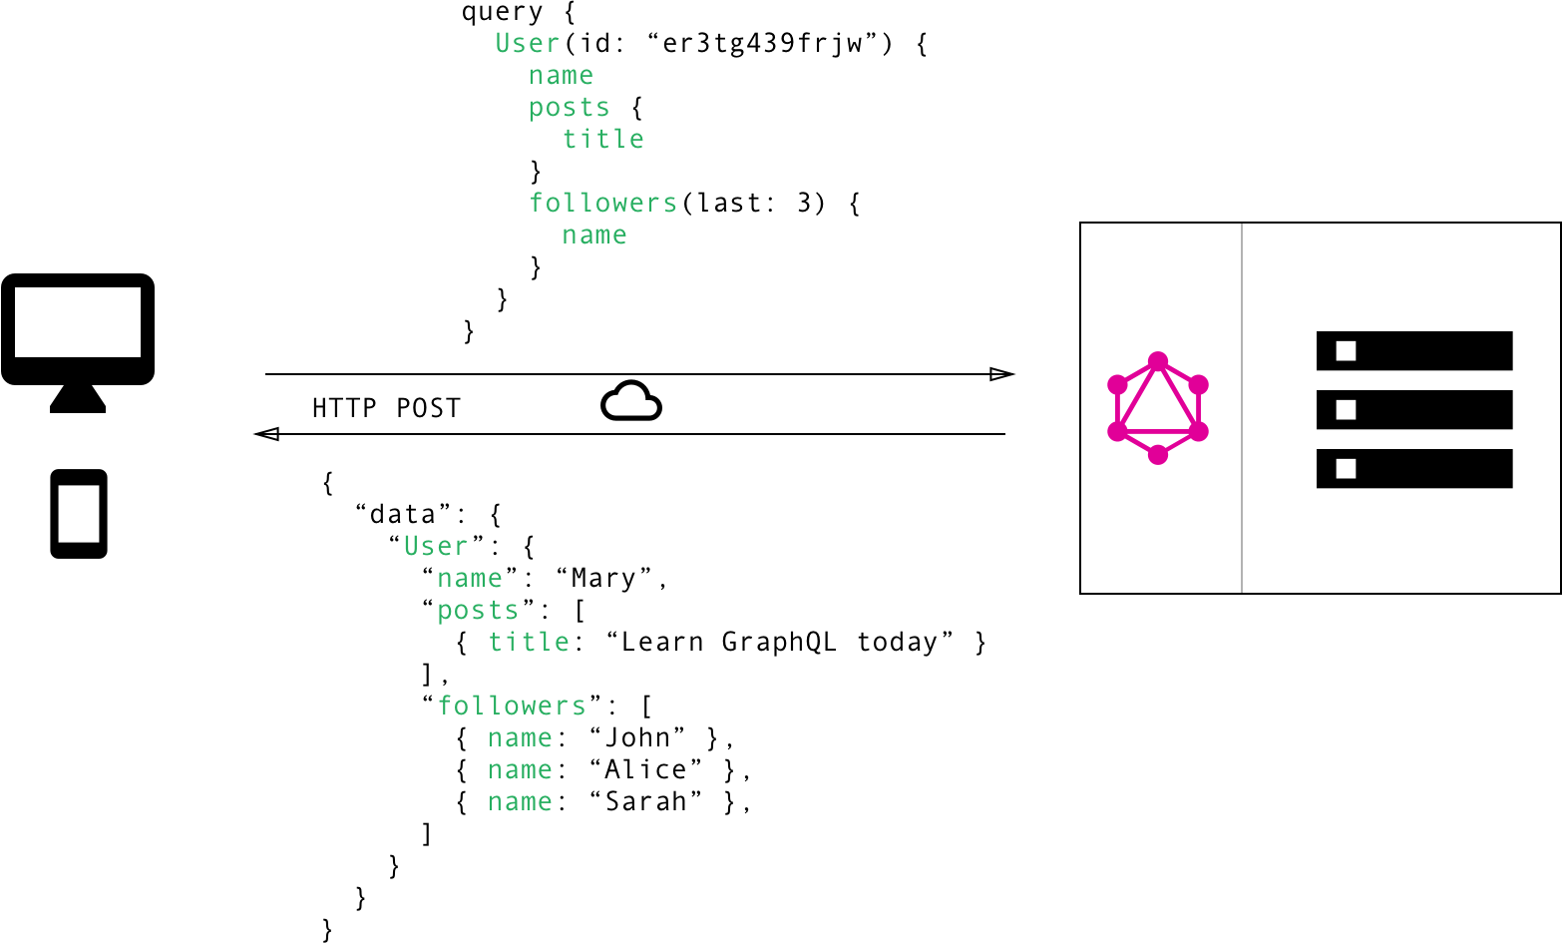
GraphQL: Fetch only data you want
Front end guy

Slide 22
REST vs GraphQL
REST way:
Fetch data from multiple endpoints
Overfetching: call too much data that won’t be all used
Underfetching: call an endpoint that has not enough data - forcing to call another endpoint
GraphQL way:
Ask for specific fields in a single API call

Slide 23
REST vs GraphQL
BUT:
GraphQL is not better because it is trending
Schema definition can become very complex in a big application
Support caching could be harder

Slide 24
Architecture use cases
GraphQL server with a connected database
GraphQL server in front of a number of third party or legacy systems and integrates them through a single GraphQL API
A hybrid approach of a connected database and third party or legacy systems that can all be accessed through the same GraphQL API

Slide 25
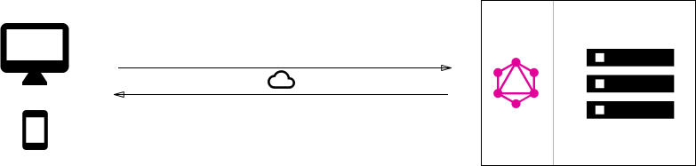
Architecture use cases
GraphQL server with a connected database

Slide 26
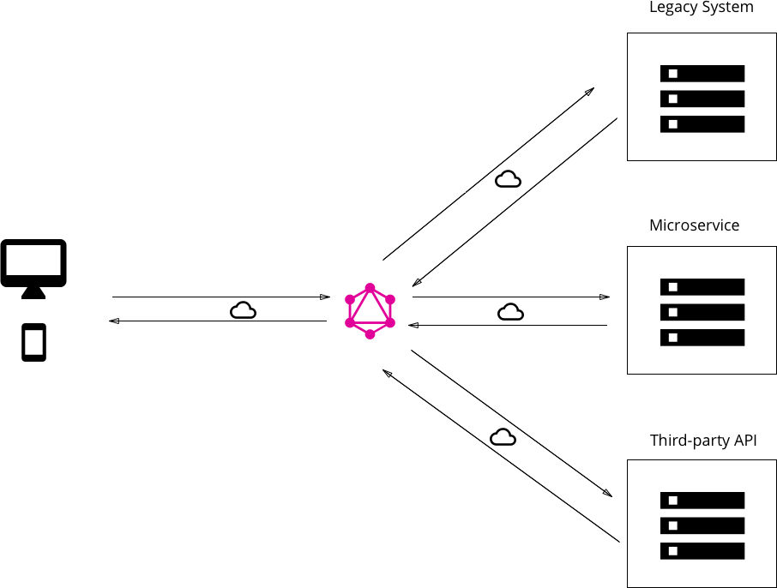
Architecture use cases
GraphQL server in front of a number of third party or legacy systems and integrates them through a single GraphQL API

Slide 27
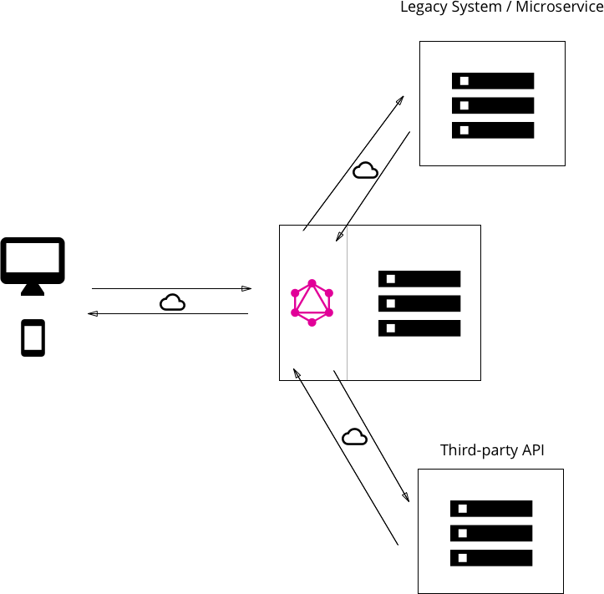
Architecture use cases
A hybrid approach of a connected database and third party or legacy systems that can all be accessed through the same GraphQL API

Slide 28
Running samples
Github V4 API Explorer: https://developer.github.com/v4/explorer/
Java sample

Slide 29
Tools & Ecosystem
Specification: http://facebook.github.io/graphql
GraphQL website: https://graphql.org/
GraphQL Reference Implementation in JS: https://graphql.org/graphql-js/
Many different language implementations: https://graphql.org/code/
Awesome GraphQL
https://github.com/chentsulin/awesome-graphql

Slide 30
Thoughts
From a client perspective, using GraphQL is amazing
From a server perspective, you gotta know what you are doing
There are a massive number of tools and libs that we can use
Some language implementations seem to be easier than others
Better have standards to structure project and big schemas
Starting point to your project might be create GraphQL API in front of your REST endpoints

Slide 31
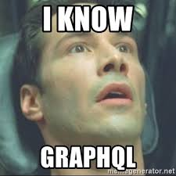
THANKS!

