Slide 1
Introduction to GraphQL
Presenter Name Swapnil Dixit

Slide 2
KnolX Etiquettes
Lack of etiquette and manners is a huge turn off.
Punctuality
Join the session 5 minutes prior to the session start time. We start on time and conclude on time!
Feedback
Make sure to submit a constructive feedback for all sessions as it is very helpful for the presenter.
Silent Mode
Keep your mobile devices in silent mode, feel free to move out of session in case you need to attend an urgent call.
Avoid Disturbance
Avoid unwanted chit chat during the session.

Slide 3
Introduction to GraphQL
Queries , Mutations & Subscriptions
SDL (Schema Definition language) , Runtime Environment & Query Language
Data Fetchers
How graphQL works in java
Difference between GraphQL & REST
Advantage & Disadvantages
Demo

Slide 4
GraphQL
Official definition GraphQL is a query language for APIs and a runtime for fulfilling those queries with your existing data. GraphQL provides a complete and understandable description of the data in your API, gives clients the power to ask for exactly what they need and nothing more.
Important points from this definition: GraphQL is a query language for APIs not a tool or a framework for designing APIs. A client gets exactly what it wants from an API nothing more than that.
In GraphQL, queries, mutations, and subscriptions are three types of operations that clients can perform to interact with a GraphQL API
In a single GraphQL request, queries, mutations, and subscriptions can be combined and executed in parallel, improving efficiency
GraphQL is a collection of three things:
SDL Schema definition language Runtime Environment Query Language

Slide 5
Queries , Mutations & Subscriptions
Queries : Queries are used by clients to request data from the server. They are read-only operations, meaning they do not modify data on the server. Queries are used to retrieve data. They specify the fields and nested data structures needed in the response. Multiple queries can be combined into a single request for efficiency.
Mutations : Mutations are used when clients need to modify data on the server. Unlike queries, mutations can cause side effects on the server, such as creating, updating, or deleting data. Mutations are used to modify or create data on the server. They include an input object with the data to be modified or created. Like queries, mutations can specify the fields needed in the response.
Subscriptions : Subscriptions enable real-time communication between the server and the client. Clients can subscribe to specific events, and the server will push updates to the client when those events occur. Subscriptions are used for real-time updates. They define an event to subscribe to and the data structure to be sent when the event occurs.

Slide 6
Schema definition language(SDL)
Schema definition language is used to define a GraphQL schema.
A GraphQL schema is used to expose the functionalities that are available in an application to its users. For ex: adding a new book to a virtual library or getting a list of all books from that library.
A GraphQL schema contains: ■ Types which are similar to classes in Java.
■ Operations which can be performed on these Types. Similar to methods in Java. type Query{ type Mutation{
getBook (id: Int) : Book createBook (name: String, pages: Int): Int
getBooks: [Book] }
} type Book{ id: Int
name: String
}

Slide 7
Runtime Environment
Runtime environment performs two major operations: Parsing the GraphQL schema file and creating an 'In memory schema' from it. Executing the operation specified in the client's request.
Parsing the GraphQL schema file Reading information from the schema file again & again will be inefficient so the runtime environment creates an Inmemory representation of the schema file that contains all the information defined in that schema file.
Executing the operation A user can use any of the operations that were defined in the schema file. Runtime environment is responsible for handling the user's request it looks for the operation specified in the request then uses the inmemory schema to check if that operation exists in the schema or not. If it exists then runtime will execute it and will perform the specified action like reading or manipulating the data at server.

Slide 8
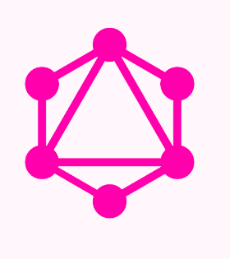
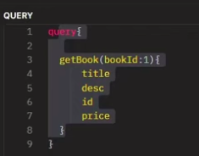
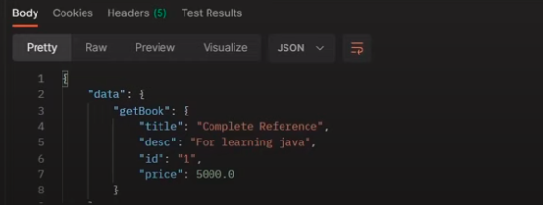
Query language(QL)
Query language is used by clients to use operations that are defined in the GraphQL schema.
QL enables a client to select only the required fields from a set of fields.

Slide 9
Data fetchers
A data fetcher is a function associated with a specific field in the GraphQL schema. It's responsible for fetching the data that corresponds to that field when a query is executed
Each field in a GraphQL schema has an associated resolver function (data fetcher). Resolvers are defined for each field in the schema, and they determine how the data for that field should be obtained.
When a GraphQL query is received by the server, the execution starts by invoking the data fetcher for the root fields. These root data fetchers may, in turn, invoke other data fetchers for nested fields.
Data fetchers can accept arguments provided in the query to customize the data retrieval process. These arguments are specified in the query and used by the data fetcher to fetch relevant data.
Data fetchers have access to a context object, which can store information shared across all resolvers. This context object can contain data such as authentication details or database connections.
GraphQL clients often request the same data multiple times. Data fetchers can implement caching strategies to optimize performance by avoiding redundant data fetches

Slide 10
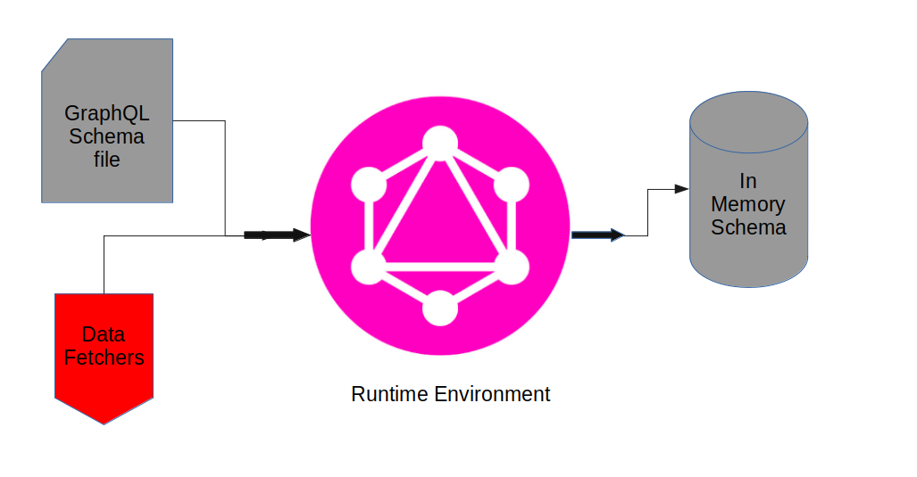
Preparing In Memory Schema

Slide 11
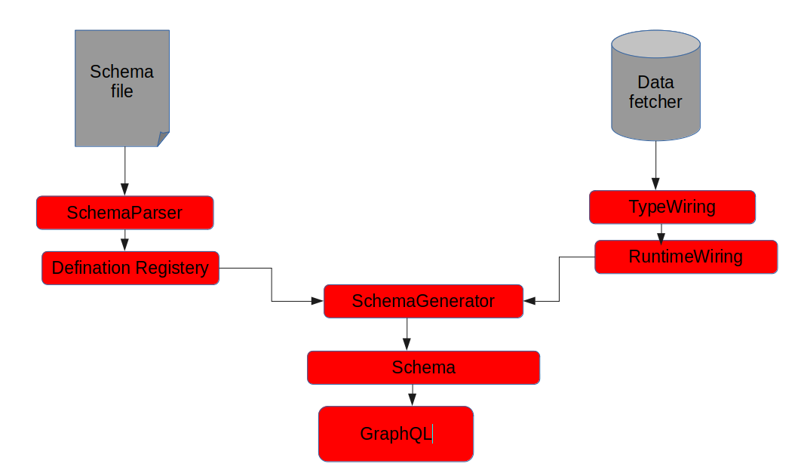
How GraphQL works in java

Slide 12
GraphQL vs REST
 | GraphQL | REST
Query Language | Query language that allows clients to request only the data they need, including nested data and related entities | Uses fixed endpoints that return predefined data structures. Clients have limited control over the shape and size of the data they receive
Data Fetching | Provides a single endpoint for all interactions. Clients can specify the structure of the response, avoiding over-fetching and under-fetching issues | Requires multiple endpoints for different resources or views. Over-fetching is common
Response Format | Responses match the structure of the query, and the server doesn't dictate the response format. Clients can request only the data they need | Responses are typically fixed, and any changes require modifications to the server. Different clients may need different versions of the same resource
Discoverability: | Introspective nature allows clients to explore the schema and understand available types, fields, and their relationships. | Requires documentation to inform clients about available endpoints, methods, and data structures.

Slide 13
GraphQL Schema file
type Mutation{
createBook(book:BookInput):Book
}
type Query{
allBooks:[Book]
getBook(bookId:Int):Book
}
type Book{
id:ID!
title:String
desc:String
author:String
price:Float
pages:Int
}
input BookInput{
title:String
desc:String
author:String
price:Float
pages:Int
}

Slide 14
Advantage & Disadvantage of graphQL
Advantage
Disadvantage
Efficient Data Retrieval - Allows clients to request only the data they need, reducing over-fetching and under-fetching of data
Flexibility and Adaptability - Clients have fine-grained control over the data they receive
Single Endpoint - GraphQL APIs typically have a single endpoint, simplifying the API structure
Real-time Data with Subscriptions - GraphQL supports real-time updates through subscriptions, allowing clients to receive real-time data when it changes on the server
Strongly Typed Schema - GraphQL APIs are defined by a strongly typed schema, which provides clarity on the data structure and helps catch errors during development
Reduced Number of Requests
Security Considerations - GraphQL APIs can be vulnerable to certain types of attacks, such as malicious queries or denial-of-service attacks
Caching Complexity Caching - In GraphQL can be more challenging than in REST because clients can request different subsets of data in each query
Backend Complexity - Server can be more complex than a REST API, especially when dealing with complex queries
Tooling Support - It has good tooling support, but may not be as mature as the tooling available for REST. Some development tools, libraries, and frameworks have better support for RESTful APIs.

Slide 15
DEMO

