Slide 1

EliotGPT Smart AI bot

Slide 2
Problem statement
Lack of functional knowledge in many teams on critical financial apps and difficulty in addressing queries on the application for PROD Support.

Slide 3

Market survey
Retrieval Augmented Generation (RAG) technique in AI is widely used solution by many organization to build Smart AI Chatbots for their custom data.

Slide 4

Unique Selling Point(USP)
24/7 Accessibility
Real-time Functional Support/Technical Support
Time-Saving for PROD Support Staff and Others

Slide 5
How it fills the gap
The ELIOTGPT Smart AI Chatbot can bridge significant gaps which are currently there (functional and PROD support for the financial apps).
Real-Time Functional/PROD Support
Streamlined Functional/PROD Support Queries

Slide 6
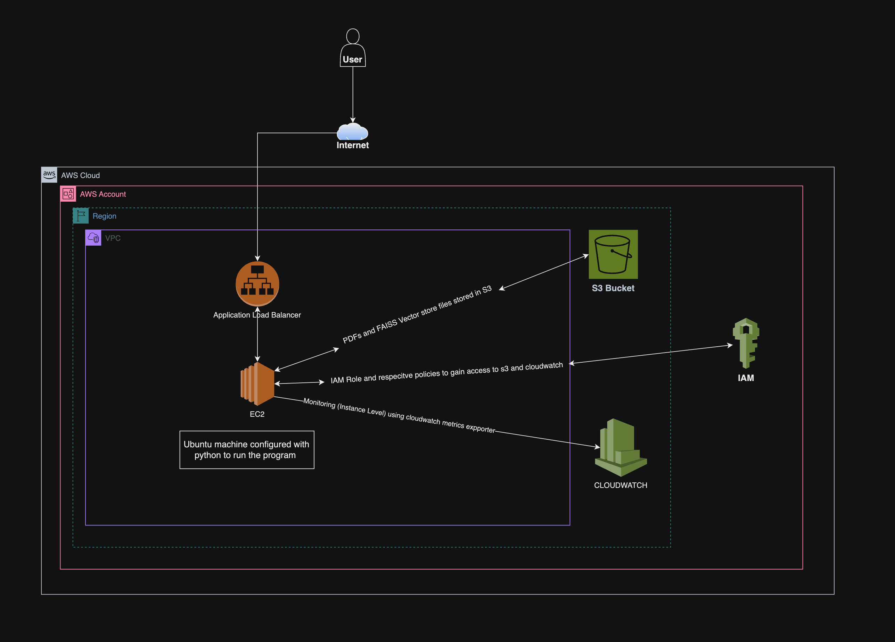
AWS Architecture

Slide 7
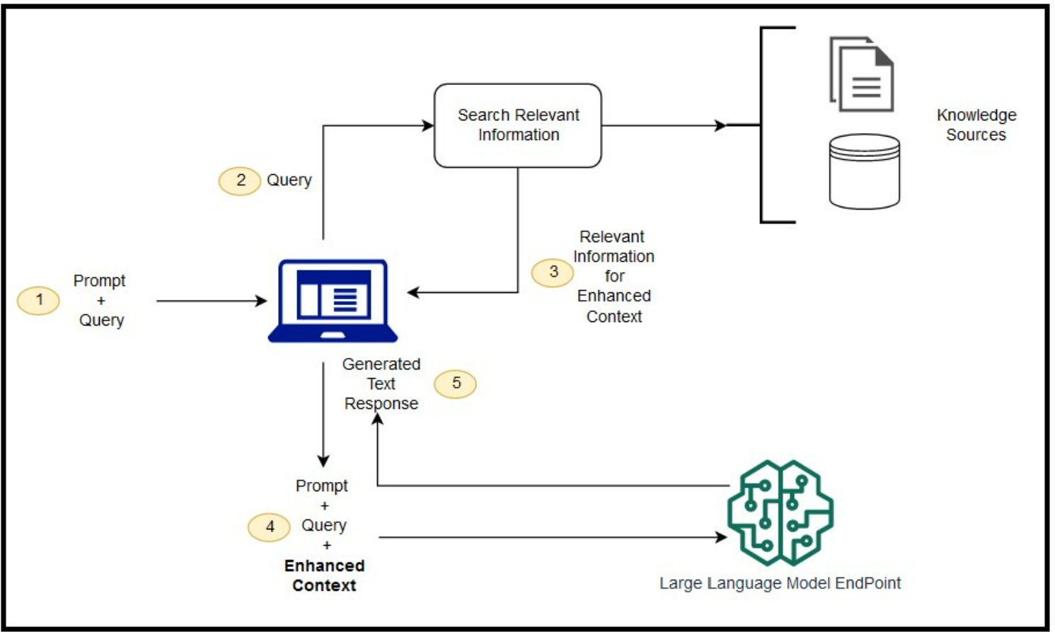
RAG Architecture

Slide 8

Tech stack
Python
LangChain
RAG framework
Google Gemini (LLM)
FAISS Vector Database
AWS Cloud (IAM, S3, CloudWatch, EC2)

Slide 9
Benefits of our solution(AI, RAG and AWS Cloud)
Enhanced Relevance:
Incorporates external knowledge for more contextually relevant responses.
Efficient Retrieval:
Leverages existing knowledge bases, reducing the need for large labeled datasets.
Dynamic Updates:
Allows for real-time or periodic updates to maintain current information.
Cost Effective
Scalability
Availability

Slide 10
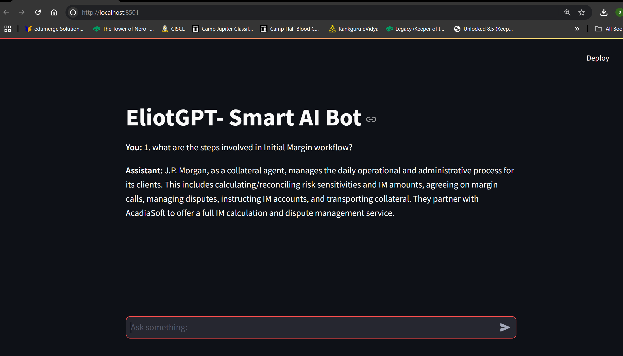
Future Scope

Slide 11
Future Scope
Extend this solution to ELIOT app with the actual functional/technical data
Extend to Trade (booking ) related /other functionalities.
Extent Information sources to different formats and Realtime Data feeding

