Slide 1
Design Example- pipeline’s FSM and Datapath
ECE381(CAD), Lecture 8.b:
Mehdi Modarressi
Department of Electrical and Computer Engineering,
University of Tehran

Slide 2
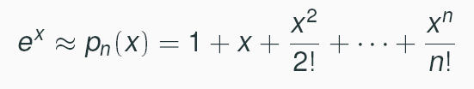
Design example
Calculation of e^{x}/y
Hard to calculate directly
Solution: Taylor series
It is an approximation: More accurate values are obtained when n increases

Slide 3

Design example
N=3 gives a good fit: its accuracy is enough for many applications:
Sometimes we may need less accuracy (use n=2), sometimes more (n>3)

Slide 4
Design example
Design an efficient implementation for e^{x}/y
With variable accuracy: user defines the right accuracy at run-time
So we should design a hardware for
With some n (n=the maximum allowable accuracy) and then adjust accuracy (use smaller n) at runtime

Slide 5
Polynomial entity
ENTITY polynomial IS
PORT( clk, clr" IN bit;
N: IN Integer;//
mode: IN bit_vector (1 downto 0);
  X: IN bit_vector(15 downto 0);
  Y: IN bit_vector(15 downto 0);
  --Coeff_add: IN bit_vector(3 downto 0);
  P :OUT bit_vector(15 downto 0);
  );
END polynomial;

Slide 6
Polynomial entity
The mode input is used to load coefficient values into internal registers.
When mode is '1', the value on the x input is loaded into the register selected by the coeff_addr inputs.
When mode is '0', the x input is used as the next data value for which the polynomial is to be calculated.
The clr input is used to clear the internal pipeline registers.

Slide 7

Pipelined design
A polynomial function of degree n is
x is the input variable
We can rewrite the polynomial as
An n-stage pipeline starting from the last term:
  Each stage evaluates a_{n-1}+ xa_{n} and passes the result and the value of x to the second stage

Slide 8

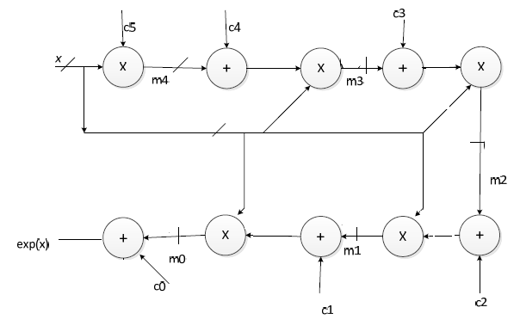
Hardware design

Slide 9
Hardware design

Slide 10
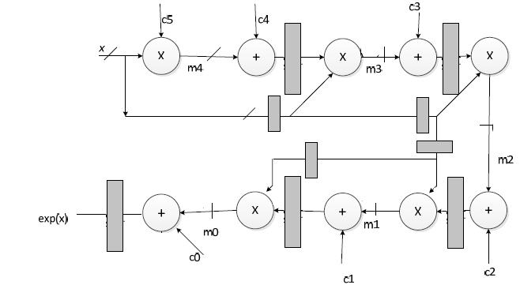
Pipeline design

Slide 11
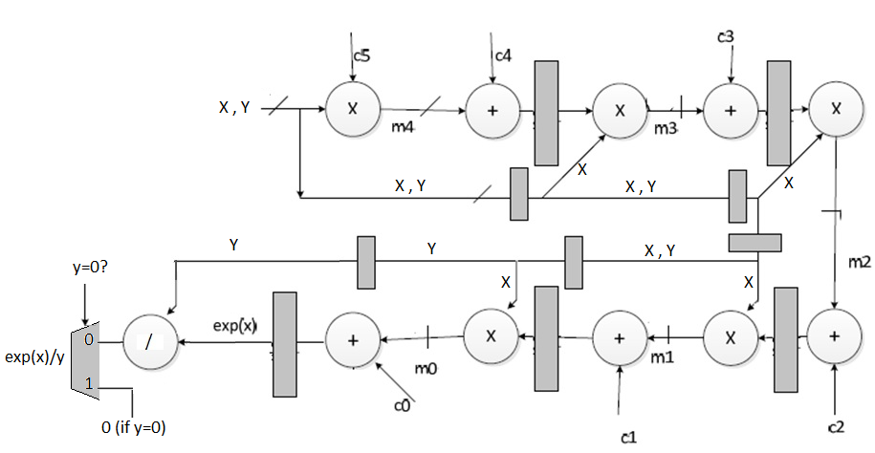
Calculating e^{x}/y
Set output to 0, if y=0
A controller determines the select line of mux and propagates the select bit with y down to the pipeline

Slide 12
Controller design
Check the y to set the select line
Check the mode (init, start, stop) and reset signals to control the start/stop of the process and to see when to load coefficients

