Slide 1
Testbench and Random Number Generation
ECE381(CAD), Lecture 9:
Mehdi Modarressi
Department of Electrical and Computer Engineering,
University of Tehran

Slide 2
Verification VS. Test
Two often confused
Purpose of test is to verify that the design was manufactured properly
  To ensure the chip is physically correct
  Done after manufacturing
Purpose of Verification is to ensure that the design has the right functionality
  The code does exactly what it should do
  Done in software before manufacturing
Notes:
Testing verifies that internal notes can be toggled
Thoroughness of testing depends on controllability and observability of internal nodes

Slide 3
Verification and Test Reconvergence Model
HW Design
Fabrication
Specification
Net list
Silicon
Verification
Test
Notes:
Thoroughness of test depends on controllability and observability of internal nodes.
One method is scan.
Linking all registers together into a chain. This chain is accessible from the chip pins. This way one can control and observe the internal nodes.
This puts restrictions into design.
It keeps down cost due to fabrication problems.
Janick’s book contains references for more info.
If restriction are imposed due to test, why shouldn’t some be imposed due to verification!!!!
Verification should be taken into consideration during architecture. Architects should ask the following 2 questions:
What is is supposed to do?
How is it going to be verified?

Slide 4
TEST
VERIFICATION

Slide 5
Verification
To make sure the code is actually does what it supposed to do
Unlike test, here we don’t have circuit nodes to sensitize
  We should check the functionality of the design and find wrong code pieces
Use testbench for verification
  PROCESS (a,b,s)
    IF(s=0)
    D<=a;
    ELSE
    D<=s;
  END PROCESS;
Wrong multiplexer code

Slide 6
What is A Test Bench?
Test Bench is a program that verifies the functional correctness of a hardware design (Design under Test= DUT).
The test bench program checks whether the hardware model does what it is supposed to do and is not doing what it is not supposed to do.

Slide 7
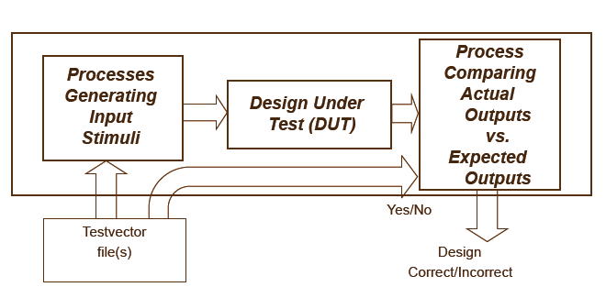
Main Functions of a Test Bench
Generate stimulus for testing the hardware block.
Apply the stimulus.
Compare the generated outputs against the expected outputs.

Slide 8
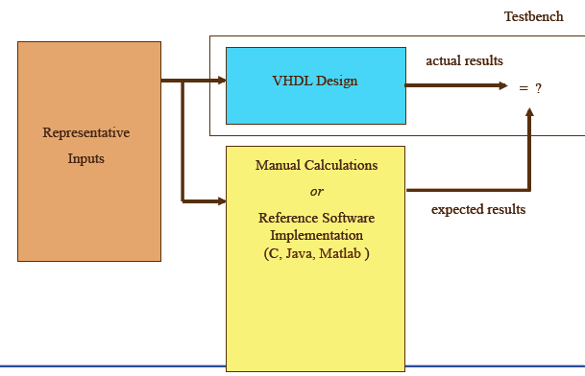
Testbench data

Slide 9
Generating Stimulus Vectors
Vectors can be generated within the test bench program or generated elsewhere and supplied to the test bench program as an input file.
Vectors can also be stored in a table within the test bench program.

Slide 10
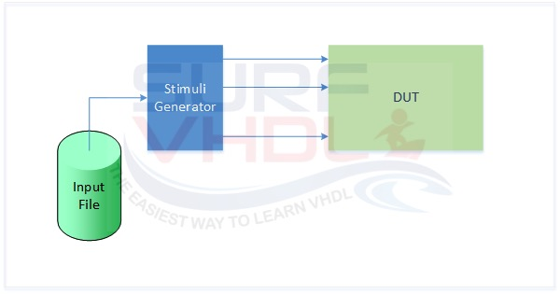
Test data from file

Slide 11
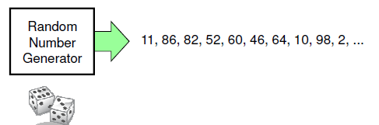
Introduction
Contents:
  Random numbers
  Random number application: Monte Carlo simulation
  LFSR
Source:

Slide 12
Random generation
Random generation is very useful in digital design
  Testbench
  Monte Carlo simulation
  Simulation for performance evaluation
  Sampling
    It is often impractical to examine all possible cases, but a random sample will provide insight into what constitutes typical behavior
  ….

Slide 13
Good random numbers
A good random number generation should satisfy:
  Uniformity
  Randomness
  Independence
  Portability
  Efficiency
Source:

Slide 14
Random generation
By naturally occurring sources
  Measure the source value and use as random
  Time, noise, …
By an algorithm
  A computer algorithm generates the numbers
  Example: X_{n+1}=(aX_{n}+b) mod m
    The initial value of X (i.e. X₀) can be the seeds of the random
    Used in many programming languages (compiler runtime libraries)
    Example: For MS Visual C++, a=214013 and b=2531011 and m=2³²
LFSR is one the most common algorithmic random generators

Slide 15
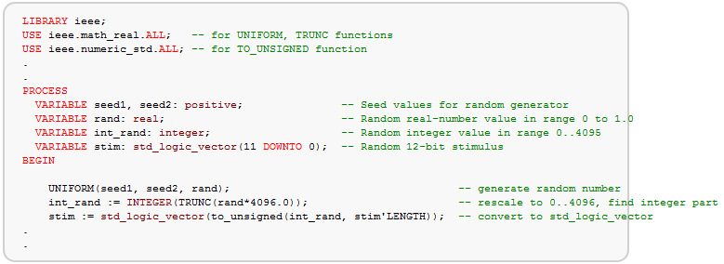
Random generation in VHDL
Some functions and procedures are used to generate random numbers
Example: a function called "UNIFORM" which returns a pseudo-random number (of type REAL) in the range 0 to 1.0
how to generate a random 12bit vector

Slide 16
Monte Carlo simulation
In addition to testbench, random number has many other applications
Monte Carlo simulation: a method to solve problems by random generation!
Very suitable for FPGA implementation to accelerate the algorithm

Slide 17
Monte Carlo simulation
The expression "Monte Carlo method" is actually very general: a large and widely-used class of approaches
  Used in everything from economics to nuclear physics to regulating the flow of traffic
  A general approximate approach to solve difficult problems
  Difficult problems: impossible to compute an exact result with a deterministic algorithm
Monte Carlo methods are based on the use of random numbers and probability statistics to investigate problems

Slide 18
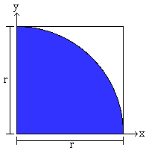
Monte Carlo simulation- Example
Monte Carlo Calculation of Pi (π)
We use the unit circle circumscribed by a square
  It is easier to just use one quadrant of the circle
Figure: The Monte Carlo Method, by J. Casey

Slide 19
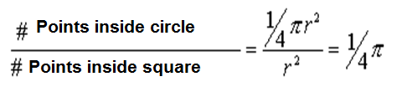
Monte Carlo simulation- Example
Select random point in the square and examine whether or not they are inside the circle
  Each iteration generates two numbers: x and y and examines if (x,y) is inside the circle
  How? remember the unit circle equation
Do this thousands (or millions) of times to wind up with an estimate of the value of pi

Slide 20
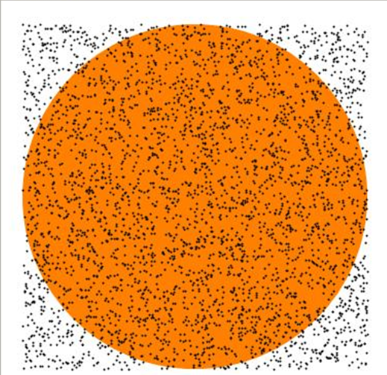


Monte Carlo simulation- Example
The more random generation is made, the more accurate solution is achieved
Figure: The Monte Carlo Method, by J. Casey

Slide 21
Basic Monte Carlo approach
1. Draw a random number
2. Process this random number in some way, for example plug it into an equation
3. Repeat steps 1 and 2 a large number of times
4. Analyze the cumulative results to find an estimation for a non random value
Source: The Monte Carlo Method, by J. Casey

Slide 22
Random generation
By naturally occurring sources
  Measure the source value and use as random
  Time, noise, …
By an algorithm
  A computer algorithm generates the numbers
  Example: X_{n+1}=(aX_{n}+b) mod m
    The initial value of X (i.e. X₀) can be the seeds of the random
    Used in many programming languages (compiler runtime libraries)
    Example: For MS Visual C++, a=214013 and b=2531011 and m=2³²
LFSR is one the most common algorithmic random generators

Slide 23
Pseudo random generation
LFSR: Linear-Feedback Shift Register
Fast random generation with simple hardware
Generates a sequence of numbers that approximates the properties of random numbers.
The sequence is fully deterministic, i.e., it can
be repeated based on an initial state.
The period of the sequence may be made very large (typically, 2^{n}-1, where n is an internal state size)

Slide 24

Shift register
A shift register is a chain of edge triggered flip-flops in which during each shift:
  Each successor flip-flop takes the value of its predecessor
  At the begin one bit is added and at the end one bit gets lost

Slide 25

LFSR
A linear feedback shift register (LFSR) is a shift register, in which in addition, the output value of the last bit is added modulo-2 to selected bit positions
A modulo-2 addition adds two bits without calculating the carry and is realized by an XOR gate

Slide 26
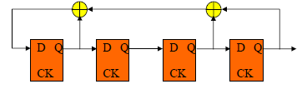
Two types of LFSRs
Internal
External
Characteristic polynomial
  defined by XOR positions
  P(x) = x⁴ + x³ + x + 1 in both examples

Slide 27
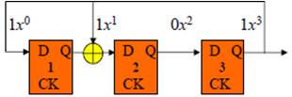

LFSR
Characteristic polynomial of LFSR
n = # of FFs = degree of polynomial
XOR feedback connection to FF _{i} ⇔ coefficient of x^{i}
  coefficient = 0 if no connection
  coefficient = 1 if connection
Two coefficients always included in characteristic polynomial:
  x^{n} (degree of polynomial & primary feedback)
  x⁰ = 1 (principle input to shift register)
P(x) = x⁴ + x³ + x + 1

Slide 28
LFSR
An LFSR generates periodic sequence
  must start in a non-zero state,
The maximum-length of an LFSR sequence is 2n -1
  does not generate all 0s pattern (gets stuck in that state)
The characteristic polynomial of an LFSR generating a maximum-length sequence is a primitive polynomial

Slide 29
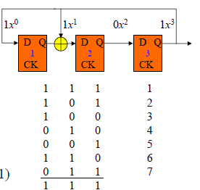
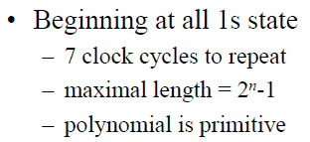
Primitive LFSR
Example: Characteristic polynomial is P(x) = x³ + x + 1

Slide 30
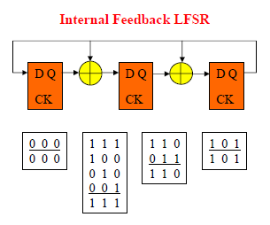
Primitive LFSR
Non-primitive polynomials produce sequences < 2^{n}-1
Example of non-primitive polynomial:

Slide 31
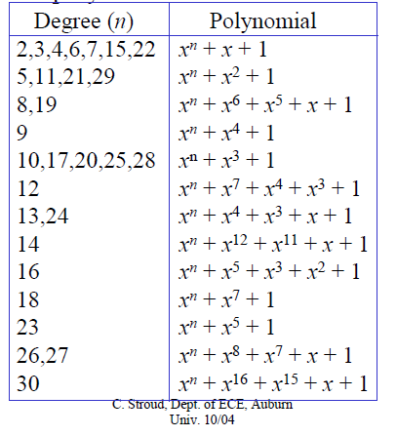
LFSR
Primitive polynomials with minimum # of XORs

Slide 32
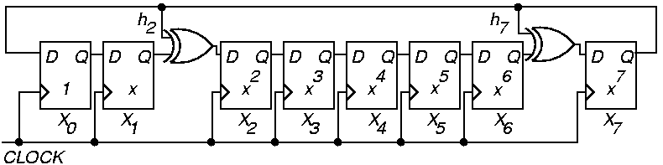
Example Modular LFSR
f (x) = 1 + x² + x⁷ + x⁸
Read LFSR tap coefficients from left to right

Slide 33
Testbench
Testbench data may be read from file or generated randomly at runtime
Runtime methods can use the VHDL random generation function (uniform) or using an LFSR
  See lecture 5
A key question is how a good a benchmark is?
  How many parts of the design is tested by a set of test input?
A good way is to calculate the code coverage of the testbench

Slide 34
Code coverage
Coverage referrers to the percent of the design that has been exercised by a testbench
For simulation, a testbench applies data to a DUT, test data generated by the testbench reach certain parts of a circuit and may never create activities in other parts
A good testbench uses a minimum set of data to cover testing of the largest possible portion of the circuit
Several methods to calculate code coverage of a testbench

Slide 35
Code coverage
ModelSim have a powerful integrated tool that calculates the code coverage
  Statement coverage
  Condition coverage
  Toggle coverage
  ….
See the ModelSim code coverage document on the course webpage

Slide 36
Code coverage
Statement coverage
Statement coverage is a measure of the number of executable statements within the model that have been executed during the simulation run.
Toggle coverage
Counts changes of state on specified nodes, in other words different values a signal takes
  Maybe a signal is activated many times by a testbench, but always is assigned the same values
  A good testbench should assign many different values to verify

Slide 37
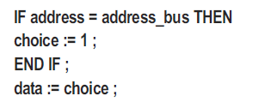
Code coverage
Branch coverage
Branch coverage, sometimes referred to as decision coverage, counts the execution of different paths of conditional expressions and case statements
Example: If the testbench forced address to always equal address_bus, the statement coverage for the below code is 100%, since every statement would be executed.
However, branch coverage would only be 50%, since the FALSE branch would not have been taken during simulation.

Slide 38
Code coverage
Code coverage gives us a metric to decide how a testbench is good and comprehensive
However, a good coverage does not guarantee that all possible errors can be found by the testbench

