Slide 1
Verilog Synthesis
CE233(CAD), Lecture 10:
Mehdi Modarressi

Slide 2
Verilog Synthesis
Learn
  How to write synthesizable Verilog code
  Common mistakes and how to avoid them
  What is synthesized for what we code

Slide 3
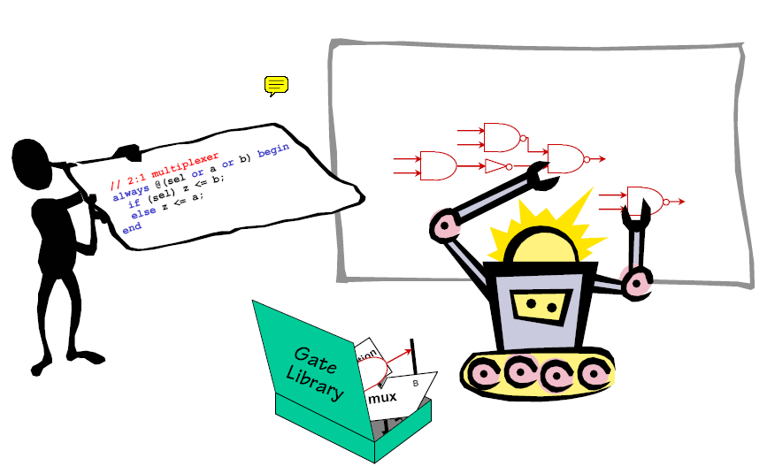
Logic synthesis
Is done automatically by synthesis tools (a.k.a. “silicon compilers”)
Synthesis tools process the HDL then
  Infer logic and memory elements
  Perform technology-independent and technology-dependent optimizations
  Map elements to the target technology

Slide 4
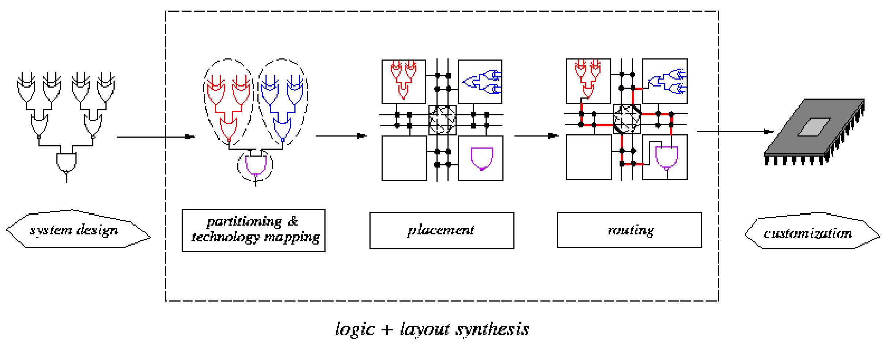
Logic Synthesis
module x (a,b,c)
….
Always@ (clk)
….
assign a=b &c;
……..
endmodule;
In this lecture, we discuss logic synthesis
Logic synthesis

Slide 5
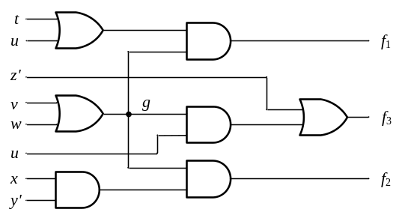
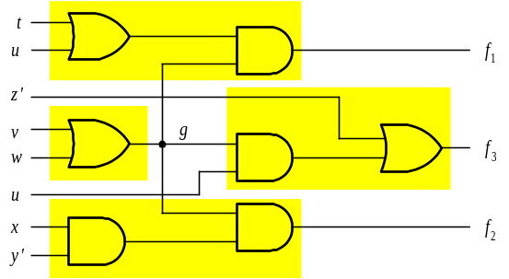
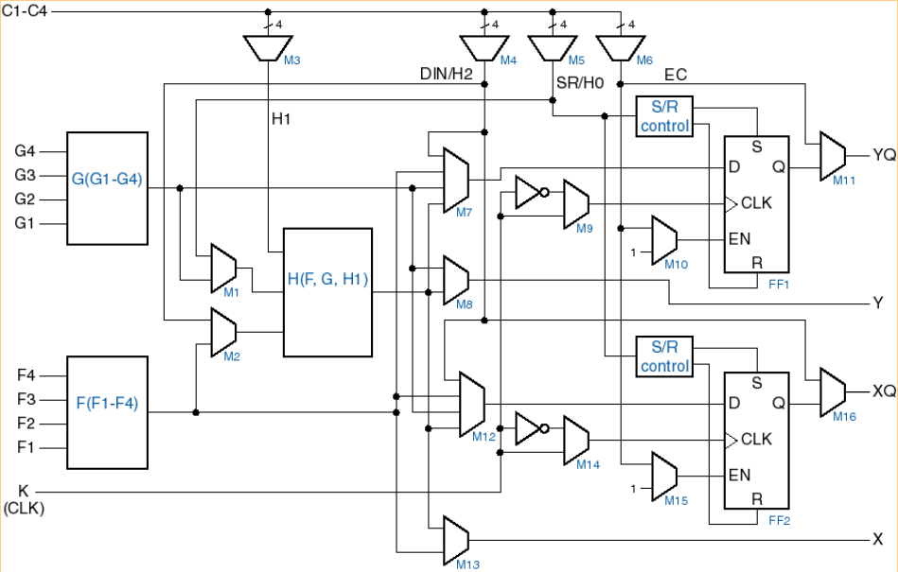
Synthesis- Partitioning
Partitioned circuit
Gate-level description
partitioning
Technology Library (Target FPGA)
(just 2-input and 3-input LUTs)

Slide 6
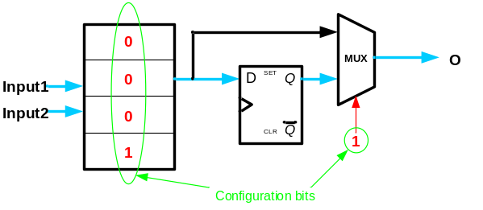
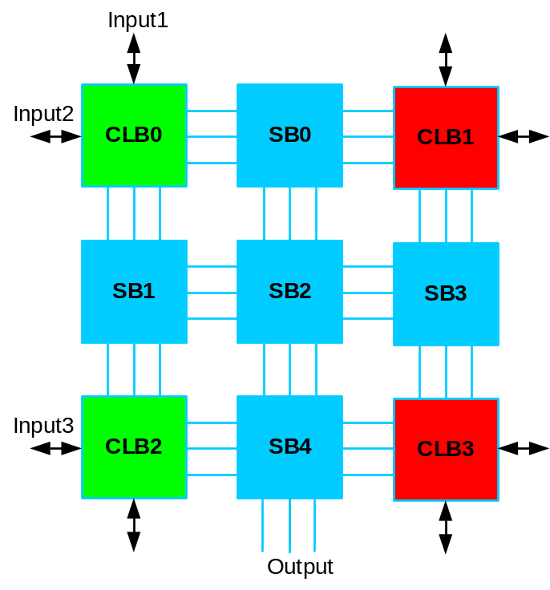
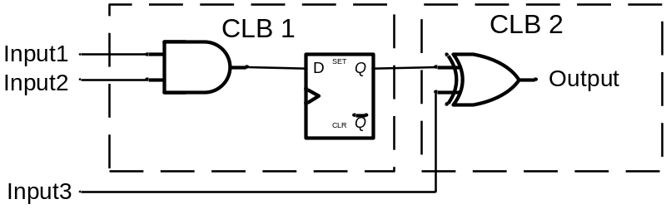
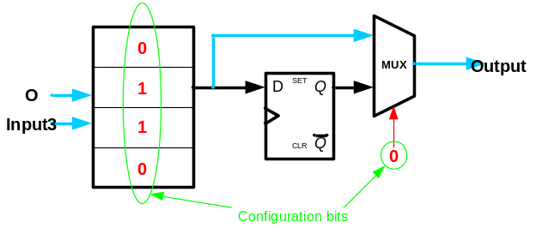
Placement: Select CLBs
CLB0: 00011
CLB1: ?????
CLB2: 01100
CLB3: XXXXX
SB0: 000000
SB1: 000010
SB2: 000000
SB3: 000000
SB4: 000001

Slide 7
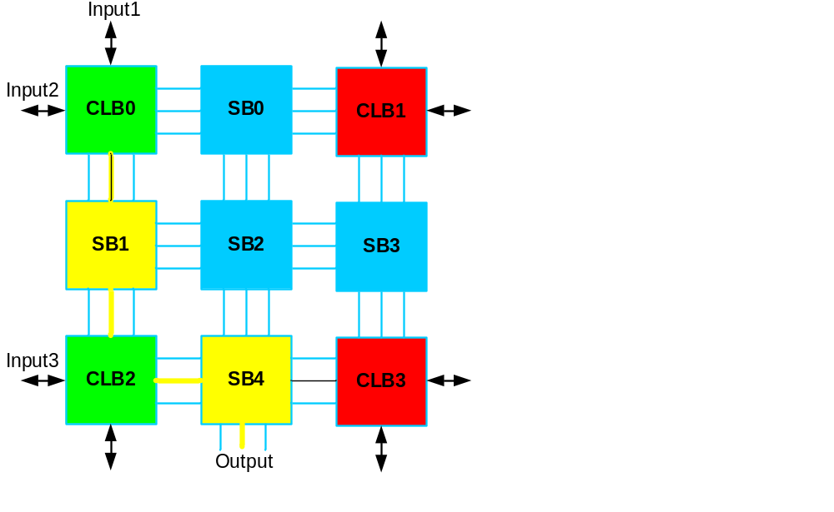
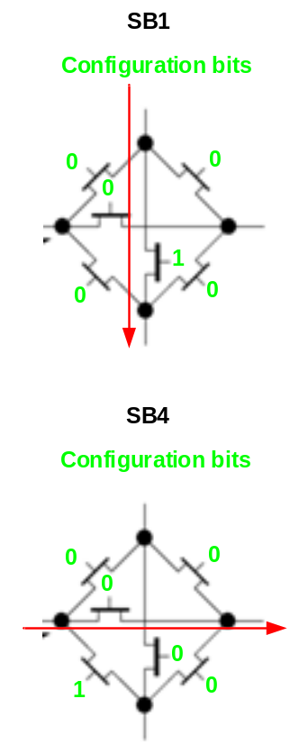
Routing: Select path
CLB0: 00011
CLB1: ?????
CLB2: 01100
CLB3: XXXXX
SB0: 000000
SB1: 000010
SB2: 000000
SB3: 000000
SB4: 000001

Slide 8
Configuration Bitstream
The configuration bitstream must include ALL CLBs and SBs, even unused ones
CLB0: 00011
CLB1: ?????
CLB2: 01100
CLB3: XXXXX
SB0: 000000
SB1: 000010
SB2: 000000
SB3: 000000
SB4: 000001

Slide 9
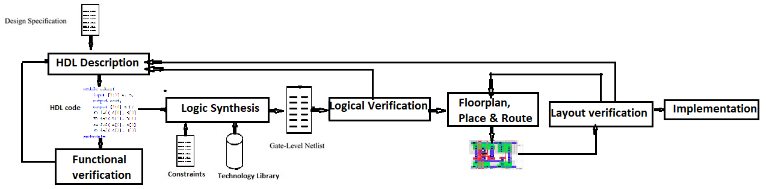
Digital Design Flow - ASIC
1. HDL Coding
3. Logic Synthesis
5. Physical Synthesis
2. Simulation &
Functional verification
4. Simulation &Timing Analysis

Slide 10
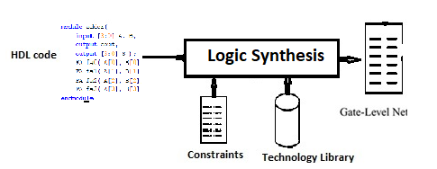
Digital Design Flow - Synthesis

Slide 11
Synthesis is Constraint-Driven
The designer guides the synthesis tool by providing design constraints:
  Timing requirements (max. expected clock frequency)
  Area requirements
  Maximum power consumption
The synthesis tool uses this constraints and tries to generate the smallest possible design that will satisfy the requirements
Without any constraints specified, the synthesis tool will generate a non-optimal netlist, which might not satisfy the designer’s requirements

Slide 12
Synthesis tool: (RTL & Logic Synthesis)
Input:
  HDL Code
  “Technology library” file
    Standard cells (known by transistor size, 90nm)
      Basic gates (AND, OR, NOR, …)
      Macro cells (Adders, Muxes, Memory, Flip-flops, …)
  Constraint file (Timing, area, power, optimization Alg.)
Output:
  A gate-level “Netlist” of the design
  Timing files (.sdf)

Slide 13
Commercial Synthesis Tools
Vendor Name | Tool Name | Target platform
Intel (Altera) | Quartus | FPGA
Xilinx | ISE/ Vivado | FPGA
Mentor Graphics | Precision | FPGA
Synplicity | Synplify | ASIC
Synopsys | Design Compiler | ASIC
Cadence | Ambit | ASIC

Slide 14
Logic Synthesis
Behavioral coding used to be used for rapid prototyping
  Now, we can get hardware out of it by synthesis tools
Assembly coding vs. C/Java programming
Gate-level modeling vs. behavioral modeling

Slide 15
Verilog Lower Abstraction Levels
Gate-level:
  All gate-level codes are synthesizable
Dataflow Models:
  Most expressions synthesizable
    Exceptions: *, /, %
  General rule: Delays are all ignored

Slide 16
Synthesis basics
Hardware Inference
  The specific coding style suggested by tool designers
  e.g. how to make FF
General rules
  Natural mapping of code structures to logic

Slide 17
Synthesizable Constructs
Not all Verilog constructs are synthesizable because:
  Does not make sense in hardware (e.g. $display, initial block )
  Not possible to achieve (e.g. delay control like #10)
  Not support by design flow
  Too difficult or too abstract for the synthesis software (e.g. A / B)
Synthesizable Constructs
• Ports (input, output, inout)
• Parameter
• module
• wire, reg, tri
• function, task
• always, if, else, case
• assign
• for, while

Slide 18
Non-Synthesizable Constructs
Non- Synthesizable Constructs
  Initial (used only in testbenches)
  real (real type data type)
  time (time data type)
  comparison to X and Z are ignored (e.g., a == 1’bz)
  delays “#” are ignored by synthesis tools as if it is not there
  The use of Z value
  * and / are synthesizable, but it can be resource-intensive and slow
Some result in error, some are simply ignored

Slide 19
Behavioral Synthesis
Sometimes not synthesizable, or undesirably synthesized
  Unless rules obeyed
initial statements:
  All ignored
  Use explicit reset signals instead
always statements
  Sensitivity list decides what is synthesized
    Combinational circuits: all variables/ports read in the block
    Sequential circuits: posedge or negedge of the clock

Slide 20
Synthesis: Combinational Logic
Combination logic function can be expressed as:
logic_output(t) = f(logic_inputs(t))
Combinational
Logic
logic_inputs(t)
logic_outputs(t)
In case of using always statement, all ports should be listed in the sensitivity list
The combinational logic must not have feedback
Specify the output of a combinational behavior for all possible cases of its inputs
Logic that is not combinational will be synthesized as sequential

Slide 21
Synthesis of Combinational Logic
There are many ways to describe combinational logic with the Verilog HDL, but some are not supported by synthesis tools.
Synthesizable combinational logic can be described by
  a netlist of structural primitives.
  a set of continuous-assignment statements,
  a level-sensitive behavior

Slide 22
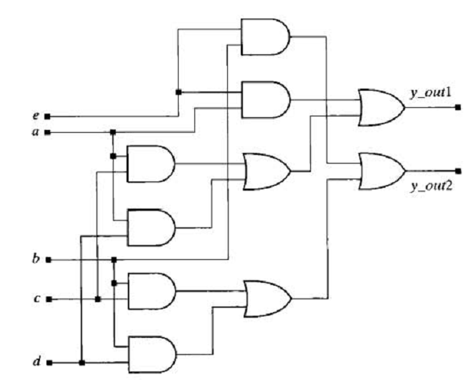
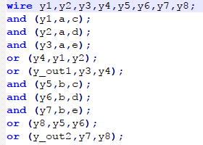
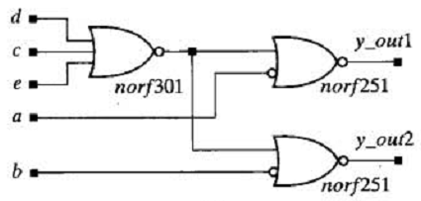
Netlist of primitives
schematic for a netlist of primitives and the circuit synthesized from the netlist

Slide 23
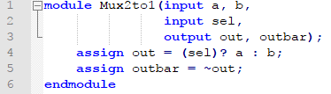
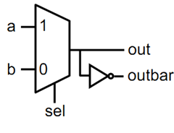
Continuous Assignment

Slide 24
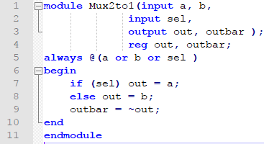
Procedural Assignment with always
Procedural assignment allows an alternative, often higher-level, behavioral description of combinational logic
Supports richer, C-like control structures such as if, for, while, case

Slide 25
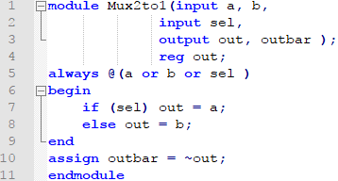
Mix-and-Match Assignments
Procedural and continuous assignments can (and often do) co-exist within a module
Procedural assignments update the value of reg. The value will remain unchanged till procedural assignment updates the variable.
This is the main difference with continuous assignments in which the right hand expression is constantly placed on the left-side
procedural assignments
continuous assignments

Slide 26
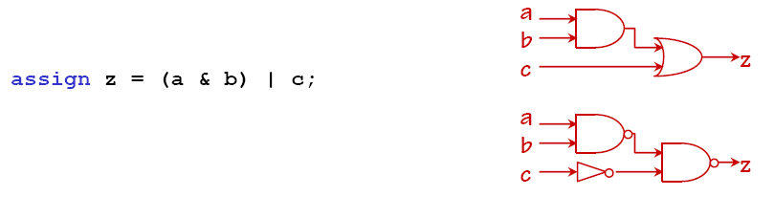
Combinational Circuits
always @ (a or b or c)
z= (a & b) | c;

Slide 27
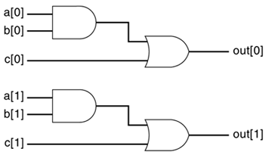
Combinational Circuits
If a, b, c, and out are 2-bit vectors [1:0], then the above assign statement will translate to two identical circuits for each bit

Slide 28
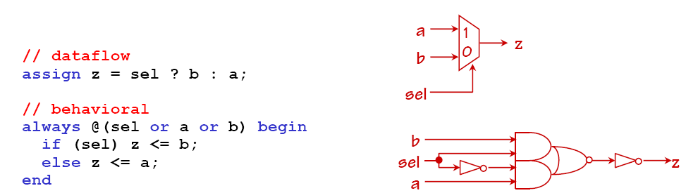
If statement
If there is a multiplexer in the library, then use it
Otherwise, use simple gates

Slide 29
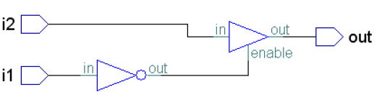
Tri-state Gates
module test(out, i1, i2);
output out;
input i1, i2;
reg out;
always @(i1 or i2)
if (i1)
out = 1'bz;
else
out = i2;
endmodule

Slide 30
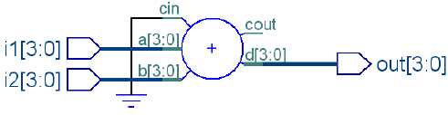
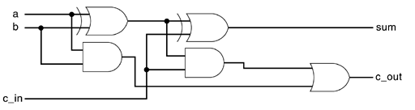
Combinational Circuits
Example: 4-bit adder:
  Used FA blocks if there is in the library
  Otherwise use gates to build it
module test(out, i1, i2);
output [3:0] out;
input [3:0] i1, i2;
reg [3:0] out;
always @(i1 or i2)
out = i1 + i2;
enddmodule

Slide 31
case Statement
  module mux_4bits (y, a, b, c, d, sel);
  input [3:0] a, b, c, d;
  input [1:0] sel
  output [3:0] y;
  reg [3:0] y;
  always @ (a or b or c or d or sel)
  case (sel)
  0: y = a;
  1: y = b;
  2: y = c;
  3: y = d;
  default: y = 4'bx;
  endcase
  endmodule
a[3:0]
b[3:0]
y[3:0]
c[3:0]
d[3:0]
sel[1:0]

Slide 32
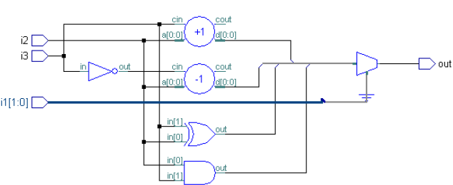
case Statement
module test(out, i1, i2, i3);
output out;
input [1:0] i1;
input i2, i3;
reg out;
always @(i1 or i2 or i3)
case(i1)
2'b00:out = i2 + i3;
2'b01:out = i2 -i3;
2'b10:out = i2 & i3;
2'b11:out = i2 ^ i3;
endcase
endmodule

Slide 33
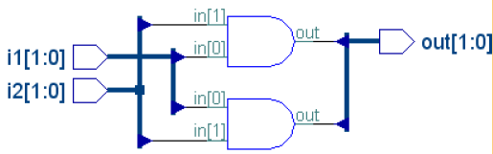
loop Statements
module test(out, i1, i2);
output out;
input [1:0] i1;
input [1:0] i2;
reg [1:0] out;
integer k;
always @(i1 or i2)
for(k=0; k<2; k=k+1)
out[k] = i1[k] & i2[k];
endmodule
Loop replicates the hardware
The loop boundaries must be known at synthesis time

Slide 34
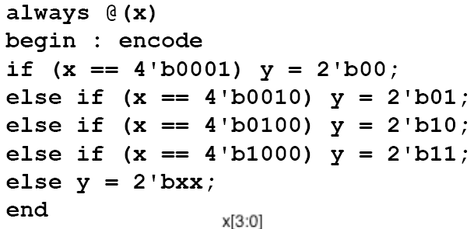
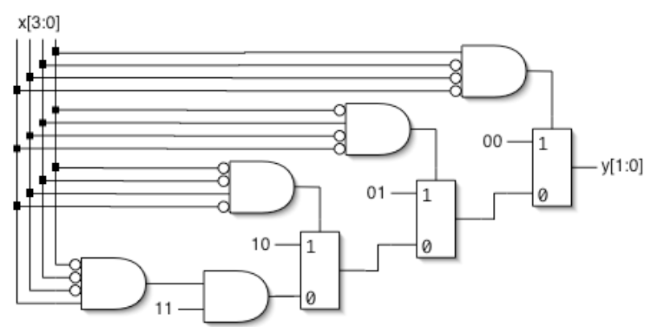
Encoder
Nested IF-ELSE might lead to an encoder
  Example: 4-to-2 encoder

Slide 35
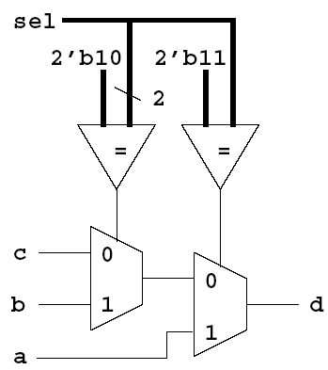
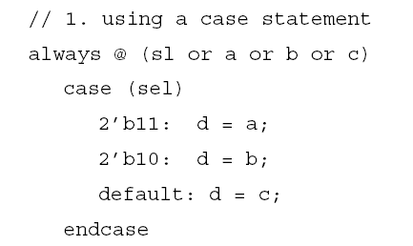
Priority Decoder
A case statement may result in a priority decoder

Slide 36
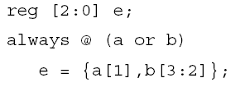

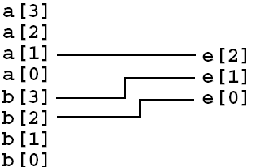
Bus - concatenation

Slide 37
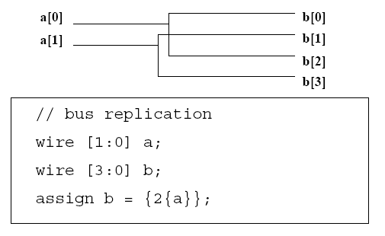
Bus - replication

Slide 38
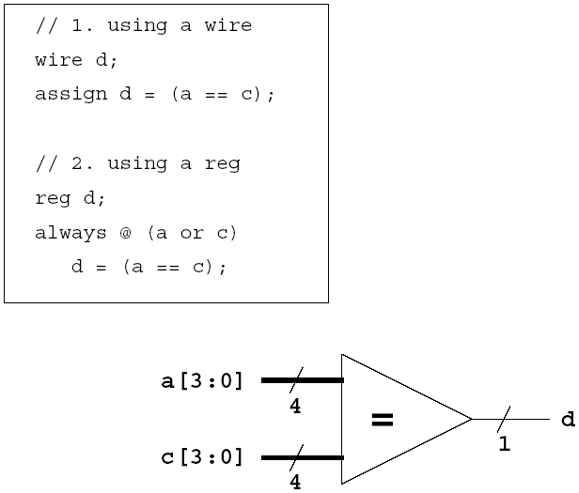
Comparator

Slide 39
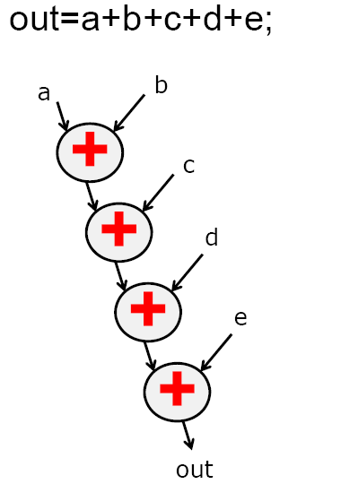
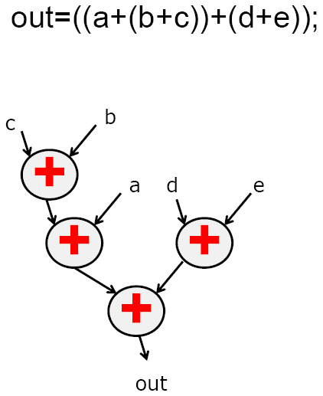
Logic Optimization
Use parenthesis
Most synthesis tools do this optimization

Slide 40
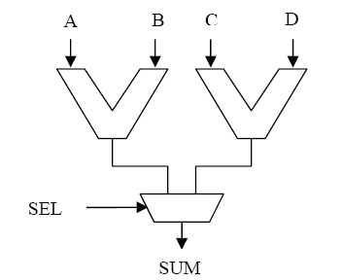
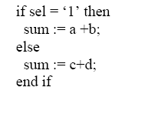
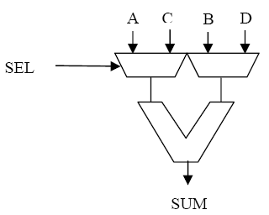
Logic optimization- Resource Sharing
Resource sharing: Sharing an operator under mutually exclusive conditions.

Slide 41
Synthesis: Sequential Logic
General Rule: A variable will be synthesized as a flip-flop when its value is assigned synchronously with an edge of a signal

Slide 42
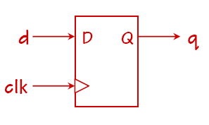
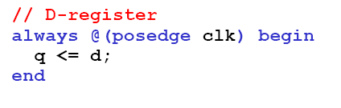
Sequential Logic- Flip-Flop
A simple FF

Slide 43
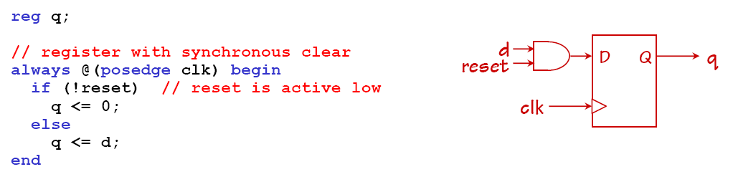
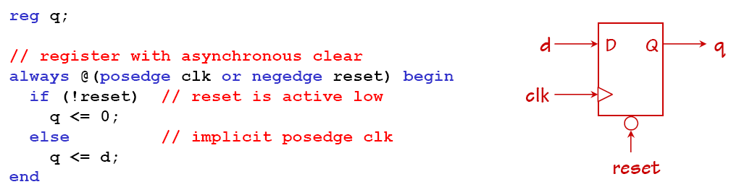
Sequential Logic- Flip-Flop

Slide 44
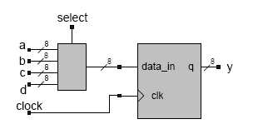
Registered Combinational Logic
Combinational logic that is included in a synchronous behavior will be synthesized with registered output.
Example:
module mux_reg (a, b, c, d, y, select, clock);
  input [7:0] a, b, c, d;
  output [7:0] y;
  input [1:0] select;
  reg [7:0] y;
  always @ (posedge clock)
  case (select)
  0: y <= a; // non-blocking
  1: y <= b; // same result with =
  2: y <= c;
  3: y <= d;
  default y <= 8'bx;
  endcase
  endmodule

Slide 45
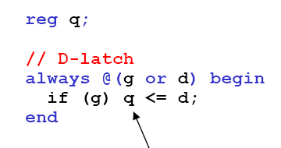
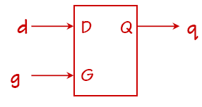
Sequential Logic- latch
If Q were simply a combinational function of D: combinational logic
But are times when the always block executes but Q isn’t assigned (e.g., when G = 0)
The synthesizer has to arrange to remember the value of “old” value Q even if D is changing
→ it will infer the need for a storage element: latch

Slide 46
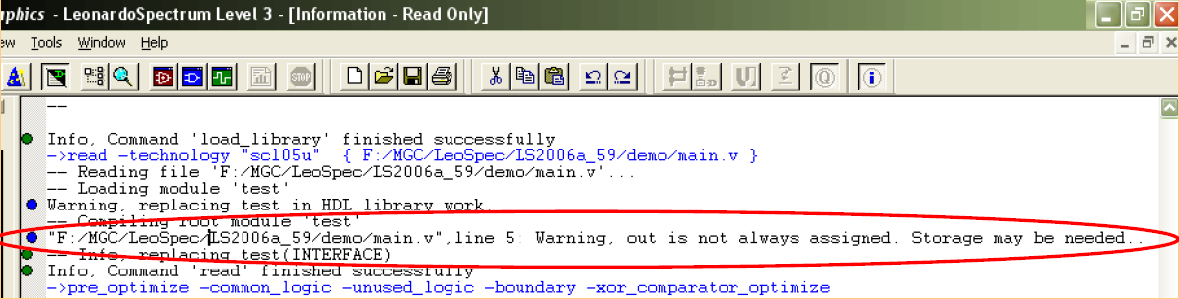
Unwanted Latches
module test(out, i1, i2);
output out;
input i1;
input i2;
reg out;
always @(i1 or i2)
if(i1)
out = i2;
endmodule
Latches in this case maybe unwanted
  We used combinational coding rules but a memory element is used

Slide 47
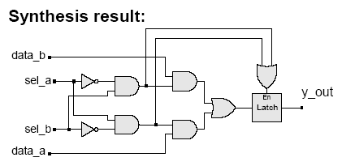
Unwanted Latches (cont.)
Unintentional latches also result from incomplete case statement
Example: case statement
  always @ (sel_a or sel_b or data_a or data_b)
  case ({sel_a, sel_b})
  2'b10: y_out = data_a;
  2'b01: y_out = data_b;
  endcase
The latch is enabled by the "event or" of the cases under which assignment is explicitly made. e.g. ({sel_a, sel_b} == 2'b10) or ({sel_a, sel_b} == 2'b01)

Slide 48
Unwanted Latches (cont.)
Example: if .. else statement
  always @ (sel_a or sel_b or data_a or data_b)
  if ({sel_a, sel_b} == 2’b10)
  y_out = data_a;
  else if ({sel_a, sel_b} == 2’b01)
  y_out = data_b;

Slide 49

Non-blocking Shift Register
Use blocking assignments for combinational logic, and non-blocking assignment for sequential logic
Example: shift register
  always @ (posedge clock) begin
  if (reset == 1'b1) begin
  reg_a <= 1'b0;
  reg_b <= 1'b0;
  reg_c <= 1'b0;
  reg_d <= 1'b0;
  end
  else begin
  reg_a <= Shift_in;
  reg_b <= reg_a;
  reg_c <= reg_b;
  reg_d <= reg_c;
  end
  end

Slide 50
Synthesis Tip
In general, the event-control expression of a cyclic behavior describing sequential logic must be synchronized to a single edge (posedge or negedge, but not both) of a single clock (synchronizing signal).

Slide 51

Clock, Reset, Combinational Feedback

Slide 52

Avoid Combinational Feedback

