Slide 1

Secure & Private AI
This executive workshop will explore best practices and advancements in securing and privatizing AI applications within robotics, aimed at empowering senior leaders to make informed decisions.
BY NAIGAM BHATT

Slide 2
Understanding the balance of opportunities and risks in AI robotics
Recognizing the critical risks associated with AI in robotics is essential
The integration of AI in robotics presents vast opportunities that can transform industries.
Automation: Robots can take on complex tasks autonomously, enhancing productivity.
Efficiency: The speed and precision of operations improve significantly, leading to cost savings.
Innovation: AI-powered robotics introduce new capabilities, creating fresh business models.
While the potential is great, there are risks that must be managed.
Data misuse can arise, leading to exposure of sensitive information.
Compliance fines may result from breaches of safety regulations.
Loss of trust can occur if AI systems fail or are misused, damaging reputations.
OVERVIEW OF OPPORTUNITIES AND RISKS
1

Slide 3
Understanding AI Risk: Prompt Injection
Key Risks and Mitigation Strategies
What Is Prompt Injection?
Impact on Robotics
Mitigation Strategies
Prompt injection is a security vulnerability where malicious or unintended instructions are inserted into AI prompts, leading to unpredictable or dangerous robot behavior. This vulnerability can arise from external actors or faulty inputs that manipulate the actions of robotic systems.
The risks of prompt injection include unintended or unsafe actions that can jeopardize safety and operational integrity. Consequences may involve data breaches, physical harm, and disruption of critical processes—ultimately eroding trust among executives in AI-driven robotic solutions.
High-level strategies to mitigate these risks include implementing strict input validation, strong access controls, and conducting ongoing audits. Additionally, educating staff on these risks and best practices is crucial to maintaining a secure robotic environment.

Slide 4
Training Data Leakage in Robotics AI Overview
Leaders Must Know
Impact
Training data leakage occurs when outside information improperly influences robotics AI models, leading to overfitting and unreliable performance that can compromise decision-making processes.
Leakage can severely undermine model accuracy and safety, resulting in operational failures, security breaches, and potential regulatory penalties that may damage both reputation and trust in AI systems.
Real-world Relevance
Mitigation
Numerous incidents have shown that even minor data leaks can lead to significant consequences, emphasizing the critical need for vigilance in data handling practices within robotics AI.
Implementing strict data access controls, regular audits, and robust monitoring will significantly reduce the risk of leakage, alongside comprehensive staff training on best practices for incident response.

Slide 5

Understanding Shadow AI Risks
Shadow AI in Robotics
Exploring hidden artificial intelligence use and its potential consequences in robotics systems

Slide 6
Shadow AI Risk in Robotics: Executive Overview
Definition of Shadow AI
1
Shadow AI refers to the hidden or unapproved use of artificial intelligence systems within robotics, often operating outside established governance frameworks, leading to significant regulatory and operational concerns.
Key Risks Identified
2
The risks associated with Shadow AI include data security breaches, compliance violations, operational instability, and reputational damage, each posing serious threats to organizational integrity and trustworthiness.
Mitigation Strategies
3
Effective mitigation strategies involve implementing robust AI governance, conducting regular audits, providing employee training, and establishing automated monitoring systems to detect unauthorized AI usage in robotics.

Slide 7

Key Vendor & Integration Risks and Mitigation Strategies
Understanding critical factors in AI robotics integration
Vendor lock-in and dependency on single suppliers
Data privacy and security concerns with sensitive information
Integration challenges with existing legacy systems
Compliance and regulatory risks affecting operations
Reliability and support issues impacting service continuity

Slide 8
Quick Wins vs Long-Term Action
IMMEDIATE ACTIONS FOR ENHANCING AI SECURITY
STRATEGIC INITIATIVES FOR ROBUST AI SECURITY
Implement strong authentication protocols for robotic systems
Regularly update AI software with security patches
Conduct vulnerability scans on AI components
Enable real-time monitoring and alerting for suspicious activities
Enforce network segmentation for robotic control systems
Develop AI models robust against adversarial attacks
Integrate explainable AI for security transparency
Establish cross-industry cybersecurity standards for robotics
Invest in AI security research and continuous improvement
Design resilient robotic architectures with built-in security by design

Slide 9
Overview of GDPR and NIST AI RMF
Understanding their roles in robotics
GDPR’s Relevance to Robotics
NIST AI RMF’s Approach
Intersections of GDPR and NIST AI RMF
The General Data Protection Regulation (GDPR) is crucial for robotics as it protects personal data within the EU. It mandates user consent, compliance obligations for data controllers, and emphasizes transparency, ensuring that personal data collection, processing, and storage aligns with user rights like access and erasure.
The NIST AI Risk Management Framework (AI RMF) serves as a voluntary guide to managing AI risks in robotics. It focuses on identifying, assessing, and mitigating these risks, outlining core functions such as Governance, Mapping, Measurement, Management, and Communication to ensure responsible AI deployment in robotic applications.
The principles of GDPR and NIST AI RMF intersect significantly in robotics, advocating for privacy by design, comprehensive risk assessments, and responsible AI deployment. These frameworks collectively promote transparency, accountability, and user trust, essential for ethical robotics integration and compliance with data protection standards.

Slide 10
Robotics Data Lifecycle Overview
Stage 1: Collection
Stage 2: Processing
Stage 3: Sharing
Stage 4: Retention
Stage 5: Analysis
Data is gathered from sensors and devices ensuring accuracy for effective decision-making.
The collected data is processed through algorithms, enhancing efficiency and optimizing performance.
Processed information is shared securely within systems, promoting collaboration and operational synergy.
Data is retained in secure storage, ensuring compliance with regulations and preventing loss.
Continuous analysis of data drives insights that inform future robotics improvements and strategies.
LIFECYCLE SUMMARY
1

Slide 11

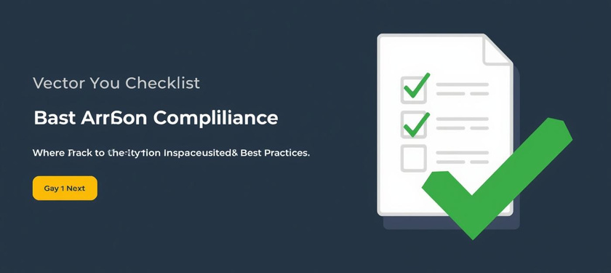




Privacy Safeguards for GDPR-Compliant Robotics AI
Data Minimization
User Consent
Limit data collection to only essential information for functionality.
Obtain clear and informed consent from users before data collection.
Encryption
Access Control
Protect data at rest and in transit using strong encryption methods.
Restrict data access only to authorized personnel to enhance security.
Auditability
Efficient Data Handling
Enable transparent logging and monitoring of data access and usage.
Implement practices that support efficient and secure data handling processes.

Slide 12
AI Governance Roles Overview
Data Scientist
CISO
The Data Scientist is responsible for ensuring model accuracy and data validation. Their expertise in analyzing data helps maintain the integrity of AI systems.
The Chief Information Security Officer (CISO) is accountable for security oversight. They implement policies and controls to protect sensitive data within AI applications.
Compliance Officer
Executives
The Compliance Officer ensures adherence to regulatory standards like GDPR and NIST. They play a crucial role in maintaining ethical use of AI technologies.
Executives hold decision accountability for AI-related initiatives. Their leadership ensures that AI governance aligns with organizational goals and risk management strategies.

Slide 13
Metrics & Cadence for AI Security in Robotics
01
02
03
04
Quarterly: Incident response drills are essential to ensure preparedness and effectiveness in addressing potential security breaches, allowing teams to evaluate and enhance response strategies.
Monthly: Prompt library reviews help maintain the quality and relevance of prompts used in AI systems, ensuring continuous improvement and alignment with security requirements.
Annually: Vendor audits and compliance checks are critical for assessing third-party relationships, verifying adherence to security standards, and mitigating risks associated with external partnerships.
Continuous: Access monitoring and red-teaming activities provide ongoing assessment of security postures, identifying vulnerabilities and strengthening defenses against potential threats in real-time.

Slide 14
30/60/90 Day Roadmap for Robotics AI
30 Days: Prompt Hardening
30 Days: Initial Data Inventory
60 Days: Conduct DPIAs
90 Days: AI Governance Board
90 Days: Integrate NIST RMF
Establishing consistent prompt responses as a key foundation.
Compiling and evaluating essential data for informed decisions.
Assessing risks associated with robotics workflows for compliance.
Forming a board to oversee AI governance and ethics.
Implementing risk management practices for AI development.
ROBOTICS AI PLAN
1

Slide 15
Integrated Recommendations for Secure AI in Robotics
01
GOVERNANCE AND COMPLIANCE
02
GDPR AND NIST INTEGRATION
Essential for scaling robotics AI, ensuring alignment with industry standards and regulations.
Combining GDPR obligations with NIST risk controls strengthens data protection and enhances compliance.
03
FOUNDATION FOR TRUSTWORTHY INNOVATION
04
SYNERGISTIC APPROACH
Overlapping layers of security, privacy, and innovation represent a holistic strategy for responsible AI deployment.
Secure AI fosters trust, enabling responsible robotics innovation and adoption across various sectors.

Slide 16

Securing the Future of Robotics
Protecting Innovation Through Trust and Governance
Robotics AI presents an incredible potential to transform industries, but it is crucial to implement robust safeguards. By committing to governance, compliance, and ongoing monitoring, we can ensure that innovation occurs responsibly, protecting privacy and security. Let's advance implementation by approving the 30/60/90 roadmap for structured progress.

