Slide 1
ICM Development in HAPS
Interference Coordination Method
for Integrated HAPS-Terrestrial Networks

Slide 2


The Speakers
Potsawat Thinkanwatthana
6410451199 potsawat.t@ku.th
Sornsiri Hongsa
6410451431 sornsiri.h@ku.th

Slide 3
Outline
HAPS, Terrestrial Networks, and Their System Model
Interference Analysis
Proposed Interference Coordination Method
Evaluation Results
Conclusions
Our Thoughts
Q&A

Slide 4
HAPS
High Altitude Platform Station
HAPS can be any Unmanned Aerial Vehicle (UAV) that fly or float in the stratosphere
Typically at altitudes of around 20 km.
HAPS system use solar power or an on-board energy source

Slide 5
Terrestrial Networks (TN)
Ground-based cellular networks.
Terrestrial networks consist of terrestrial base stations which randomly distributed within the coverage area of HAPS.

Slide 6
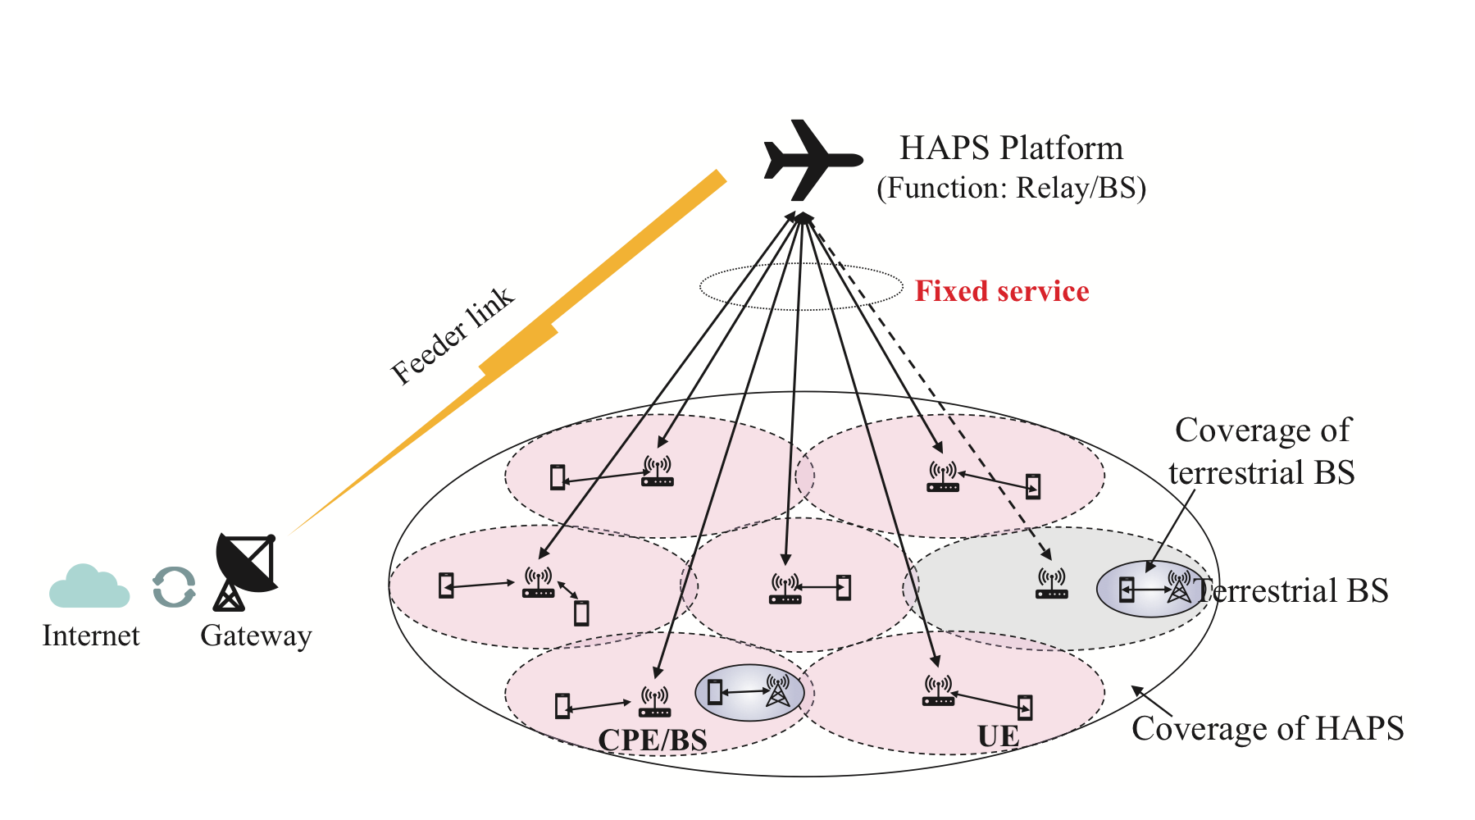
System Model of HAPS
Case 1 - HAPS provides services for customer premise equipment (CPE) or terrestrial base stations (BS) on the ground and CPE/BS provide mobile services for user equipment (UE)

Slide 7
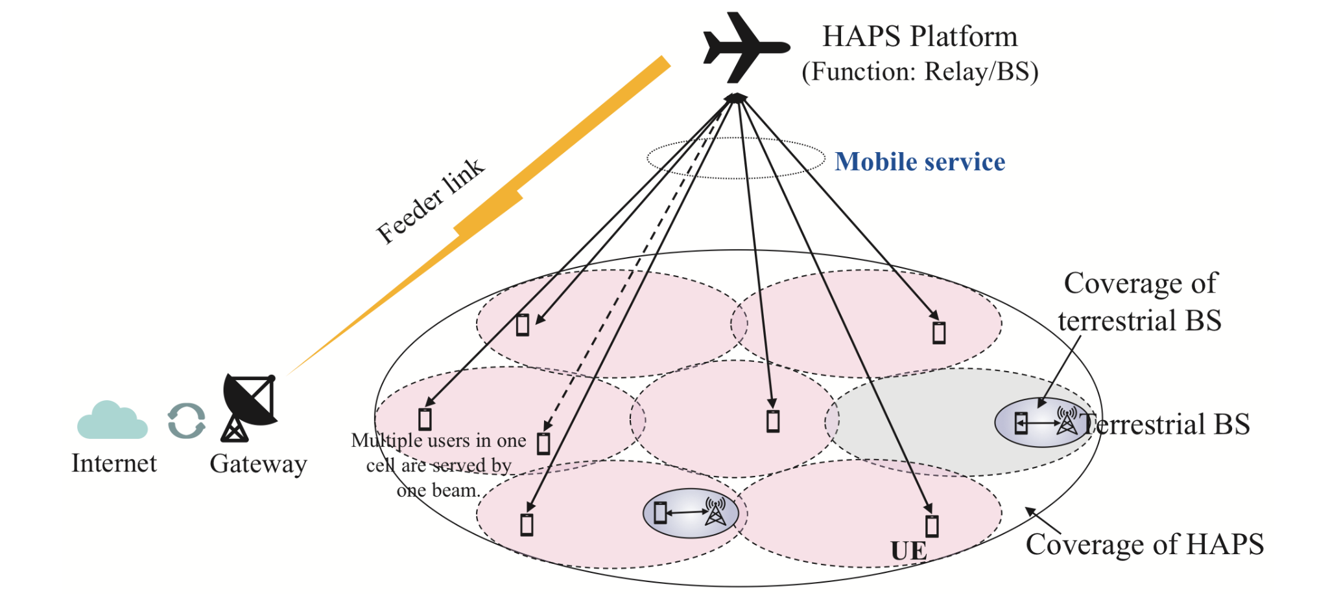
System Model of HAPS
Case 2 - HAPS directly provides mobile services for UE on the ground

Slide 8
System model of TN
Terrestrial networks have path loss and shadow fading, which are influenced by the scenario configuration
Terrestrial Base Station can use fully dynamic beamforming and precoding schemes for better performance

Slide 9
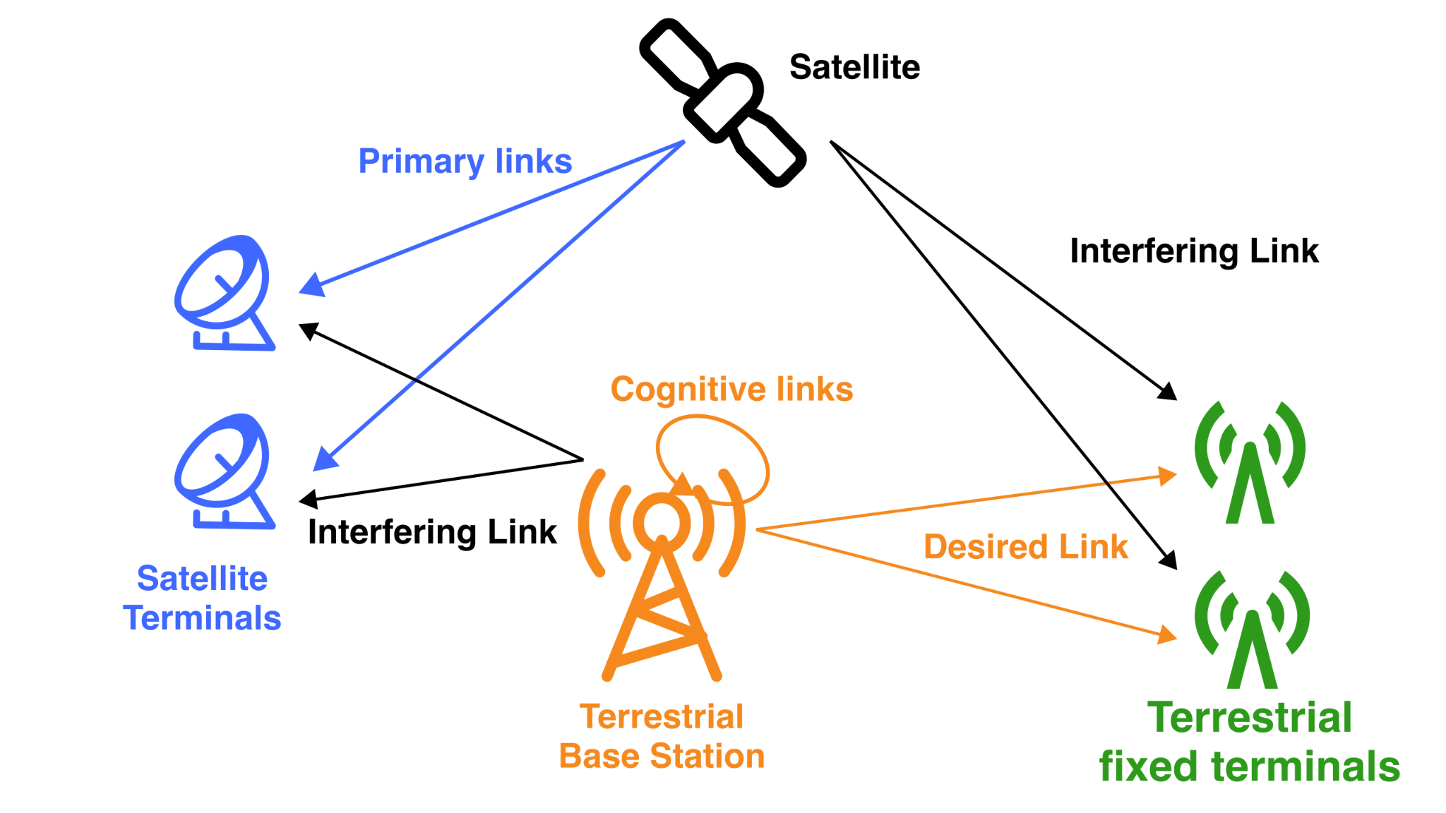

Slide 10
Interference Analysis
The highlight of interference in integrated system is the interference from HAPS downlink to terrestrial downlink, especially to user equipment (UE)
Multi-beam transmission in HAPS can cause inter-beam interference. And its will lead to intra-beam interference.
This method goals is to achieve better resource utilization and performance by dynamically considering the changing traffic load in HAPS and terrestrial networks

Slide 11
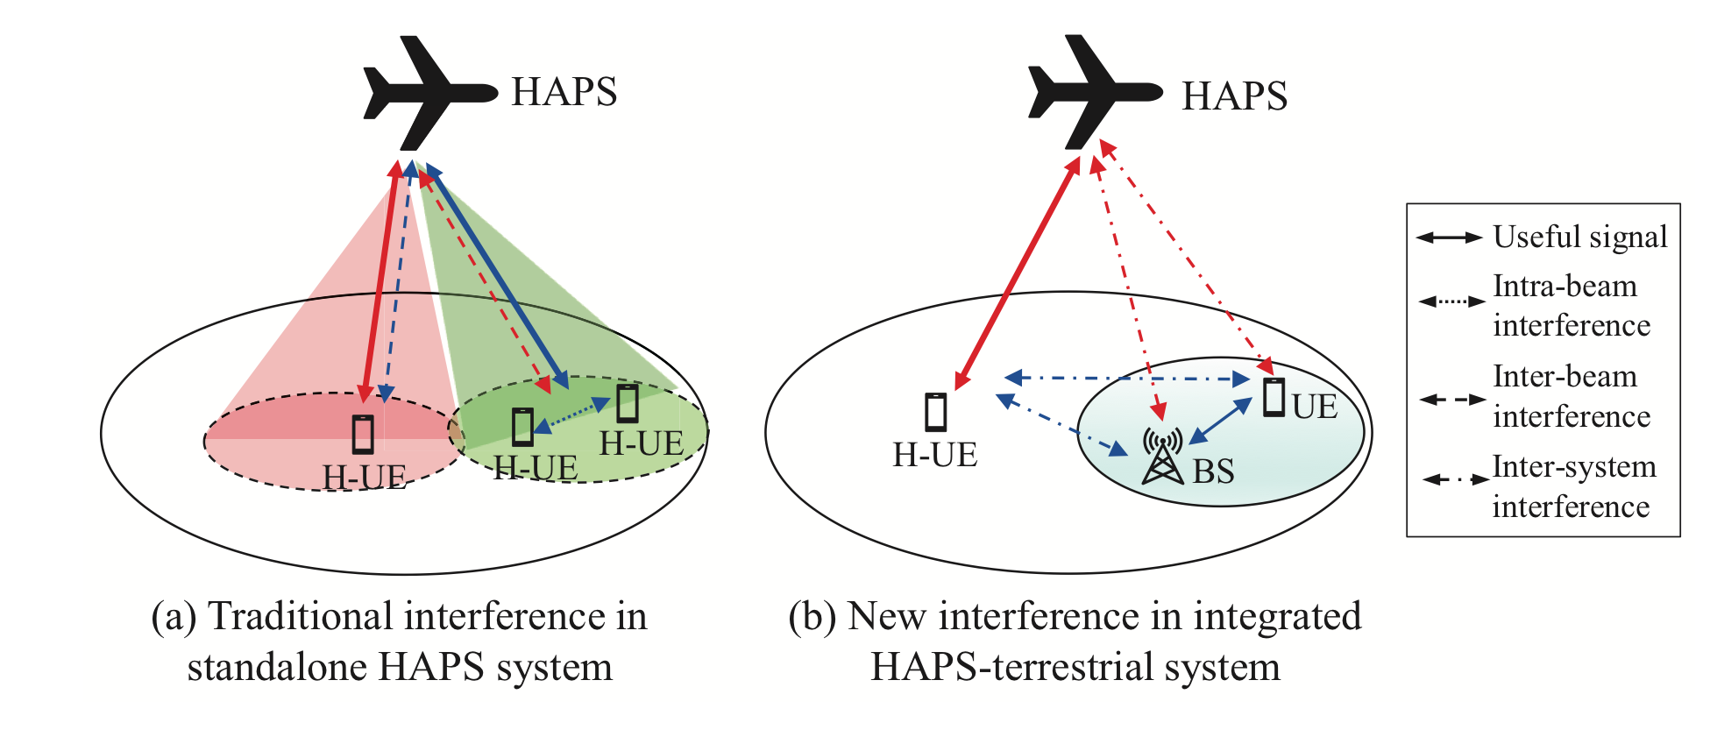
Interference Analysis

Slide 12
The Proposed Method

Slide 13
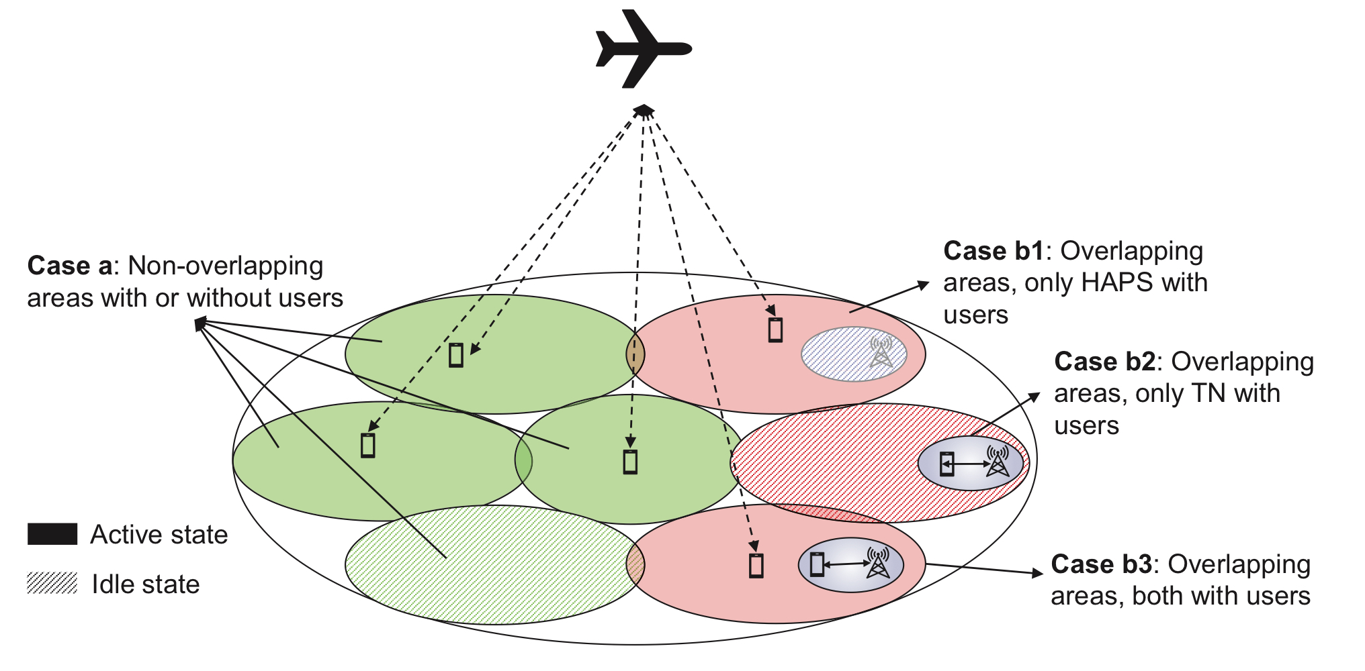
Traffic Load and Deployment
Different cases based on traffic distribution and deployment of integrated system
Liu, W., Hou, X., Chen, L., Hokazono, Y., & Zhao, J. (2022). Interference Coordination Method for Integrated HAPS-Terrestrial Networks. 2022 IEEE 95th Vehicular Technology Conference: (VTC2022-Spring). https://doi.org/10.1109/vtc2022-spring54318.2022.9860546

Slide 14
Case A: Non-overlapping Areas
No overlaps between HAPS and TN coverage, only HAPS coverage is provided
No interference

Slide 15
Case Bs: Overlapping Areas
Their exist overlapping areas between HAPS and TN coverage
Considering traffic distribution in HAPS and TN, this case is further divided into 3 subcases, B1 through B3

Slide 16
B-subcases
Subcase | Traffic Load | Condition | Consideration
B1 | HAPS | Inter-system interference can be ignored; long distance between HAPS and TN | Turn TN base stations into idle state
B2 | TN | No interference from HAPS to TN | Turn HAPS beam or CPE for the cell off
B3 | HAPS and TN | Inter-beam interference from HAPS cells Inter-system interference | Further analysis required (next page)

Slide 17
Case B3 Analysis: The Patterns
Pattern # | HAPS is active | TN is active | Coordination
1 | ✔ | ✔ | ✗ Both HAPS and TN serve users with same time-frequency resources
2 | ✔ | ✔ | ✔
3 | ✗ | ✔ | ✗
4 | ✔ | ✗ | ✗

Slide 18
Evaluation Results
Result | Proposed Method | Baseline 1 (Fixed Allocation) | Baseline 2 (Orthogonal Allocation)
Throughput (HAPS Users) | Higher | Lower | Higher
Throughput (Terrestrial Users) | Higher | Higher | Lower
Interbeam Interference | Mitigated | Ignored | Significant

Slide 19
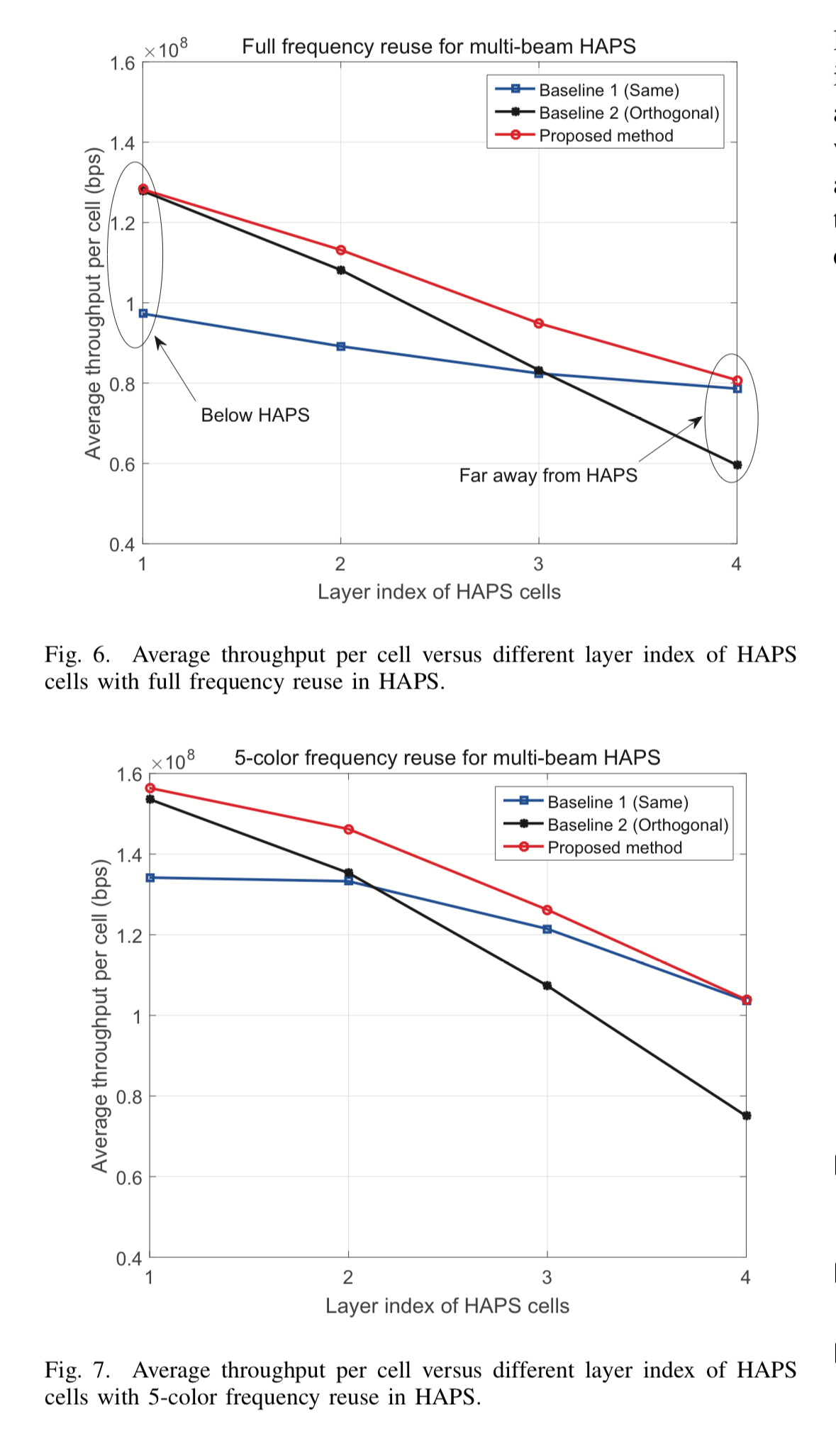
Evaluation Results

Slide 20
Conclusions
To coordinate HAPS and TN, we must take into account the inter-system interference.
The paper shows possible scenarios and proposed a method that can be used to determine the optimized pattern for distributing traffic between the two systems. The optimized pattern is the pattern such that throughput is at its maximum and is subject to the minimum data rate requirement.
The evaluation results show that this method improves performance by maximizing throughput when comparing to the current HAPS architecture.

Slide 21
Our Thoughts: Potsawat
The ICM method does help improve efficiency and traffic optimization between HAPS and TNs by distributing workload between the two.
Nevertheless, the evaluation results show that this method majorly covers particular regions with particular distance from HAPS cells. This may also mean the increased implementation cost in order to fairly provide service to users across a coverage area.
HAPS is meant to both improve performance, and reduce implementation and maintenance cost.

Slide 22
Our Thoughts: Sornsiri
The primary consideration from this paper is the reduction of resources used for data exchange in each time.
If this issues can be fixed, not only HAPS but the overall efficiency of the terrestrial network (NTN) will improve significantly.
This method could potentially lead to the development of 5G and 6G signal networks in the future.

Slide 23
References
[1] Wenjia Liu and others. “Interference Coordination Method for Integrated HAPS-Terrestrial Networks”. in 2022 IEEE 95th Vehicular Technology Conference: (VTC2022-Spring): 2022, pages 1–6. DOI: 10.1109/VTC2022-Spring54318.2022.9860546.
[2] GSMA. High Altitude Platform Systems. Tower in the Skies. version 2.0. 2022.

Slide 24
Q&A

