Slide 1
HAPS
High Altitude Platform Station

Slide 2


The Presenters
Potsawat Thinkanwatthana
Student ID | 6410451199
Email | potsawat.t@ku.th
Sornsiri Hongsa
Student ID | 6410451431
Email | sornsiri.h@ku.th

Slide 3
Outline
Terminologies
Classifying Networks by Their Altitude
HAPS
HAPS Architectures
Use Cases
Conclusion
Our Thoughts on HAPS
Notes:
Nai

Slide 4
Terminologies
Base Station
Drones
Platform
Notes:
Nai

Slide 5
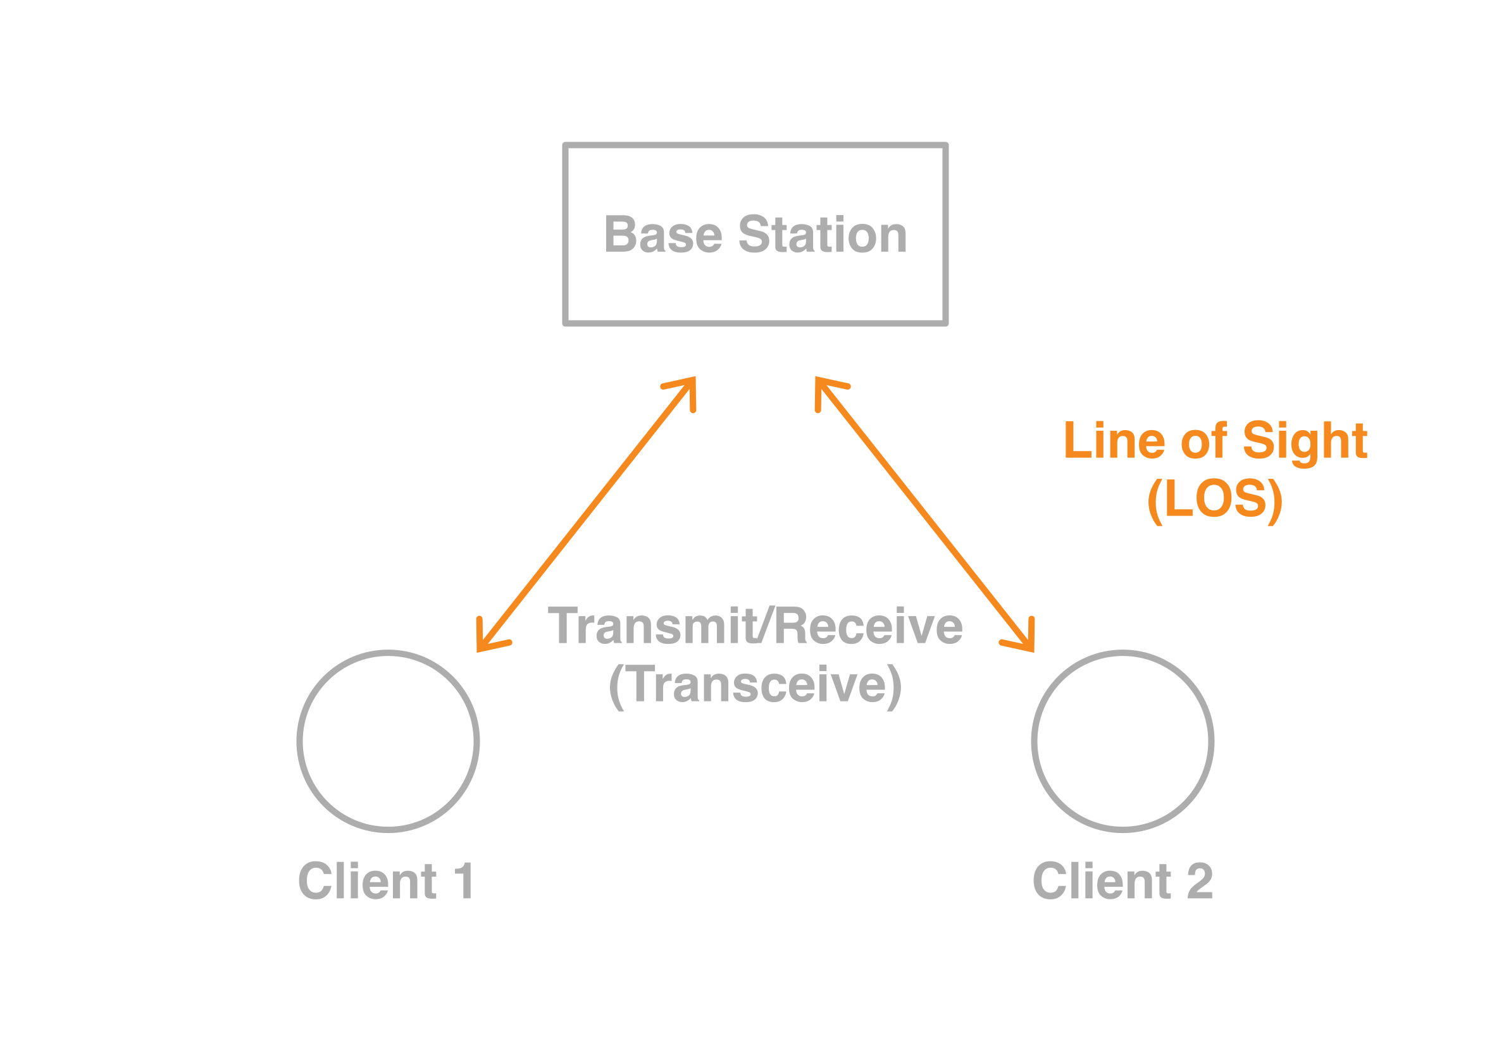
Terms: Base Station
Fixed transceiver – transmitter/receiver
Main communication point for one or more wireless mobile client devices
Wright, G. (2021). base station. WhatIs.com. Retrieved from https://www.techtarget.com/whatis/definition/base-station
Notes:
Nai

Slide 6
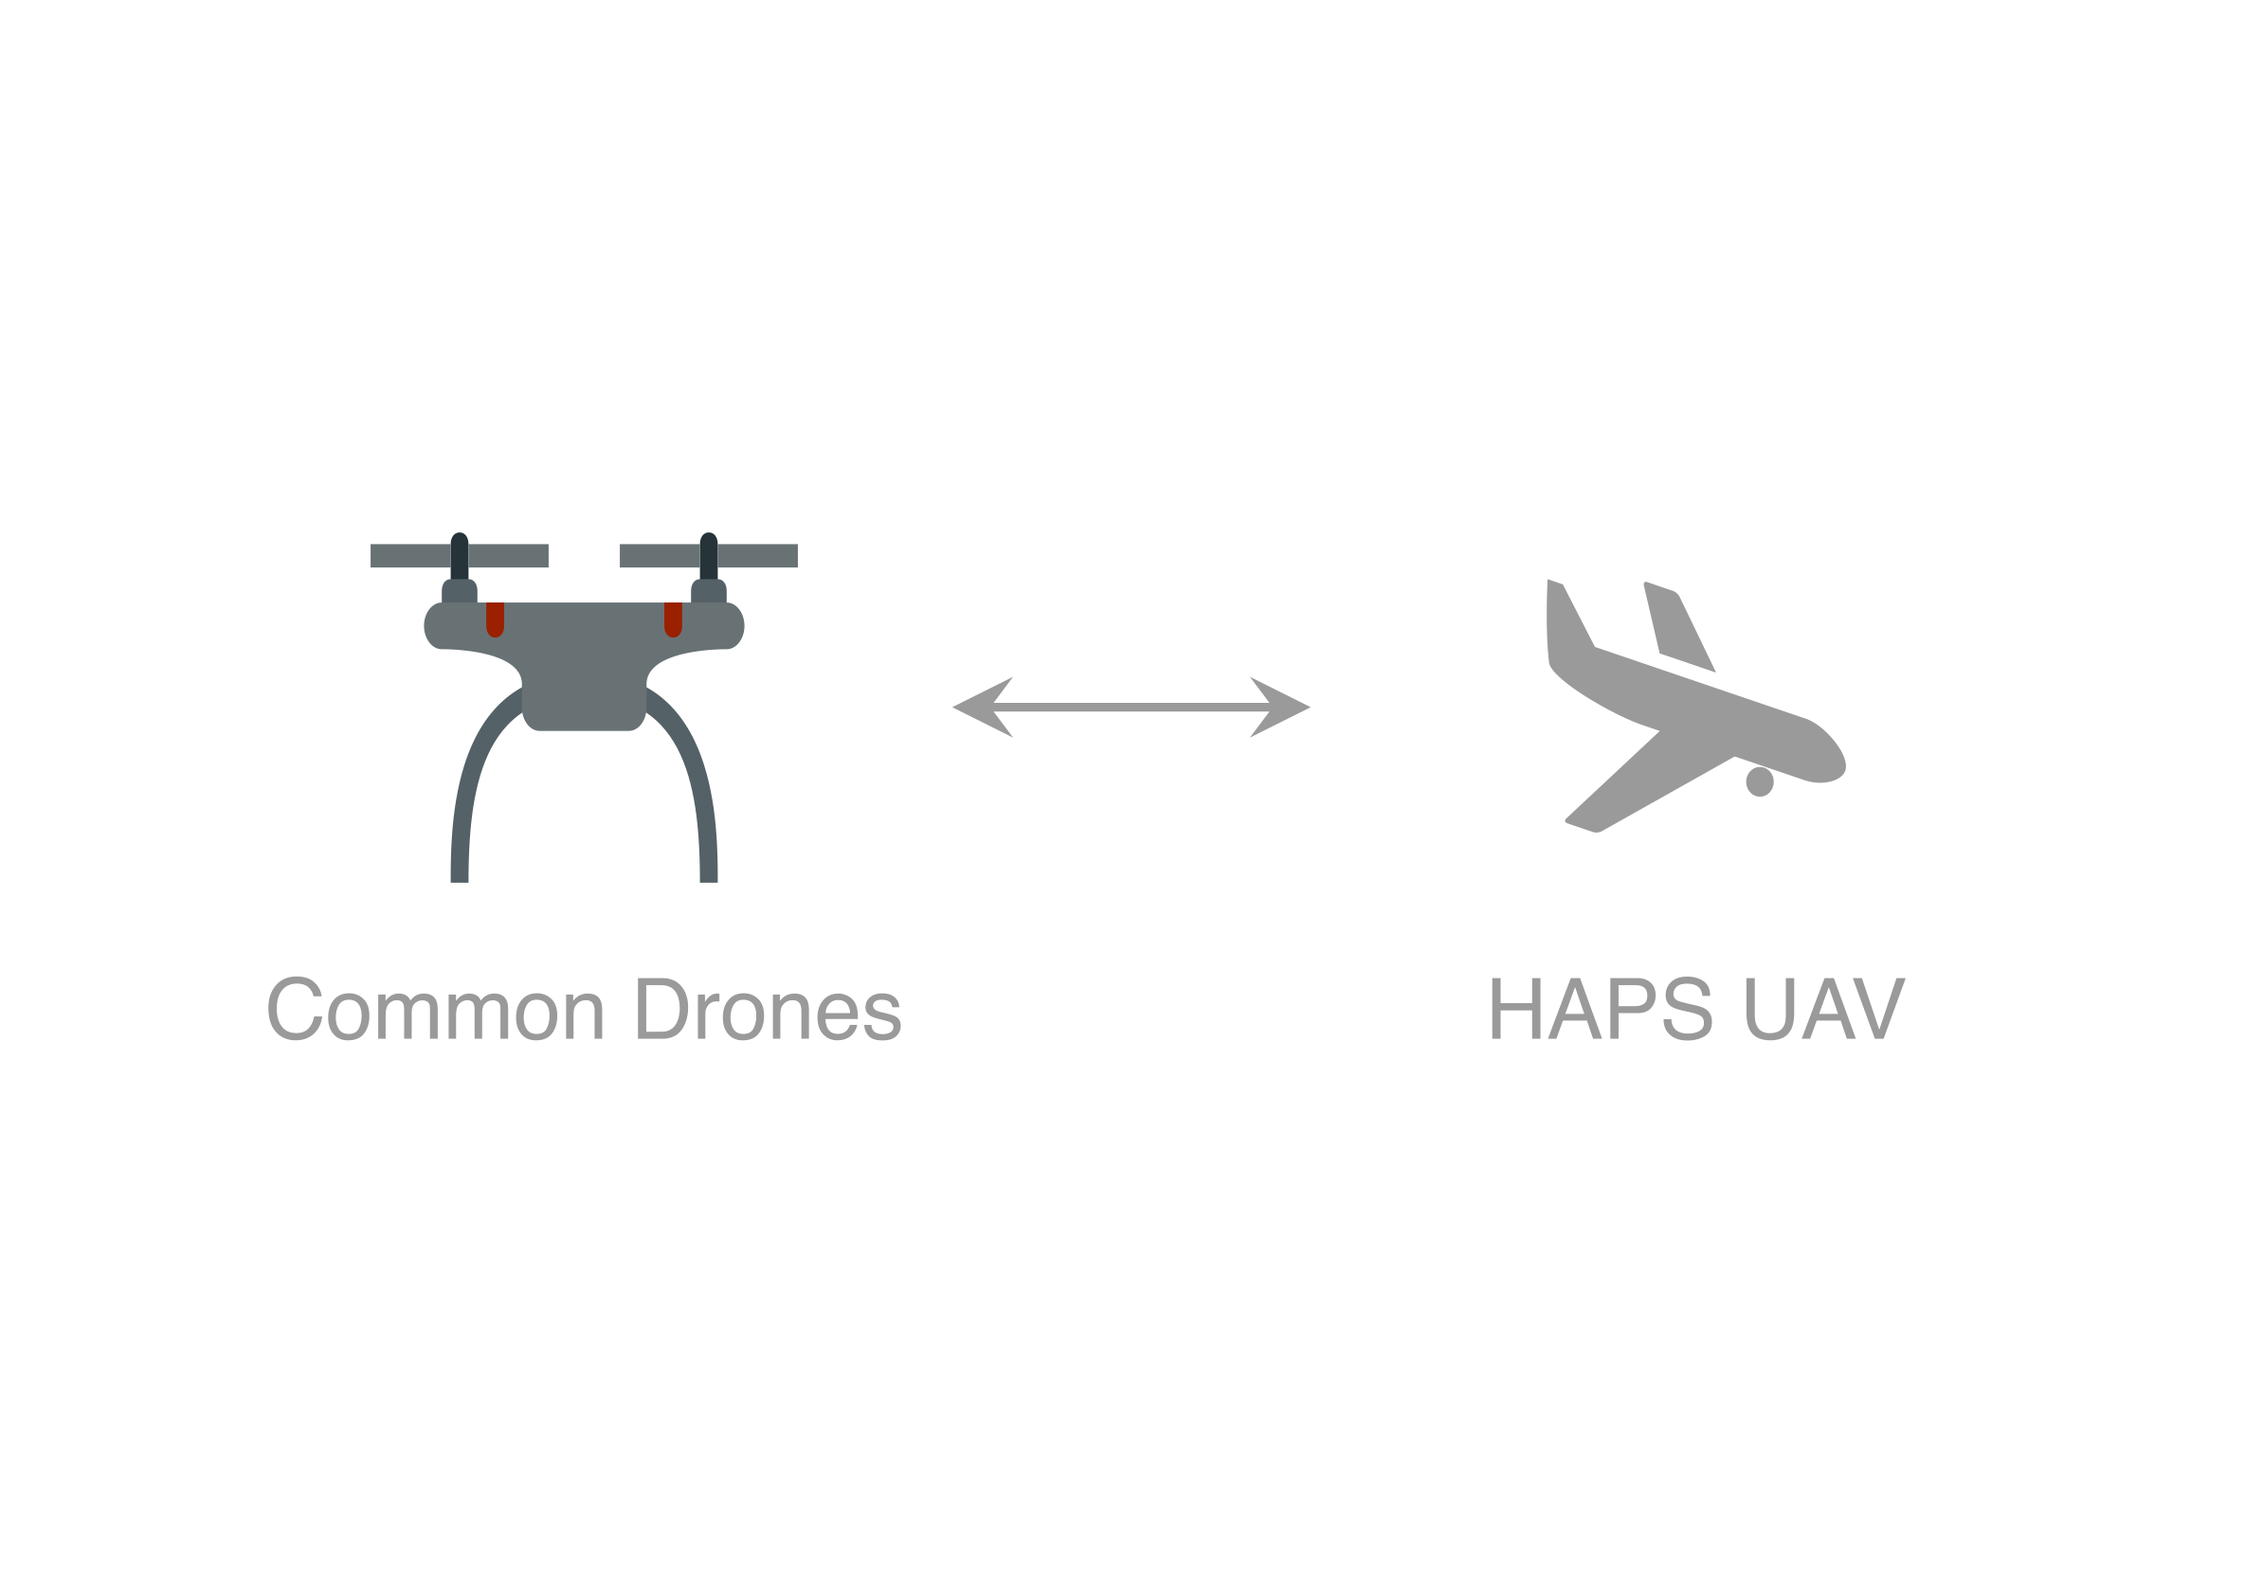
Terms: Drones (Unmanned Aerial Vehicles)
Drones are more formally known as unmanned aerial vehicles (UAVs) or unmanned aircraft systems.
Lutkevich, B., & Earls, A. R. (2021). drone (UAV). IoT Agenda. Retrieved from https://www.techtarget.com/iotagenda/definition/drone
Notes:
Joe

Slide 7
Terms: Platform
Set of installed hardware and software on a computing device required for specific software to run
Platform. (2020, April 30). Retrieved from https://www.computerhope.com/jargon/p/platform.htm
Notes:
Joe

Slide 8
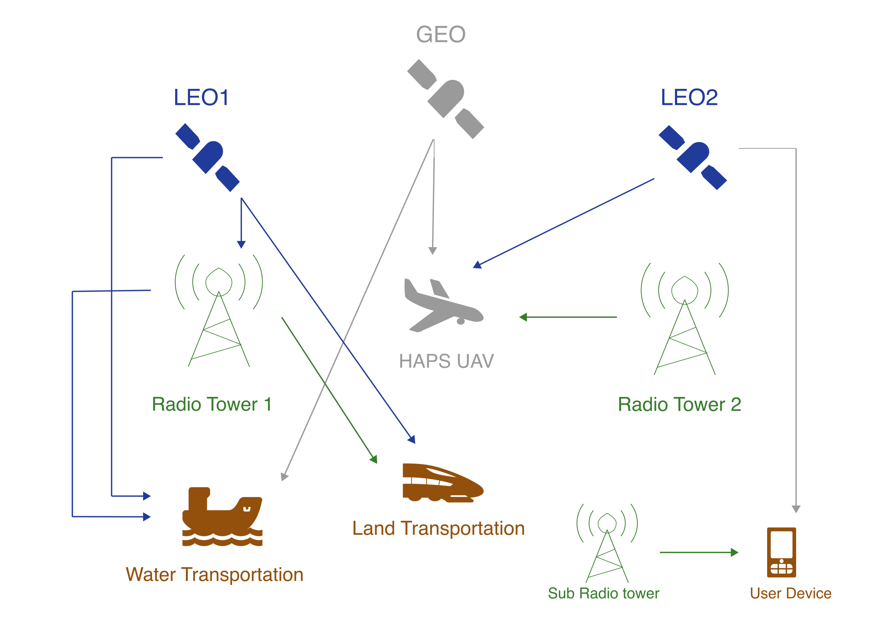
Classes of Communication Networks
Classified by altitude – distance above sea level
Terrestrial Networks (TN) Installed/deployed the ground
Non-terrestrial Networks (NTN) Installed/deployed above sea level, typically found in the space
Nguyen, V. (2022). Non-terrestrial networks could be the next frontier for 5G. 5G Americas. Retrieved from https://www.5gamericas.org/non-terrestrial-networks-could-be-the-next-frontier-for-5g/
Notes:
Joe

Slide 9
Non-terrestrial Network Orbits
TYPE | ALTITUDE (Km)
Geostationary Earth Orbit (GEO) | ≥ 35,786
Medium Earth Orbit (MEO) | 2,001–35,785
Low Earth Orbit (LEO) | 500–2,000
…
3rd Generation Partnership Project (3GPP). (2019, October). Study on New Radio (NR) to support non-terrestrial networks (TR 38.811 V15.2.0 (2019-09)). 3GPP. Retrieved from https://www.3gpp.org/ftp//Specs/archive/38_series/38.811/38811-f20.zip
Notes:
Joe

Slide 10
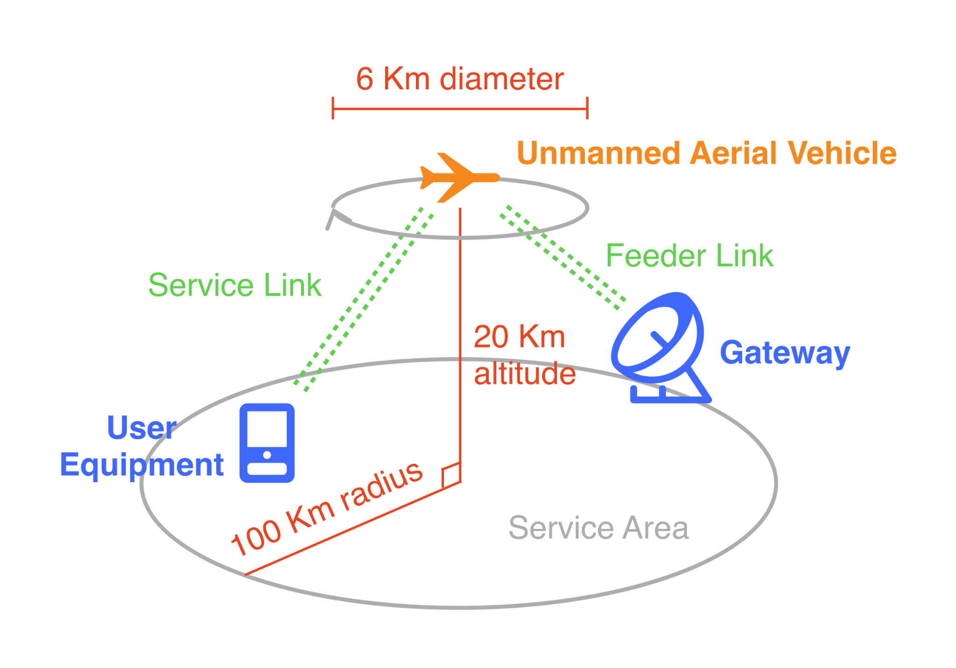
Repetitive Flight Pattern (Station Keeping)
Hsieh, F., Jardel, F., Visotsky, E., Vook, F., Ghosh, A., & Picha, B. (2020, December 1). UAV-based Multi-cell HAPS Communication: System Design and Performance Evaluation. IEEE Xplore. https://doi.org/10.1109/GLOBECOM42002.2020.9322476
Notes:
Nai

Slide 11
HAPS
Notes:
Nai

Slide 12
H igh A ltitude
P latform
S tation
1
18–24 km above the ground – stratosphere
Set of installed hardware and software on a computing device required for specific software to run
2
Base Station: A fixed transceiver that is the main communication point for one or more wireless mobile client devices
3
Platform. (2020, April 30). Retrieved from https://www.computerhope.com/jargon/p/platform.htm
UAV-based Multi-cell Haps Communication: System Design and Performance Evaluation. GLOBECOM 2020 - 2020 IEEE Global Communications Conference. doi:10.1109/globecom42002.2020.9322476
Wright, G. (2021). base station. WhatIs.com. Retrieved from https://www.techtarget.com/whatis/definition/base-station
Notes:
Nai

Slide 13
What Does HAPS Improve?
Have shorter delay (1–2 ms) than LEO
Small change in frequency in Doppler shift
Lower maintenance cost than LEO and the rest of non-terrestrial networks
3rd Generation Partnership Project (3GPP). (2020, September). Technical Specification Group Radio Access Network; Study on New Radio (NR) to support non-terrestrial networks (Release 15) (TR 38.811 V15.4.0 (2020-09)). 3GPP. Retrieved from https://www.3gpp.org/ftp//Specs/archive/38_series/38.811/38811-f40.zip
Notes:
Joe

Slide 14
Bent-pipe Architecture (BP)
HAPS as a repeater
Requires lower weight and power consumption than Regenerative Architecture (RG)
Requires access link (AL) and feeder link (FL) together
Hsieh, F., Jardel, F., Visotsky, E., Vook, F., Ghosh, A., & Picha, B. (2020, December 1). UAV-based Multi-cell HAPS Communication: System Design and Performance Evaluation. IEEE Xplore. https://doi.org/10.1109/GLOBECOM42002.2020.9322476
Notes:
Joe

Slide 15
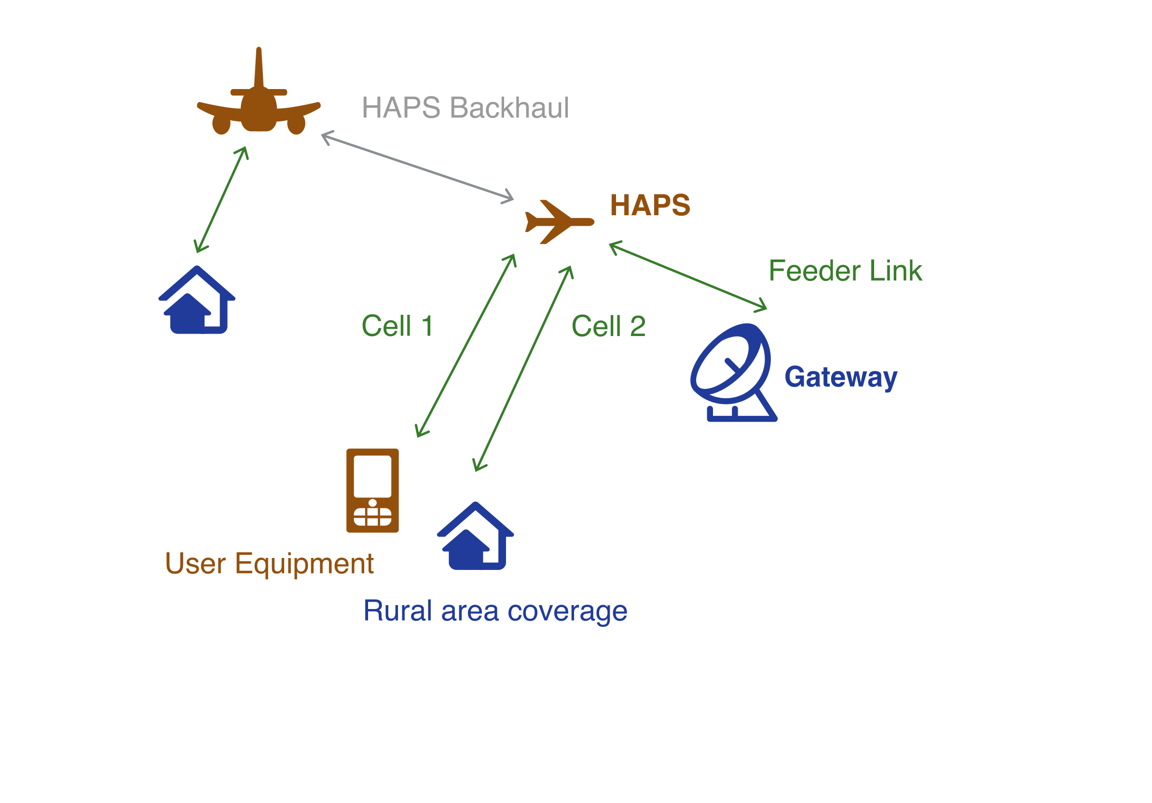
Bent-pipe Architecture (BP)
Bent-pipe HAPS architecture: HAPS as a repeater
Notes:
Joe

Slide 16
Regenerative Architecture (RG)
HAPS works as base station
Access link and feeder link can be used independently
Consume more power and require more weight than Bent-pipe
Notes:
Nai

Slide 17
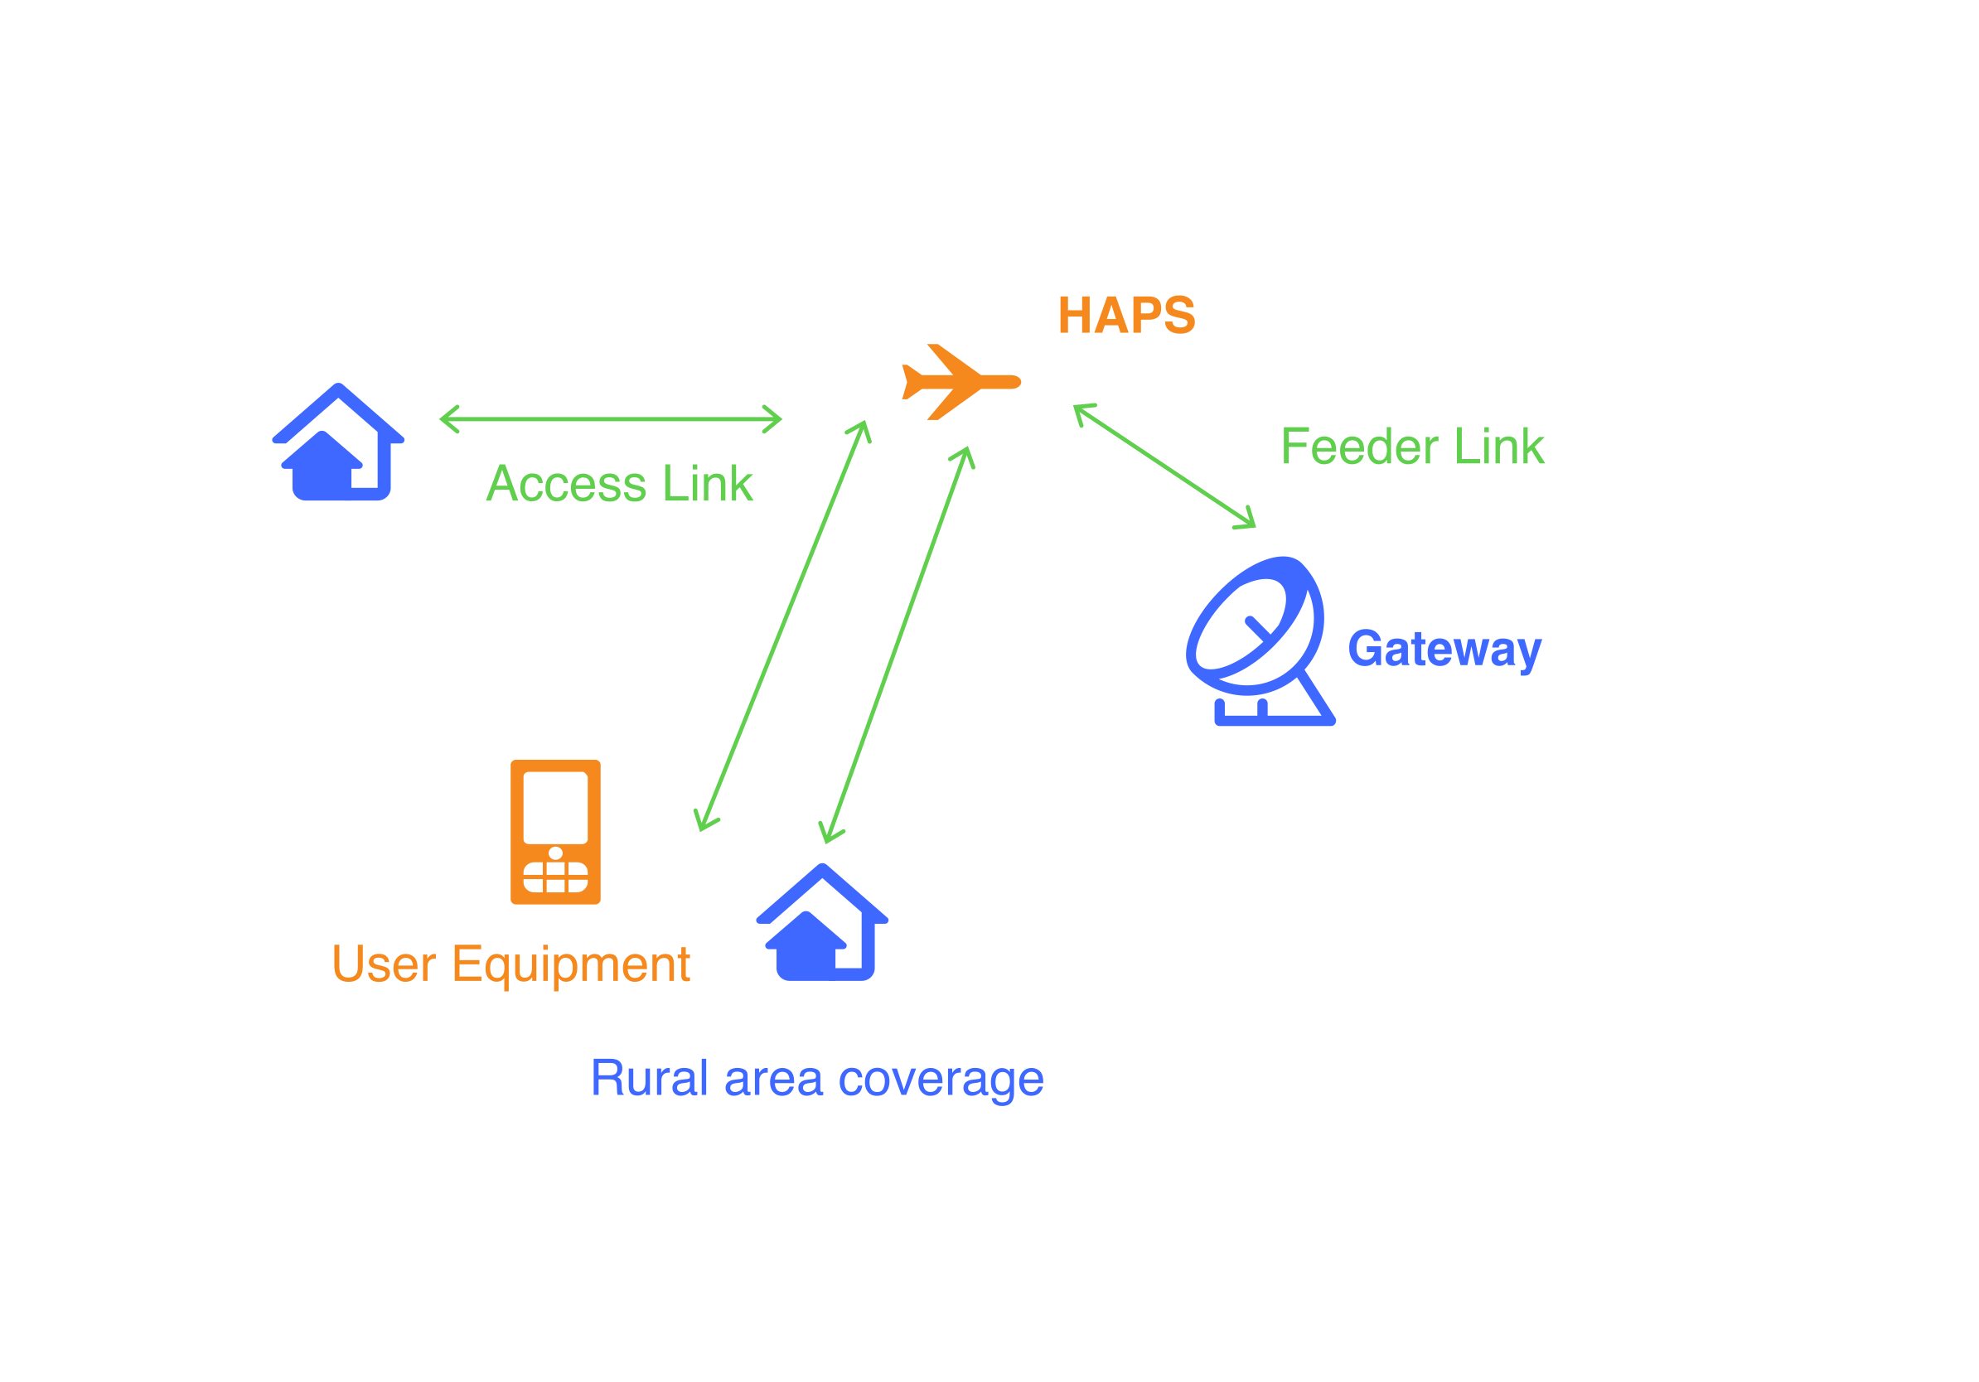
Regenerative Architecture (RG)
Re-generative HAPS architecture: HAPS as a base station
Notes:
Nai

Slide 18
Use Cases
Expanding telecom coverage into rural and challenging terrains HAPS can act as floating cell towers
Provides emergency coverage in times of outages and disasters HAPS operate above the weather and can be moved at will
High Altitude, Higher Ambitions. (2020, May 1). Retrieved from https://hapsalliance.org/wp-content/uploads/formidable/12/Stratosphere_Whitepaper_May1-1.pdf
Notes:
Nai

Slide 19
Conclusion
HAPS is a technology that involves deploying unmanned aircraft in the stratosphere to serve as communication platforms
Classifying networks by altitude
Terrestrial Networks (TN)
Non-terrestrial Networks (NTN)
HAPS is NTN, at the height of 18–24 Km – stratosphere
HAPS uses unmanned aerial vehicles (UAV) as platform for base station
HAPS can act as a repeater or a base station, depending on architectures
Notes:
Joe

Slide 20
References
Xing, Y., Hsieh, F., Ghosh, A., & Rappaport, T. S. (2021). High Altitude Platform Stations (HAPS): Architecture and System Performance. IEEE 93rd Vehicular Technology Conference (VTC-Spring). https://doi.org/10.1109/vtc2021-spring51267.2021.9448899
Hsieh, F., Jardel, F., Visotsky, E., Vook, F., Ghosh, A., & Picha, B. (2020, December 1). UAV-based Multi-cell HAPS Communication: System Design and Performance Evaluation. IEEE Xplore. https://doi.org/10.1109/GLOBECOM42002.2020.9322476

Slide 21
Our Thoughts
“HAPS will resolve some network problems, but it still can't solve at all .”
HAPS makes Internet more accessible.

Slide 22
Q&A

