Slide 1

US House Prices Data analysis and modelling
-Sachin Naik

Slide 2
Overview
The goal of this project was to identify 5 zip codes that will yield a good return.
Where we got our data and How we filtered it?
What does our model say?
What kind of risk is associated with our predicted housing markets?

Slide 3

Our data
We got our data from Zillows database .
Its based-on Zillow housing value index
The data comprises of median housing prices of about 15k zipcodes over the past 20 years .

Slide 4
Criteria for Zipcode selection
Top 25% urbanized zip codes.
Housing markets that have appreciated 3% or more annually for the past 20 years
Currently experiencing appreciation for the past 2 years
Did not depreciate during the great recession of 08

Slide 5
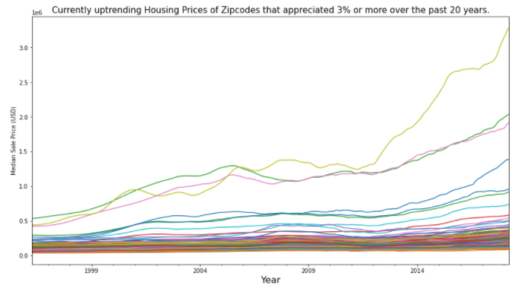
Key observations about filtered data
Most of them were under 500k
Doubled or more over the past 20 years
The return was more stable than the national average by over 10%

Slide 6
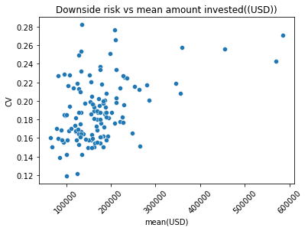
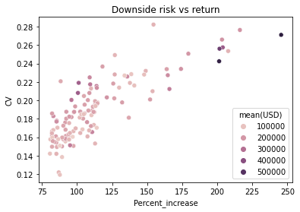
Risk vs return
Risk had a high correlation percent return.
Almost no correlation with the amount invested.

Slide 7
Top 10 zipcodes
Since our filtered zip codes were comparatively stable, we decided to narrow them down based on returns.
We chose the top 10 highest returning

Slide 8
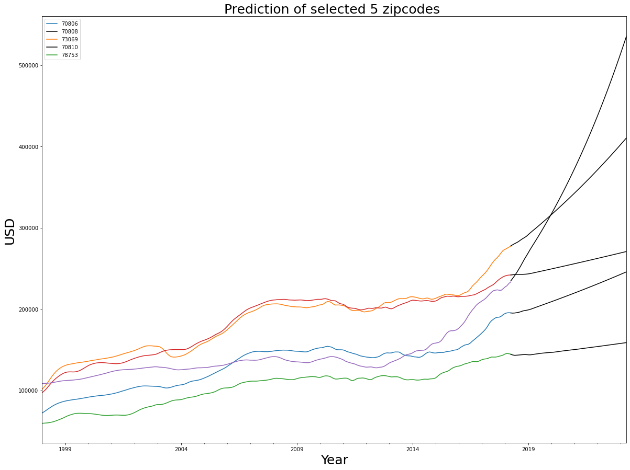
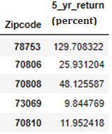
Predictions
Our model predicts on average the top 5 zip codes will return about 45% overall in the next 5 years with 95% confidence.

Slide 9
Future work
1) Cluster zipcodes based on the underlying geography as an external factor.
2) Including other external factors such as mortgage rates, local economy, income , crime etc to improve prediction
3) Inlcude and analyze rental data as rental income can be a factor in real estate investment.

Slide 10
Thank you!
Questions ?

