Slide 1
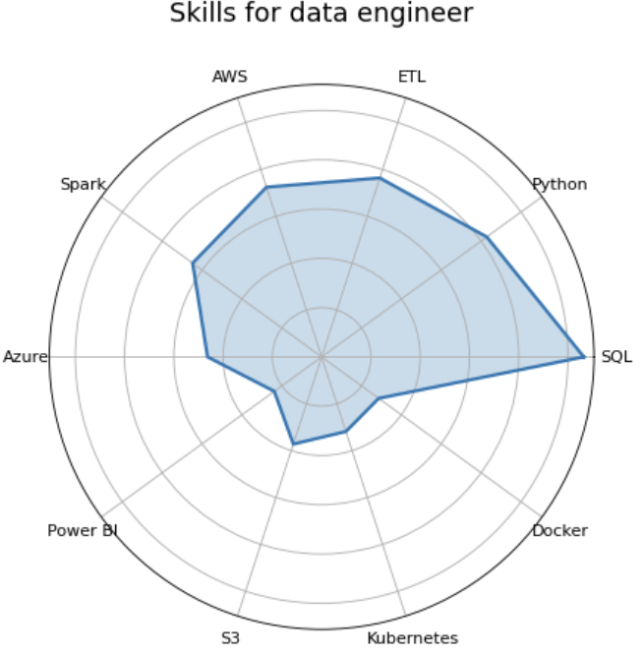
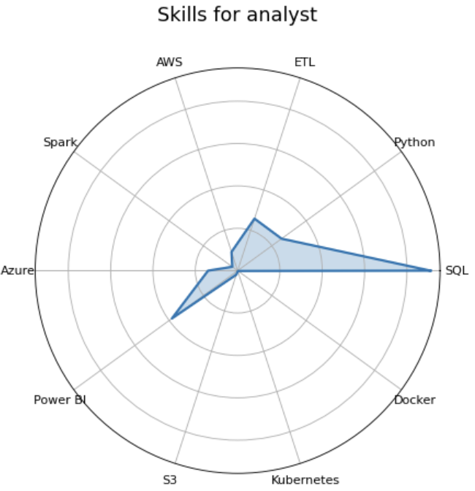
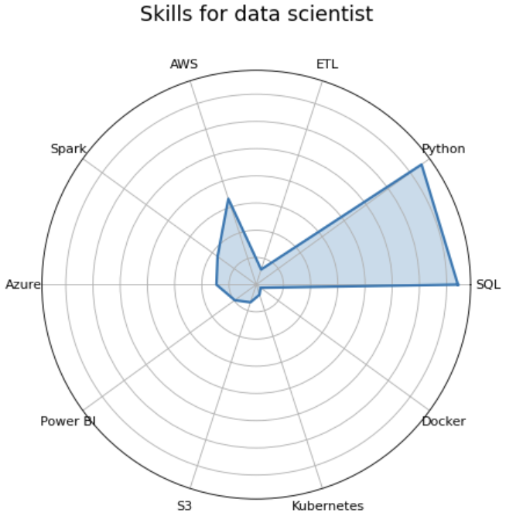
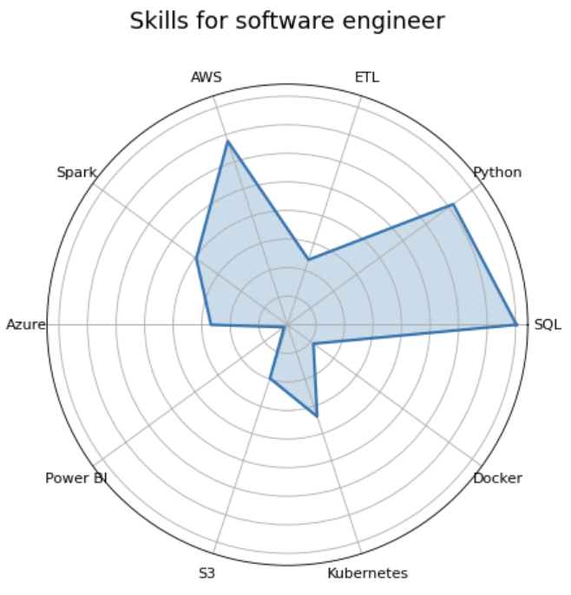
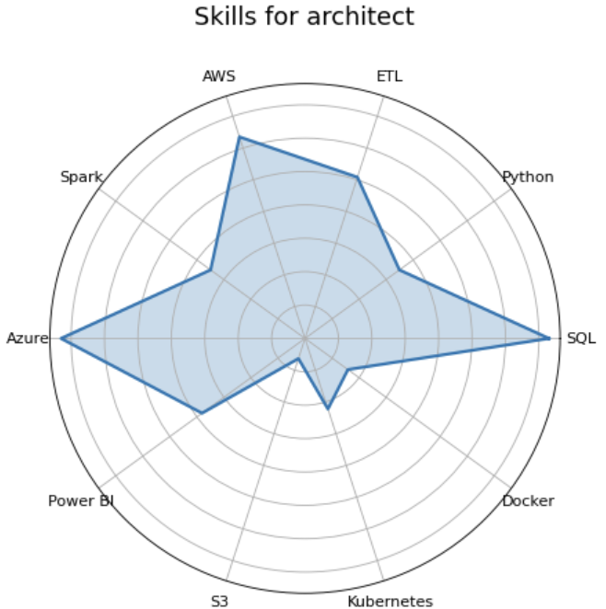
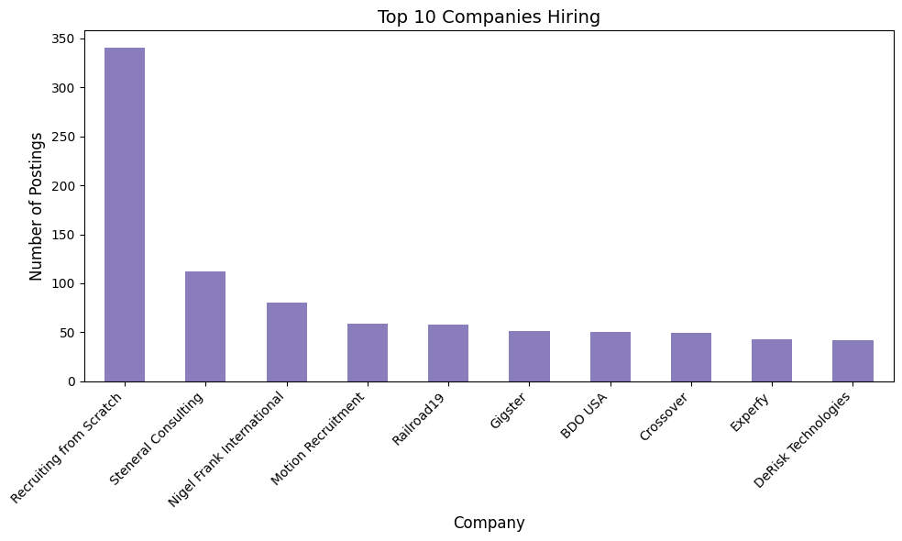

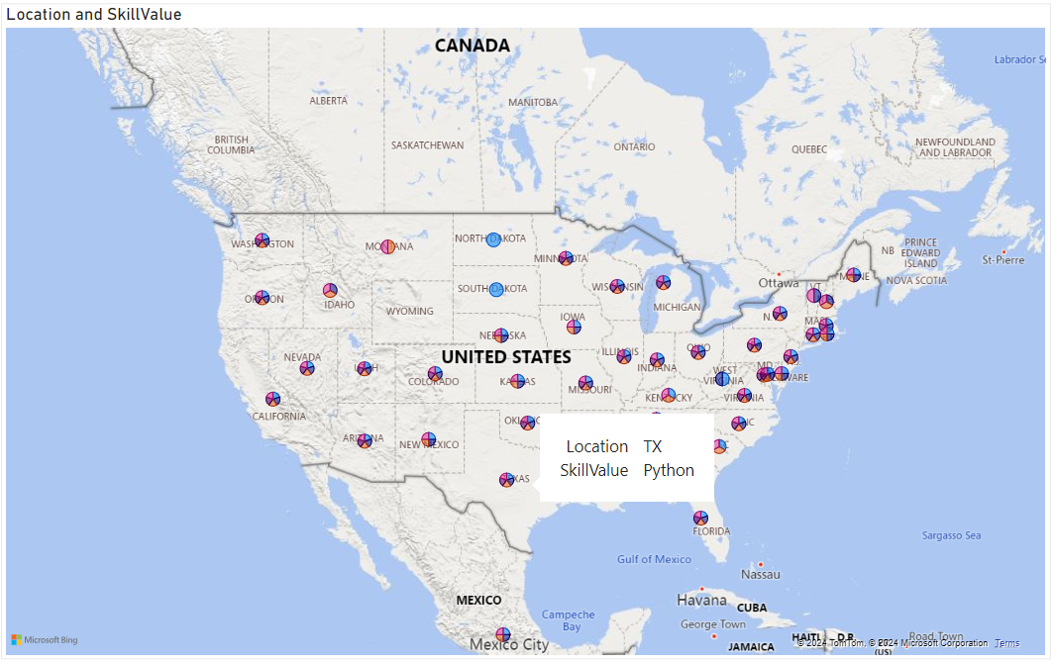
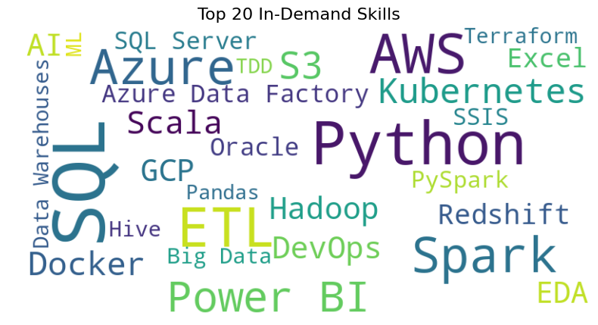
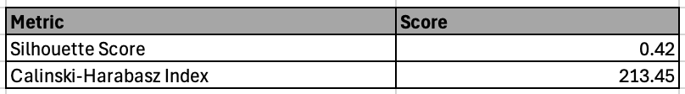
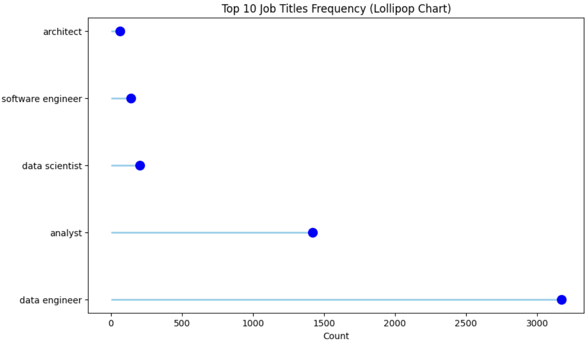
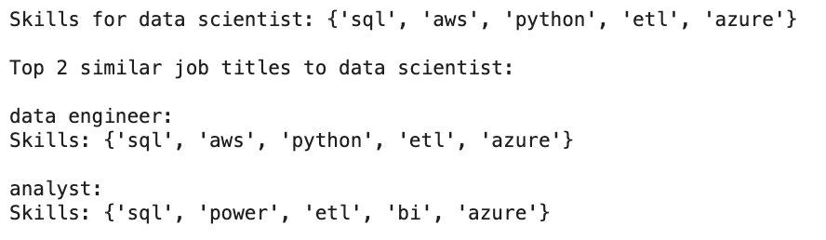






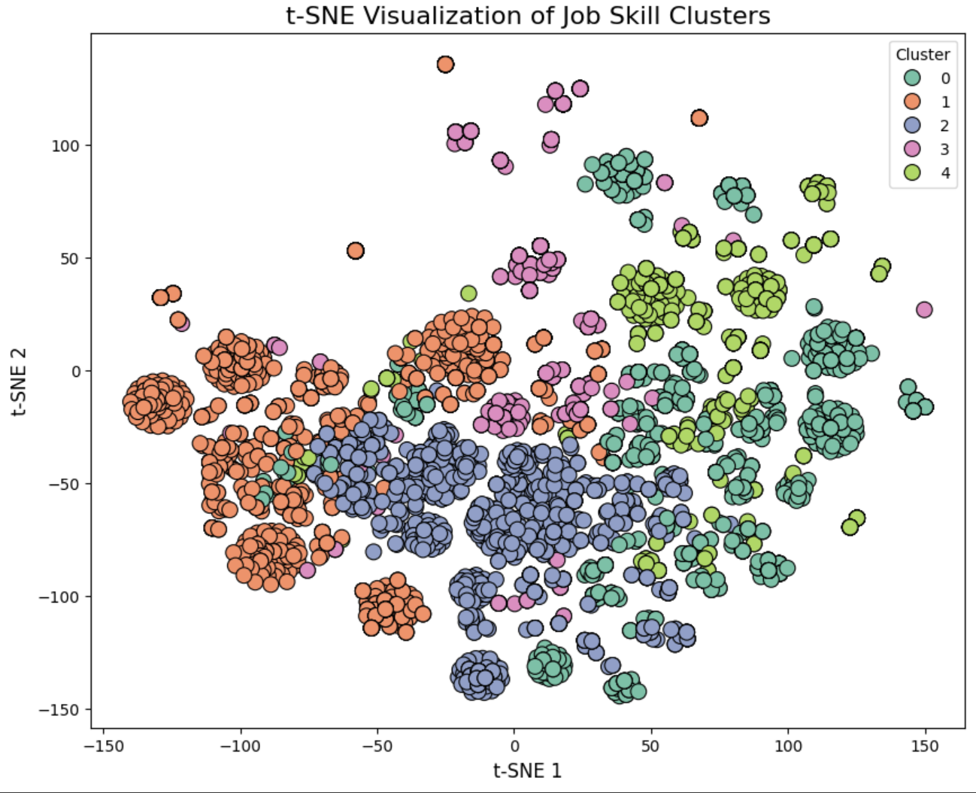




Skill Wiser
03
Visual Analysis of Model
Radar charts visualizing the skill distribution across the top 5 job titles, highlighting key skills required for each role.
Team Members
Abhishek 1001916610
Aishwarya 1002186951
Tharun 1002207785
Tushar 1002194530
The graph highlights the top 10 companies with the highest number of job postings, showcasing hiring trends in the market.
Visualizing the most frequently used skills across different states on a map
The word cloud visually represents the top 20 in-demand skills, with the size of each skill indicating its frequency in job postings.
01
Introduction
Project aims to identify and highlight the top 20 essential skills that are highly sought after across various industries in today's job market. It offers a dynamic tool where users can input a specific job role, and in return, the system will provide two closely related job roles along with the critical skills required for each. By offering these insights, the project seeks to help individuals better understand the skill sets needed for career development and navigate their professional growth effectively.
Lollipop chart visualizing the frequency of the top 10 job titles, highlighting their relative counts.
Displays clustering evaluation metrics, including Silhouette Score and Calinski-Harabasz
04
Conclusion
02
Tools Used
t-SNE visualization illustrating distinct job skill clusters based on reduced dimensionality.
05
References
https://ijece.iaescore.com/index.php/IJECE/article/view/31326/17022
https://online-journals.org/index.php/i-jac/article/view/34779

