Slide 1

Relevant Information Extraction Based on Term Mining and Context Based Search Applied To Web Pages
Sponsored by
Jayesh Pawar Internal Guide
Mandar Haldekar Prof.Rekha Kulkarni
Prajakta Naik External Guide
Aishwarya Bhide Mr.Vedang Manerikar

Slide 2
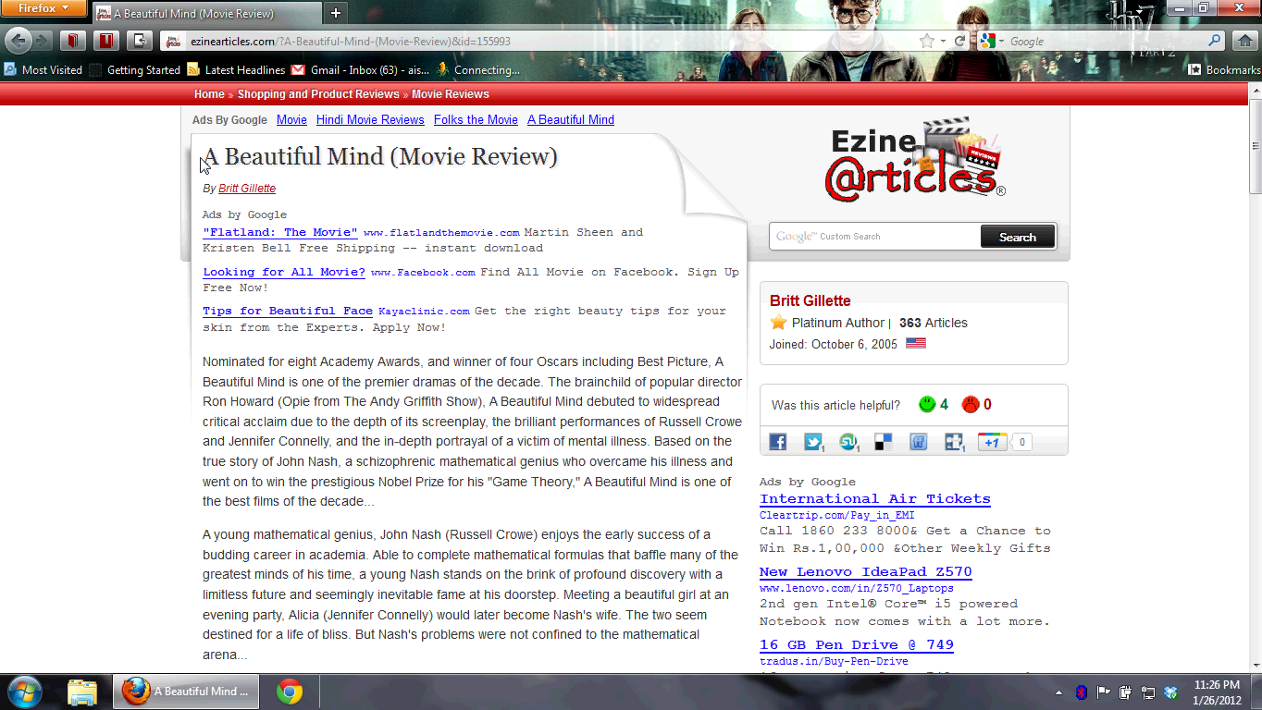

Slide 3

RIFU
Relevant Information for Users

Slide 4
RIFU
Finds the relevant information
Improves the searching mechanism(Automated Search)
Reduces browsing efforts
Finds what people are saying about it

Slide 5
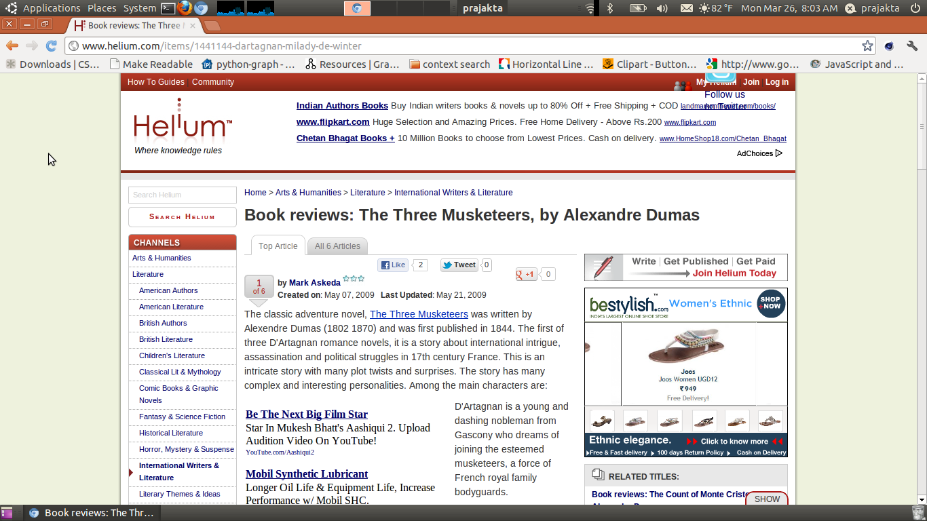
Problem Defiinition
Books
Finding The Context of the Keywords
Movies
Search Engine
People
Current Web Page
Keyword Extraction
Keyword Classification

Slide 6
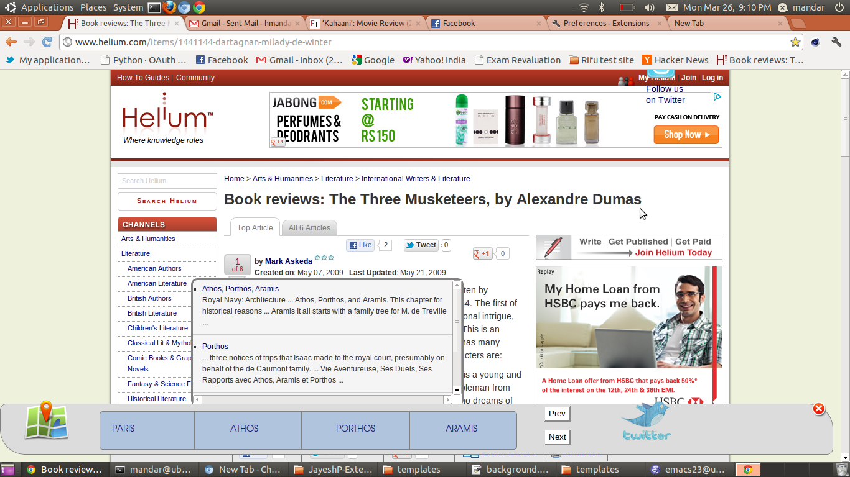
Search Results

Slide 7
Term Extraction
Scrape web page
Tokenize text
POS tags
NP chunks
Frequency and position
Extract keywords

Slide 8
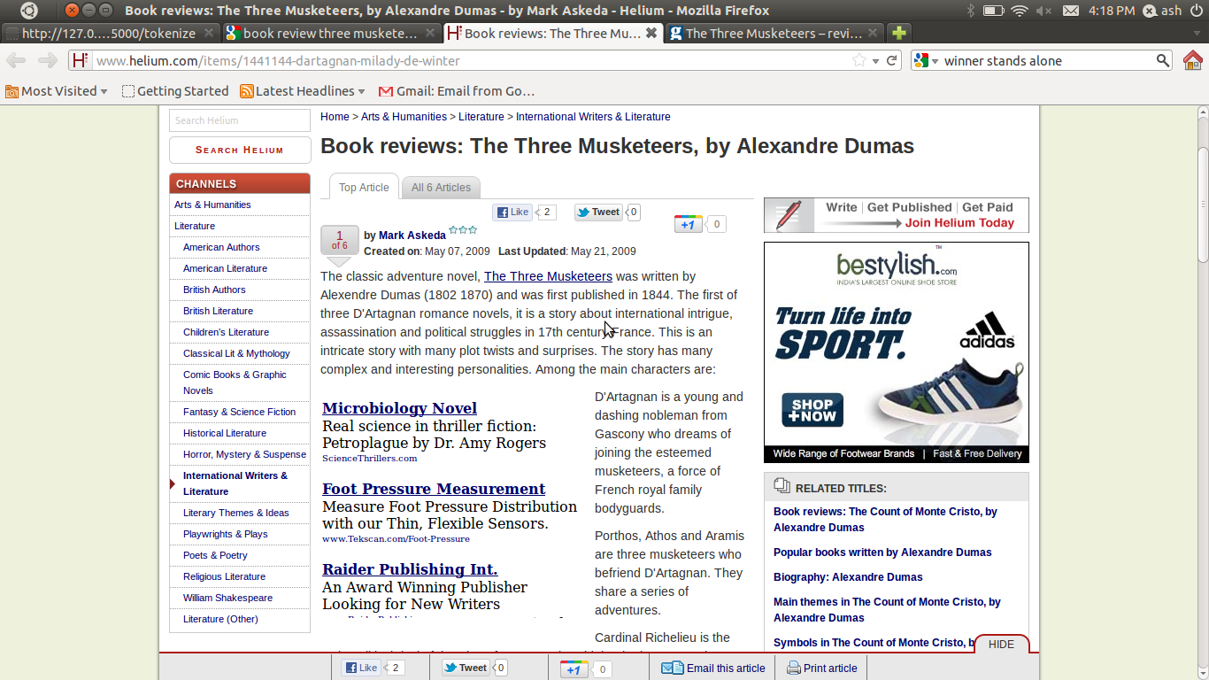

Slide 9
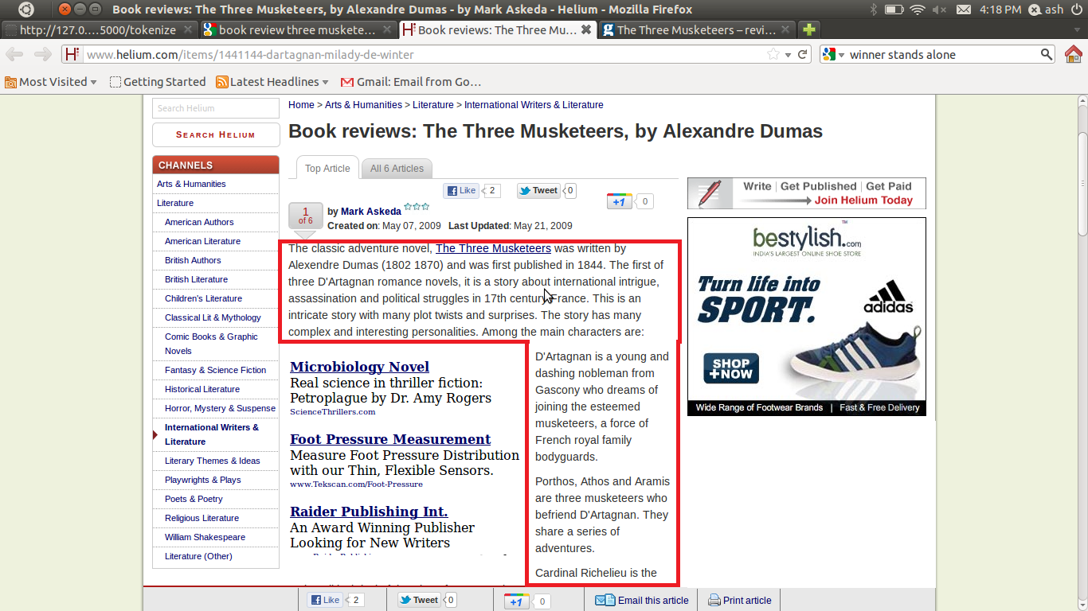

Slide 10
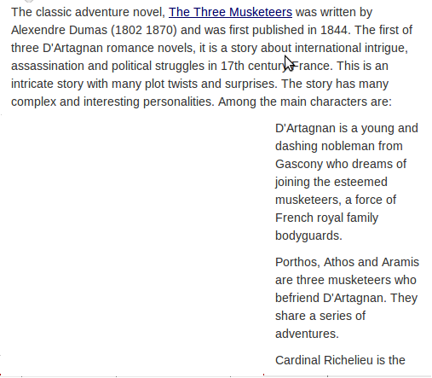
Pos_tag
N-P chunks

Slide 11
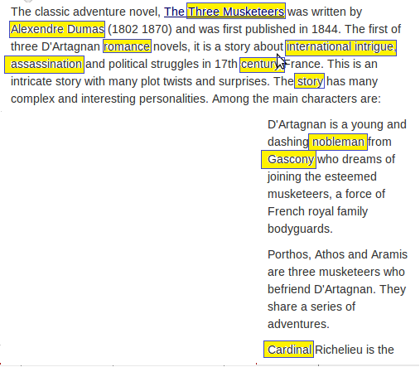
Pos_tag
N-P chunks

Slide 12

assassination
century
nobleman
Three Musketeer
Intrigue
story
Cardinal
Gascony
Alexandre Dumas
Alexandre Dumas
Three Musketeer
story
cardinal
Final Keywords

Slide 13
Categorization
To increase the relevance of information
Predefined domains:
a) Books
b)Movies
c)Places
d)People

Slide 14




K2
K1
K5
K4
K3
K5
Books
Places
Movies
People
Categorized Keywords
K4
K3
K2
K1

Slide 15
Context of Keywords
Get Proper Nouns in proximity
Sort using document frequency

Slide 16
Most Hindi films initiate with a bang, but run out of gas by the time they reach the finale, often getting deflated in between as well, but AGNEEPATH is vigorous from the very commencement to the absolute conclusion. The conflict at the very initiation and also towards the closing stages, the tension between Vijay and Kancha and also between Vijay and his mother, the game of one-upmanship played by Vijay to grab power… AGNEEPATH is one exhilarating ride. A vendetta story needs to be garnished with several terrific dramatic moments and Malhotra does just that. His handling of the subject deserves brownie points. The only 'hiccup', if one may say so, is the romantic track towards the first hour, which is lackluster.
Gaurav Malani hails the film saying that this is "how a remake is supposed to be! Retaining the spirit of the original and having a soul of its own":
The remake isn't essentially remodeled to modern times because the film retains its original era thereby reviving the raw essence of the 1990 film. And beyond the epoch, Malhotra also imparts the cinematic treatment of that time period to his film. So both the villain and hero have stylized entries, their confrontations boast of high-voltage drama and, in the climax, when the bruised and battered protagonist rises to take revenge (in exactly the same manner like his father was killed), he wins instant applause.
I agree with the stylized entries and the high-voltage drama but what I don't understand is why did the protagonist wait for 15 years to avenge his father's death? His master plan was a completely futile exercise because 15 years of strategizing and planning boils down to a mere fist fight between him and the villain.
http://in.movies.yahoo.com/blogs/movie-reviews/y-meta-review-agneepath-094945066.html

Slide 17
Vijay
Kancha
Doc Freq
Context:
Kancha, mother
Vijay
mother

Slide 18





Search Results
Keywords
+
Context
Query
Domain Specific Web sites
Web Search
Search Results

Slide 19
Accuracy
Web Pages
Figure 2 : Results of keyword extraction

Slide 20
Graphical Results
Figure 1 Improvement In Precision Using Categorization
Figure 1 Improvement In Precision Using Categorization
Site 1: http://www.helium.com/items/1441144-dartagnan-milady-de-winter
Site 2: http://www.buzzle.com/articles/effects-of-water-pollution.html
Site 3: http://in.movies.yahoo.com/blogs/movie-reviews/y-meta-review-agneepath-094945066.html
Site 4: http://www.cinemablend.com/reviews/Sherlock-Holmes-4339.html
Site 5: http://www.guardian.co.uk/film/2011/jul/07/harry-potter-deathly-hallows-part-2-review
Site 6: http://ezinearticles.com/?A-Beautiful-Mind-%28Movie-Review%29&id=155993

Slide 21
Demo

Slide 22
Future Enhancement
Machine Learning
Improving Context relevance
Location based information
Moving on Android
Compatible for more languages

Slide 23

Conclusion
Automated Searching mechanism
Reduces Browsing Efforts
Meets the purpose of User

Slide 24
References
Li Liu , Quan Qi, “Combined method for automatic domain-specific Terminology Extraction” Eight International conference on Fuzzy System and knowledge Discovery(FSDK)
Anette Hulth, “Improved Automatic Keyword Extraction given more linguistic knowledge ”
Alexander Patry, Philippe Langlais ,”Corpus Based Terminology Extraction” 7th international conference of Terminology and knowledge Engineering, Copenhegan, Denmark, 2005, pp 313-321
Bhowmik, R. Sam, Huoston State Univesity, “Keyword Extraction from abstract and title” ,Southeaston, 2008 IEEE.
M. Brunzel and M spilopoulou, “Domain relevance on term weighting” Natural Language Processing and Information, pp 437-432, 2007
Hongyan Jing, Evelyne Tzoukermann, “Information Retrieval Based on Context Distance and Morphology”, 22nd annual international ACM SIGIR conference on Research and development in information retrieval ,1999
Salton, G., & McGill, M. “ Introduction to Modern Information Retrieval” McGraw Hill.

Slide 25

Achievements
Paper Selected at EMS2011 IEEE conference
Paper selected at ISAI conference Dubai2011

Slide 26
Evaluation:
 | Poor | Fair | Good | Very Good | Outstanding
Originality | ○ | ● | ○ | ○ | ○
Innovation | ○ | ○ | ● | ○ | ○
technical merit | ○ | ○ | ● | ○ | ○
applicability | ○ | ○ | ○ | ● | ○
Presentation and English | ○ | ○ | ● | ○ | ○
Match to Conference Topic | ○ | ○ | ● | ○ | ○
Recommendation to Editors
 | Strongly Reject | Reject | Marginally Accept | Accept | Strong Accept
Recommendation | ○ | ○ | ○ | ● | ○

Slide 27


Thank You
NLTK

Slide 28
Questions ?

Slide 29
Results for Keyword Extraction
http://www.shakespeare-online.com/plots/hamletps.html
Words before refining :
[u'Am'],[ u'Murder'],[u'My'],[u'Norway'],[u'Norwegian'],[u'O', u'God'],[u'Ophelia'],[u'Pale']
[u'Paris'],[u'Plucks'],[u'Poland'],[u'Polonius'] [u'Prince', u'Hamlet'],[u'Queen', u'Gertrude'],[u'Reynaldo'],[u'Rhenish'] [u'Rosencrantz'] [u'Rozencrantz'] [u'Satisfied'][u'Scene'] [u'Shakespeare', u'Online'] [u'She'][u'Summary', u'How'][u'Than'][u'Their'][u'Then', u'Horatio'][u'Touching'][u'Trojan', u'War'][u'Tweaks'][u'Ungarter'][u'Upon', u'Hamlet'][u'V'][u'Voltimand [u'Amanda'][u'Amidst'] [u'As'][u'Aug'][u'Barnardo'][u'Continue'][u'Cornelius'][u'Denmark'][u'Despite'][u'Elsinore'] [u'Ere'][u'First', u'Player'][u'France'][u'Francisco'][u'Ghost'][u'Gonzago'][u'Guildenstern'] [u'Ha'][u'Had'][u'Hamlet', u'Plot', u'Summary'][u'Happy'][u'Hercules'][u'His'][u'If'][u'In'] [u'King', u'Claudius'][u'Laertes'][u'Let'][u'Lord', u'Hamlet'][u'Mabillard'][u'Marcellus'] [u'May'][']
Keywords obtained after refinement:
[[u'Barnardo'], [u'Denmark'], [u'Elsinore'],[u'Francisco'], [u'Ghost'], [u'Horatio'], [u'Marcellus'], [u'Norway'],[u'Touching']]

Slide 30
Mapping Functions ,Input , Output
Mapping Functions f(x) | INPUT | OUTPUT
F₁(Text,freq.dist,pos_tag,position, collection freq.) → K | Text | K
F₂(K,DC,DR)→KD DC: Domain Consensus DR: Domain Relevance | K | KD
F₄(KD)→ CT | KD | CT
F₃(KD,CT)→ SR | KD,CT | SR

Slide 31
Mathematical Model
S ={Text,K,D,KD,SR,CT}
Where,
Text = {w_{i} | w_{i} € webpage }
K= {k_{i} | k_{i} € Text and k_{i} € f₁(Text) }
D={books, places, movies, people}
KD={kd_{i} | ¥ ( kd_{i} € K) and f₂ (kd_{i}) € D}
CT = U_{i=1..m} CT_{i}
CT_{i} = {ct_{j} | ct_{j} € f₄(kd_{i}) }
SR = {s_{i} | s_{i} € f₃(kd_{i} , ct_{i}) ¥ kd_{i} € KD }

