Slide 1

Lucidify Image Dehazer

Slide 2
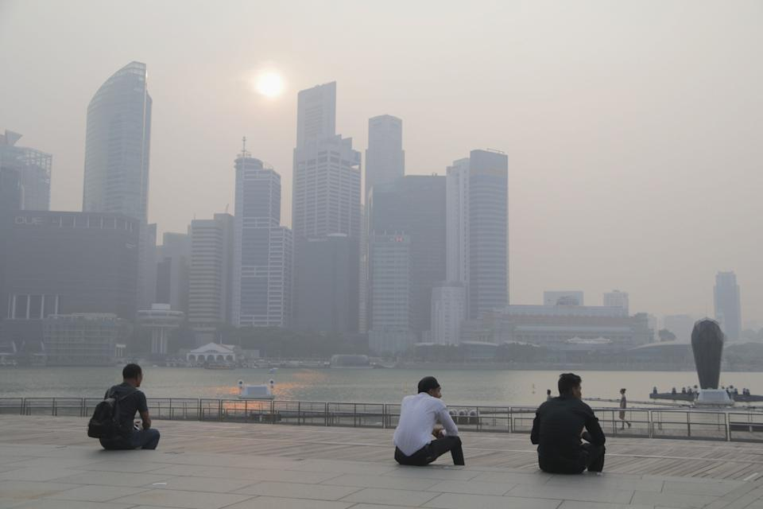


Slide 3
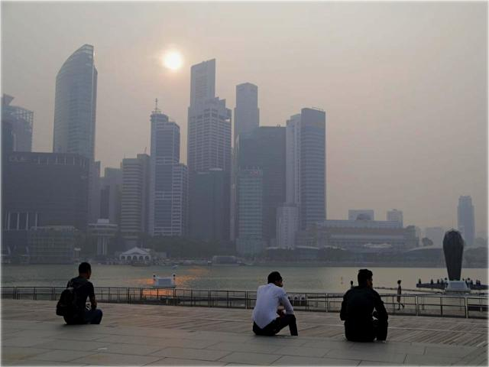
With Lucidify, you can remove the haze from your images, thereby making the vision better.

Slide 4



Purpose
Haze is a common atmospheric phenomenon that can impair daily life and machine vision systems.
It reduces visibility and the contrast of the images.
To find a solution to this problem, we have create an image dehazer based on deep learning techniques.

Slide 5

Lucidify Dehazer was created by using Google’s Tensorflow Library for machine learning.
It uses CNN (Convolutional Neural Networks) to remove the haze from the image.
This model is trained on a dataset of 5000 images.
This model actually learns the atmospheric haze function and uses it to create an image with minimized haze.
Working

Slide 6
ARCHITECTURE
Layer | Filters | Kernel Size
Conv1 | 3 | 1
Conv2 | 3 | 3
Conv3 | 3 | 5
Conv4 | 3 | 7
Conv5 | 3 | 3
Working
All the layers use L2 regularization and all of them use the same ReLU activation function.

Slide 7
ARCHITECTURE
While compiling the model:
Adam optimizer was used
Batch Size of images was 32
Also, MSE (Mean Squared Error) was used to calculate loss during each epoch.
Based on this loss, the parameters were updated.
SGD and other optimizers were also tried, but Adam gave the best results.
Working

Slide 8
Atmospheric Scattering Model
This model assumes that the hazy images are based on the following function: I(x) = J(x)t(x) + A(1 – t(x)) where, I(x) is the hazy image J(x) is the original image t(x) is a transmission matrix A is the global atmospheric lightning
t(x) represents the amount of light that reaches the camera from the object.
Working

Slide 9
Atmospheric Scattering Model
The equation can be reframed as: J(x) = K(x)I(x) – K(x) + b
Hence, after the image is passed through the model, the model estimates K(x) after the 5th convolutional layer.
Using the equation above, we can calculate the original image matrix and hence get a dehazed image.
Working

Slide 10
Performance Metrics Used
The performance metrics used in the evaluation of the model are:
MSE – Mean Squared Error
PSNR – Peak Signal to Noise Ratio
SSIM – Structural Similarity Index
The testing set of our model included 500 images based on which these metrics were calculated.
Analysis

Slide 11
PSNR
PSNR stands for Peak Signal to Noise Ratio.
It can be calculated as 10(log(255² / MSE)) for images with pixel values between 0-255, and as 10(log(1 / MSE)) for images with normalized pixel values.
Higher PSNR values denote the lower perceptual distortion and therefore better quality of the reconstructed signal.
PSNR for our model was 22.55
Analysis

Slide 12
SSIM
SSIM stands for Structural Similarity Index.
It is a widely used metric to evaluate the quality of an image or video signal in image processing, and video compression algorithms.
SSIM for our model was 0.97
Analysis

Slide 13
Some More Dehazed Images

Slide 14
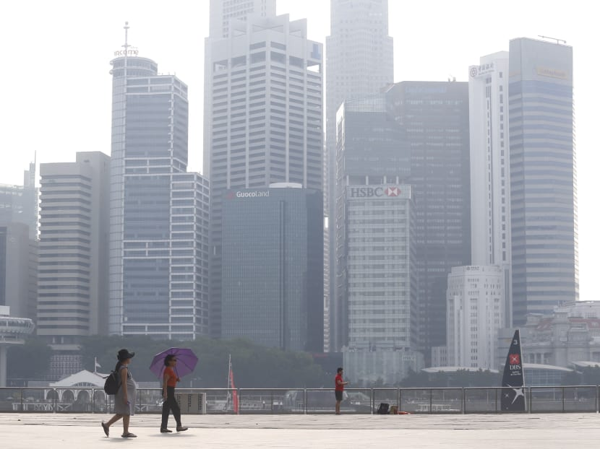

Slide 15
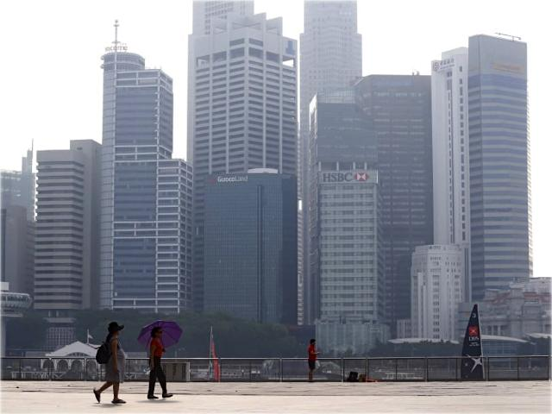

Slide 16
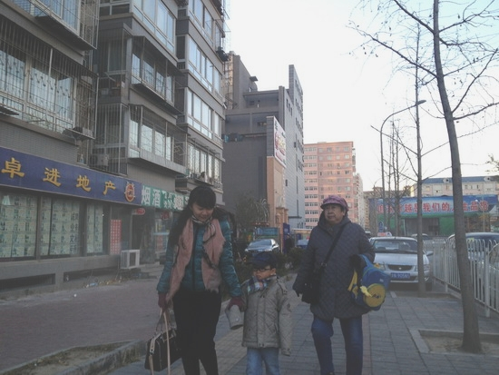

Slide 17
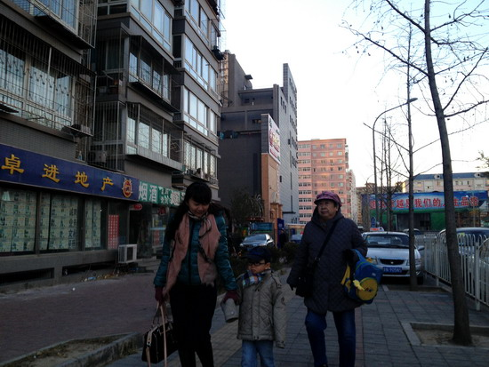

Slide 18
Thank You
CE063 Krish Makadia
CE071 Murtaza Mister
CE073 Shrey Naik

