Slide 1
BLENDER + PYTHON · MICRO PROJECT
Back-Face Culling for Real-Time Architectural Rendering
Visualising how face orientation changes rendering work.

Slide 3



WHY IT MATTERS
Real-time rendering spends work on visibility
Interactive 3D scenes
Architectural meshes
Back-face culling
Must generate images quickly enough to support camera movement.
Contain many triangles, including surfaces that face away from the camera.
Skips back-facing polygons before rasterization when they cannot contribute visible pixels.

Slide 4
REAL-TIME ARCHITECTURAL RENDERING
Hide what the camera cannot see
Back-face culling skips surfaces facing away from the viewer, so the renderer spends its work on the walls that matter.

Slide 5
THE QUESTION
The project asks one focused question
Show face orientation relative to the current viewpoint.
Compare culling enabled and disabled.
Expose the limits of a geometric estimate.
How can back-face culling be demonstrated interactively on a 3D architectural model without confusing visibility optimisation with a change to the model itself?

Slide 6





PROJECT OBJECTIVES
Objectives: make the invisible work visible
Build
Classify
Toggle
Build a hollow architectural model procedurally in Blender and Python.
Classify triangles as front-facing or back-facing from the active camera view.
Toggle culling interactively and show an educational overlay.
Count
Observe
Display estimated total, rendered, and culled triangle counts.
Observe how camera angle changes the result.

Slide 7
GEOMETRIC TEST
Face orientation decides what can be discarded
Each polygon has a winding order and a surface normal. Relative to the camera, the normal identifies whether the face points toward or away from the viewer.
N
face
point P
C
N: face normal · C: camera position · P: a point on the face
Under this project’s convention, a non-positive dot product marks a back-facing triangle.
Normal points toward or away from the camera.

Slide 8
SCENE DESIGN
The igloo makes orientation easy to see
Shell | Outer and inner hemispherical domes with approximately 1.2 Blender units of shell thickness.
Structure | 32 circumferential segments and 12 rings.
Entrance | Arched tunnel with outer, inner, and rim surfaces.
Materials | Alternating blue and white material assignments create an ice-block appearance; blocks are not separate objects.
Ground | A single-sided ground plane exposes the limits of viewing a surface from behind.

Slide 9
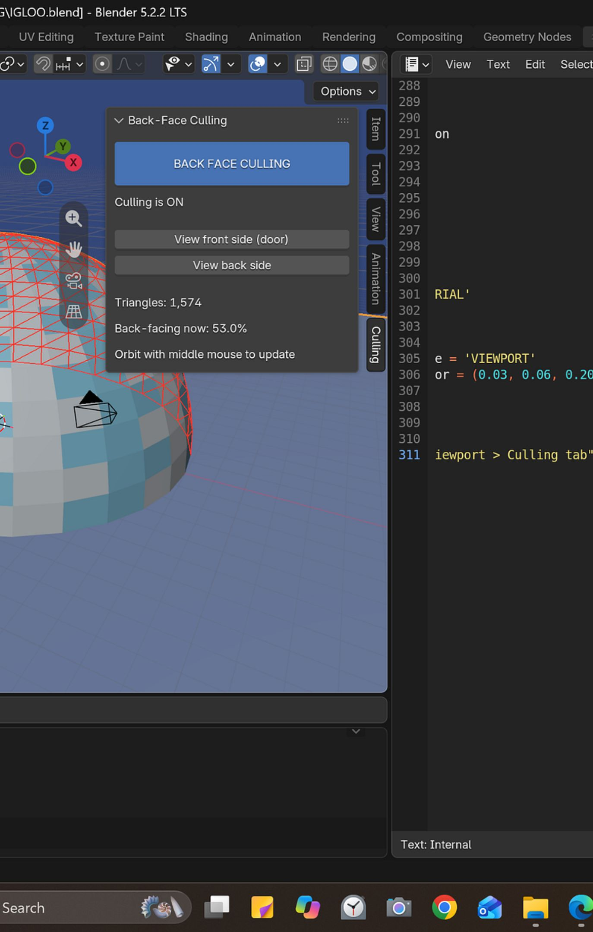

DEMONSTRATION
One scene, two culling states
CULLING OFF
CULLING ON
Back-facing faces can remain available to the rendering pipeline. The script marks identified outer-shell faces with translucent red triangles.
Applicable back-facing faces are discarded at the relevant rendering stage. The script represents them with red wireframe lines.
Controls: open the N-panel, select Culling, toggle back-face culling, switch front/back views, and orbit with the middle mouse button.

Slide 10




IMPLEMENTATION
The implementation combines native settings with custom maths
 | Procedural geometry | bmesh constructs the dome, tunnel, and ground; explicit vertex ordering establishes intended normals.
 | Classification | NumPy stores triangle data; dot products update when the camera view changes.
 | Visualisation | gpu and gpu_extras.batch draw the overlay; blf renders the HUD.
 | Interface | Blender operators and a custom sidebar panel expose the controls.
 | Reliability | Cleanup logic removes prior handlers and registrations before a script rerun.

Slide 11
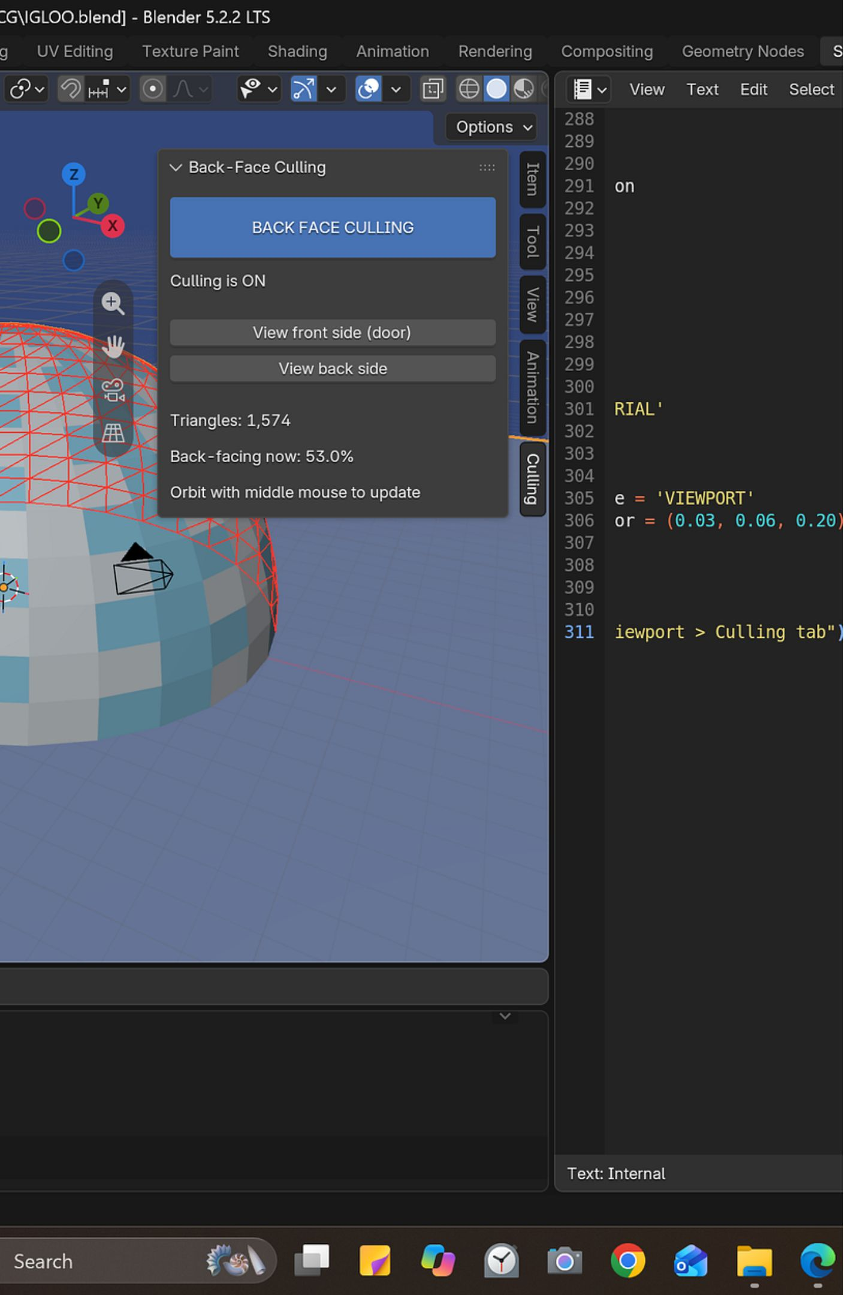
RESULTS · SUPPLIED RUN
The demo shows changing visibility, not a proven FPS gain
1,574
834
53.0%
classified triangles
back-facing triangles
back-facing share
Displayed rendered-side count: 740 in that view.
Orbiting the camera changes the classification; looking through the entrance exposes interior surfaces.
The outside image may look similar because discarded faces were not contributing visible pixels.
Culled percentage = Back-facing triangles / Total classified triangles × 100

