Slide 1


Data Analysis
Study report for fast food restaurants in US

Slide 2

Problem Statement
Problem Statement : Opening new restaurant in US.
Objective : To identify location in given province for innovative restaurant ideas.
Reference : 10000 restaurants data made available by INSAID.
Variables : Address, City, Country, Key (unique number), latitude, longitude, Name, Postal Code, Province, Website
Concept Map : Opening a new restaurant in US by identifying locations where new innovative concepts of fast food can be executed without directly affecting existing players. Food on Wheel !!
Hypothesis : Running low cost innovative business model in densely populated area is a profitable business within year. Tools : Statistical Plots, Probability, MCT, Measure of Spread, Measures of Shape, Hypothesis Testing.

Slide 3
Data Profiling
Highlights :
Website has 4.6 % missing values.
Province has 52 distinct values.
Only 27.8 % cities are unique which means 72.2 % city’s have more than one restaurant.
Name provides McDonald’s, Burger King and Taco Bell as top 3 most penetrated fast food restaurants in US.
Postal Code 57701 is having 23 restaurants which is highest.
Province CA has highest 676 restaurants.

Slide 4
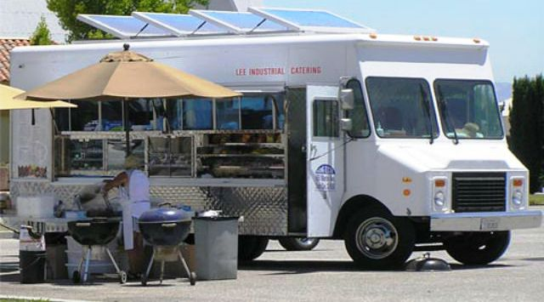
Online Orders
4.6 % missing values in website suggest that little more than 95 % restaurants have online order system,
targeting minimum competitive areas don’t require mobile App services or Online services,
targeting higher competitive areas requires these services to stay in competition.

Slide 5

Finding right province…

Slide 6
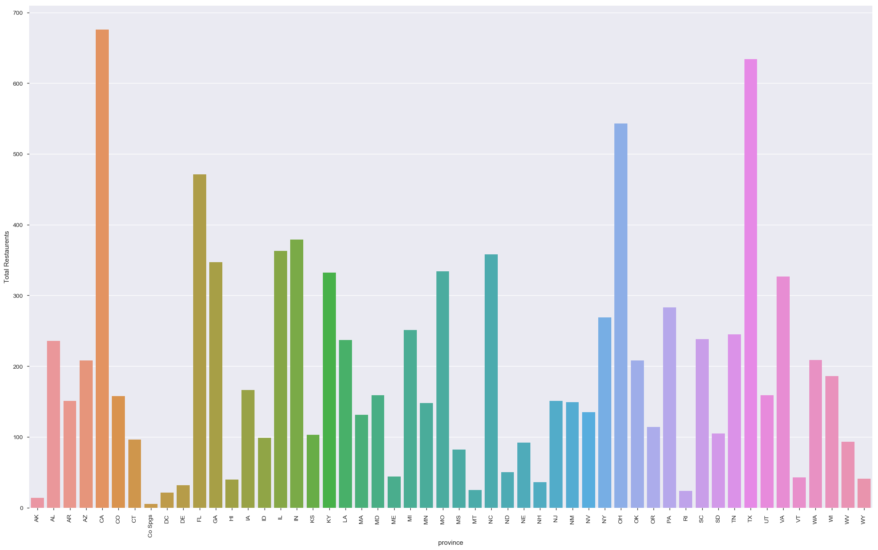
Above bar graph explains the density of restaurants in each province, we can find most of the province have number of restaurant's outlets between 100 to 250. There are also significant number of province which are having more than 300 restaurants.

Slide 7
Finding my place…
Let’s dig more deeper into data !!

Slide 8
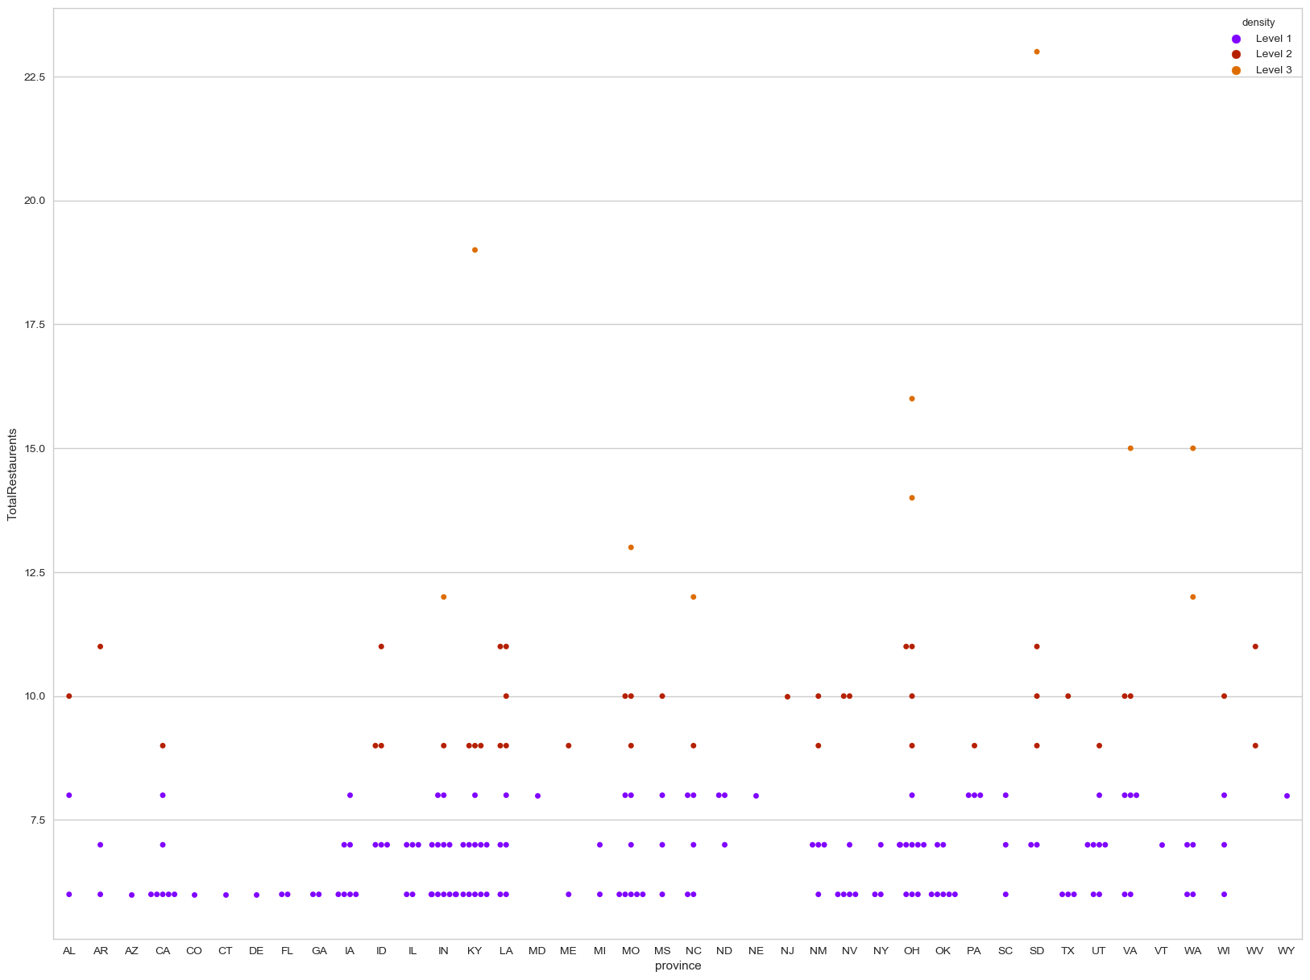
Take a closer look, surprisingly; Province like CA and TX having highest numbers of restaurants in graph 1 here in graph 2 has only 1 postal code which is Level 2 competitive. Well we can derive competition level of each province and target specific postal code for our "Blue Ocean Strategy" or "Red Ocean Strategy".

Slide 9
Type of Strategy
Types of Strategies :
Blue Ocean Strategy - Identify menu from website of a restaurant and create a mouth watering innovative and creative dishes which are generally not offered by these restaurants. Product differentiation.
Red Ocean Strategy - At the lowest price make available each menu item and generate volume, this is possible because of no real estate cost, offer service differentiation like live telecast of sports matches by using top of vehicle, develop app ordering or online ordering system for targeted province or postal code areas, offer discount schemes and marketing strategies like happy hour, combo meals etc. Price differentiation combined with service differentiation.

Slide 10
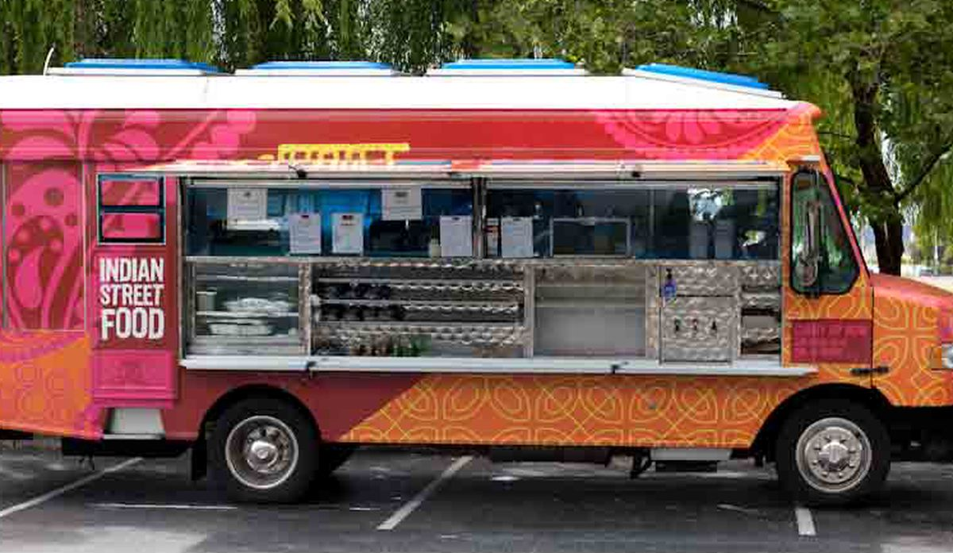
Conclusion
Food on Wheel being low cost investment idea which expected to give higher ROI need such in-depth analysis which can be dig more further on menu items to be offered. We can identify sweet spots and install our setup "Food on Wheel" for month or two or even more but when customer's habits changes there taste we can identify new sweet spot with relatively new strategy to run our continuous ongoing business venture.

Slide 11
Thank You !!

